Slide 1
Warm-up #10
Describe three scientific and mathematic advances made during the Renaissance?
Would you prefer copying something by hand or receiving a printed copy? Why?

Slide 2
Chapter 11.2 Review
2b. Why may a historian call Niccolo Machiavelli “the first modern Italian”?
Machiavelli may be referred to as the “the first modern Italian” because his interest in practical politics could be considered modern.
3a. What are three techniques for showing perspective?
To show perspective, artists may make background figures smaller, lines diagonal, or use different colors to show distance.
4a. Name one Renaissance achievements in each category of mathematics, architecture, astronomy, and cartography.
Math – symbols, architecture, double-layered dome, astronomy – earth revolves around the sun, cartography – used calculations to create better maps.
4b. How did the choice of school subjects change during the Renaissance?
School changed to include the humanities as courses of study.

Slide 3
Chapter 11.2 Review
5. Draw a graphic organizer like the one shown here. Use it to show how Turkish conquest east of Europe contributed to the growth of the Renaissance.
Scholars fleeing the Turks carried precious works of literature
Discover of these works created interest in classical culture.
Scholars begin to focus on the classics. The Renaissance begins.

Slide 4
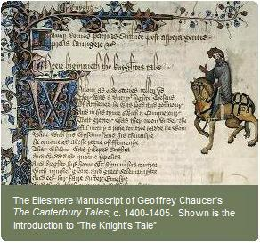
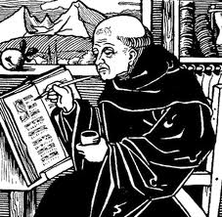
Before the Renaissance, everything had to be copied by hand!
Only Churches had copies of the Bible. You could read it, you had to go to church to hear someone read it to you. The Church “owned” all the knowledge.

Slide 5
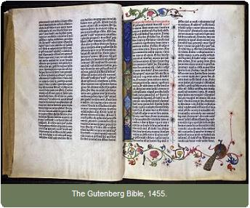
First Printed Book EVER!
You can see a copy anytime at the
Huntington Library!

Slide 6
Cause and Effect Sort
Sort the following events.
Put them in sequential order based on your prior knowledge.
Be able to explain your choice.
Review
  What events should you record on your own paper? Why?

Slide 7
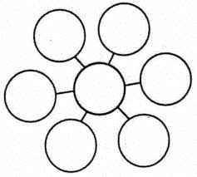
How did the printing press change society?
Johann Gutenberg’s Printing
Press

Slide 8
Review Questions
How do you think the availability of paper and the printing press would have changed student’s lives?
If you needed to create a copy of a single 100-page book, do you think it would be easier to use Gutenberg’s press or to write the book by hand? Why?
What are two advantages that paper had over animal skins?

