Slide 1
Think about this…
“A drug crop is grown in fields, where it is harvested and put into 100-pound bags. These bags are sold by the farmer for anywhere between $70 and $100. The product is then brought into another country, often using middlemen, where it is processed, refined, and sometimes mixed with other substances before being sold on the street. The final market value of the original bag can now be as high as seven to ten thousand dollars. What crop are we talking about?”
Write your answer down-

Slide 2
Guesses:

Slide 3
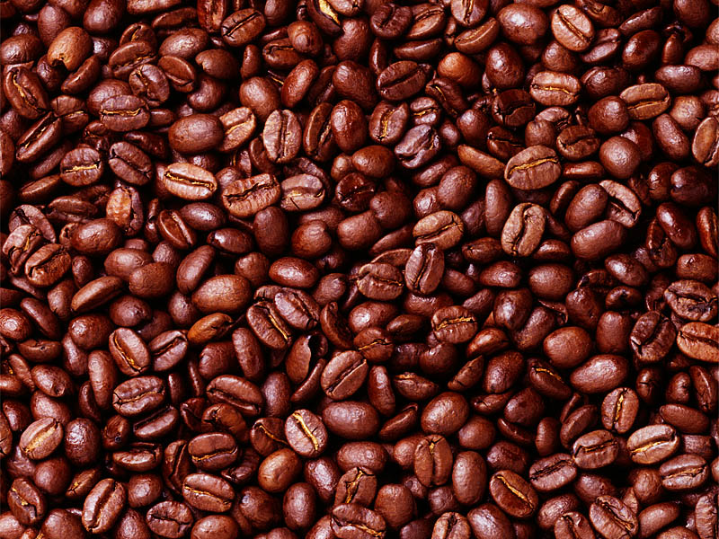
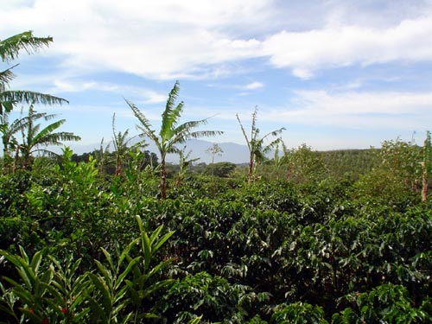

Slide 4
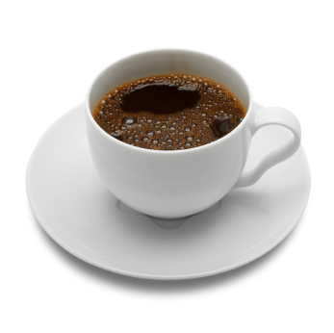
Coffee!
What is the prejudice that
coffee is a drug?
Is it abnormal that our culture
accepts coffee into every day life and cultural customs?

