Slide 1
CH 2 Insights
Goal Questions
  1) Compare and Contrast why England and Spain settled the New World. (Give one similarity and one difference)
  2) Explain (use your own words and opinion)why England had trouble settling at Jamestown.
  3) Evaluate (Judge) if you feels that America was originally founded on the principles and ideas that you had previously believed before today? How was Americas’ founding similar or different from what you believed.

Slide 2
Ch 2 Insights
ID- Elizabeth I
Summary 1- What country was she the queen of?
  England
OI- Elizabeth Energizes England
1) What happened at Roanoke Island?
1st English settlement of North America (Virginia), disappeared
2) What was the goal of the “Invincible Armada” (AKA Spanish Armada)
To invade England
Conflict b/t Catholic Spain vs. Protestant England
(Protestant is every Christian religion not Catholic)
3) How did the result of the Spanish Armada change England’s position in the world?
England dominant navy in world (could settle and explore N. Am w little competition f. Spain

Slide 3
ID- George Percy (P 29)
Summary #2- Explain how the livings conditions were for the first English settlers in the New World.
Dreadful (death, disease, starvation)
Why are Eng. Settlers dying if there is food around them?
OI- England Plants the Jamestown Seedling
4) As a joint stock company, what was the goal of the Virginia Company in the New World?
To make money/profit (not freedom or create a new society)
5) What did a charter guarantee to the settlers of the New World?
Settler in America had same rights and freedom as in Eng (esp property rights)
6) Why did many of the settlers of Jamestown die?
disease, starvation, Gentleman Settlers (did not know how to survive)
7) What was the worst crime committed by one of the settlers?
Cannibalism (one man ate his wife)
8) How many settlers survived from the original 400 settlers?
Sixty survived the “starving time” winter of 1609-10

Slide 4
ID- Advertising of a Voyage to America (p 33)
Summary #3- What incentive is the advertisement offering people to move to Virginia?
  Good land to grow food on
OI- Virginia: Child of Tobacco
9) What product saved Jamestown and allowed settlers to make a living?
  Tobacco
What type of product is tobacco classified as today? What business was the US founded on?
10) How did people in Jamestown react to the fact that this product could make them money (give an example of how far people went to make the product?)
  They grew tobacco every where they could (b/t homes, went inland)

Slide 5
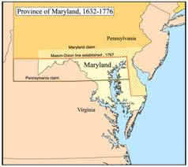
ID- Early Maryland and Virginia (P 34)
Summary #4- What advantage does the Chesapeake Bay offer a settlers to trade their product overseas?
Easy access to the ocean to send their product back to England (transportation)
OI- Maryland: A Catholic Haven
14) Who founded Maryland and for what reason?
Lord Baltimore, safe place for Catholics
15) How did Maryland try to attract settlers?
Huge tracts of land were given to settlers and nice homes built

Slide 6
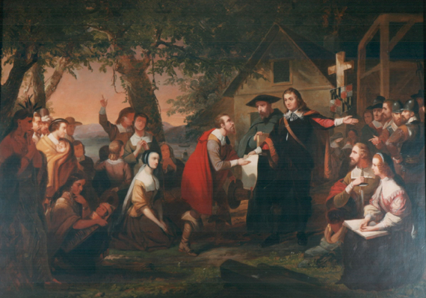
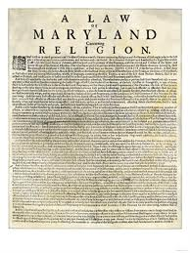
16) What did the Act of Toleration establish?
Freedom of religion for all Christians (death penalty for Jews and Atheists)
17) Why do you feel the Catholics establish the Act of Toleration?
Because Catholics were afraid a Protestant majority would control politics and make unfair laws against Catholics
  What are some unfair laws that majorities have imposed on minorities?

Slide 7
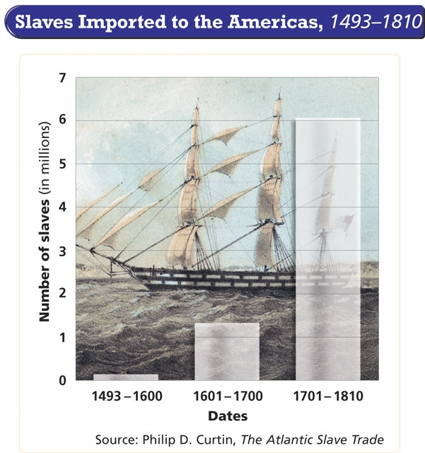
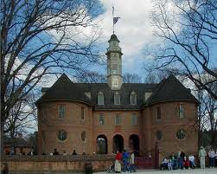
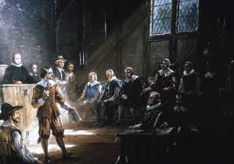
11) What was brought to Jamestown by a Dutch warship? How did this change the colonies forever?
  Slaves, Af/Am. Are part of the US society (AF/AM 2nd largest ethnic group until recently)
12) What was the House of Burgesses?
  1st legislative assembly (representative government where local people elect a representative to make laws for the colony)
13) Why is the House of Burgesses important to the future of the government of the United States?
  The US is a representative government voted on by the people

Slide 8
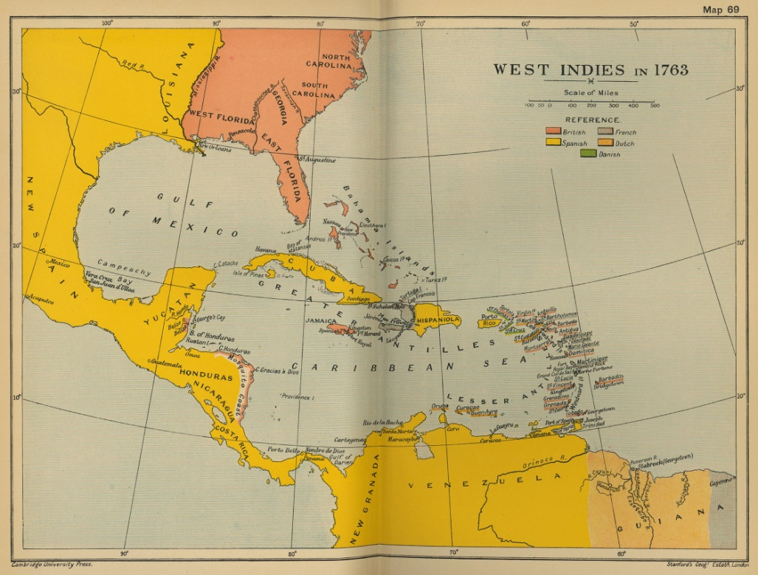
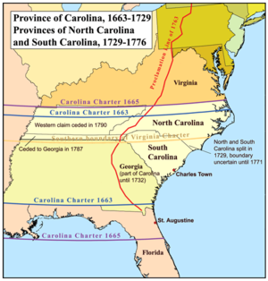
ID- Early Carolina and Georgia Settlements
Summary #5- What country has claimed land next Georgia?
Spain (Eng. fear SP. Invasion of SC)
OI—Colonizing the Carolinas
18) Why was South Carolina founded?
  To feed the West Indies (sugar colonies in Caribbean Sea)
    Settlers to SC from West Indies, not England. Bring slavery and racism

Slide 9
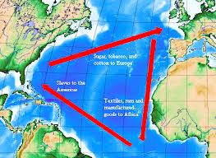
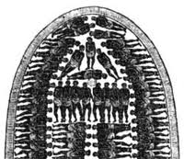
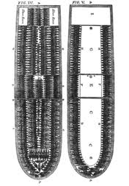
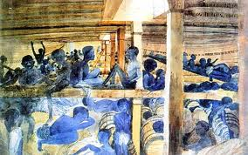
  Slavery
    Barbados Slave Code- stated slaves are property, have no rights
    Middle Passage- voyage from Af. To America, 25-60% of slaves dies
    *Is such a harsh slave law necessary?

Slide 10
South Carolina vs North Carolina
North Carolina
  Independent and less aristocratic (rich)
    Squatters that could not afford SC or VA

Slide 11
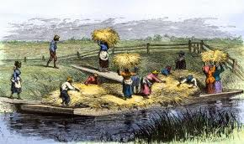
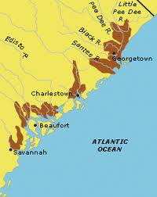
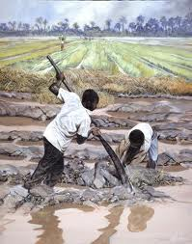
19) What crop became the dominant crop of South Carolina?
Rice
20) What group was ideal for growing this crop and give one reason why?
African (because they knew how to grow rice)
What is hypocritical about Eng. Settlers believing they could own slaves because blacks were inferior to whites?

Slide 12
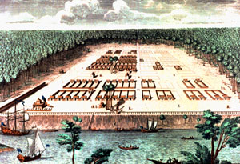
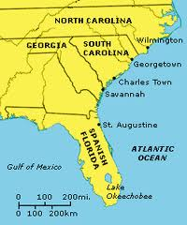
OI- Late-Coming Georgia: The buffer Colony
21) Why was Georgia founded?
  Buffer Colony- protect (rich) S. Carolina from Spanish invasion
Who would want to live in a dangerous area
  Debtor Colony- people who owed money could move to Ga. Rather than go to jail
22) Who was the founder of Georgia?
  James Oglethorpe (Oligopoly- rule by a small group)
How is government in GA. different from the other colonies?
  No representative Gov. in GA., Oglethorpe had total control in GA.

