Slide 1
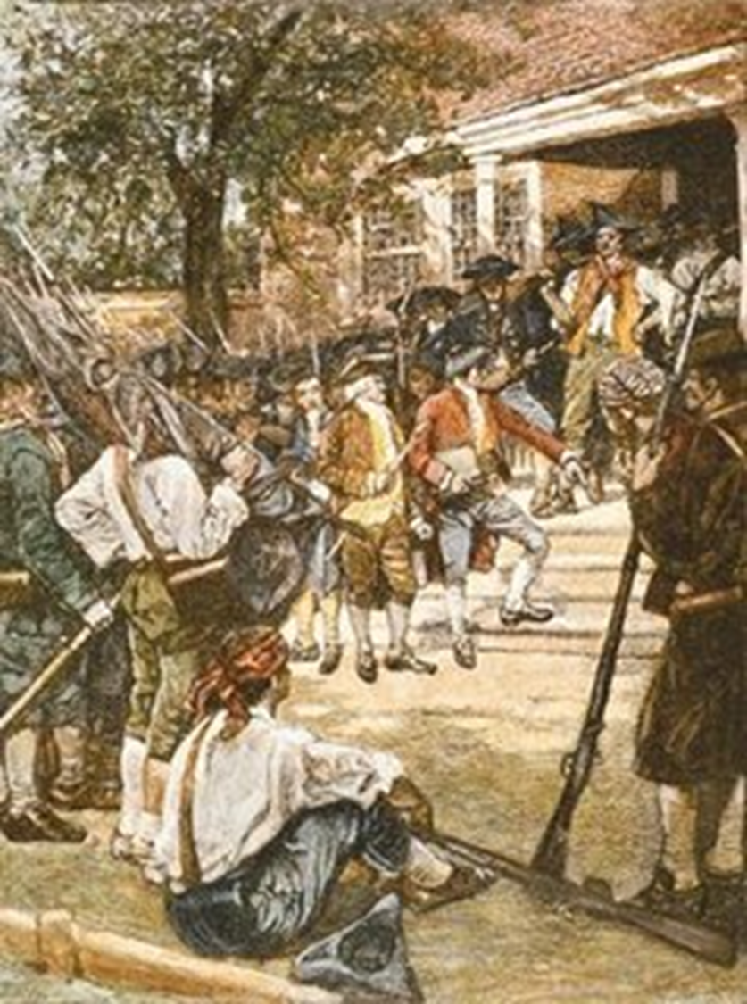
Daniel Shays Rebellion

Slide 2

Shays Rebellion 9/21/12
What happened in Shays rebellion?
How is it connected to the Articles of Confederation?
According to the textbook, how did Americans respond?

Slide 3
Central Question: Did all Americans think the Articles of Confederation were too weak? How did Americans react to Shays’ Rebellion?
Guiding Questions:
Sourcing
1. Thomas Jefferson wrote the Declaration of Independence. Do you think he wanted to see America form a strong central government? Why or why not?
Contextualization
2. According to Jefferson, have the colonies been peaceful or chaotic?
Support your answer with evidence from the document.
3. Jefferson thinks the people at the Constitutional Convention are overreacting to Shays’ Rebellion. What does he worry they might do as they write the new Constitution? (Note: this answer is not in the document; you need to think).
Close Reading
4. What does Jefferson mean when he says, “The tree of liberty must be
refreshed from time to time with the blood of patriots and tyrants?”
Corroboration
5. How does this document challenge or expand the information you read in the textbook?

Slide 4

Pros of a strong central government | Cons of a strong central government

