Slide 1
Warm Up #9
Compare and contrast Michelangelo and Leonardo da Vinci?
What Italian City State did both of these masters begin their careers in?

Slide 2
Review
Leonardo da Vinci was a true Renaissance man who helped push human knowledge forward in the fields of painting, engineering, architecture, anatomy and more.
Michelangelo became a master painter, architect, poet and sculpture, creating such masterpieces as the David and the ceiling of the Sistine Chapel.

Slide 3
Renaissance Advances
What advances were made during the Renaissance in math and science?

Slide 4
Key Terms
Filippo Brunelleschi
Nicolaus Copernicus
Heliocentric
Galileo Galilei
Gerardus Mercator

Slide 5
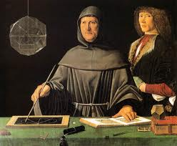
Mathematics
The rise in the need for accurate accounting by merchants helped push a renewed interest in Mathematics
Luca Pacioli was the first to publish symbols for plus and minus

Slide 6
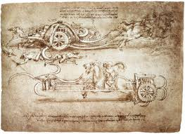
Engineering
Engineers were able to use these new advances in mathematics to come up with many new designs.
Leonardo da Vinci dreamed up many interesting machines

Slide 7
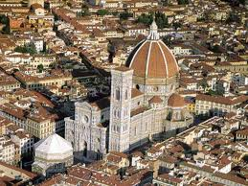
Architecture
Architects were also able to use these new mathematical concepts to strengthen buildings
Resurgence of classic building elements: arches, domes, columns, etc…
Filippo Brunelleschi came up with a design for a massive dome for the Santa Maria del Fiore cathedral in Florence

Slide 8
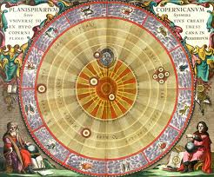
Astronomy
Nicolaus Copernicus came up with the radical idea that our solar system was heliocentric
Galileo Galilei was able to craft telescopes that enabled him to see the moons of Jupiter and the craters on our Moon

Slide 9
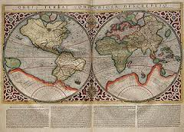
Cartography
Trade brought better tools of navigation from other cultures.
The invention of printing made maps much more widely available
Gerardus Mercator of Flanders developed a cylindrical projection that is still widely used today

Slide 10
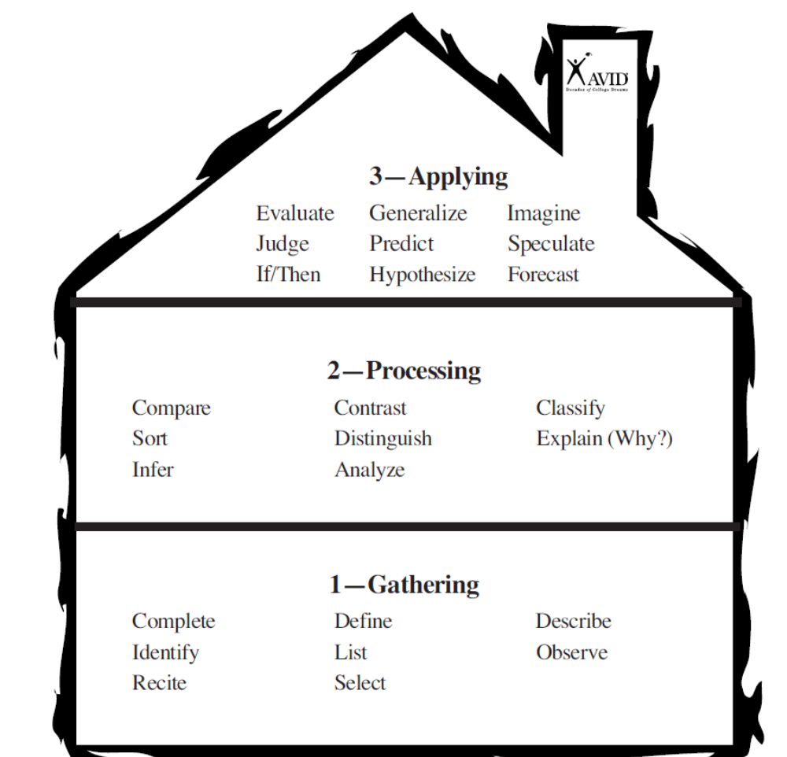

Slide 11
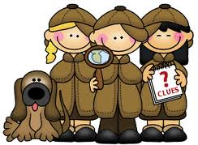
Who did it?
I’ll show you a famous work, you tell me who made it.

Slide 12
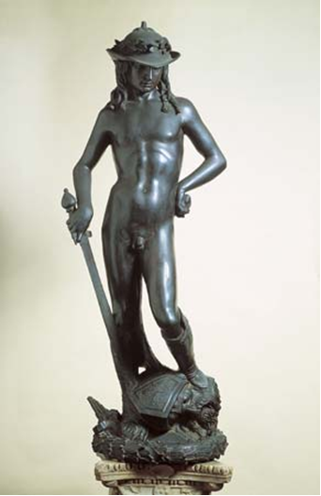

David Donatello

Slide 13
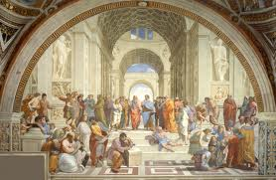
School of Athens – Raphael

Slide 14
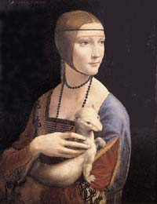
Lady with an Ermine – Da Vinci

Slide 15
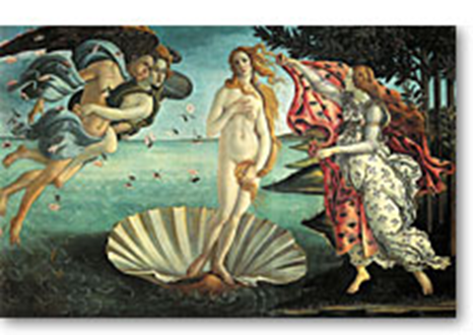
Birth of Venus - Sandro Botticelli

Slide 16
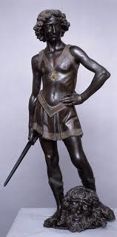
David Raphael

Slide 17
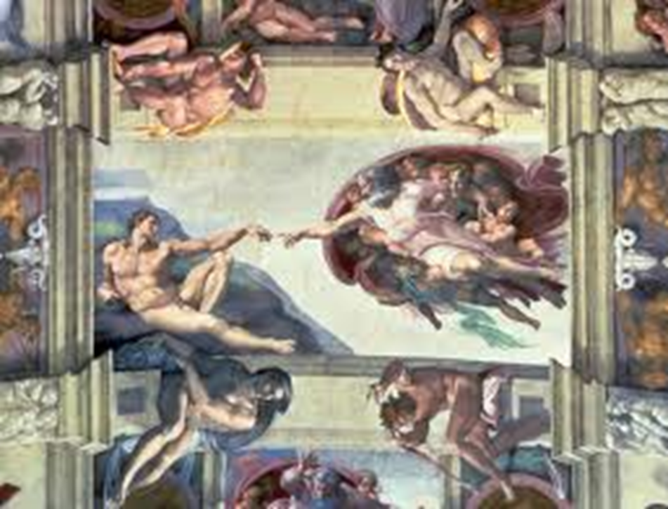
Sistine Chapel Michelangelo

Slide 18
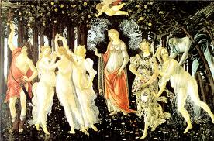
La Primavera - Sandro Botticelli

Slide 19
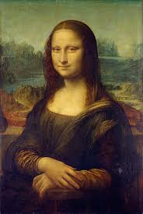
Mona Lisa Da Vinci

Slide 20
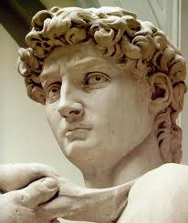
The David Michelangelo

Slide 21

Homework
Review for tomorrow’s quiz.
Finish notes.
Chapter 11.2 Review #s 1a, 2b, 3a, 4a, 4b
Honors will also do #5.

