Slide 1
Classical Civilizations

Slide 2
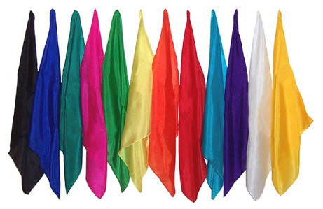
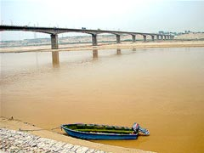
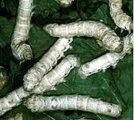
China
Huang He-a valley that had terrible floods and was known as “China’s Sorrow”. People made silk (fine cloth) from silkworms here.

Slide 3
Silkworms
http://www.youtube.com/watch?v=-wbmEjTvszI#!

Slide 4
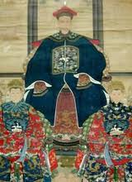
Vocabulary
Ancestor-a relative (family member) from a long time ago.
The Chinese felt that honoring their ancestors was very important, as well as honoring their homes, their families and their land.

Slide 5
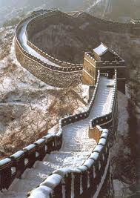
Vocabulary
Dynasty-a period of time in China in which they had one group of people as rulers (bosses).
Great Wall of China-a wall that is over 4,000 miles long, 25 feet high and about 15 feet wide.

Slide 6
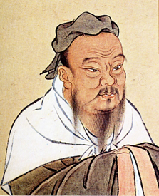
Confucius
Born in 551 B.C.
His ideas had the biggest influence on Chinese life for more than 2,000 years.
He was worried about how people treat each other.

Slide 7
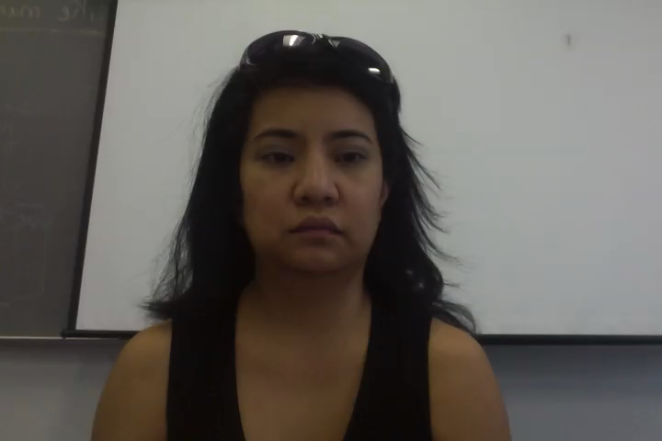
How does it apply to me?
Confucius said.. “Never do to others what you would not like them to do to you”

Slide 8
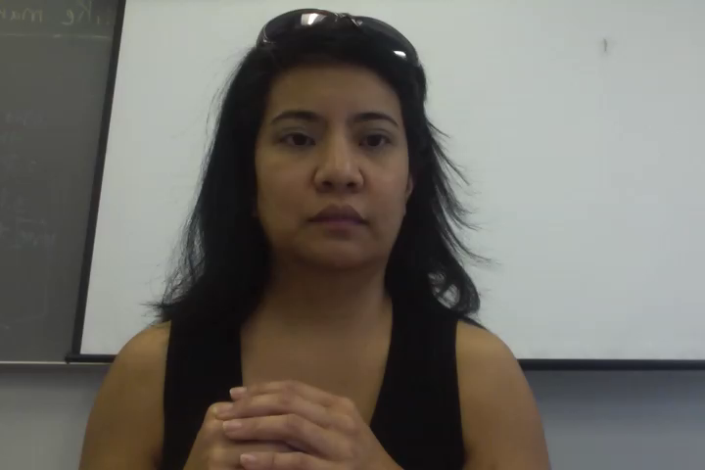
ASL Assignment…

Slide 9
Vocabulary
Write the following words in your notebook and find out what they mean. Write the definitions in your notebook. Finally, videotape yourself spelling out each word and explaining what it means. E-mail me your ASL essay and this essay for a grade.
Ancestor -Great Wall of China
Dynasty

