Slide 1
Chapter 13: The Spread of Chinese Civilization-Japan, Korea, and Vietnam
AP World History I

Slide 2
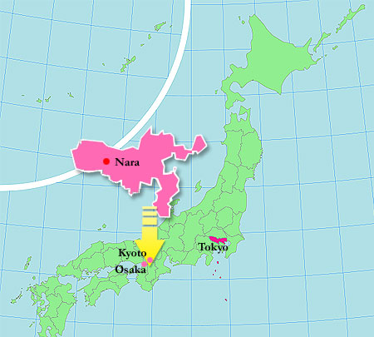
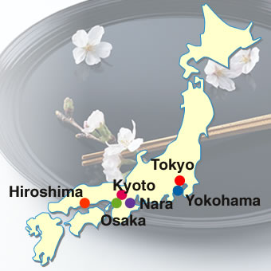
Heian Japan
In the 600’s, the Japanese Imperial Family, the Yamato, ruled from the city of Nara.

Slide 3
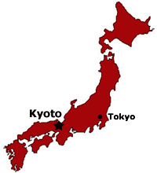
Heian Japan
Yamato emperors wished to escape the political influence of Nara’s Buddhist priesthood, so they moved the capital to Heian, present day Kyoto.
  The classical Heian period (794-1185) is a golden-age in pre-modern Japanese History.

Slide 4
Heian Japan
The Emperor was considered to be descendant of Japan’s Shinto gods, and therefore sacred.
During the Heian period, the emperor lost political power but remained important as a symbolic figurehead.
  Real power rested with whatever noble family gained the position of chancellor (kwampaku) and, with it, the duty of “protecting” emperor.
  The Chancellor had to keep the emperor in seclusion and rule in his name

Slide 5
The Fujiwara Clan
From 858 through the 1100’s Heian Japan was dominated by the Fujiwara clan.
  Peaceful, prosperous, and culturally brilliant time period.
  Painting excelled
  Writing like Lady Murasaki’s “The Tale of Genji” was an epic about love and Japanese Court Life.
  Many of Japan’s classical prose writers were female.

Slide 6
Early Japanese Culture
Japanese culture was influenced in many ways by China.
  Religion was shaped by the importation of Buddhism, and to a lesser extent, Confucianism and Daoism.
  All of those intermixed with Japan’s native faith, Shinto
  China’s system of ideograms influenced the development of the Japanese alphabet.
  Poetry, painting, and architecture of Tang China had a great impact on Japanese style.
After 1000, the Japanese began to develop their own independent cultural traditions.

Slide 7
Disunity…
The Fujiwara pursued cultural refinements to the degree that they neglected military affairs.
Military responsibilities were delegated to warrior clans, who would often quarrel amongst themselves.
By the 1100’s they were quarreling with each other, and the Fujiwara.
The Taira-Minamoto war (1156-1185) destroyed the Fujiwara clan by 1160.
  Taira and Minamoto were clans who supported rival claimants to the emperors throne.
  The Taira gained the upper hand at first, but were eventually defeated by the Minamoto.

Slide 8
The Minamoto
The Minamoto clan created a new government known as the Shogunate.
  This conflict marked Japan’s transition from classical age to medieval period (like the fall of Rome in Europe).
The Minamoto moved the capital to Kamakura, far from Heian, and established a decentralized military based government.
Again, the Emperor was an important figurehead, but real power lay now in the hands of the Shogun.

Slide 9
The Shogunates
Two Shogunates governed Japan during this period in Japanese history
  Kamakura Shogunate (1185 – 1333 CE)
  Ashikaga Shogunate (1336 – 1573 CE)
Both Shogunates were Feudal systems in which the shogun shared power with landowning warlords called Daimyo.
The Shogun and Daimyo came from warrior class known as the SAMURAI (“one who serves”).
  Just as European knights theoretically followed the code of chivalry, Samurai followed the code of Bushido (“way of the warrior”).
    The most extreme penalty for violating Bushido was ritual suicide.

Slide 10
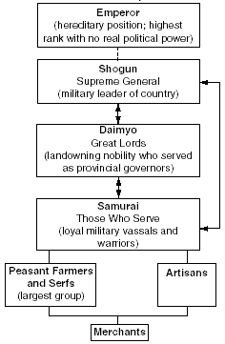
Japanese Feudalism

Slide 11
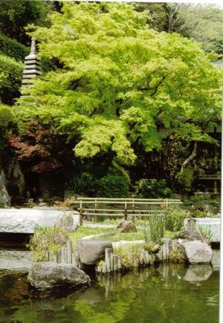
Women in Japanese Society
Heian Japan had recognized the importance and brilliance of women…
  The change of government and the impact of the warrior ethic of the Shogunates allowed women fewer responsibilities.
  Unlike Chivalry, the code of Bushido did little to encourage respectful treatment of women.

Slide 12
Buddhism in Japan
Zen (Chan) Buddhism proved popular among the Samurai class
  Philosophical simplicity affected cultural practices such as the cha-no-yu tea ceremony, landscaping, and haiku poetry.
Pure Land (Jo Do) Buddhism promised a heavenly afterlife and gained a large following amongst the lower classes.

Slide 13
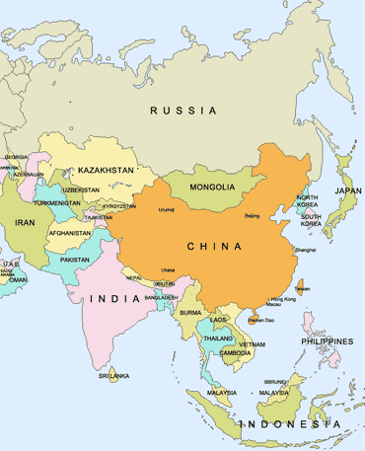
Korea and Vietnam

Slide 14
Korea and Vietnam
Korea and Vietnam fell under the cultural, religious, and sometimes political control of China.
Agricultural production revolved around rice cultivation.
Art, literature, and architecture was shaped by China.
Writing systems were based on Chinese Ideograms
  Hiragana and kanji in Japan
  Hangul in Korea
  Cho nom in Vietnam
Confucianism and various strains of Buddhism came from China as well

Slide 15
Korea
Jogosean Kingdoms (Old Choson) formed as early as the 2000’s BCE.
By the 500’s CE, the Chinese had formed a long, tangled relationship with China.
  Silla, the first kingdom to unite the entire peninsula was a close ally of Tang China and collapsed when the Tang fell.
  Koryo, the next state, had ties with the Song, then was invaded by the Mongols.
    It won its freedom by the 1300’s, but then collapsed.

Slide 16
Korea
The Korean Kingdom of Yi (1392-1910) enjoyed ties with Ming China.
Block printing was developed in Korea under the Koryo state, and then passed it onto the Chinese.
Additionally, it was through Korea that most of China’s influence on Japan passed through.

Slide 17
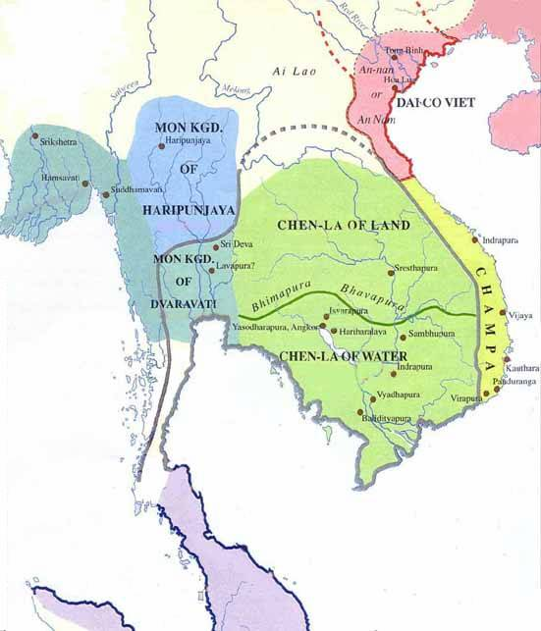
Vietnam

Slide 18
Vietnam
Vietnamese had contact with China as early as the 200’s BCE.
Close ties were formed between Tang China and the Vietnamese states of Annam and Champa.
After 1000 CE, Annam and Champa were under Chinese rule, paid tribute to China, or allied with China.

Slide 19
Vietnam
The widespread practice of rice-paddy farming, or growing rice by means of wet cultivation, originated in SE Asia, most likely Vietnam around 500 BCE.
  Before this, Rice had been grown dry. Wet cultivation led to increased crop yields
  Spread to other parts of Asia, including China and Japan.

