Slide 1
Parasites:
-African Sleeping Sickness
-Chagus
-Leishmania
-Toxoplasma*

Slide 2
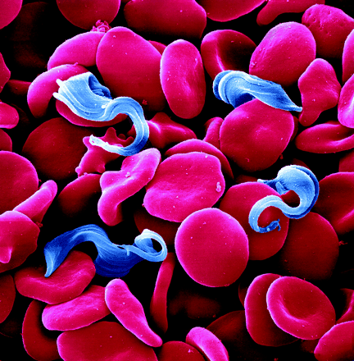
African Sleeping Sickness
Are called hemoflagellates
  They live in the blood stream and have a flagellum, used for movement
They are only one celled organisms
The scientific name is – Trypanosoma brucei

Slide 3
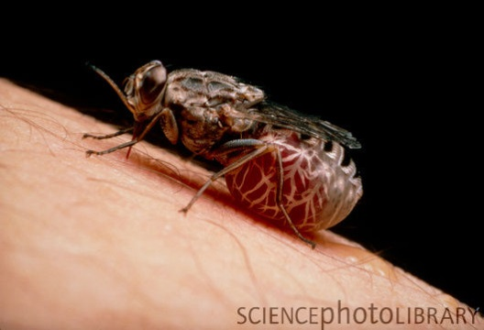
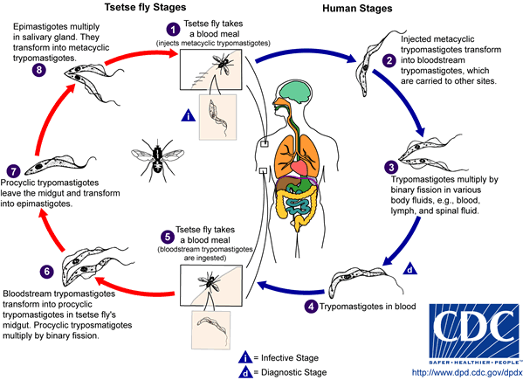
Life Cycle
The Tsetse fly is the intermediate host that then infects humans

Slide 4
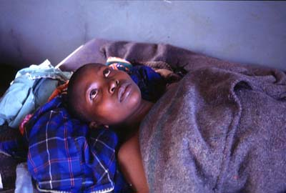
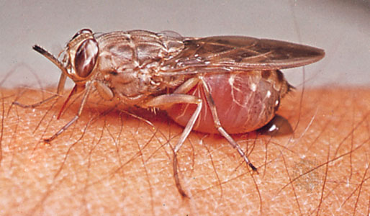
Symptoms
After a bite from an infected tsetse fly there are no symptoms for a few days to a few weeks. Sometimes there is an ulcer formation at site of bite.
Symptoms after a few weeks if the parasite takes:
  Headaches, Anorexia / generalized weakness
  Extreme emaciation and loss of coordination and slurred speech
  Final stages: convulsions and then become comatose

Slide 5
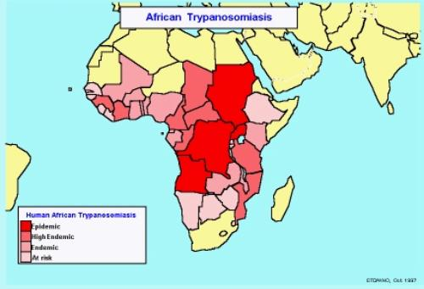
Epidemiology
An estimated 100,000 deaths a year in sub-Saharan Africa, southern Sudan, Democratic Republic of the Congo and Angola

Slide 6
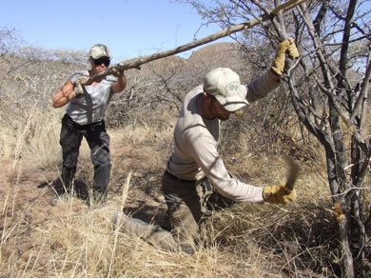
Treatment/ Prevention
Drugs that can be used:
  Arsobal
  Sumarmin for less toxicity
Preventive Measures:
  Bush clearing of tsetse fly breeding sites
  Wear protective clothing
  Bed netting
  Insect repellents

Slide 7
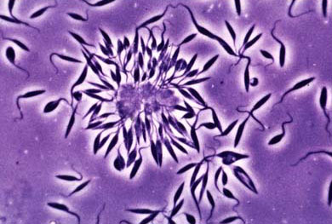
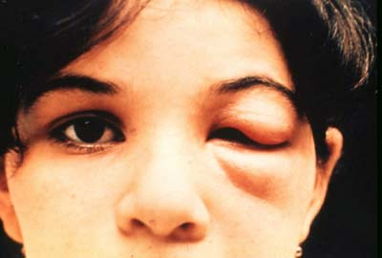
Chagus
Very similar to African Sleeping Sickness – Hemoflagellate.
Difference is that it will infect heart muscle
Scientific Name: Trypanosoma cruzi

Slide 8
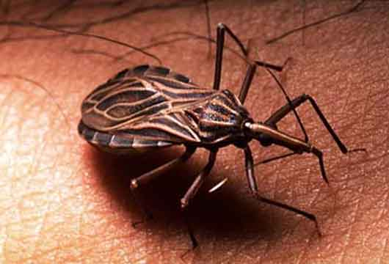
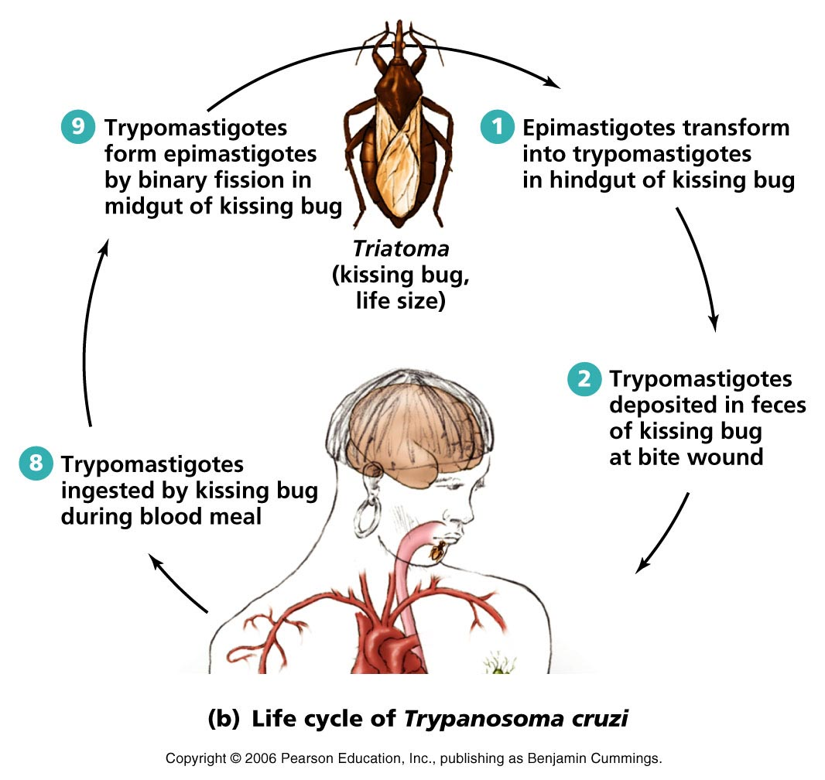
Life Cycle
Intermediate host is the reduviid bug

Slide 9
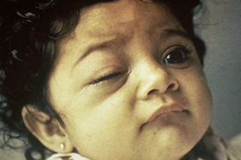
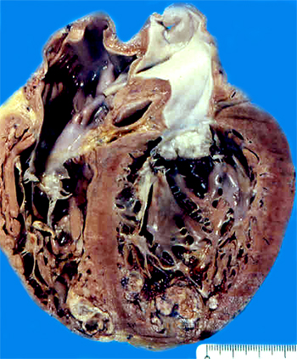
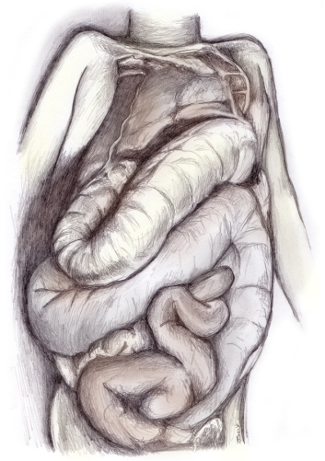
Symptoms
Is most severe in children under 5 years old and effects CNS
  Romaña’s sign
  Chills, high fever
  Muscle pains
  CNS involvement which leads to death within weeks.
  Heart failure
  Dilation of the Digestive Tract

Slide 10
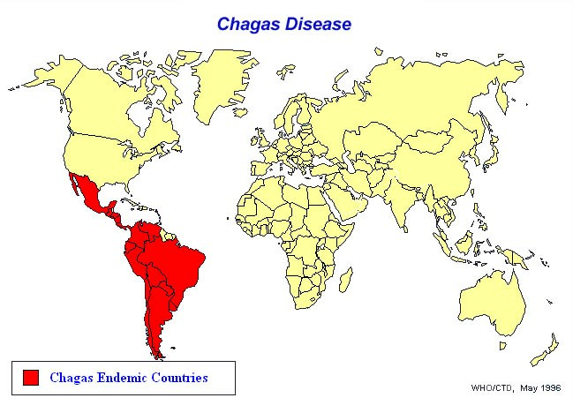
Epidemiology
Found in Central American and South American Countries

Slide 11
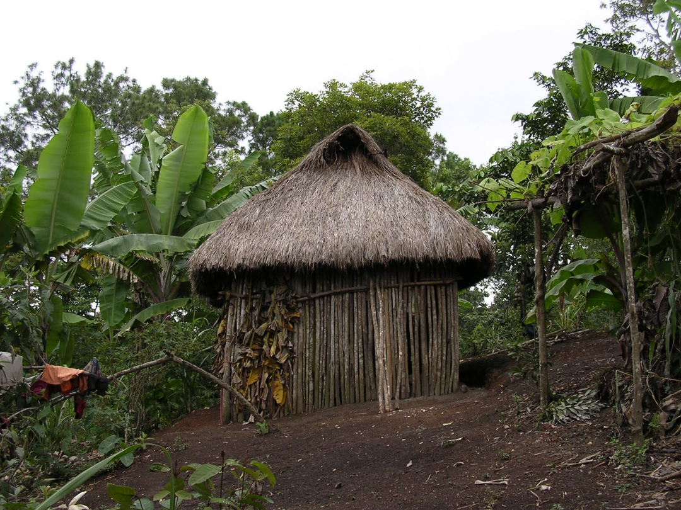
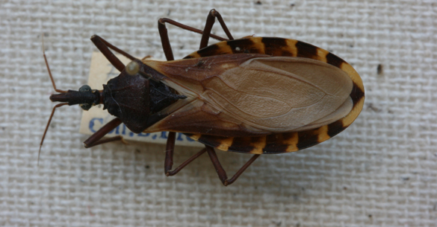
Treatment/ Prevention
Drugs most commonly used: Lampit and Benzidazole
Control of the insect vector
  But difficult, the insect is very resilient
  Use of DDT
  Education of reduviid-proof housing

Slide 12
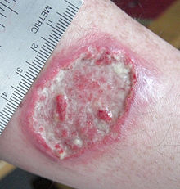
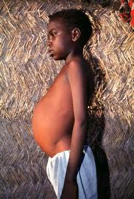
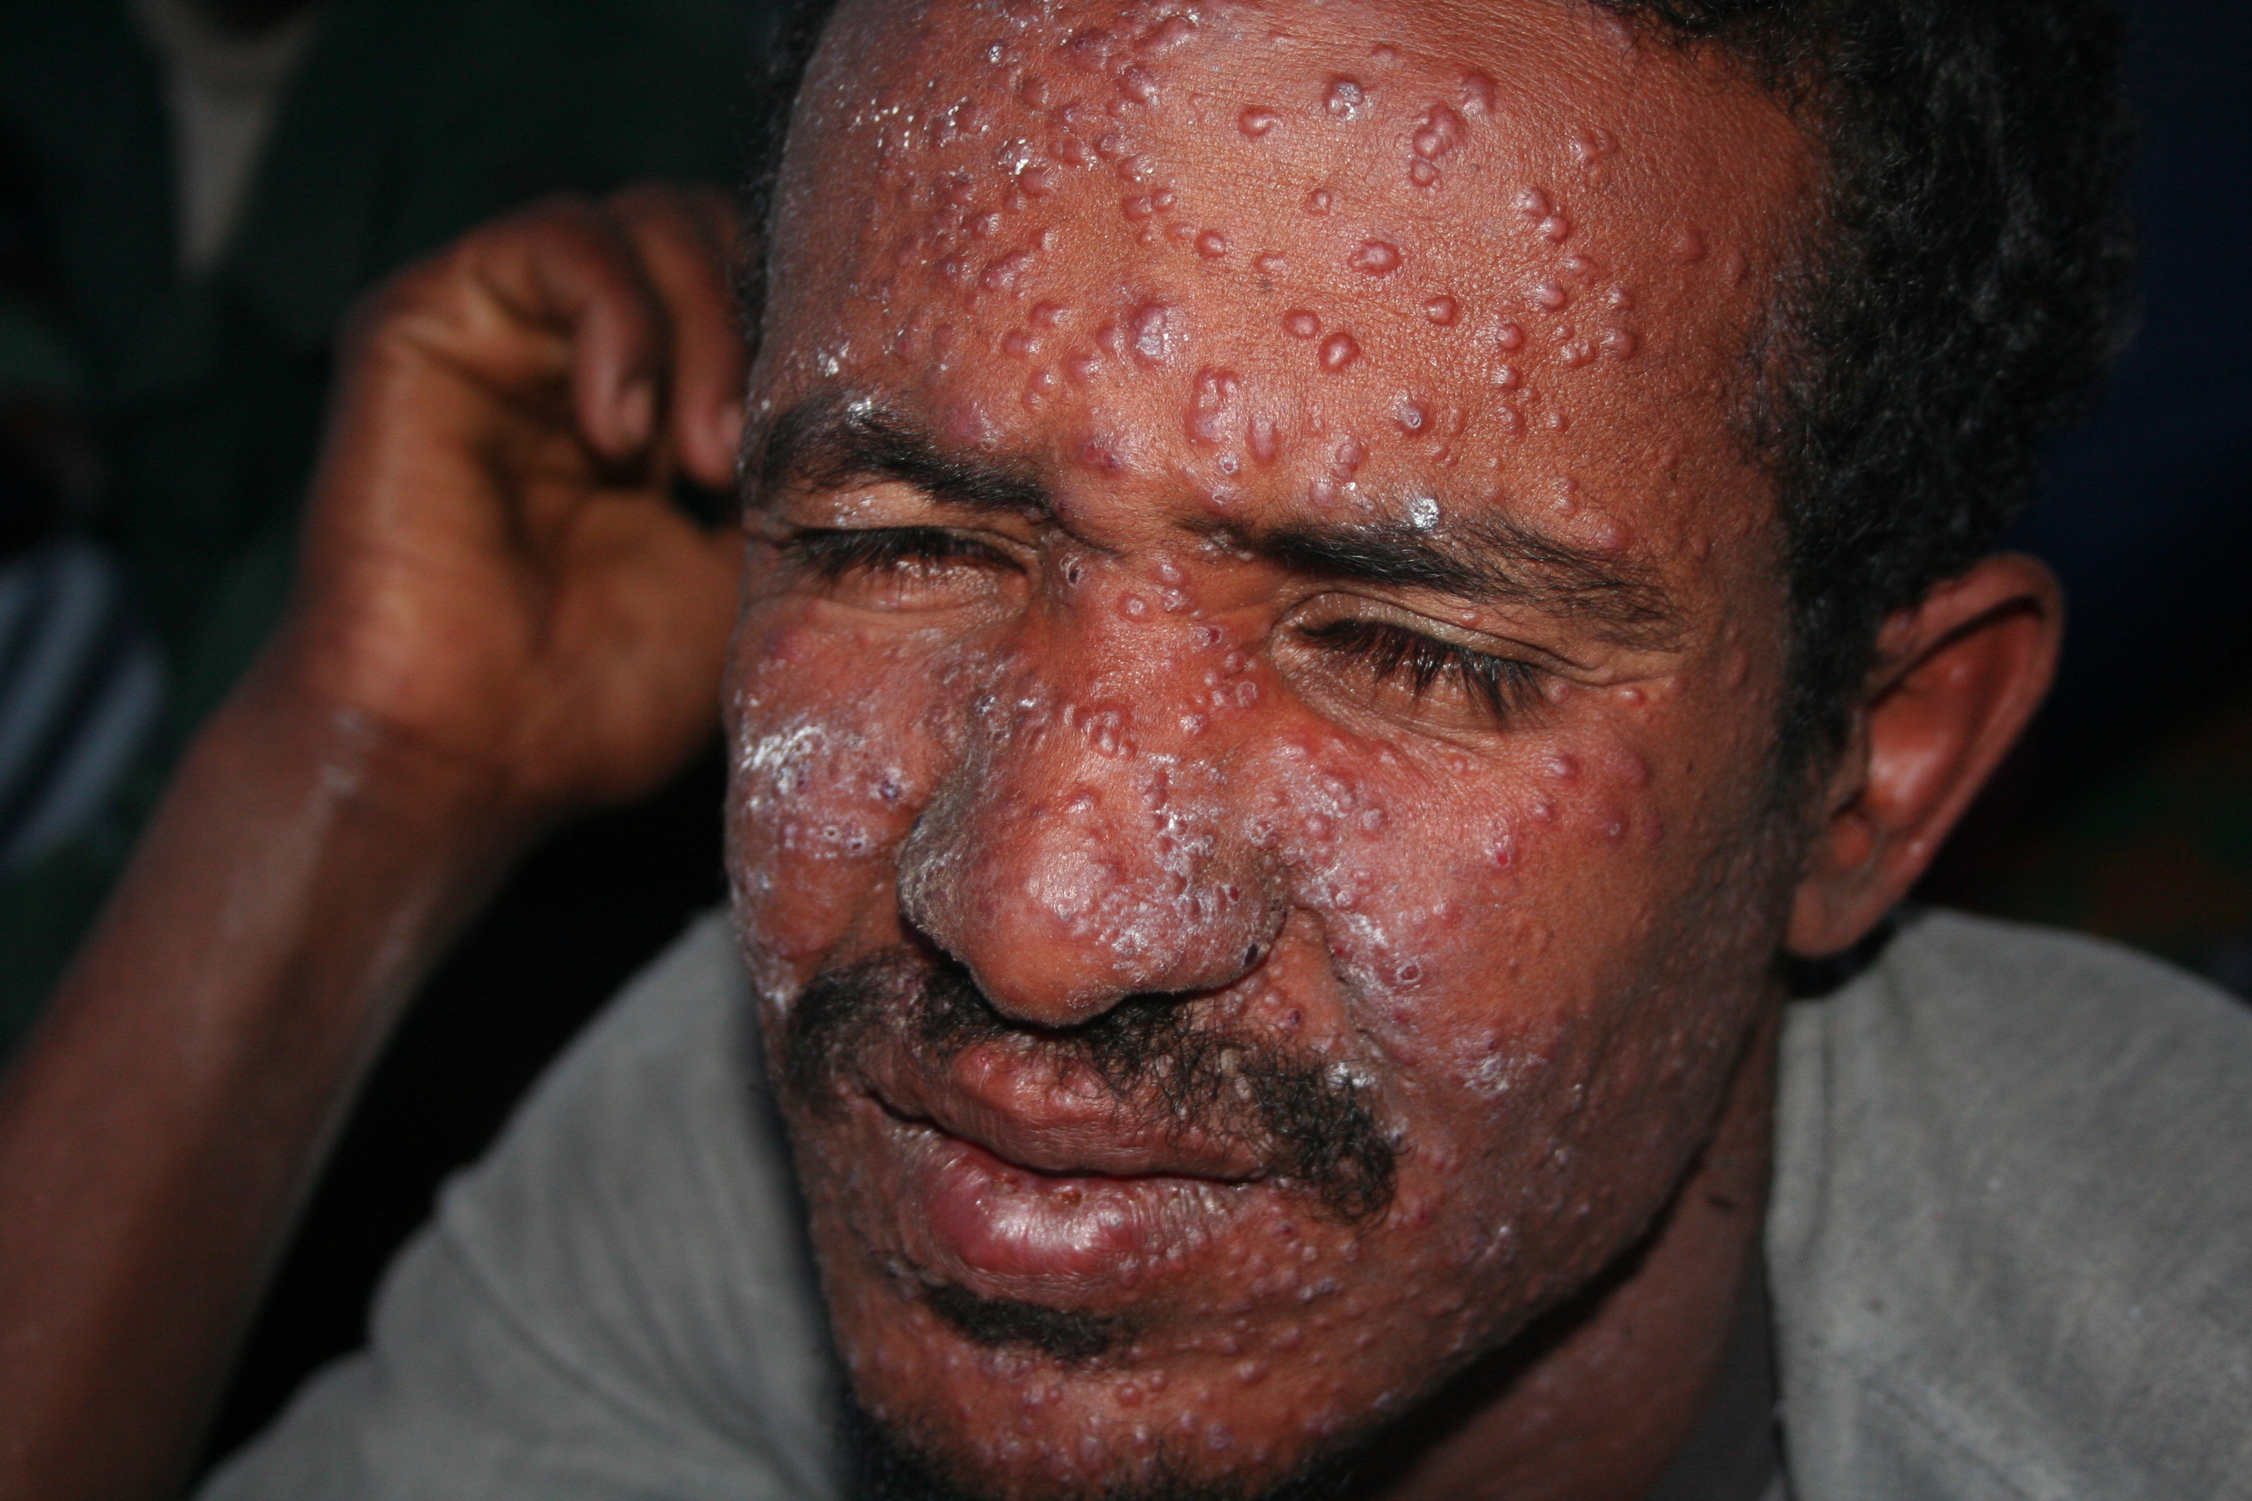
Leishmaniasis
Small parasitic protozoa that lives in white blood cells
Two forms:
  Cutaneous leishmaniasis – causes skin sores
  Visceral leishmaniasis – affects internal organs
    Usually the Spleen, liver, and bone marrow.

Slide 13
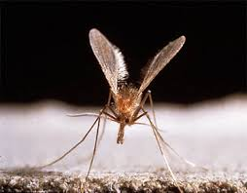
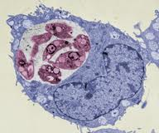
Life Cycle
Intermediate Host is the Sandfly
Leishmania then infects your white blood cells and reproduce themselves
Sandfly bites human or other mammal to pick up parasite and cycles continues

Slide 14
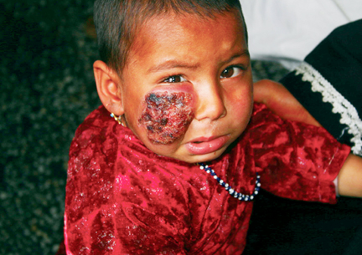
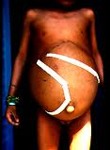
Symptoms
Cutaneous Leishmaniasis – begin as small bumps or lumps and eventually end up as skin ulcers
Visceral Leishmaniasis –
  Fever
  Weight loss
  Enlargement of Liver and Spleen
  Anemia and Leukopenia
    Low Red blood count and white blood count

Slide 15
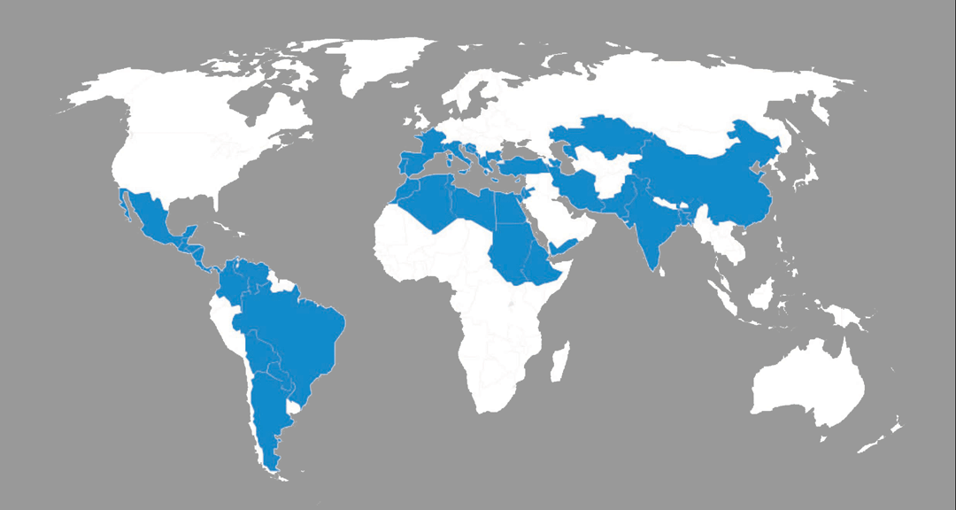
Epidemiology
People can get infected in tropical regions as well as in desert regions
More common in rural areas but can be found in some city outskirts
Cases of Cutaneous form range from 700,000 – 1.2 million
Cases of Visceral form range from 200,000 – 400,000

Slide 16
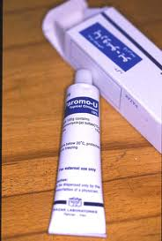
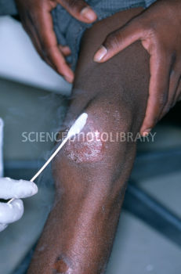
Prevention and Treatment
Prevention-
  Wear proper clothing – long sleeves, long pants
  Insect repellent
  Spray living areas with insecticide to kill insects
  Bed nets
Treatment
  Cutaneous – cryotherapy (liquid nitrogen), ointment
  Visceral – various medications depending on severity

Slide 17

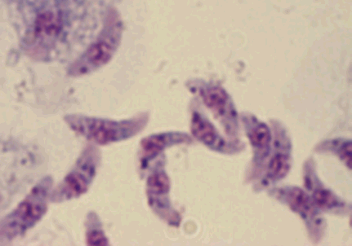
Toxoplasma
Parasite most commonly associated with domesticated regions.
Scientific name is - T. gondii
Definitive host is the cat

Slide 18
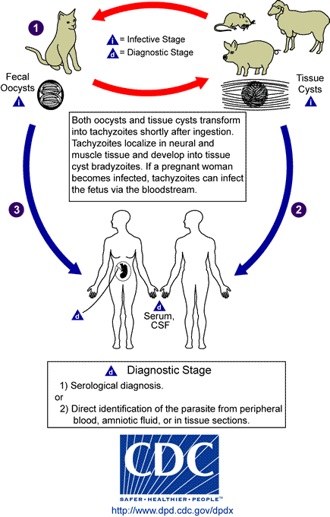
Life Cycle
We are an intermediate host to toxoplasma.
Main host is the cat.
You also find it in the muscle and organs of cows, pigs and sheep.

Slide 19
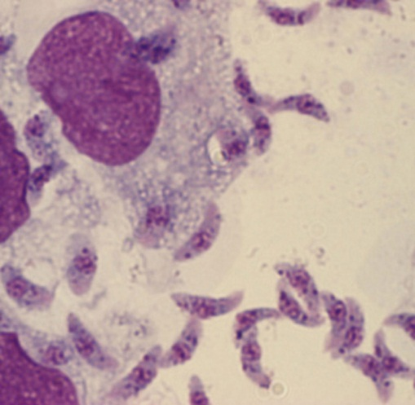
Symptoms
Majority of human infections of Toxoplasma is benign or not harmful.
Some symptoms are:
  Symptoms similar to mono
  Chills and fever
  Extreme fatigue
Biggest problem is with newborn infants:
  Why many people get rid of cats when they have a new born.

Slide 20
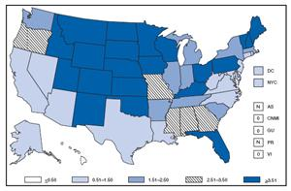
Epidemiology
Wide spread and prevalence rates differ given different circumstances.
Highest rate was 93% in women from Paris. Mostly because of eating undercooked or raw meat.

Slide 21
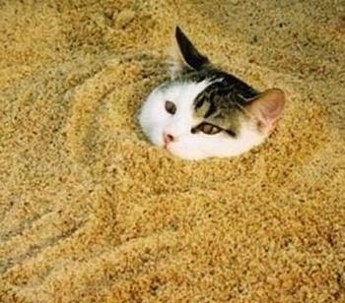

Prevention and Treatment
Human infection usually comes from consumption or handling of infected meat or coming in contact with cat feces.
  Preventative measures:
    Cooking food properly
    Feeding cats proper food and keeping litter boxes in secluded areas and clean
  Treatment:
    Pyrimethamine daily for a month

