Slide 1
Chemistry
Chapter 1
Matter and Change

Slide 2

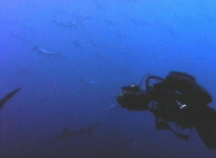
What is Chemistry?
The study of the composition, structure and properties of matter, and the changes it undergoes.
Questions like: “What is it made up of?” or “What happens if you mix it with something else?”

Slide 3
6 Main Branches of Chemistry
1. Organic Chemistry: study of most compounds containing ______________
2. ___________Chemistry: study of non-organic compounds
3. Physical Chemistry: study of properties, changes, and relationships between _______ and ______________
4. Analytical Chemistry: identification of the components and composition of materials

Slide 4
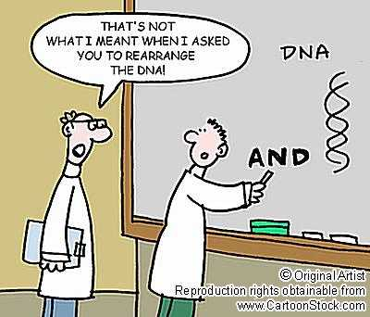
5. BioChemistry: study of substances and processes occurring in living things
6. Theoretical Chemistry: use of mathematics and computers to design and predict the properties of new compound
BUT…
All branches work with _____________:
any substance that has definite/ consistent composition.
e.g. __________, _____________, _________, ________

Slide 5
Within each branch, there are 2 types of Studies:
Basic Research: (Pure Chemistry)
  Research conducted for the sole purpose of __________ ______________
    e.g. Water boils at 212°F
__________ Research: Research carried out to solve a problem
  e.g. How to neutralize toxic chemicals spilt into a river.
Both can lead to a ____________ ______________: Products that improve our quality of life.
  e.g. Teflon (from NASA to my kitchen)

Slide 6
Why Chemistry?
For Money (inspiration to ________)
To Understand and ______________
To _______ everything (medicine and biotechnology)
To provide more ________ (agriculture)
To Save the Earth (identifying and remediating pollution)
The ___________ a galaxy far far away

Slide 7
Before Chemistry was Alchemy
Alchemy is ‘chemistry’ without answers…
Its the __________ of ___________
  Which material was perfect? (Gold)
  They purified chemicals but could not explain how they interacted.
When philosophy ended, experiments began

Slide 8
When philosophy ended, experiments began
It was no longer about what you believed to be true… but what the ________ showed.
  Now instead of believing things burned because of a substance (phlogiston) being released, scientists experimented to PROVE that oxygen was required for something to burn.
  Like forensics and the justice system

Slide 9
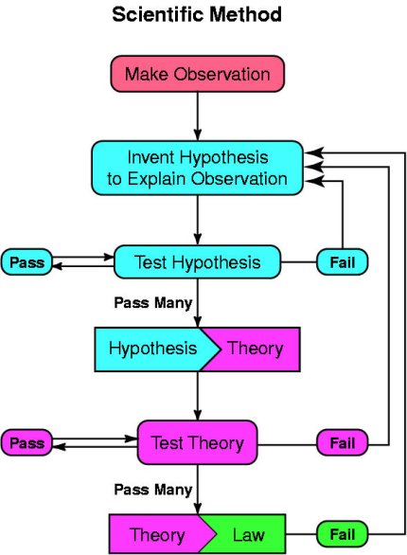
Scientific Method:
__________ researchers use to carry out investigations
A logical approach to solving problems by:
    Observing & collecting data
    Formulating a hypothesis
    Testing

Slide 10
1) Observation / Collection
Observe with 5 senses (sight, smell…)
Make measurements & collect data
2 types of data:
  _______________ (numerical): data expressed in numbers
    e.g. boiling T = 212F, mass = 10oz, Volume = 12 cub.inch
  ____________ (descriptive): data expressed in terms, not numbers
    e.g. Copper has Gold color, is shiny and malleable

Slide 11
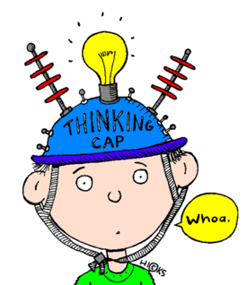
2) Formulating Hypothesis
  a specific statement (or an educated idea / guess) about a problem
  So far, it is ____________ (_________ or __________)
  You should have a prediction, but not KNOW the answer.

Slide 12
3) Testing Hypothesis
  Design and run an experiment that will help you decide if your hypothesis is supported or unsupported

Slide 13
More on hypotheses
Done with a ‘control’
  isolating a single, ______________ variable by treating two experiments the same except for one variable
  Allows for a standard of comparison
  Analyzed by checking a dependent variable to see if the independent variable was affected. (the results ‘depend’ on if the control was in or out)
If supported go to step 4… if not back to step 1!!!

Slide 14
4) Theorizing
You can construct a “model” that explains your results. The model relates your data to known theories
It may even contribute to a Theory - a broad _____________ that ________ a body of ________ or phenomena.
e.g. the phenomena/model that says “when you drop something it falls” is part of the big “ Gravitational theory” which explains a whole lot more

Slide 15
A word about theories…
A theory is not the same for science as it is the common English language.
A Scientific Theory is a hypothesis that
  Stands up to years of tests
  Is ________ _____ _______ ___________gathered to date
  Is useful in __________ about unknown things and has been tested many times

Slide 16
Some common Scientific Theories
  Gravitational Theory
  Cell Theory
  Plate Tectonics Theory
  Evolutionary Theory
  Kinetic Theory of Gases

Slide 17
5) Repeat, Repeat, Repeat
Repeat your experiments to show that it will happen again, and again.
6) Publish
Get famous – scientifically speaking!
But also just to let others know of your discovery
  Science
  Cell
  Nature

