Slide 1
Notes: Basic Chemistry
EQ: What are the two types of chemical bonds and what makes each one unique?

Slide 2
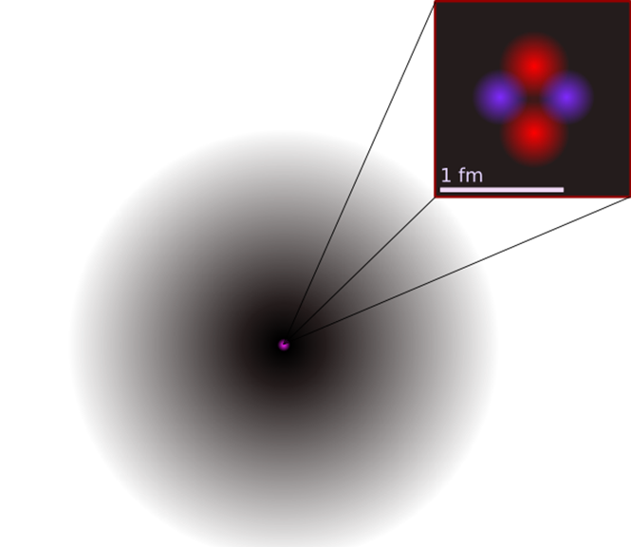
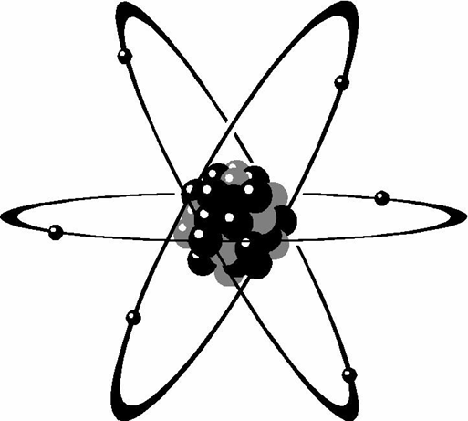
Atoms
The study of chemistry begins with the basic unit of matter, the atom
If an atom is placed side by side, 100 million atoms would make a row about 1 cm long

Slide 3
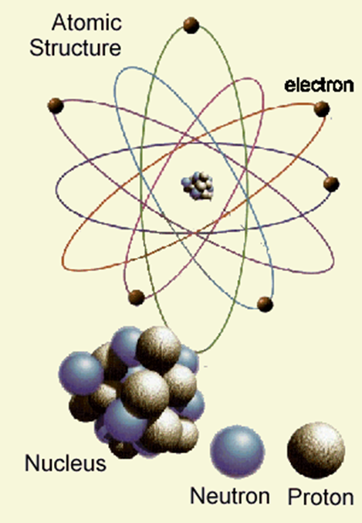
Atoms Subatomic Particles
The atom has 3 subatomic particles
Proton – positively charged particle
Neutron – no charge
Electron – negatively charged particle
Atoms are neutral in total charge because the number of protons equals the number of electrons

Slide 4
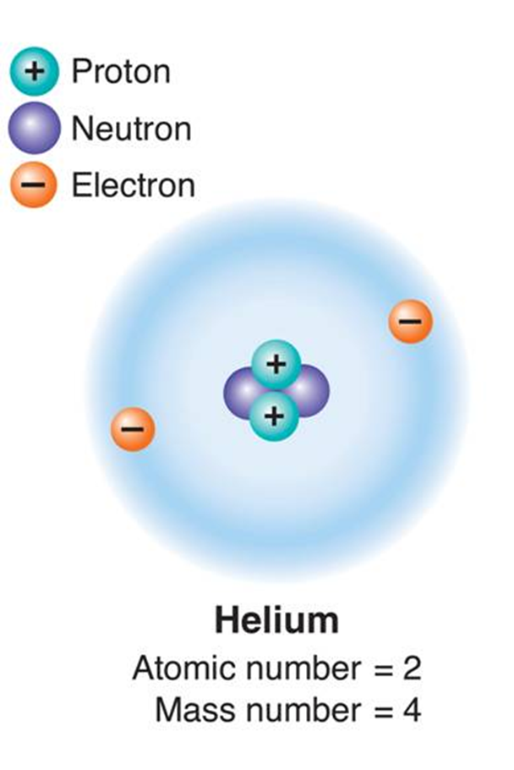
Atoms Subatomic Particles
Protons and Neutrons make up the nucleus of the atom and make up the majority of an atoms mass.
Electrons do not have much mass but are the particles responsible for the atoms reactivity.

Slide 5
Elements and Isotopes
An element is a pure substance that consists entirely of one type of atom.
O stands for Oxygen
Au stands for Gold
Fe stands for Iron

Slide 6
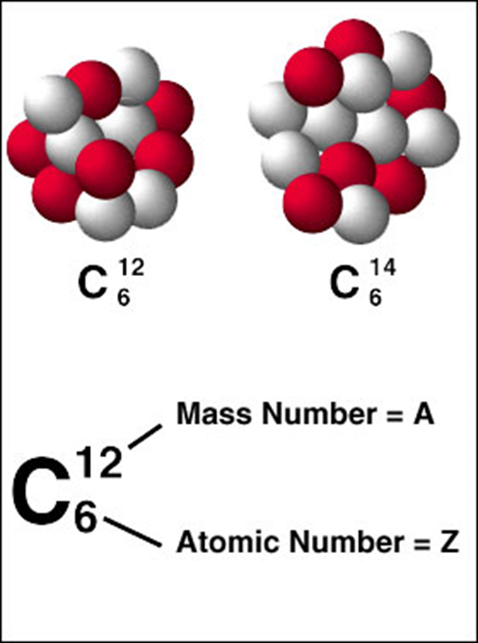
Elements and Isotopes
Atoms of the same element but have a different number of neutrons is called an isotope.
Isotopes of the same element still have same properties because electron number is the same.

Slide 7
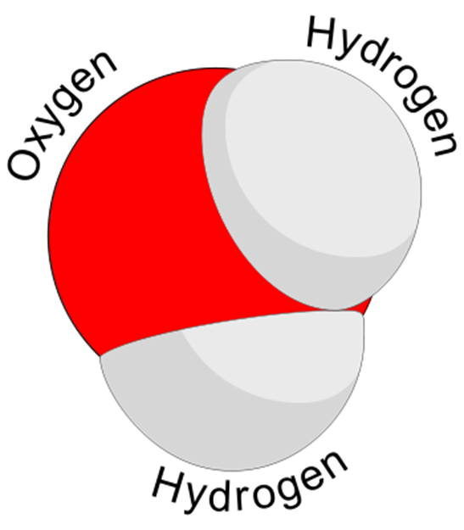
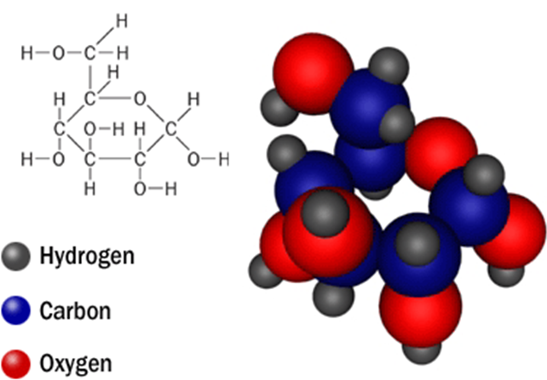
Chemical Compounds
Chemical compound is a substance formed by the chemical combination of two or more elements.

Slide 8
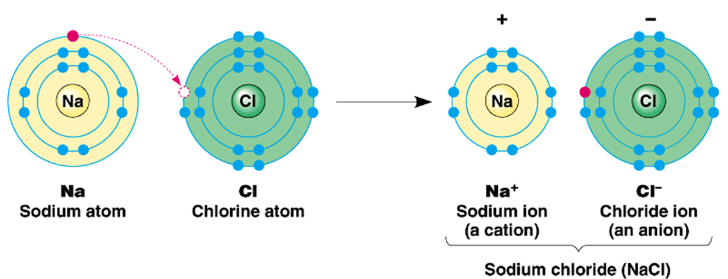
Chemical Bonds
Compounds are held together by chemical bonds.
There are 2 main types of bonds
Ionic Bond
Formed when an electron is transferred from one atom to another
This forms a positively and negatively charged atoms and are called ions

Slide 9
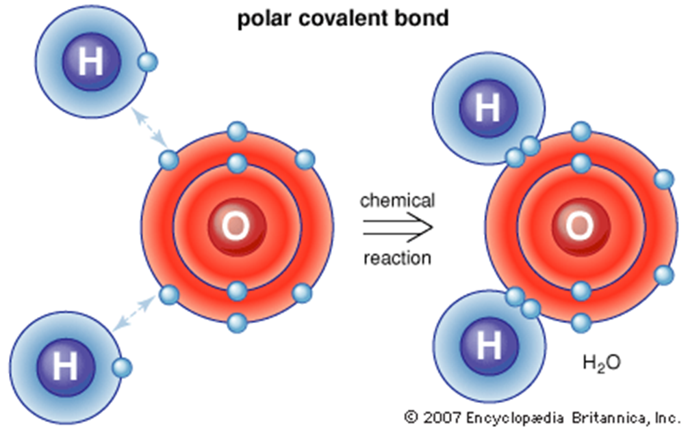
Chemical Bonds
Covalent Bond
Formed when electrons are shared by atoms
The structure that results from a covalent bond is known as molecule

Slide 10
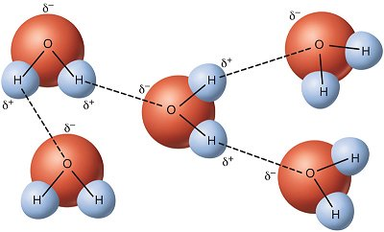
Van der Waals Forces
Occurs between molecules that are close together and there is a slight attraction between each other.
The most common type is called the Hydrogen bond

Slide 11
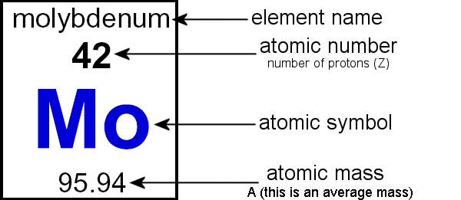
Element Project
Make a Periodic Table Element
Include Drawing
Atomic Number
Atomic symbol
Element Name
Atomic Mass
Whether it is a Solid/Liquid/Gas

