Slide 1
Warm-up #8
Where did feudalism first emerge? How did it spread? (pg 244)
What do you think makes a castle strong?

Slide 2
Definition
Castle - (Latin - castellum,”small fortified place”)
A fortified residence of a lord or monarch. Derived from the walled cities of ancient Rome and the fortified palaces of Byzantium, the castle became virtually ubiquitous in western Europe during the wars of the late Middle Ages.

Slide 3

Insert “feudalism_life in a castle”

Slide 4
History
The main function of all castles was defense.
Types
  Simple Wooden Structures (Ring Works)
    Set on mounds of dirt
    Surrounded by a ditch
  Stone Walls (Palisades)
    Better Protection
    Motte (Moat) – earth mound
    Bailey – court yard
Time Frame
  6th Century - 10th Century (medieval)
  11th Century – 15th Century (post-medieval)
Construction Influences
  Residential Castles
    Status Symbol
  Military Castles
    Castle walls were increasingly thicker and stronger in response to the development of artillery.
Notes:
History: The First Castles
The earliest castles appeared in the 9th and 10th centuries, when the empire created by Charlemagne in modern France, Germany, and northern Italy was falling because of raids by peoples such as Vikings and Magyars, or Hungarian nomads. Lords built castles for protection and as bases for their soldiers. Most of these early castles were built of earth and timber.
The simples castle structure was the ring-work. This was an enclosure surrounded by a ditch with an earth rampart inside it. A strong fence (or palisade) was built on the rampart. In the 11th century motte-and-bailey castles became popular to build. An earth mound (or motte) was built next to a yard (or bailey).
Motte-and-bailey style
These castles were built in the 11th and 12th centuries. There was a bailey or courtyard, protected by a ditch and palisade, and an entrance gate sometimes with a lifting bridge, a drawbridge, or maybe a gate tower. Within the bailey were stables and workshops, a well, and sometimes a chapel. There was also a motte which the castle stood on. The bridge then went down to the bailey.

Slide 5
Keeps (Donjon) – 40 to 50 feet high
  Norman Influence
  Located within the Bailey
  Moats with Drawbridges
  Square vs. Round
  Final Defensive Position
End of Castles
  Around 1500 AD (Gothic Period)
  Invention of Gunpowder
  Imposing Residence (Churches)
Notes:
History (cont.)
At first the castle consisted of a simple wooden structure on top of a mound, surrounded
by a ditch. If a lord's domains were flat, he constructed an artificial mound, or motte. As
medieval siege craft developed, a wall or series of walls or palisades was raised around the
motte and at a distance from it; the open area within these walls became known as the
bailey. By the 11th century the motte-and-bailey form of castle was widely prevalent. Outer
walls gradually became thicker and were topped with wide battlemented parapets.
The next step in the development of the castle was the addition by the Normans of a
towering masonry keep, or donjon, within the bailey. The keep, often some 12 to 15 m
(some 40 to 50 ft) high, had thick walls and small windows. The White Tower within the
Tower of London is an example of a Norman keep. Wide, deep moats replaced the crude
ditches; ideally filled with water but often dry, these moats were crossed by drawbridges
that could be raised from within the castle. At the castle end of the drawbridge was an
opening in the wall, containing a portcullis, a thick, iron-plated wooden door that could be
raised to clear the entrance. Within the Norman keep were private apartments, a well for
water, and everything else necessary to sustain the inhabitants of the castle through a long
siege. At first the keep was rectangular; later, it was learned that a round keep was easier
to defend. In the 13th century the castle became increasingly sophisticated. Living and
administrative quarters were moved from the keep into new buildings raised within the
bailey. The keep, made smaller and stronger, became the final defensive position within a
series of battlements.
HOW TO CITE THIS ARTICLE
"Castle (architecture)," Microsoft® Encarta® Online Encyclopedia 2000
http://encarta.msn.com © 1997-2000 Microsoft Corporation. All rights reserved.

Slide 6
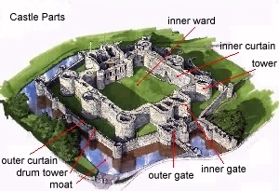

Slide 7
Construction
Considerations
  Castle License - Under Norman rule, noble men could not build castles without the monarch's permission.
  Manpower (2000 tradesmen)
  Weather
  Time
    10 Feet of Elevation Per Year
    5 – 45 years
  Cost (“Tens of Thousands of Pounds”)
    Material
    Manpower
    $170.00 per sq. ft. in today's market + overhead
Built On Cliffs or a Bend In a River
Style
  Ring-work - enclosure surrounded by a ditch with an earth rampart inside it, and a wooden fence around the rampart
  Motte-and-Bailey – mounds of dirt – wooden tower
Notes:
Construction
A castle was often built on the edge of an impregnable cliff, ideally at a bend in the river where it could command a view of the surrounding countryside. The Château Gaillard, built by Richard I, King of England, in Les Andelys, France, is an example of a strategically located castle. The use of gunpowder in projectiles brought to an end the impregnability of the
medieval castle. After 1500 the construction of castles was no longer feasible, and castle became a term for an imposing residence.
The simplest castle structure was the ring-work. This was an enclosure surrounded by a ditch with an earth rampart inside it. A strong fence (or palisade) was built on the rampart. In the 11th century motte-and-bailey castles became popular to build. An earth mound (or motte) was built next to a yard (or bailey).
Building The Castle
When a suitable site with fresh water was found, the lord employed a master mason, often on contract, to help plan and build a castle. The lord would most likely employ a master mason if they could get the building materials themselves. The master mason would take charge of the building work. Under him were an army of workers. Hewers but the stone at the quarry; freemasons cut the fine blocks of stone (known as ashlar) and carved decorative moldings; rough masons and layers built the walls. There were many other workers doing specific jobs, from carpenters to well-diggers, metal smiths to quarrymen.
Masons and Smith
Shaping stones was skilled work. A 15th century mason would inspect a fine squared stone block to ensure it will fit. Chisels were used for cutting and dressing stone, although some stone was soft enough to be cut with a saw. A smith was needed on site because the tools wore out quickly.
Mortar Trowel
Mortar was mixed and laid on with a trowel. The mortar was made by mixing sand and lime; the latter could be provided by burning limestone on site. Mortar bound together the rubble walls of rough stone and the fine ashlar facings. It was also used to build the brick castles which appeared in the later Middle Ages.
Layout of a Castle
This shell wall separated the castle into two regions. The outer ward/bailey (from ballium) was the area
between the inner curtain wall and the shell wall, which contained the general retainers (quarters, stables,
stores, forge, well, etc.). The inner ward/bailey was the area between the inner curtain wall and the keep tower
itself which contained the lord and his family and their more personal servants. Another style of castle would
have a wall with various corner and perimeter towers, the most important and largest of which was the keep,
also known as the donjon, arx, turris, domus, or munitio. It was very often square or rectangular, with at least a
tower at each corner. Both styles often had a steep sloping base, called a talus or plinth. The style of the keep
castle was carried to the Mediterranean by Norman conquerors of Sicily and to the Holy Land by Crusades.
The keep would contain a (great) hall, a well, a kitchen, private chamber/ solar, stables, storerooms,
workshops (smith, armorer), and (very occasionally in the beginning and more often as time passed) a chapel.
With walls up to 20 feet thick and the entrance on the first floor (not the ground floor), the keep was the most
secure part of the castle. The enemy would have to breach many obstacles (barbicans, moats, ditches, mottes,
high walls with archers perched atop them, machicolations, drawbridges, more walls, meurtrières, portcullises,
more walls) in order to reach the inner sanctum. It was a castle within a castle for the ultimate in safety and
privacy.
The most important chamber in the castle was the hall. Sometimes the hall would be within the keep tower
itself, and sometimes it would be a separate building within the inner curtain. Often with very elaborate and
high wooden ceilings, the hall was usually an enormous room that could fit hundreds. This very often served as
a courtroom, where the lord would perform his administrative and judicial duties, and was where all meals
were taken. After the meals, the tables would be collapsed and moved to provide room for dancing and later
on, servants and lesser guests would sleep on the rushes that were strewn on the floors. Sometimes, as at
Chepstow, the hall took the place of the keep, having two stories, with storage in the vaulted ground floor and
the hall and chamber in the hall-keep style on the first floor side-by-side. The public nature of the Frankish,
Celtic, and Viking civilizations is at this point still vestigially evident in hall-keeps, where the private chamber is
next to the hall on the same floor, reached only through crossing the hall. Later on, the idea of privacy became
more important, and tower-keeps, where the private chamber was over the hall, reached through a circular or
mural stair, gained popularity.
By analyzing the facilities of the castle, one can gage with certainty each castle’s characteristics. Features such
as fireplaces, chapels, wells, and latrines imply permanent occupation, and the number of latrines built into the
castle corresponds to how many people lived there. Later on, when castles became less function-oriented and
more decorative, large rooms would be partitioned into smaller chambers. People preferred to sleep in
bedrooms rather than in a bed enclosed within heavy curtains in a huge room with perhaps a dozen or more
other similar beds, each occupied by two or more people (the famous Bed of Ware could sleep twelve
comfortably, it has been said). Decor became more lavish, with more attention paid to carved and even padded
furniture and frescos on the plastered interior of the walls. Even the columns holding up the ceilings and roofs
(in aisle formation in England and a single central spine layout on the continent) were elaborately sculpted, the
columns themselves having intricate geometric or foliate patterns incised upon them.

Slide 8

Insert “Castles and Lords”

Slide 9
Bailey or Ward: courtyard within the walls of the castle.
Concentric: having two sets of walls, one inside the other
Crenel: notched battlement made up of alternating openings in a square, saw-teeth pattern.
Donjon: the inner stronghold (keep) of a castle.
Drum Tower: a round tower built into a wall
Merlon: part of a battlement, the square "saw tooth" between crenels
Moat (Motte): The name moat, properly meaning, bank or mound, was transferred to the ditch surrounding a castle. The trench around the rampart of a castle or other fortified place was often filled with water.
Palisade: a sturdy wooden fence built to enclose a site until a permanent stone wall could be constructed
Sapping: undermining, as of a castle wall
Turret: a small tower rising above and resting on one of the main towers, usually used as a look out point
Wall Walk: the area along the tops of the walls from which soldiers could defend the castle
Notes:
Castle Terms:
Allure or Wall-walk: passage behind the parapet of a castle wall
Apse: circular or polygonal end of a tower or chapel
Arcading: rows of arches supported on columns, free-standing or attached to a wall (blind arcade)
Arrow Loop: A narrow vertical slit cut into a wall through which arrows could be fired from inside
Ashlar: blocks of smooth, squared stone of any kind
Bailey or Ward: courtyard within the walls of the castle
Ballista: engine resembling a crossbow, used in hurling missiles or large arrows
Barbican: an outwork or forward extension of a castle gateway
Barrel vault: semicircular roof of stone & timber
Bartizan: overhanging corner turret
Bastion: a small tower at the end of a curtain wall or in the middle of the outside wall
Battlement: a narrow wall built along the outer edge of the wall walk to protect soldiers against attack
Belfry: tall, movable wooden tower on wheels, used in sieges
Brattice: (see hoarding)
Buttery: room for the service of beverages
Concentric: having two sets of walls, one inside the other
Crenellation: a notched battlement made up of alternate crenels (openings) and merlons (square saw teeth)
Cross-wall: an internal dividing wall in a great tower
Curtain wall: a castle wall enclosing a courtyard
Cut: assault tower
Corbel: stone bracket projecting from a wall or corner to support a beam
Donjon: the inner stronghold (keep) of a castle
Drawbridge: a wooden bridge leading to a gateway, capable of being raised or lowered
Drum Tower: a round tower built into a wall
Dungeon: the jail, usually found in one of the towers
Enceinte: an enclosing wall, usually exterior, of a fortified place
Embrasure: the low segment of the altering high and low segments of a battlement
Escalade: scaling of a castle wall
Finial: a slender piece of stone used to decorate the tops of the merlons
Fore-building: a projection in front of a keep or donjon, containing the stairs to the main entrance
Garderobe: latrine
Gate House: the complex of towers, bridges, and barriers built to protect each entrance through a castle or town wall
Hall: principle living quarters of a medieval castle or house
Hoarding: covered wooden gallery affixed to the top of the outside of a tower or curtain to defend the castle
Inner Ward or Inner Bailey: open area in the center of a castle
Keep: the inner stronghold of the castle
Loophole: slit in wall for light, air, or shooting through
Machicolation: a projection in the battlements of a wall with openings through which missiles could be dropped on besiegers
Mangonel: stone:throwing machine worked by torsion, used as a siege weapon against castles
Merlon: part of a battlement, the square "saw tooth" between crenels
Meurtriere: arrow loop, slit in battlement or wall to permit firing of arrows or for observation
Moat: a deep trench usually filled with water that surrounded a castle
Motte: an earthwork mound on which a castle was built
Murder Holes: a section between the main gate and a inner portcullis where arrows, rocks, and hot oil could be dropped from the roof though holes
Oilette: a round opening at the base of a loophole
Oriel or Oriel Window: projecting room on an upper floor, later an upper-floor bay window
Oubliette: a dungeon reached by a trap door
Palisade: a sturdy wooden fence built to enclose a site until a permanent stone wall could be constructed
Parapet: protective wall at the top of a fortification, around the outer side of the wall:walk
Portcullis: vertical sliding wooden grille shod with iron suspended in front of a gateway, let down to protect the gate
Postern Gate: secondary gate or door
Putlog Hole: a hole intentionally left in the surface of a wall for insertion of a horizontal pole
Ram: battering ram
Revet: face with a layer of stone, stone slabs etc., for more strength. Some earth mottes were revetted with stone.
Sapping: undermining, as of a castle wall
Screens: wooden partition at the kitchen end of a hall, protecting a passage leading to the buttery, pantry, and kitchen
Solar: originally a room above ground level, but commonly applied to the great chamber or a private sitting room off the great hall
Springald: war engine of the catapult type, employing tension
Trebuchet: war engine developed in the Middle Ages employing counterpoise
Turning Bridge: a drawbridge that pivoted in the middle
Turret: a small tower rising above and resting on one of the main towers, usually used as a look out point
Wall Walk: the area along the tops of the walls from which soldiers could defend the castle
Ward: courtyard or bailey

Slide 10
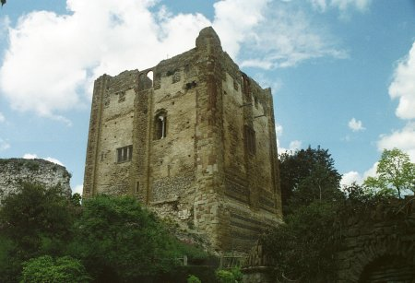
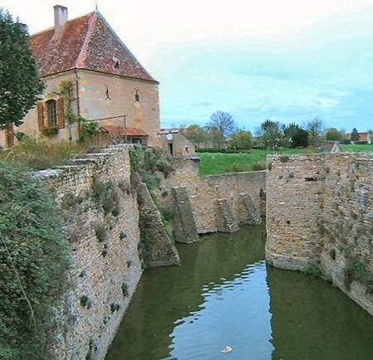
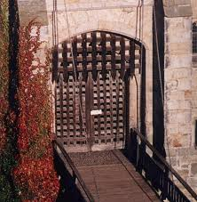
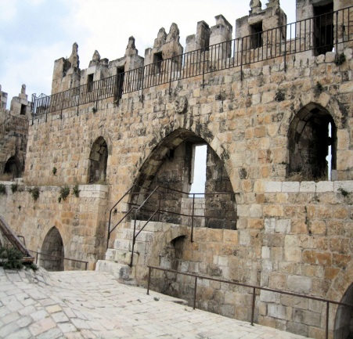
A keep (from the Middle English kype) is a type of fortified tower built within castles during the Middle Ages by European nobility. Scholars have debated the scope of the word keep, but usually consider it to refer to large towers in castles that were fortified residences, used as a refuge of last resort should the rest of the castle fall to an adversary.

Slide 11

A moat is a deep, broad ditch, either dry or filled with water, that surrounds a castle, other building or town, historically to provide it with a preliminary line of defence. In some places moats evolved into more extensive water defences, including natural or artificial lakes, dams and sluices. In later periods the moat or water defences may be largely ornamental.

Slide 12
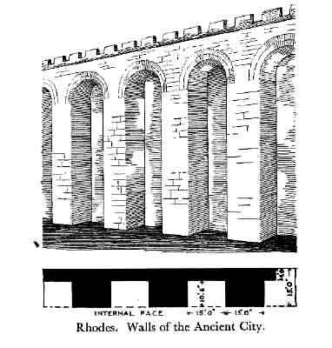
Example Wall:

Slide 13
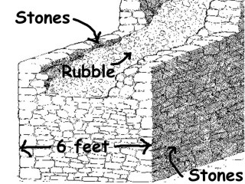
Wall Construction

Slide 14

A rampart is a type of defensive wall.

Slide 15
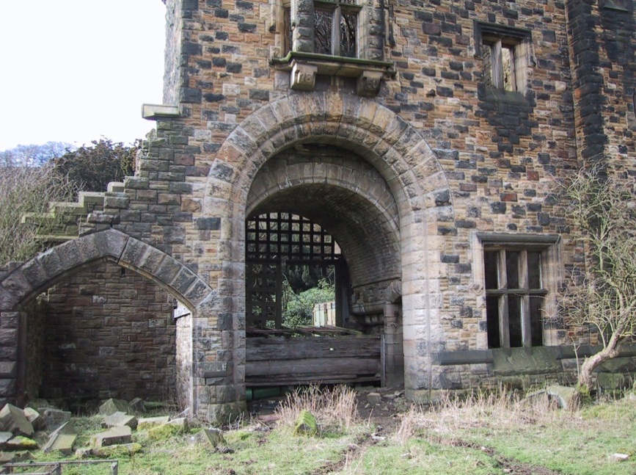
A portcullis (from the French "porte coulissante" or gliding door) is a latticed grille made of wood, metal or a combination of the two. Portcullises fortified the entrances to many medieval castles, acting as a last line of defence during time of attack or siege. Each portcullis was mounted in vertical grooves in castle walls and could be raised or lowered quickly by means of chains or ropes attached to an internal winch.

Slide 16
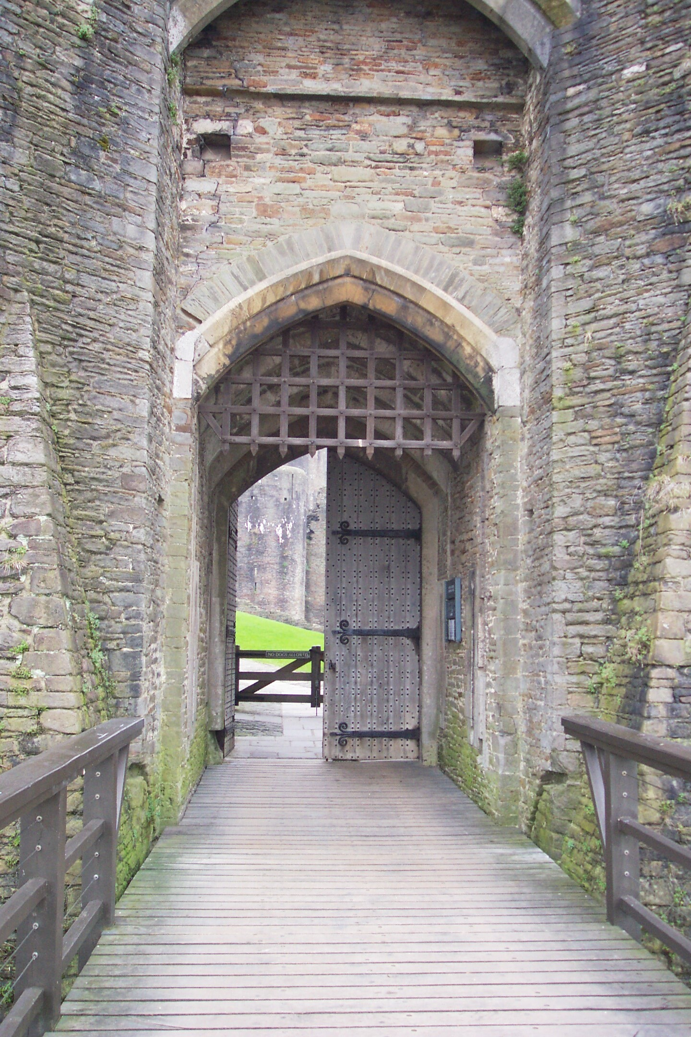
Defending the Castle
Portcullis
Murder Holes
Defendant Passageway

Slide 17
Murder Holes
These were holes in the ceiling of the
entrance to the castle.
People in the castle would pour hot
limewater or boiling tar onto invaders.

Slide 18
Defendant Passageway
These were long slits in the walls where
people shot arrows to kill and wound
unwanted visitors.

Slide 19
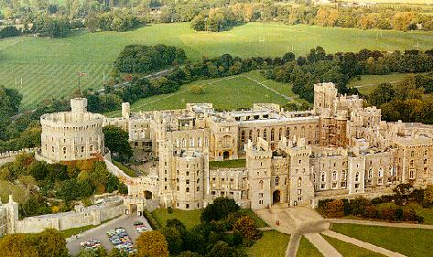
Windsor Castle (13 Acres)
Built by William the Conqueror

Slide 20
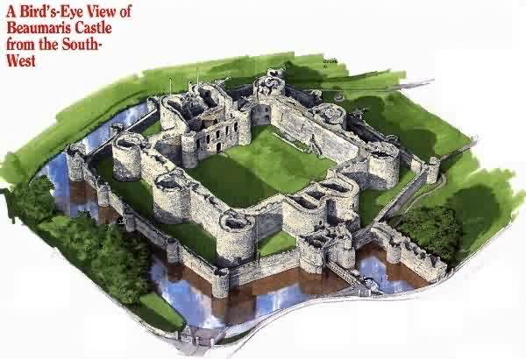

Slide 21
Read both sides of “A Medieval Castle”
Label the 16 points on your castle diagram.
Color your diagram.
Write a one paragraph summary explaining which parts (3-5) of the castle you think provided the best defense during a siege and why you think they were effective.

Slide 22
ADVANCED:
Read both sides of “A Medieval Castle”
DEISNG YOUR OWN CASTLE
  COLOR
  OUTLINE
  15 ELEMENTS LABELED
  ½ (2-3 PARAGRAPH) PAGE EXPLANITIAON OF WHY YOUR CASTLE PROVIDES GOOD DEFENCE DURING A SEIGE.

