Slide 1
Warm-up #5
How did the framers solve the issue of representation in the legislative (law-making) branch of the federal government?
What disputes over slavery rose? How were they solved?

Slide 2
Chapter 8 Worksheet
Correct front
Do first section on the back (8.8).
We’ll come back to the rest of this handout another day.

Slide 3
Essential Question
How did the Constitutional Convention deal with issues surrounding slavery.
  Three-Fifths Compromise
  Slave Trade

Slide 4
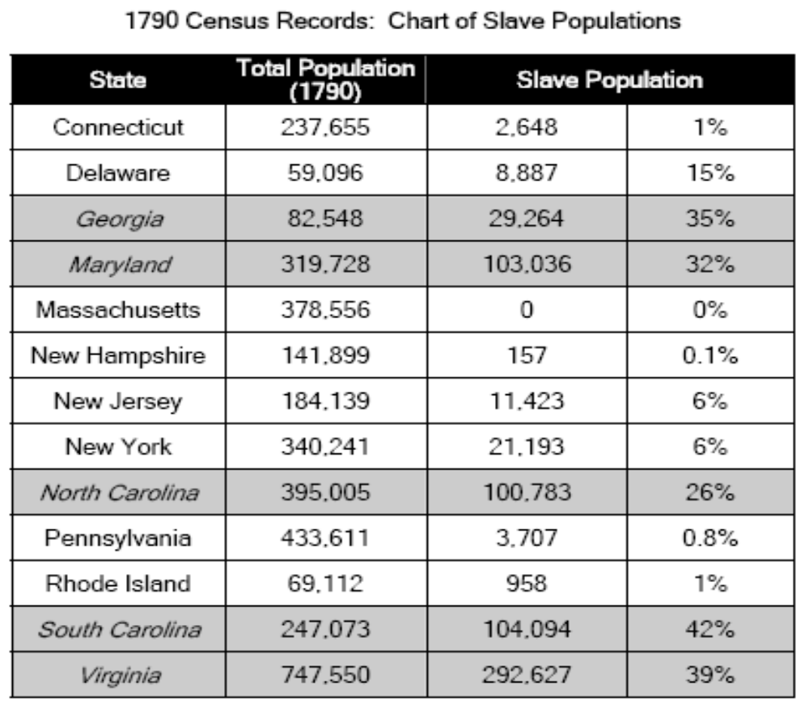

Slide 5
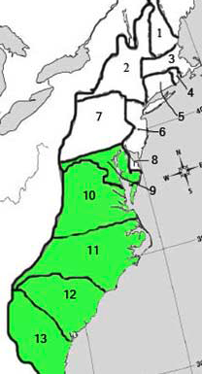
Three Fifths Compromise Worksheet
Which state has the highest number of slaves?
Which has the highest percent of slaves in their population?
Where are the states with the most slaves located? Why?
Read the excerpts for the Constitution:
  When would the slave trade be banned?
  In what other ways did the Constitution support slavery?

Slide 6
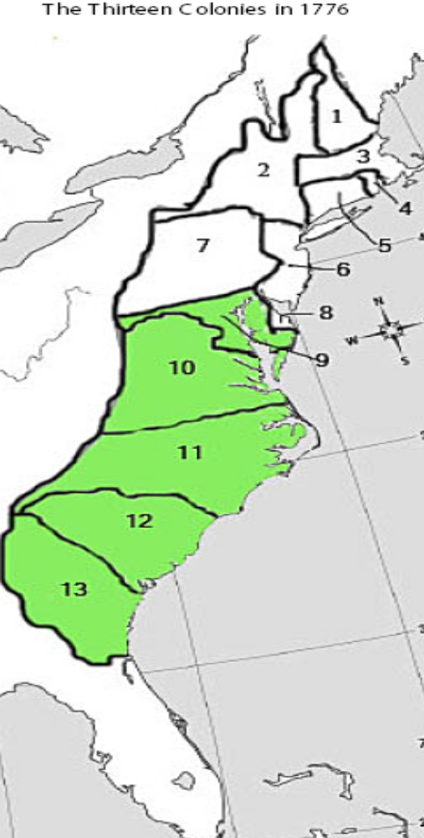
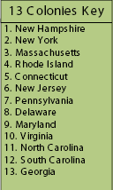

Slide 7
Pair Share
What did the Constitution say about the slave trade?
What did the states with large numbers of slaves threaten to do if the Constitution limited slavery?

Slide 8
Three Fifths Compromise Background
Once the Great Compromise was made, the delegates at the Philadelphia Convention had to decide who would be counted as part of the states population.
  States with large numbers of enslaved persons wanted to count slaves as part of their population so they would have more representatives in the House of Representatives. They did not want to count slaves for taxation purposes because they wanted to keep taxes low. (Virginia Plan)
  States with few states did not want count slaves as part of the population for representation but wanted to count them for taxation so that the South would pay higher taxes. (New Jersey Plan)
The compromise that solved the dispute was called the three fifths compromise because it decided to count three of every slaves for both taxation and representation.

Slide 9
Slave Trade
Issue 2
  Should the federal government ban the importation of slaves from foreign nations (i.e. the slave trade).
    Slave holding states – no, slavery is important to our economic survival and our natural right to own property (yes that was very racist). Threaten to leave is slavery trade is limited.
    Non-slave holding states/abolitionists – no slavery is wrong and makes us look bad internationally.
  Congress agrees to make no laws regarding the slave trade until 1808. However, owners of imported slaves can be taxed.

Slide 10
Constitutional Convention Slavery Debate Quotes:
Were the founding fathers for or against slavery?
We are going to read quotes from several delegates at the Constitutional Convention.
Use a plus sign to mark supporters of slavery and a minus sign to mark slavery’s opponents.
Underline the part of their quote that supports your opinion.

Slide 11
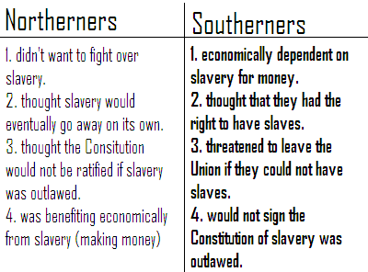
Constitutional Convention Debates
Create a T-Chart showing why the Founders allowed slavery to continue when they wrote the Constitution.

Slide 12
Slavery Spectrum
Against Slavery
Neutral
For Slavery

Slide 13
Warm-up #6
Quick Write:
Write a paragraph explaining if the founders (authors of the Constitution) for or against the slave trade? Use at least two pieces of evidence from yesterday’s handout to support you opinion.

