Slide 1
Geothermal Energy
Created by Stuart Harvey
Research by Stuart Harvey
Perfected by Stuart Harvey
Presented by Stuart Harvey along with Paramveer K.

Slide 2
Geothermal energy
Also known as thermal energy
Geothermal energy is thermal energy that is generated and stored in the earth
The energy originates from the creation of the earth(20%) and radioactive decay(80%)

Slide 3
History of geothermal Energy
Originally used in Paleolithic times for bathing in hot springs
Used in Roman times to heat spaces
First district heating system that uses geothermal energy was located in Boise, Idaho in the year 1892
1904 first geothermal energy generator used
1930 Charlie Lieb developed first down hole heat exchanger to heat his house
1946 the Commonwealth Building in Portland used the first commercial heat pump to heat the building

Slide 4
History (cont.)
1960 PG&E Opened first Geothermal electric plant opened in the U.S.

Slide 5
How they generate electricity
Liquid Dominated geothermic electric plants are usually located next to faults and hot spots
Water gets heated rises heats a heat plate that heats other materials that turns a turbine and generates electricity

Slide 6
costs
EXPENSIVE
Costs $10 million to drill
Drilling has a 20% failure rate
Drilling costs half of the total cause

Slide 7
Things to note
93% of homes in Iceland are heated by Geothermic Energy
Reykjavík was known as the most polluted city in the world and is now considered as one of the cleanest due to geothermal energy
There has been earthquakes caused by hydraulic fracturing which is used to reach the area necessary to heat the water
Uses a lot less water needed to make electricity than other methods like nuclear energy

Slide 8
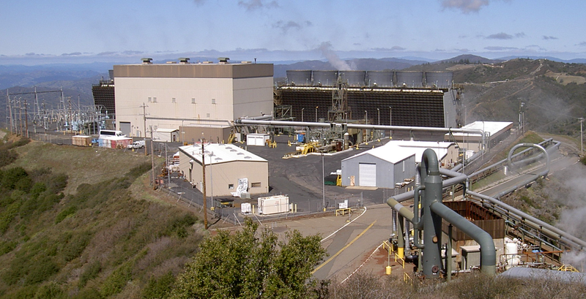
The geysers geothermal power plant in northern california

Slide 9
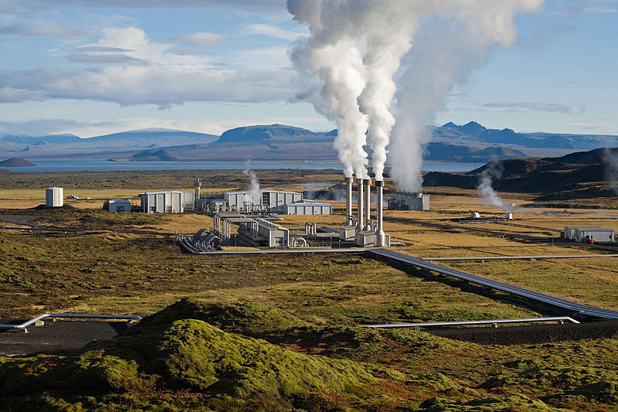
Geothermal Power Plant in Iceland

Slide 10
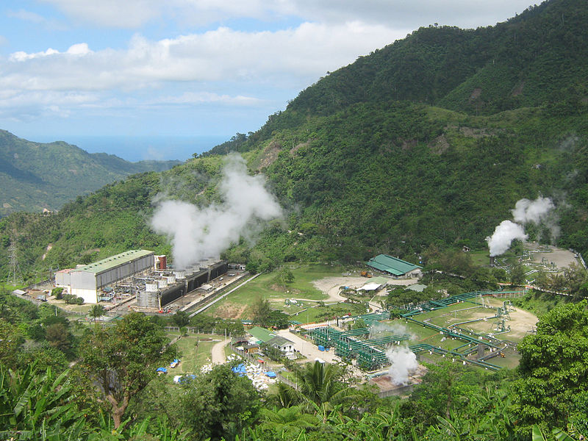
Geothermal POWER PLANT IN PHILLIPPINES

