Slide 1
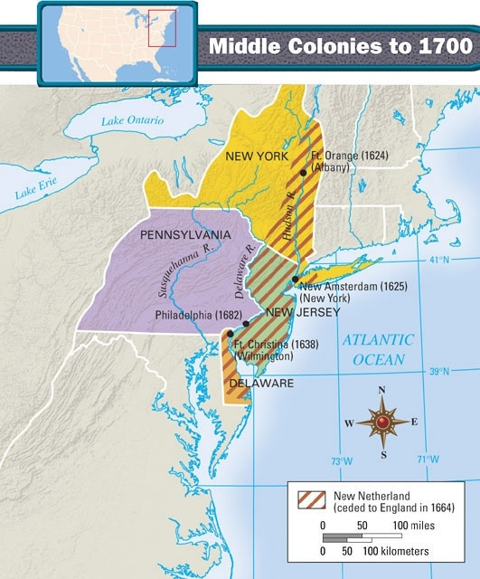
The Middle Colonies
New York, Pennsylvania, Delaware, and New Jersey

Slide 2
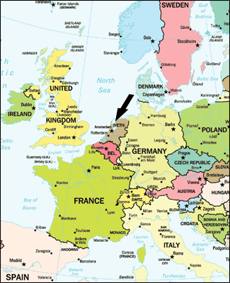
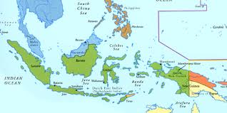
New Netherlands (New York)
Holland/Netherlands- small nation, colonial power
-Dutch East Indies (Indonesia) and Dutch West Indies (Caribbean Sea)
  -Henry Hudson- found present Manhattan (bought from Na.AM. for $28)
  -New Amsterdam- becomes NYC, business town
Duke of York- ordered by King of Eng. To take over New Amsterdam, no fighting involved
  Dutch Influences- Haalem, Breuklin, Waffles, Santa Claus
  * How might New York be different if it was settled by the Puritains?

Slide 3
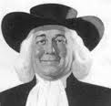
Pennsylvania
Quakers- protestant, pacifist, anti-slavery, pro-Na.AM (friendly)
  William Penn- given land by King to create a haven in New World for Quakers
  -Advertising- all over Europe
  -Liberal Land Policy- good land, access to rivers (transportation)
  -Philadelphia- planned city to grow, largest city in colonies
  -Expansion- more settlers from Europe moved in, worse relations w Na.Am.
  *How is Penn. different from New England

Slide 4
Similarities of Middle Colonies
Soil- fertile and expansive
Rivers- provide transportation to sell goods in seaports
Seaports- New York City and Philadelphia (centers of trade)
Ethnic Mix- religious toleration and democratic control
  Which of the three regions has the greatest impact on the US today? (New Eng, Middle Colonies. Southern Colonies)
  Least?

