Slide 1
Vincent Van Gogh
The Large Plane Trees (Road Menders at Saint-Rémy)
1889
oil on canvas

Slide 2
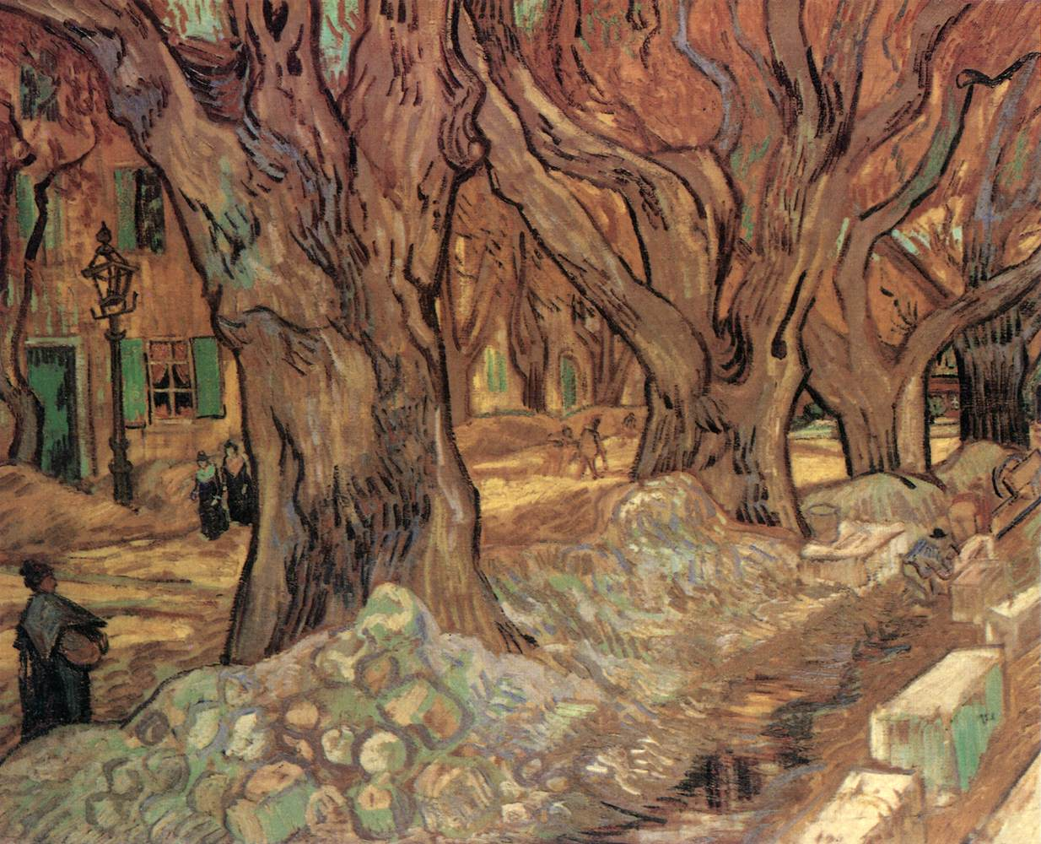
Notes:
The Large Plane Trees (Road Menders at Saint-Rémy), 1889
Vincent van Gogh (Dutch, 1853-1890)
oil on fabric, Framed - h:104.50 w:124.50 d:7.62 cm (h:41 1/8 w:49 d:3 inches) Unframed - h:73.40 w:91.80 cm (h:28 7/8 w:36 1/8 inches). Gift of the Hanna Fund 1947.209
Location:
Gallery 222b
Hide Description In May 1889, Van Gogh voluntarily committed himself to an asylum near the small town of Saint-Rémy in Provence. His doctors soon gave him permission to paint on day excursions to surrounding fields. While walking through Saint-Rémy that November, he was impressed by the sight of men repairing a road beneath immense plane trees. "In spite of the cold," he wrote to his brother, "I have gone on working outside till now, and I think it is doing me good and the work too." Rushing to capture the yellowing leaves, he painted this composition on an unusual cloth with a pattern of small red diamonds visible in the picture's many unpainted areas.
Hide See Also Collection:
Modern European Painting and Sculpture
Artist:
Vincent van Gogh (Dutch, 1853-1890)
Type of art work:
Painting
Medium:
oil on fabric

