Slide 1
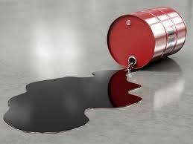
Crude Oil
Kevin Chang
Academic Decathlon
5/1/14

Slide 2
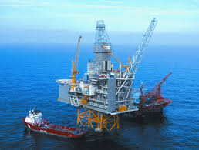

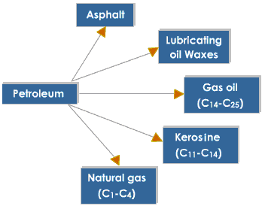
Facts about crude oil
Also known as petroleum, and when refined as diesel, gasoline, oil, propane, kerosene, paraffin, butane, and fossil fuels.
Consists of hydrocarbons and other organic compounds. Formed when decayed organisms (mainly plants) are buried under rock with pressure and heat.
With the internal combustion engine, airplanes, and discoveries in the use of industrial chemicals, oil became the most dominant form of energy in order to fuel these new discoveries.
Petroleum energy makes up about 40 percent of all energy consumption in the world.

Slide 3
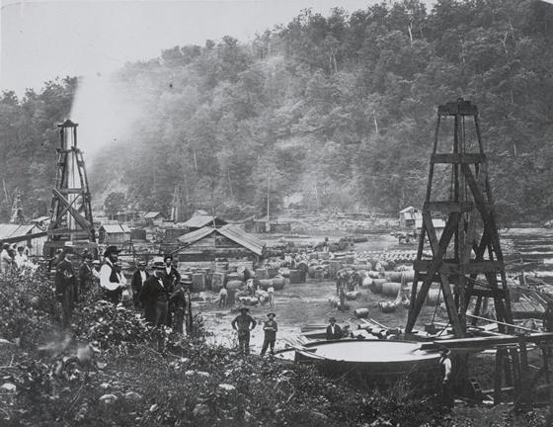
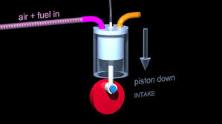
History
Oil before the 19th century were mainly for lighting, heating, and sometimes for construction.
In 1847, paraffin was managed to be refined from crude oil. Business with oil started, and kerosene was started to be refined from oil. In 1859, the first commercial oil rig was made in Titusville, Pennsylvania by Edwin Drake.
The internal combustion engine, combined with Ford cars in the 20th century makes oil in high demand. This high demand is still in place today.
Internal Combustion Engine is where a fuel is combusted with an oxidizer and creates force through the expanding heat and pressure of the combustion reaction. This allowed for oil to become very useful for transportation.

Slide 4
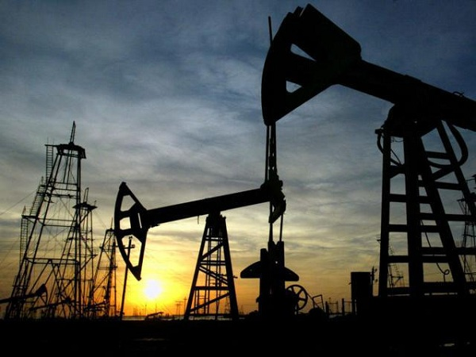
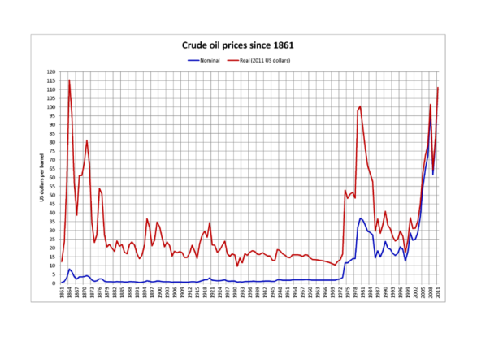
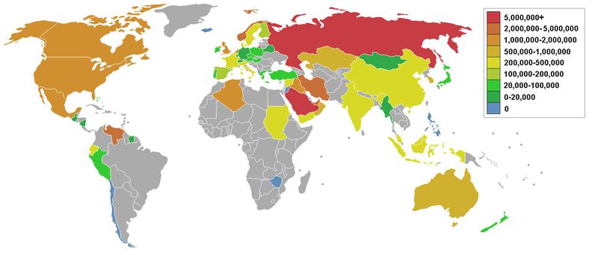
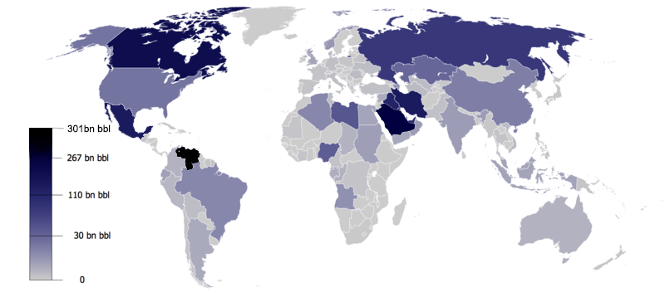
Economy
Steps: It is gathered/drilled from the ground, then refined and transported by pipeline or a vehicle to storage. From there, it is can be used for commercial uses.
Some refining techniques are distillation, catalytic cracking, and isomerization.
The biggest oil exporters in the world are in the Middle East, Russia, and Nigeria.
We use 90 million barrels per day.

Slide 5


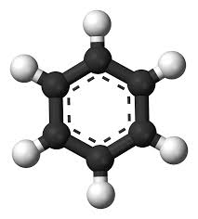
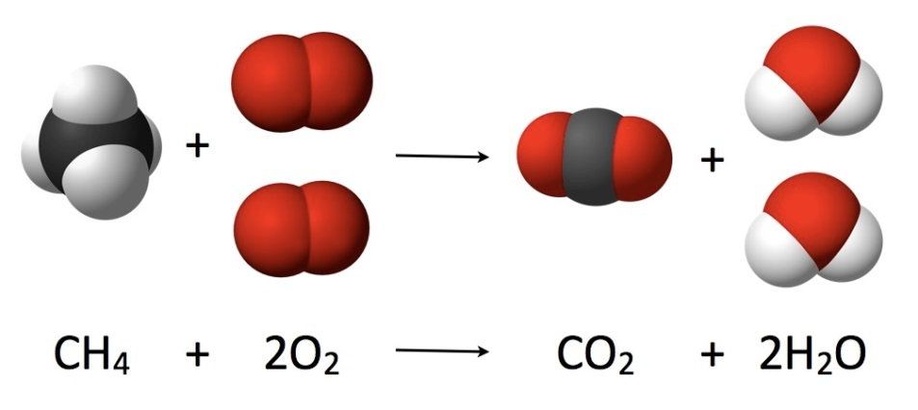
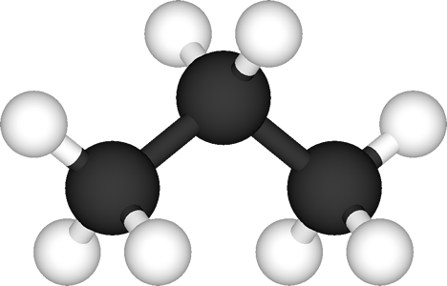
Science
Petroleum is made up of hydrocarbons and other organic compounds (have Carbon in them)
To utilize fossil fuels it is reacted with oxygen by heat to release energy, carbon dioxide and water vapor (combustion reaction).
Hydrocarbons also include aromatic hydrocarbons and asphaltene molecules.

Slide 6
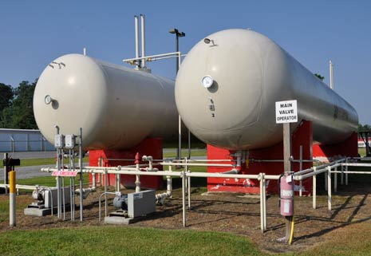
Saturated Hydrocarbons(Alkanes)
Saturated Hydrocarbons are where all of the available valence electrons of the carbons are filled (No electrons left un-bonded).
These are called alkanes, which make up the long chains found in crude oil.
The more carbon atoms in the molecule chains, the more condensed the molecule tends to be. This explains why methane, with one carbon atom is a gas, and explains why asphaltenes, with many carbon atoms, is a solid.

Slide 7
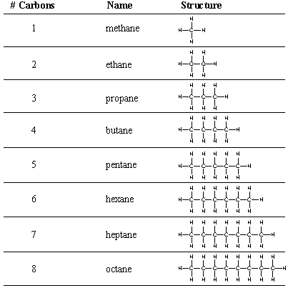
List of common alkanes

Slide 8
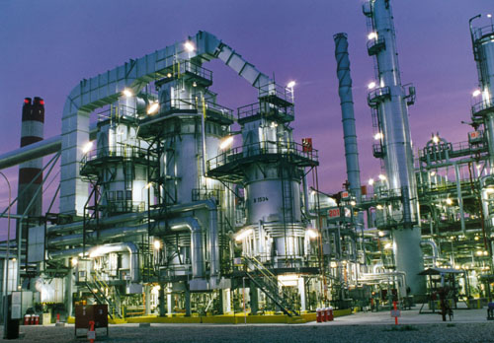
Positives of Petroleum
Oil is a very important energy resource that powered the 20th century.
Hydrocarbons are very effective fuels since they have high energy density, are easy/safe to manage, and stay in liquid form under many conditions.
Petroleum has enabled us to advance greatly in technology and improve our standards of living.
It is cheaper and less harmful than coal mining.

Slide 9
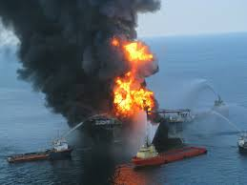
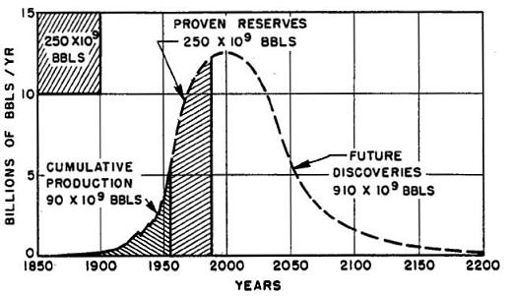
Negatives of Petroleum
Fracking, a way to get shale gas by fracturing the ground with a high pressure mixture can be very damaging to the surrounding area.
A “Peak oil”, of petroleum has been predicted, which is also known as the Hubbert Curve. This predicts the peak production of oil.
During the 1970’s the price of oil skyrocketed due to many different factors. This also happened during the 2008 recession.
With the Deepwater Horizon oil spill and other oil-related incidents, other environmental issues have been raised.
Since burning petroleum releases carbon dioxide, use of oil has been attributed to global warming.

Slide 10
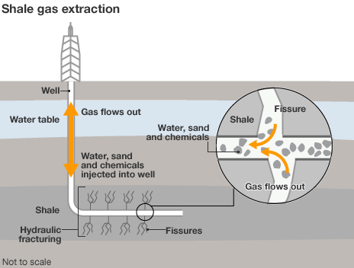
Fracking

