Slide 1
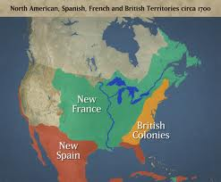
ID- France’s American Empire at Its Greatest Extent, 1700 (107)
Summary #1 Describe the areas controlled by France, Spain, and England
France- Canada, Middle America (Mid-West, Great Plains)
Spain- Mexico, SW US, Florida
England- East Coast of US
What country is the weakest colonial power in 1700? How do you think things turn out?

Slide 2
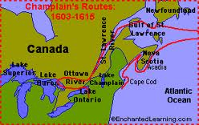
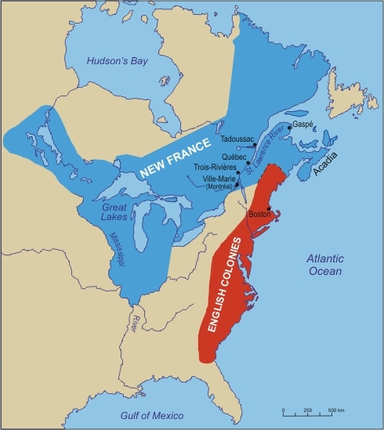
OI- France Finds a Foothold in Canada
1) Who, where, when was France’s first colony in the America’s
Sam Champlain, Quebec, 1608 (1 yr. after Jamestown)
2) How many people populated New France by 1750?
60,000
3) What group of religious dissenters could have helped fill this gap in population but where denied access to New France?
Huguenots
How could the future French settlement in N. Am. been different if France had allowed more settlers to move to N. Am.?

Slide 3
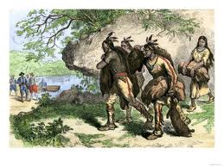
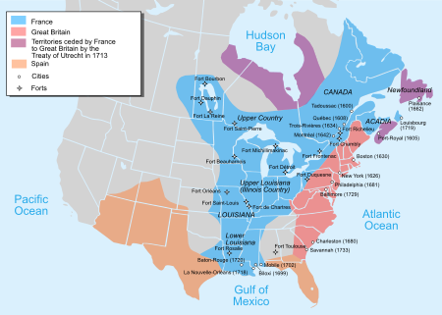
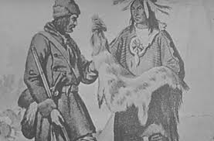
ID- Fur Trading Posts (p 108)
Summary 2-Why were there trading posts spread across the continent?
Fur trade with Indians
OI- New France Fans Out
4) What was the most valuable resource of New France?
Beaver fur
5) What settler founded Detroit?
Antoine Cadillac
6) What was the most important French established on the Mississippi River?
New Orleans (Why?)
New Orleans controlled access into the Miss. R. and interior of US

Slide 4
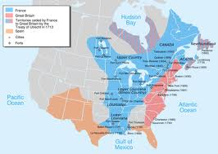
ID- British Territory After Two Wars (P 110)
Summary #3-Identify the three rivers controlled by France
Ohio, Mississippi, Missouri
OI- George Washington Inaugurates War with France
7) What region of North America was critical to the westward movement of English colonists?
Ohio Valley
Why do you think Americans wanted and needed the Ohio Valley?

Slide 5
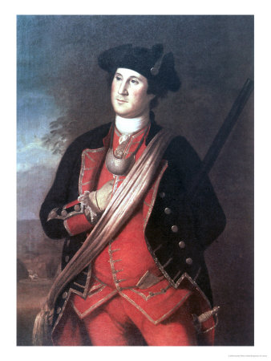
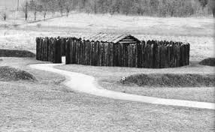
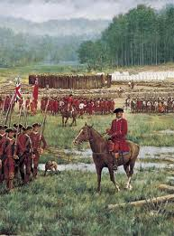
8) Who was responsible for starting the French/Indian War (country/person)?
English Colonies (George Washington)
9) Who was forced to surrender at Fort Necessity?
George Washington

Slide 6
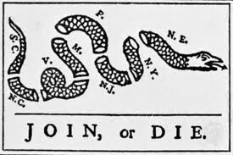
ID- Famous Cartoon by Benjamin Franklin (113)
Summary #4-What does every section of the snake represent? What is the cartoon saying about the colonies?
A colony
They need to unite in order to be strong enough to fight France
What was the opinion colonies had of each other until that point?
OI- Global War and Colonial Unity
10) What was the name of the French/Indian War in Europe?
Seven Years War

Slide 7
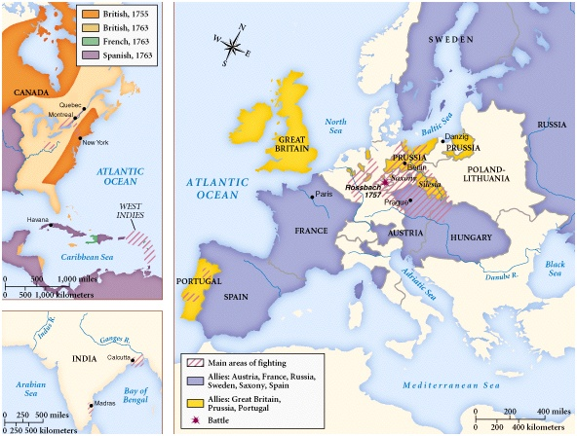
11) Identify the countries that sided with England and France.
England- Prussia (Germany)
France- Spain, Austria, Russia
12) What did Benjamin Franklin want the purpose of the Albany Congress to be?
Ensure Iroquois ally/side with English colonies
Colonial Unity- unite to fight France (and possible even colonial home rule free of England)
Why was this idea rejected by the colonies? (Why do you think the colonies are not ready for independence yet?

Slide 8
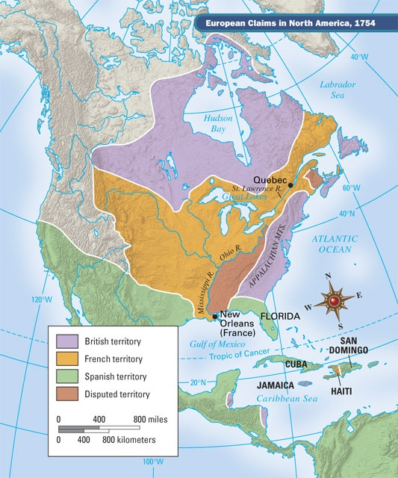
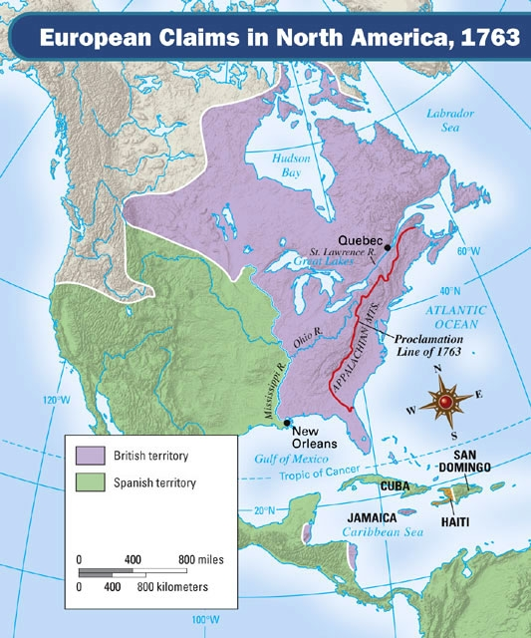
ID- North America Before 1754, North America After 1763 (P 119)
Summary #5-What are the differences in the two maps for each country
a) French-
lost all land in N. Am.
b) England
gained all land east of Miss. River and Canada
c) Spain
gained all land west of Miss. River
What other country is starting to make claims on the West Coast?

Slide 9
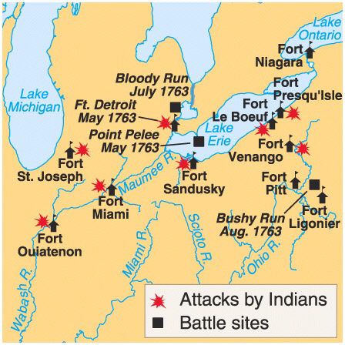
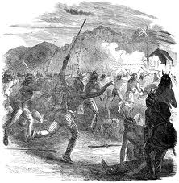
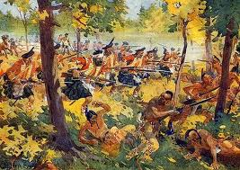
OI- War’s Fateful Aftermath
13) How did the war change the Indians most valuable weapon?
The Indians could no longer play the Fr. And Eng. Against each other (Eng. Controlled everything and no longer had to work with Indians)
14) How did Chief Pontiac respond to the French loss against English settlers?
Pontiac’s Rebellion- killed 2000 settlers (besieged Detroit and captured 3 forts)
What other US catastrophe has similar numbers of dead?

Slide 10
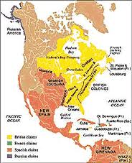
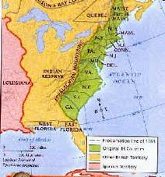
15) What was the Proclamation of 1763?
Said no English settlers could move west of Appalachian Mts. (imaginary line) into Ohio Valley
16) Why did the settlers not like the Proclamation of 1763?
Fought a war to gain Ohio Valley and cannot move there
1st time England has set a rule on where settlers can live

