Slide 1
Warm-up #5
Read the section about city and country life on pages 50-51 of the Brown History Alive textbook (you’ll have to share) and create a T-Chart.
City Life | Country Life

Slide 2
City Life | Country Life
1/20 colonists lived in city. Waterfront = heart of the city. Marketplaces sold eggs, milk, fish, cheese, and other goods. Information/gossip gathered here. Streets lined with shops (tailor, cobbler, clockmakers, silversmiths…) Noisy and smelly from garbage, animals, and open sewers. Homes close together made with wood and thatched roofs, small windows. Torches, candles, and betty lamps provide light. Handed buckets of water up the lines to get h20. | Economy based on farming, commerce, and handcrafts. 9/10 ppl lived on farms making everything they needed. Only simple tools made clearing land etc…hard. Fire heat only for warmth and cooking. Work sun up to sun down.

Slide 3
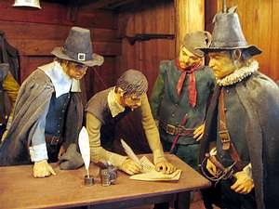
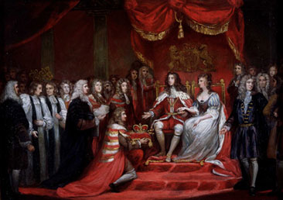
Ideology of Revolution
Defining the rights of Englishmen

Slide 4
Mayflower Compact 1620
Why did the Pilgrims write the Mayflower Compact?
What does it say?
They wanted to make rules before they started their community because they landed outside of their charter.
Colonists will be ruled by a representative assembly (people elected by their peers)
All colonist agreed to abide by the assembly. = first representative government in North America.

Slide 5

Mayflower Compact 1620
Watch the video and add at least three facts to your notes.
Pair Share – tell your partner what you added.
If they have something good, add it to your notes.
http://www.youtube.com/watch?v=FfAq0Lp-AmA

Slide 6
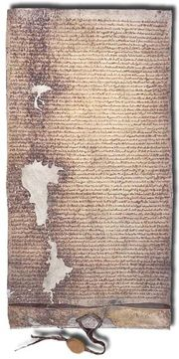
Magna Carta 1215
It protected the Church and nobles by reducing the rights of King John; he had to follow the law.
The Magna Carta was the foundation for constitutional law.
The influence of Magna Carta can be seen in the United States Constitution and Bill of Rights.
http://www.youtube.com/watch?v=FfAq0Lp-AmA

Slide 7

English Bill of Rights
During the 1680s there was a revolution in England. During the revolution, William of Orange invaded England. William and his wife Mary were crowned king and queen of after accepting the English Bill of Rights in 1689.

Slide 8
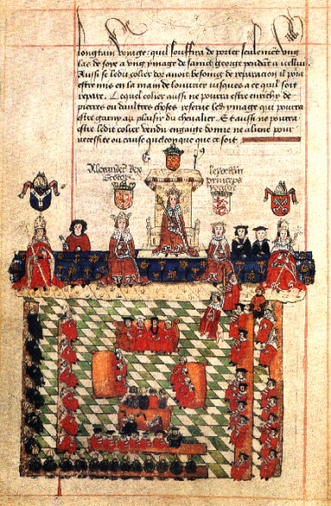
English Bill of Rights 1689
What is the English Bill of Rights?
Why is it important to US History?
The Bill of Rights protects citizen’s natural rights. Citizens can:
  1) couldn’t suspend laws made by Parliament.
  2) couldn’t raise taxes without Parliament’s approval.
  3) no standing army without consent of Parliament
  4) People determine religion of the nation/king.
  5) right to demand change from the king (petition)
  6) Trial by Jury.
  The first eight amendments of the US Constitution are based on the English Bill of Rights.

Slide 9
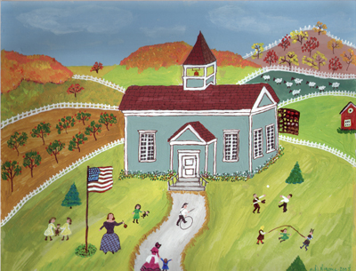
Homework
* Complete the T-chart comparing the three documents we discussed today.

