Slide 1
Cultural Landscape
Ch. 1

Slide 2
Cultural landscape: the visible mark of human activity on the land.
  Term from famous geographer Professor Carl Sauer from UC Berkeley!

Slide 3
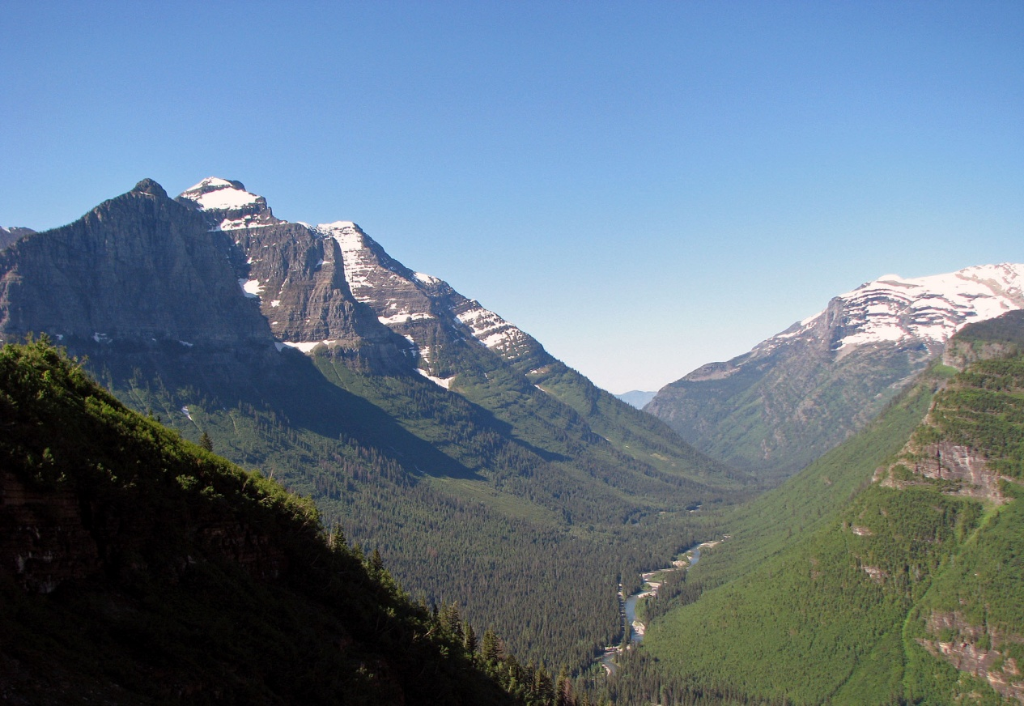
No place on Earth is in a “pristine” condition- humans have made an impact on every place on the planet.
We can see the cultural landscape in:
  The layers of buildings
  Roads
  Memorials
  Churches
  Fields
  homes

Slide 4
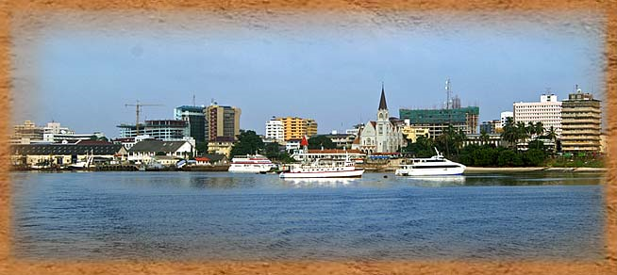
As each group of people arrives and occupies a place, they bring their own technological and cultural traditions, transforming the landscape.
Sequent occupance: each new group of residents can also be influenced by what they find when they arrive and leave some in return. The impacts are layered one on top of the other.
Example: Dar-es-Salaam, Tanzania:
Zanzibar Arabs
Germans
British
Indian migration

