Slide 1
Biblical Allusions 3
The Old Testament:
Moses to Ahab & Jezebel

Slide 2
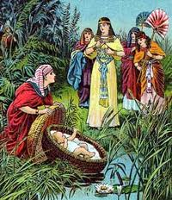
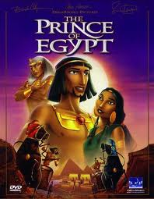
Moses Childhood
Notes:
Many hundreds of years pass after Joseph and all his family move to Egypt. As the Israelites grow, the Egyptians become afraid of their power, and so, they start to enslave them. Pharoah hears that a Hebrew male will be king so he declares all newborn Hebrew males had to be killed to eliminate the threat. His mother hid Moses in a basket, by the side of the Nile.
He’s found by an Egyptian princess who raises him as a prince

Slide 3
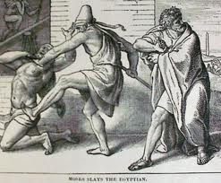
Moses Flees Egypt
Notes:
Prince Moses sees an Egyptian man abusing an Israelite. He kills the Egyptian. For this act he flees into the wilderness where he is found by a man Jethro who later becomes his father-in-law.

Slide 4
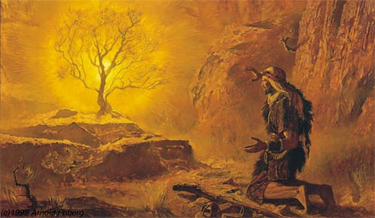
Moses and the burning bush
Notes:
According to the Book of Exodus the burning bush was a bush on fire that was not consumed by the flames. Moses saw the bush and was contacted by an Angel. God then spoke to Moses and appointed him as the leader that would lead the Israelites out of Egypt and into Canaan.

Slide 5
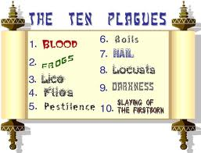
Let My People GO!

Slide 6
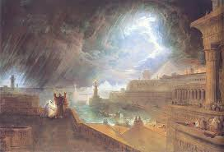

Slide 7
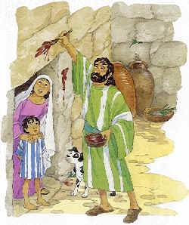
The Passover

Slide 8
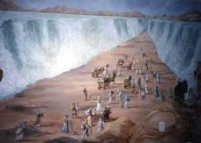
Parting the Red Sea

Slide 9
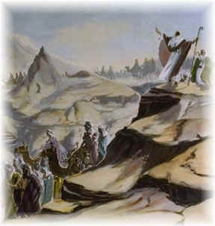
The 10 Commandments
Notes:
Because of the Israelites’ ungratefulness and lack of faith in God they were punished by him. Moses and the Israelites wandered for 40 years in a trip that should have taken less than 1 year.

Slide 10
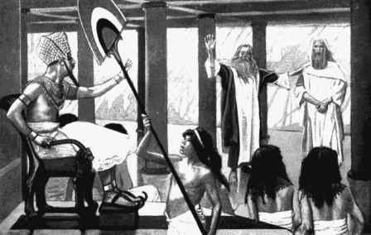
Aaron
Notes:
Aaron was the brother of Moses. He became the first high priest of the Hebrews. God sent Aaron to help Moses bring His people out of Egypt because Aaron could speak well and Moses had a speech impediment.

Slide 11
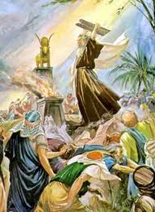
The 10 Commandments & the Golden Calf
Notes:
When Moses climbed the mountain alone to retrieve the stone tablets that God had ordered him to get, Aaron was alone and in charge of the people. Moses had not returned for some time and the people begged Aaron to create and idol that they could worship.Aaron was not very strong willed especially without his brother, so he demanded that they all give him the gold that they had. He then took all of the gold earrings and created a golden calf for the people to worship . This angered God and do he threatened Moses that he would destroy all of his people if he did not return from the mountain and restore order.
Once Moses returned he destroyed the golden calf and burnt it in a fire and then put it in water so that all of his people could drink it, in order to punish them for worshiping a false God.

Slide 12
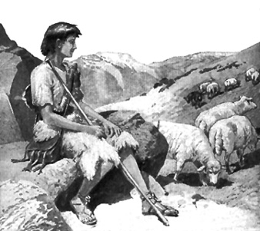
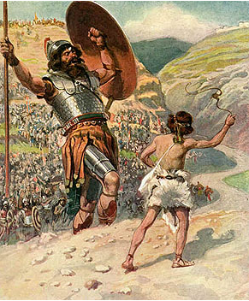
David
Notes:
He is the youngest of the sons of Jesse. When King Saul begins to be wicked, The prophet Samuel says that Saul will be replaced by another king. David is chosen by god through Samuel to be the next king.
David hears the Philistine champion, the giant Goliath, and insists that he can defeat Goliath.
David is indeed victorious, felling Goliath with a stone from his sling, at which the Philistines flee in terror and the Israelites win a great victory.
David brings the head of Goliath to Saul. Saul begins to be jealous of David’s acclaim. He tries to kill him and begins a civil war with David.
David was the second king of the united Kingdom of Israel according to the Hebrew Bible/Old Testament.
He is depicted as a righteous king as well as an acclaimed warrior, musician and poet.

Slide 13
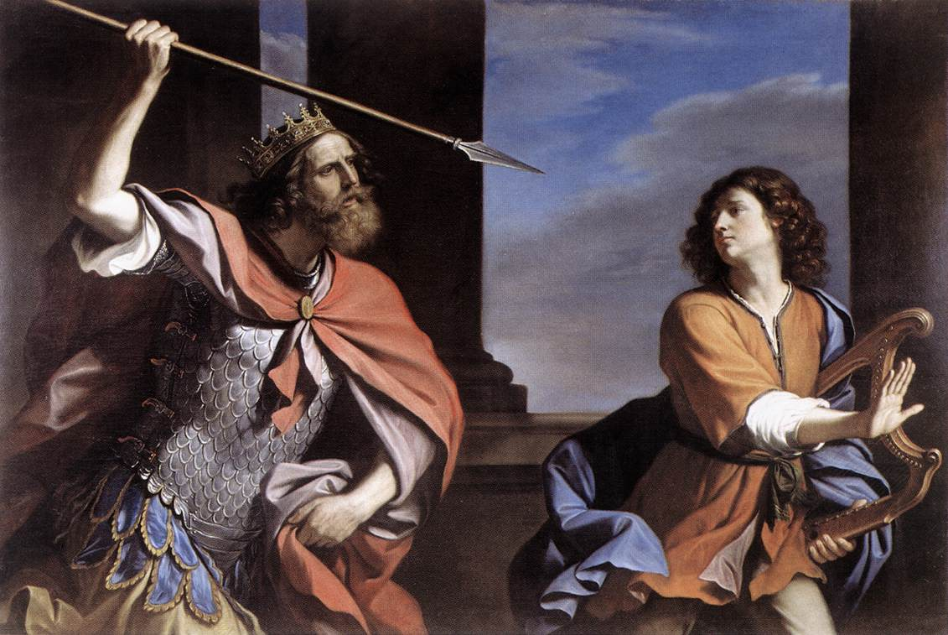
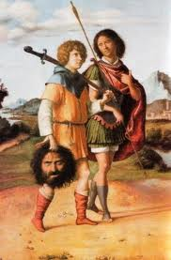
David & Jonathan
Saul vs. David
Notes:
Jonathan was Saul’s son, but becomes David’s best friend. He helps David escape from his father’s murderous attacks. Jonathan is killed in a battle and upon hearing of his son’s death, Saul commits suicide.

Slide 14
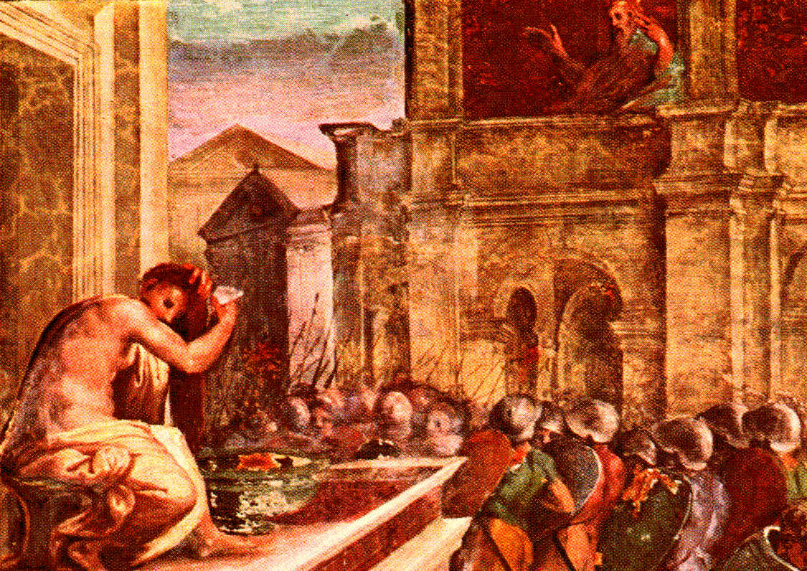
David and Bathsheba
Notes:
David first saw Bathsheba while she was bathing
He found out who she was and laid with her
However, she was married to David’s general Uriah
Bathsheba got pregnant and David began to feel guilty
So he had Uriah the Hittite (Bathsheba’s husband) killed in battle
David was now able to take Bathsheba to be his wife
God was displeased with David so he killed Bathsheba’s baby shortly after birth; they had another son named Solomon

Slide 15
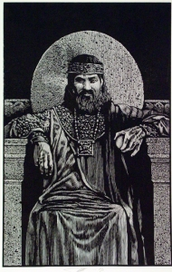
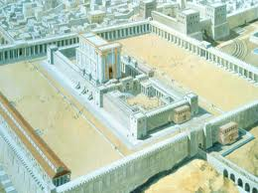
Solomon
Notes:
The biblical King Solomon was known for wisdom, wealth and writings.
Son of King David and Bathsheba, who reigned after his father’s death.
The finally builds a temple as the permanent home for the Ark of the Covenant, which held the original tablets of the ten commandments [remember Raiders of the Lost Ark???] which had been carried from Moses’ time and housed in a tent

Slide 16
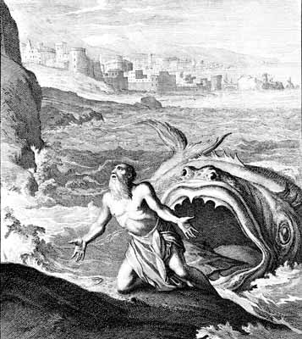
Jonah
Notes:
Prophet who was swallowed by a fish
Seeks to flee from “the presence of the Lord” and a storm arises
The sailors throw him overboard to calm the seas after learning he is to blame for the dangerous storm.
Storm ceases and Jonah is swallowed by a great fish for 3 days and 3 nights
After Jonah commits to paying for his mistakes and thanks God for saving his life, God commands the fish to vomit Jonah out.

Slide 17
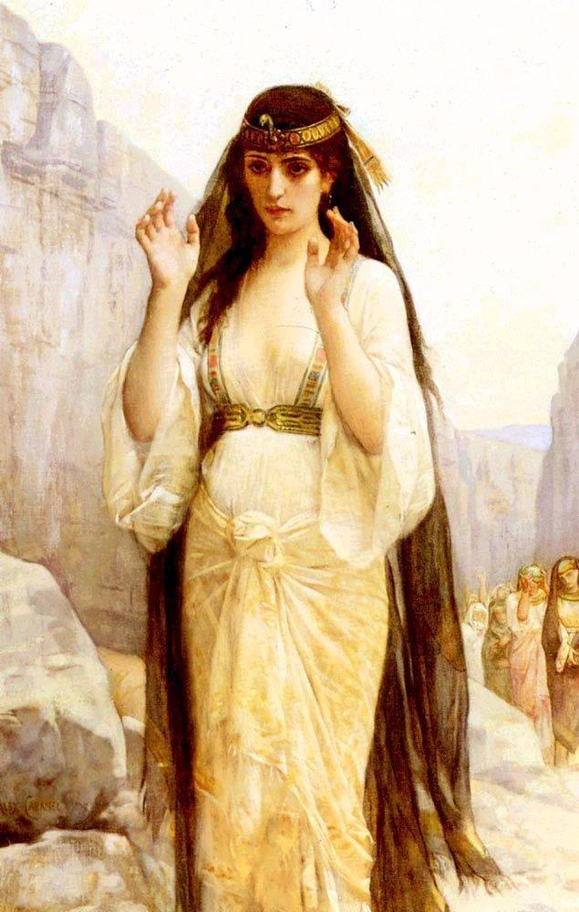
Jephthah’s Daughter
Jephthah the Gileadite vowed before going into battle that if he succeeded in battle he would offer up the Lord as a burnt offering whatever first came through the doors of his house to meet him
His daughter walks through the door
“Oh! My daughter! You have made me miserable and wretched, because I have made a vow to the Lord that I cannot break.”
She asks to spend two months in the mountains with her companions, to bewail her virginity.

Slide 18
Ahab & Jezebel
Jezebel(Phoenician Queen) marries King Ahab of Northern Kingdom at the time the nation was divided into Northern(Israel) and Southern(Judah) kingdoms
She turns Ahab away from Yahweh and toward the worship of Phoenician god, Baal
Ahab and Jezebel let temples of Baal operate in Israel, and the pagan religion receives royal patronage
The queen uses her control over Ahab to lead the Hebrews into idolatry, sexual immorality and subjected them to tyranny

Slide 19
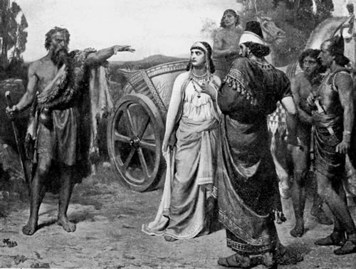
Ahab & Jezebel (Cont.)
She has prophets of Yahweh slaughtered
Elijah challenges 450 prophets to a test, exposes their god as powerless, has them slaughtered, and incurs Jezebel’s furious enmity

