Slide 1
European Middle Ages (7th Grade)
By Leila Doty

Slide 2
Geography

Slide 3
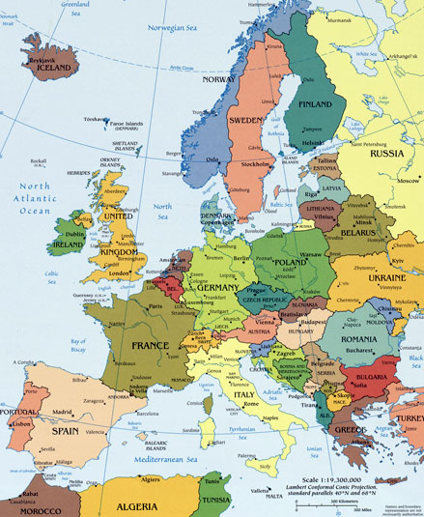
Topography
Europe is a very large landmass, connected to Asia
    Landmass-one very large unbroken area of land
There are various land features; mountains in north and south, vast plains in central land
Small peninsulas extend into surrounding seas:
    Scandinavian Peninsula, Jutland Peninsula, Iberian Peninsula, Italian Peninsula, Balkan Peninsula

Slide 4
Topography
Alps is a mountain range that protects Mediterranean from invaders and blocks cool winds from entering; climate is very warm
Pyrenees m0untain range divides Spain from France
The north European heartland is very fertile and used for farming lots of crops.
Rivers were important: highways for trade, brought water to farmland, natural boundaries
    Many cities were built on rivers

Slide 5
Topography
Many different people migrated through:
    Romans, Germanic tribes, Burgundians, Angles, Saxons, Jutes
Europe had different climates because of its wide range of topography.
    Topography-arrangement of physical features

Slide 6
Religion

Slide 7
Religious Orders
Christianity centered mainly in Mediterranean.
Nuns and monks who were deeply religious decided to live in a religious order.
    Religious order-community of men and women devoted to prayer and service and bound by certain vows.
    These were vows of poverty, chastity, and obedience to the order. Rules were founded by the Benedict of Nursia. He founded a monastery in 529.

Slide 8
Religious Orders
In order to become a monk, one must:
    Spend one trial year at a monastery and be approved by the abbot, take Rule of St. Benedict vows.
        Abbot-head monk of a religious order.
A monk’s day was very busy and long:
    Started very early, prayed, studied and copied manuscripts, gardened, worked in the workshops, cared for ill, and worked in the library

Slide 9
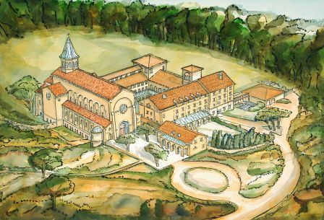
Religious Orders
In order to become a nun, women followed the same rituals and rules as monks.
While at the convent, nuns:
      Studied, prayed, cared for ill, beekeeping, grew herbs, and cooked meals.
Women became nuns for a variety of reasons, some were widows or did not want to marry. Others came seeking a scholarly life and education. Some nuns even became musicians or poets.

Slide 10
The Spread of Christianity
Missionaries spread Christianity across Europe.
    Missionaries gave people fear and hope.
St. Patrick was a famous missionary.
    Captured by pirates, sold into slavery. Escaped after 6 years, went home.
    Went to Ireland to convert people because he was always deeply religious.
    Founded 300+ churches
    Almost entirely converted Ireland

Slide 11
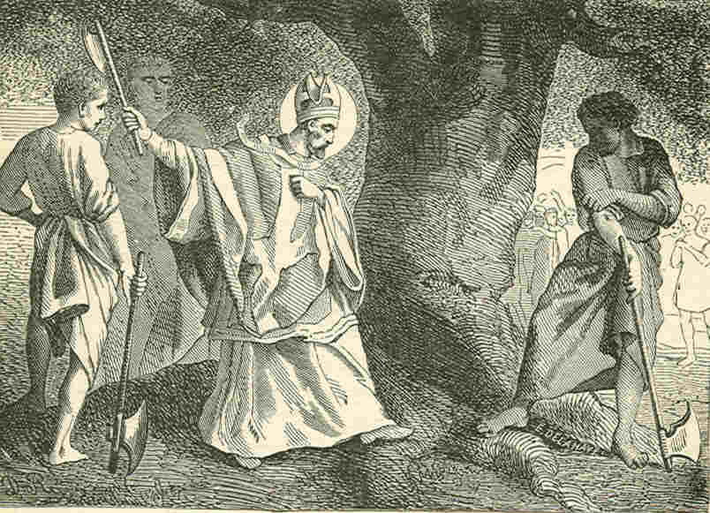
The Spread of Christianity
St. Boniface worked 35 years to convert Germany and Netherlands.
    Was very successful, known as the “Apostle of Germany”.
    Chopped down a fir tree to disprove Thor, who was part of the religion the people previously believed in.
    Murdered at age 80 by angry pagans.
Gregory I was the pope.
    Sent monks to England in 597, the king helped to almost fully convert England.

Slide 12
The Way of Christian Religion
Humans were believed to be sinful and weak.
    Devil tempted humans, the only way to resist was to follow the Church.
    Heaven and Hell were places after death, Heaven=eternal happiness, Hell=eternal suffering.
    Holy Sacraments helped to resist temptation.
The Church has great power, and even kings have to submit to the power of God.

Slide 13
Christendom
Charlemagne wanted to rule a Christendom.
    Wanted to create a large community of Christians across Europe and give people a common identity and sense of purpose.
    Chose advisors from the clergy and revised manuscripts, creating Christian texts.
    Wanted to have the title “Emperor” because it had a closer relationship with God.
    Pope Leo III crowned him emperor, which strengthened the power of the Church.

Slide 14
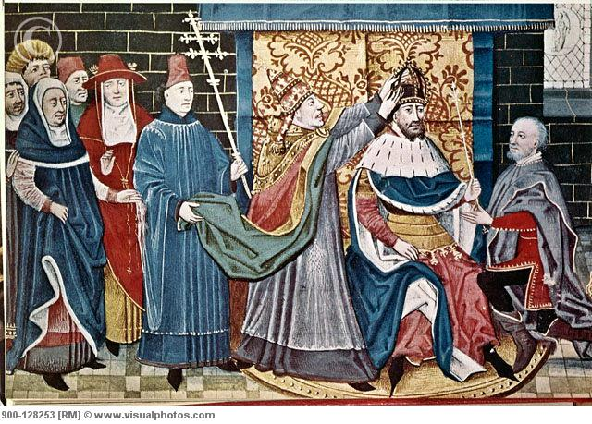
Religious Trifles
There was a conflict between Pope Leo III and Charlemagne.
    Pope believed that it was the emperor’s duty to help the Church in God’s will.
    Charlemagne believed that God made him the emperor to carry out His work.

Slide 15
Religious Crusades
Pope Urban II called a crusade to free the Holy Land.
    Crusade-Christian religious war
    Defeated Turks in 1099, liberated Jerusalem
    Crusaders had a hard life: had to sell homes and leave family.
The 2nd crusade failed against Turks of Edessa.
    There was a lack of support from Palestine because they were treated cruelly and with disrespect.

Slide 16
Religious Crusades
The 3rd crusade was against Saladin, who was a noble opponent and respected even by his enemies.
    England, France, and Germany joined to defeat him.
The 4th crusade was a disgrace to the pope.
    The crusaders went wild and killed Christians, going against the mission’s purpose.
    The crusaders were never forgiven, and the pope was furious.

Slide 17
Religious Crusades
Crusades never regained the Holy Land, but had lasting effects.
    People traveled and saw new things; experienced new things.
    Encouraged eastern trade: new goods like silks and spices
Crusades also had negative effects:
    Jews were persecuted and there were violent acts against them.
    Some churchmen tried to protect them, but were too weak.

Slide 18
Religious Crusades
Crusades had negative effects(continued):
    Muslims were also persecuted, some committed suicide to escape persecutors.
    Christian heresies were targeted, there was no room for small differences in belief.
    Heretics were persecuted, but some still clung to beliefs. This worried Christians because others might follow their beliefs.

Slide 19
Religious Crusades
Pope Gregory IX created the Inquisition to completely abolish heretics.
    It was a church court designed to investigate and judge heretics.
    Tried to convert them and change their beliefs, if it did not work, they were punished.
    Small errors resulted in a whipping or fasting, larger ones could end with execution or fines.

Slide 20
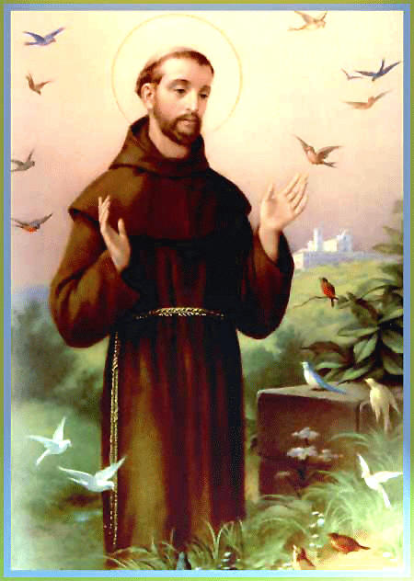
An Age of Faith: 1000-1300
During 1000-1300, new religious orders formed that revolved around more outward looking goals, resulted in creation of mendicant orders.
    Mendicant orders- orders whose members lived on donations and lived in a community, not a monastery.
St. Francis of Assisi had a powerful religious experience and was a friend to all living things.
    His pure and simple way of life attracted many followers.

Slide 21
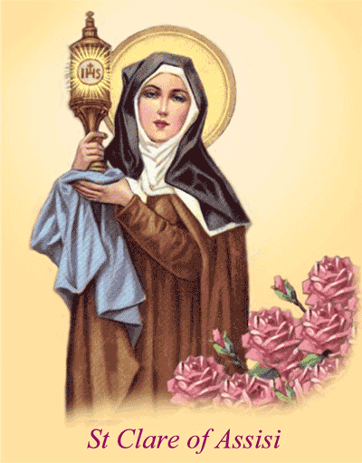
An Age of Faith: 1000-1300
St. Clare of Assisi founded an order based on St. Francis’s teachings (Poor Clares).
    They were know as the Poor Clares because they took a vow of poverty and devotion to God.
During this time, cathedrals were a form of devotion to God.
    They had thick walls, narrow windows, a dome roof, and thick columns.
    Gothic cathedrals were a popular cathedral type.
    They were tall, decorated with carvings and statues of saints and angels, and stained glass windows.

Slide 22
Achievements

Slide 23
Advances in Farming
Improved wooden plows to iron plows.
    Had steel blades and sifted through thick soil easier.
Horses replaced oxen for plowing because they were faster and were more food efficient.
    Widespread use of horses caused invention of a new harness and horse shoes to protect hooves.
Developed a better crop rotation system.
    Crop rotation- changing of fields over time.
    Old system: 2 fields, 1 planted, 1 fallow
    New system:
    3 fields, 1 for summer, 1 for spring, 1 fallow, served as a back-up if 1 field failed

Slide 24
Revival of Trade
More food from farmers led to an increase of population.
People were healthier and lived longer lives due to the better food supply.
Some areas specialized in what type of crop grew best there.
    Spain=olives, France=grapes
High quality trade was more available for commoners.
    They could buy things like pot, pans, sharp knives, or leather boots.

Slide 25
Revival of Trade
Some cities were famous for a special product.
    Spain=swords, Flanders=cloth
Merchants had to travel with very large amounts of money and were often robbed by bandits.
    A letters of credit system was created. A merchant could deposit in one town and withdraw in another.
Towns grew larger because of the revival of trade.
    Some had weekly markets, merchants and craftsmen set up shops, and fairs attracted people from all places and were a form of entertainment.

Slide 26
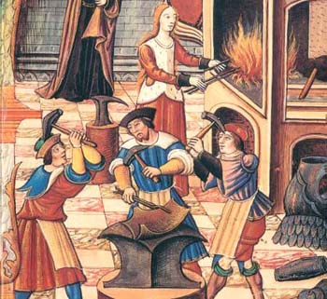
Guilds
Artisans of the same area of expertise formed guilds together.
  Guild-group of people practicing the same craft.
    Example: tailor, fisherman, winemakers, blacksmith
  The guild protected and regulated businesses. They watched the quality of goods and set fixed prices on items. If a member produced cheap items or cheated his customers, punishments were set.

Slide 27
Politics

Slide 28
Early European Rulers
In early 530’s Franks controlled most of France and Germany.
The Franks were wealthy, but they had a weak government, so they broke into smaller kingdoms.
Charles Martel (a.k.a. Charles the Hammer) reunited the Franks.
    He defeated the Spanish Muslims in Spain in 732.
    Charles the Hammer’s son was Pepin the Short.

Slide 29
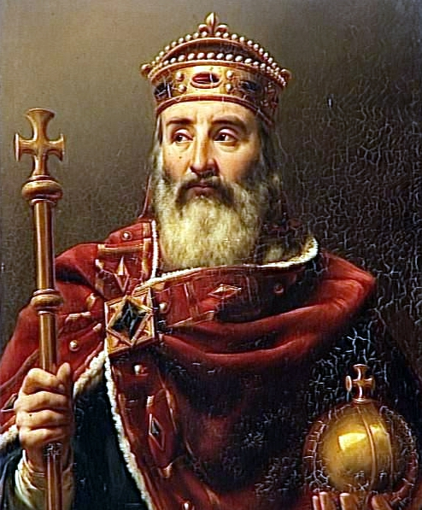
Early European Rulers
Pepin the Short was the first king of the new dynasty, and had a son named Charlemagne.
Charlemagne was very famous and became king at 26 years old.
    He was a devout Christian and wanted to rule a Christian empire.
    He forced pagan Saxons to convert or be killed.
    His kingdom lost against converting the Muslims, but it inspired an epic poem called the Song of Roland.

Slide 30
Early European Rulers
    At 800, his empire included most of central and western Europe.
    Charlemagne was a just and fair ruler who liked law, learning, and music. He created a palace school and library and encouraged the learning of Greek and Latin.
    Charlemagne had a weak government because he ruled personally, causing him to rely on the pope.
Otto the Great was a German king during 960. He built a small empire and used the church to support his authority.

Slide 31
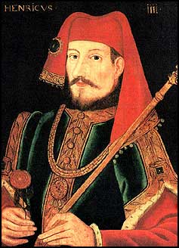
Early European Rulers
In 1073, Pope Gregory VII believed that the pope had power over the Church and non secular leaders.
    He also believed that the pope alone had the power to choose bishops and could remove emperors from the throne.
These beliefs enraged Henry IV who was the emperor at that time.
    The king ignored the pope’s rules and the pope excommunicated the king from the religious community.
    The king tried to remove the pope, so the pope freed the king’s subjects from their loyalty to him.
    The rivalry continued long after their deaths.

Slide 32
Early European Rulers
In 1006, on his deathbed, the weak King Edward gave the throne to Harold Godwin.
    This gained Harold two rivals who thought that they would be receiving the throne.
One of these men was William the conqueror who got his revenge on Harold by killing him in a war.
    His troops burned and looted villages after their victory.

Slide 33
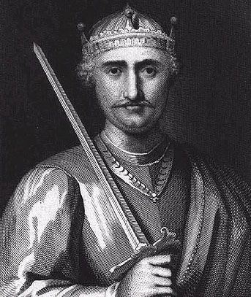
Early European Rulers
When William took the throne, England changed into a feudal system.
    There was a new ruling class; everyone in power was of Norman birth.
New kings tried to strengthen the government, but the feudal lords opposed.
    In order to stand against the opposing feudal lords, the king had to hire barons to fight for him.

Slide 34
Early European Rulers
In 1204, King John tried to gain more power after a very weak rule.
    To do this, he planned on raising taxes, but it caused a conflict with the barons.
    The barons came together and formed the Magna Carta which was a document that demanded rights against King John’s military failures and high taxes.
    King John agreed not to collect anymore taxes without the barons approval.
    Today, we take the idea of trial by jury, rule by law, and rights of people from this event.
    This action gave birth to Parliament which is a law-making body of representatives.

Slide 35
Early Hardships
At one point in time, there was too much rain, and it gave the cattle a serious disease.
    The cattle dies, crops died, and people starved.
    This period of strife is known as the Great Famine.
There was a Hundred Years War between France and England.
    English won early battles due to their longbow weapon.
    Later, both sides developed guns and cannons.
    Joan of Arc led the French to victory but was burned at the stake.

Slide 36
Early Hardships
In 1347, the bubonic plague struck Europe.
    Plague-deadly infection, epidemic-widespread disease
    It was called the Black Death because the bleeding left black spots on the skin.
    Caused by infected fleas that live in rats, began in Asia and spread with trade.
    1/3 of the population died and the Jews were used as scapegoats.
    Scapegoat-when someone is blamed for something they did not do.
    The pope told people not to kill the Jews but was widely ignored.
    People in every class died because of this outrage.

Slide 37
Social

Slide 38
A Feudal Country
The feudal system occurred because of a weak and broken government.
    In this system a person who gets a fief, or piece of land, is called a vassal. The vassal pledges to the lord who granted him the fief.
    When farmers were in trouble, they could go to a lord’s fortress for protection.
    The lords controlled farms, market prices, and taxes in the region they ruled.
    Knights in a feudal system came from a noble class. They trained early and learned how to be gentlemen. They operated on the code of chivalry.

Slide 39
Manorialism
After the feudal era, Europe moved on the manorialism system.
    Manorialism-when the lord of a manor governs the town surrounding it
    The manor produced everything the village needed.
    Everyone worked their share: women spin wool, men worked the land, butcher got the meat, and the carpenter and blacksmith worked at the estate.
    The rule of the lady was to run the household. She made sure that there was enough food and linen and was properly educated. She ran the manor when the lord was away.
    The lord settled arguments and taxed the farmers their crops.

Slide 40
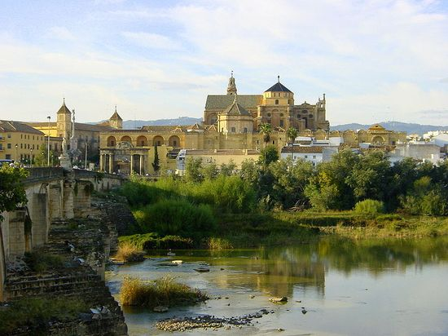
Moorish Spain
Spanish Muslims were known as Moors.
Moorish Spain quickly became the most advanced medieval civilization.
The capital of Moorish Spain was Cordoba.
    It was the largest city and bookshops and public baths could be found there.
    Houses had mosaic floors, gardens, and fountains.
Foreign students came to study philosophy, music, and medicine.
    The science in Moorish Spain was much more advanced than any other country in Europe.

Slide 41
Moorish Spain
The rulers of Moorish Spain were very tolerant of Christians and Jews.
    They could hold high positions in society, and plus, converting them was impossible because the Muslims were greatly outnumered.
    In return for not being persecuted, they had to pay a special tax and follow special rules.
In 1002, the Muslims lost control of Spain.
    The kingdoms split, and later some united together.

Slide 42
The Reconquista
The pope ordered the soldiers to conquer the other kingdoms for Christendom, the movement was known as the Reconquista.
    Toledo was apprehended and captured, and an alliance was formed. Soon only the nation of Granada was left.
    Granada had to pay tribute in order to be left alone. This let them survive for a few centuries.
    Ferdinand of Aragon and Isabella of Castile Leon united kingdoms. They conquered Granada and the pope was happy.

Slide 43
Religious Persecution
Until the 1300’s the Jew had lived safely, but then they were prosecuted. Isabella and Ferdinand wanted to reunite Spain as a Catholic country.
    Many of them converted for fear of the punishments.
    Muslims and Jews were forced to leave Spain and Portugal. This act harmed the economy and culture.
    Cathedrals became universities where men were trained for priesthood.

Slide 44
Medieval Universities
Medieval universities did not have a specific campus.
    The professors and students made up the university.
    Some times they were held in rented rooms or churches.
    Students came from all over the world. Latin was the language everyone spoke there.
Thomas Aquinas was a professor.
    He was very impressed by Aristotle’s beliefs.
    He wanted to show that there was no difference between Aristotle’s teachings and God because faith and reason both came from God.

Slide 45
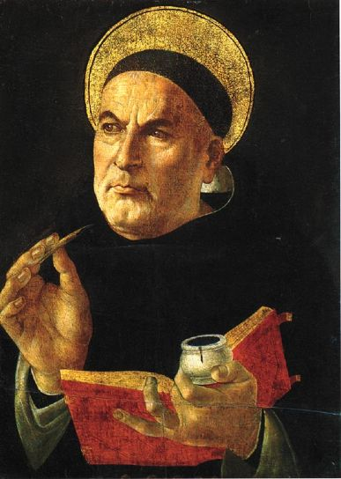
Medieval Universities
Thomas Aquinas believed that the laws of nature could be applied to both the natural world and human affairs.
    He said that the natural law could be used to prove God because everything is caused by something.

Slide 46
The End of Medieval Europe
Towards the end of medieval Europe, manor lords were desperate for workers.
    Serfs moved to wherever the wages were high, so the lords tried to limit their movement.
    This caused the peasants to revolt and they were eventually put down. However, this changed the traditional relationships in the social ladder.
    The social classes were no longer stable and people began to act as individuals, heading more towards our current society.

