Slide 1
Fables
Discovering the True Intention of these Clever Animal Stories

Slide 2
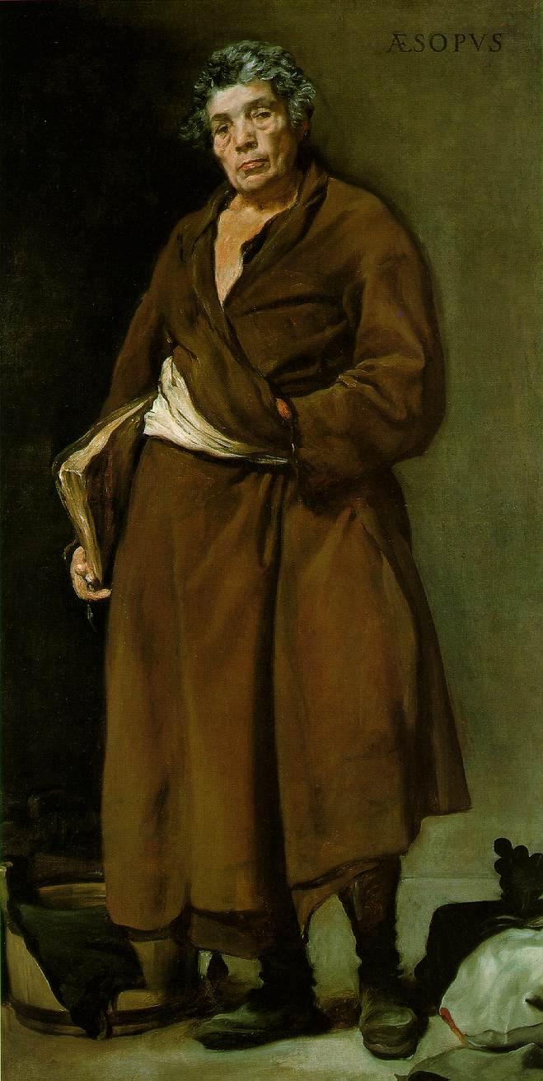
Aesop
Lived from 620-560 B.C.
  Not much is known about him
  No one is certain where he is from, or what he looks like because he was depicted in different ways; as a disfigured man or as a handsome, strong man
  Many scholars deny he ever existed
He was a slave in the 6th century B.C.
  He eventually freed by his master most likely due to his wit
Aesop composed many fables that were passed down orally

Slide 3
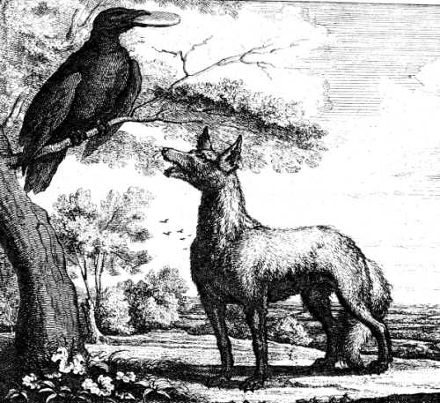
Fable Requirements
A fable is a short animal tale with a moral tagged on in the form of a proverb
Always features animals, plants, inanimate objects, or forces of nature which are anthropomorphized (human qualities to animals)

Slide 4
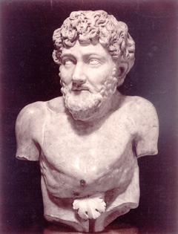
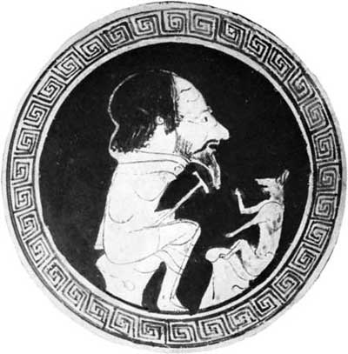
Purpose of Fables
Aesop was able to stand up to his accusers and point out their ironies and hypocrisy through his clever fables
  His tales told of human folly and the abuses of power (much like our political cartoons), and he lived during a period of dictatorial/oppressive rule in Greece

Slide 5
Animal Farm Historical Information
Connecting Fables to Animal Farm

Slide 6
Animal Farm is a satirical novella or one long fable which reveals and gives humans a warning about being controlled by a totalitarian government.

Slide 7
Definitions
Socialism: ideology advocating the equal distribution of wealth among all people
Communism: equal pay for all jobs and equal money for all people
Totalitarianism: government exercises firm control over the public and private lives of its citizens
Authoritarianism: government controls its people by taking away all democratic rights
  Government relies heavily on propaganda, promotion of group mentality, and censorship
  Also known as Dictatorship or Fascist Regime
Can you think of past governments that have utilized these ideologies or used this kind of control over its people?

Slide 8
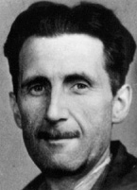
George Orwell
Eric Blair was born in 1903 in India
Worked as a police man- required to enforce strict laws of political regime he despised
Went to live among the poor in London
  After reemerging, he wrote a book about his experiences
Later lived among coal workers
Traveled to Spain and witnessed the nightmarish atrocities committed by fascist political regimes
Lived while Hitler and Stalin were dictators
  Hatred of totalitarianism led to writing many politically charged novels
Animal Farm was published in 1945
January 1950, an artery burst in his lungs, killing him at 46

Slide 9
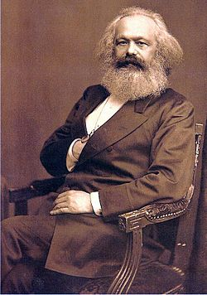
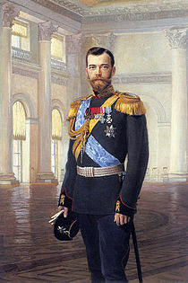
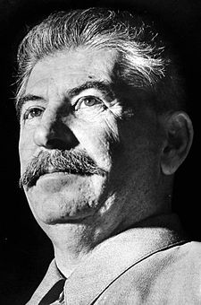
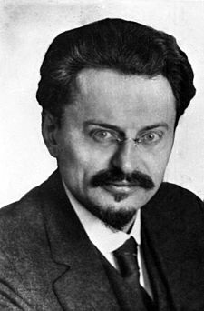
Russian Revolution- The Major Players
Marx: Created the socialist ideals with the positive intention to generate equality for all
Tsar Nicholas II: Ruler of Russia from 1894-1917
  Saw Russia go from super power to a collapse
  Nicknamed “Bloody Nicholas”
Stalin: 1922-1953 served as the General of the Communist Party
  Launched rapid industrialization
  “Great Purge” to get rid of people who did not hold the Communist beliefs
Trotsky: Leader of the Russian Revolution
  Was exiled and assassinated under Stalin’s orders

Slide 10
Allegory
Similar to metaphors, but an allegory is a comparison that extends over the entire story
Each character is symbolic and represents some person or idea (in this case most characters represent someone specific in the Russian Revolution)

Slide 11
Copy down the character map to see how the characters are allegories.

Slide 12
Irony
Situational: when an event takes place that produces and unexpected outcome
Verbal: when the character says one thing but really means another (similar to sarcasm)
Dramatic: when a character, seeing only appearances, acts in ignorance to what the audience knows as the truth

Slide 13
It is important to know that Orwell write this novella as a warning t people to watch out for what will happen if a government gains too much control over you. It is about the Russian Revolution; however, Orwell wanted everyone to be aware of this happening in their world.
Why do you think Orwell, the author, would choose to give this warning in the form of an animal tale?

