Slide 1
Chapter 4
A social history of
American Life in the 17th Century
1607-1692

Slide 2
1. What are three distinct features of the New England?
2. What is the Half-Way Covenant?

Slide 3
1. What was Bacon’s Rebellion?
2. What were the three levels of stratification in Southern Society?

Slide 4
1. Who was Nathaniel Bacon?
2) What are three features of New England life?

Slide 5
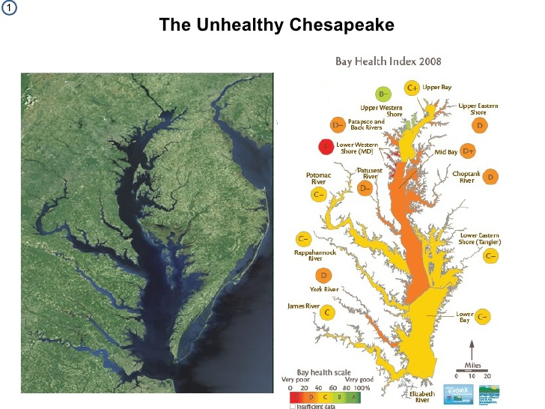
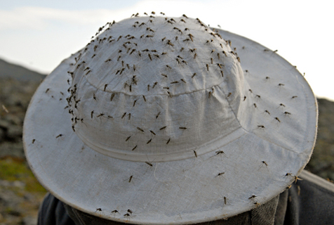
The Unhealthy Chesapeake
Themes: Demographics – fresh immigration and low life expectancies
Ferocious Environment: malaria, dysentery, typhoid cut off 10 years of life expectancy for newcomers. didn’t make it to 20th bday.
fresh immigration from England – mostly single men in late teens and early 20s. Most died soon after arrival.
Scarely any women, the surviving men competed for women. 6:1 ratio of men to women. Few families. Men can’t find mates. Marriages ruined by death of partner within 7 years. No grandparents
girls were pregnant before marriage. In Maryland, more than 1/3 of all brides were already pregnant when they wed.
Sign of unhealthy families: high unmarried teen pregnancies.
Notes:
Despite all these troubles, the Native born acquired immunity to killer diseases that ravaged older immigrants. More women = more families. By 1700, Virginia had population of 59K. Maryland had 30K.

Slide 6
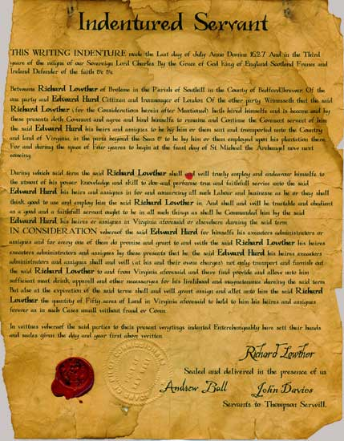
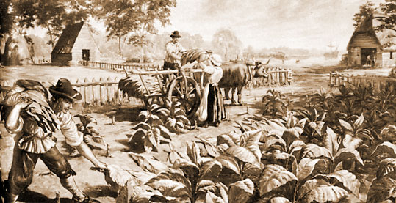
Tobacco Economy
Theme: Environment, Have/Have nots
Chesapeake: unhealthy for human life, but great for tobacco
“indentured servants”
The “Headright” System
Indentured servants lived a hard but hopeful life, expecting freedom. But as prime land got scarce, masters stopped giving out parcels and made sentences more harsh for the servants.
Notes:
Profit-hungry sellers planted tobacco more than corn! They got into more fights with NA because they needed fresh land to plant more
1.5 million pounds of tobacco exported out of the Chesapeake Bay by the 1630s’s and over 40 million by the end of the year
. The farmers needed workers: families procreated too slowly, NA aren’t immuned to white ppl diseases, AA slaves are too expensive.
“indentured servants” who in exchange for their work got eventual “freedom dues” such as barrels of corn, a suit of clothes, and sometimes, a parcel of land
The “Headright” System - whoever pays for the passage of a laborer received the right to acquire 50 acres of land. So the masters are soon taking their money and making huge fortunes in real estate. Chesapeake planters brought over 100,000 white servants

Slide 7
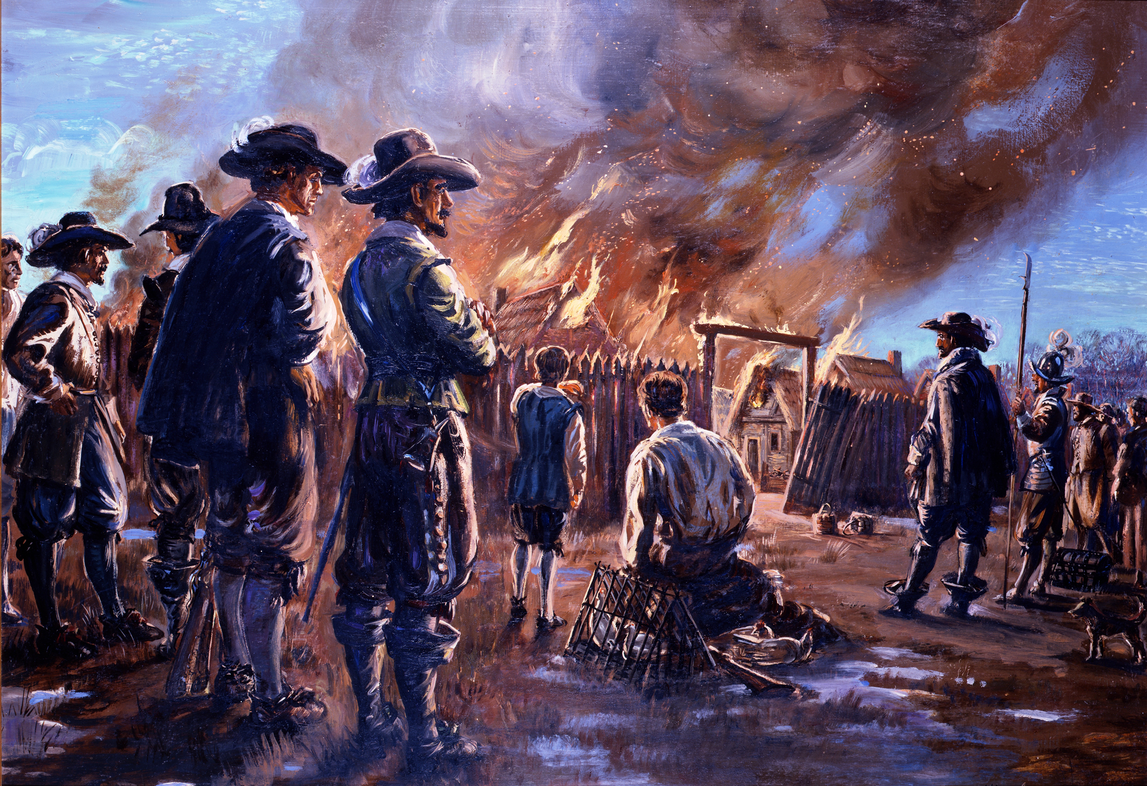
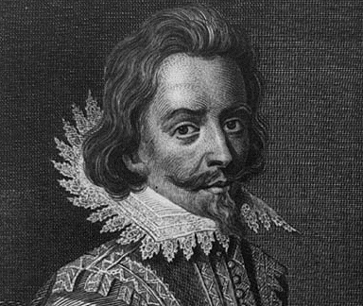
Frustrated Freedmen and Bacon’s Rebellion
Theme: Have/Have nots, Cause and Effect, Slavery
Virginia’s Governor, William Berkeley, looked down upon the lowly saying, “how miserable that man is that governs a people where 6 parts of 7 at least are poor, endebted, disconted, and armed.”
Nathaniel Bacon (29 year old) and about 1,000 frontiersmen were angry at Berkeley for being friendly with the NA and not protecting them as they are searching for arable lands. He created a riot, attacking NA’s, driving Berkeley out of Jamestown, with tons of plundering and pilfering (looting.) THINK LA RIOTS!
It was landless former servants vs. haughty gentry plantation owners
The tensions remained though the rebellion was put out, so the white plantation owners looked about for less troublesome workers: African slaves
Cause and Effect of Bacon’s Rebellion: What are the various outcomes?
Notes:
Many young men wandering around the Chesapeake region frustrated by no women and no way to acquire land. The established planters treated them like riffraffs.
Virginia’s Governor, William Berkeley, looked down upon them saying, “how miserable that man is that governs a people where 6 parts of 7 at least are poor, endebted, disconted, and armed.”
Nathaniel Bacon (29 year old) and about 1,000 frontiersmen were angry at Berkeley for being friendly with the NA and not protecting them as they are searching for arable lands. He created a riot, attacking NA’s, driving Berkeley out of Jamestown, with tons of plundering and pilfering (looting.) THINK LA RIOTS!

Slide 8
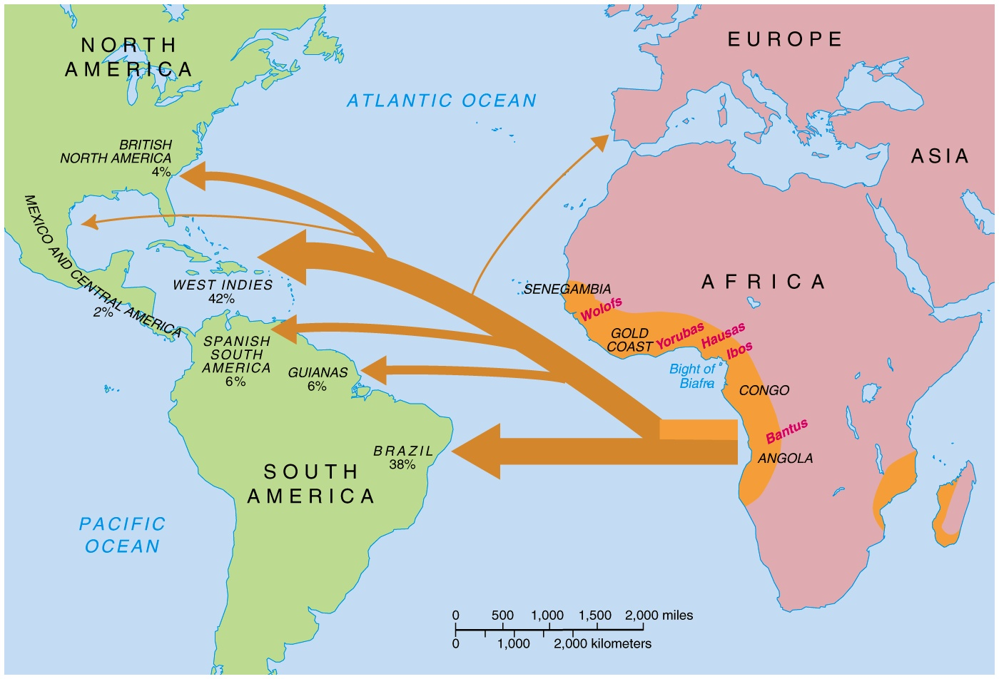
Colonial Slavery
Themes: Politics/Citizenship, Slavery, Demographics, Identity, Have/Have nots, Econ
Notes:
Out of the 10 million African slaves, only about 400,000 made it to North America. The rest were taken to South America and the West-Indies
First A.Slave was brought in 1619, but by 1670, there were about 2,000 – about 7% of population
At first, white planters couldn’t afford them, especially if they would die quickly. But by 1680s, A.slaves outnumber white slaves on plantation because Americans started to get involved with the slave trade. After 1700, more than 10 thousand slaves came to N. America.
Most slaves came from the West coast of Africa and caught by coastal tribes and sold to European or American flesh merchants.
Put on ships and endured the “middle passage” on which 20% died
Few African immigrants gained freedom and became slave owners, but as the number of Africans in their midst increased, the whites reacted to this “racial threat.” ( Scared White person of the African person).
Created statutes (Laws) stating conditions for Blacks. This is the earliest blackcodes you will find in history like all blacks and their kids are chattel (property) for life of white masters, it’s a crime to teach a slave to read and write.
Slavery started economically. But it just got racial.
FOUR WORLDS: SLAVERY

Slide 9
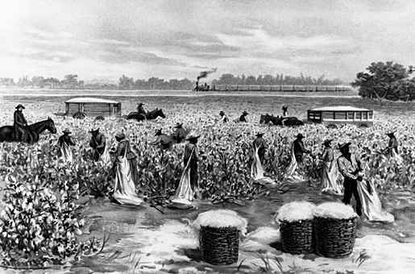
Africans in America
Themes: Agency, Culture, Identity, Slavery, Economics, Diversity
In the deep South of S. Carolina, slavery was harsh. Weather, loneliness, back-breaking work on rice and indigo plantations
Tobacco farming in the Chesapeake was a lot easier and the plantations are larger and closer together, which allowed slaves to talk. Slaves began to reproduce and create a larger slave society
Slaves developed their own distinctive culture: speech, religion, and folkways. South Carolina sea islands: language called “Gullah”
The slaves mainly did menial tasks like clearing swamps, cutting trees, etc. Some tried to revolt, but generally, they were a much manageable labor force than whites.
No slave uprising matched the damage of Bacon’s Rebellion.

Slide 10
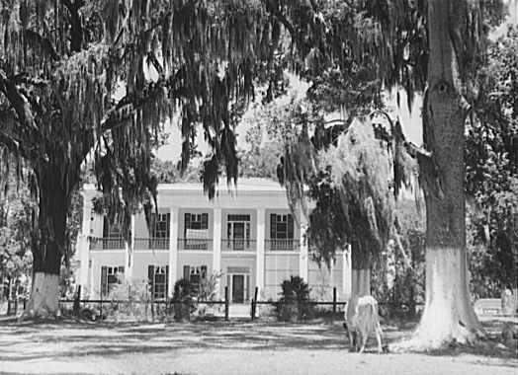
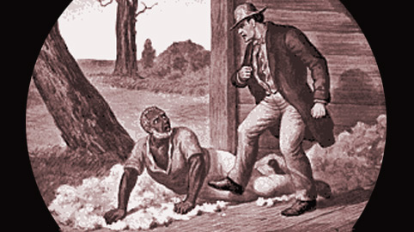
Southern Stratification in Society
Themes: Have/Have Nots, Identity, Culture
At the top of the Southern Social ladder was a small group of great planters who owned gangs of slaves and tons of land. They ruled the economy and monopolized political power.
Next were the small farmers, making the largest social group. Maybe some had 1-2 slaves. They barely made a living
Then are the landless whites, who were probably indentured servants
At the bottom were the black slaves.
Plantations were far from one another. People traveled through waterways. Roads were really bad that people started burying their dead in front of their house.

Slide 11
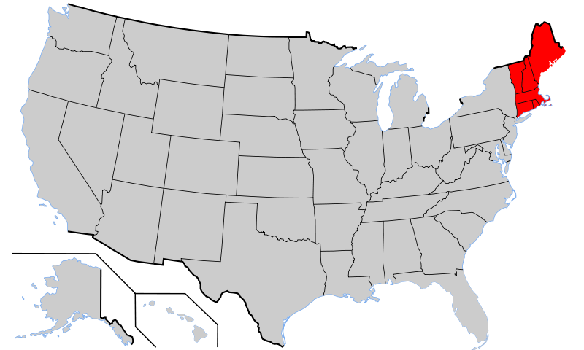
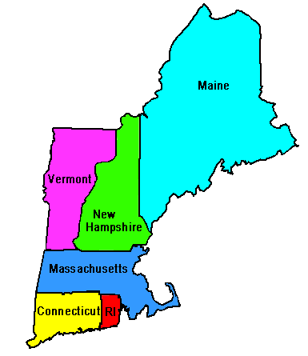
The New England Family
Themes: Demographics, Identity: Hardwork, Christian, Educated, Aristocratic
While nature was cruel to the people of the Chesapeake, nature was kind to NE. Had clean water and cooler temperatures. Those who moved to NE from England ADDED 10 years to their life. Many families migrated together and the family remained the center of NE life.
Women are popping out babies. Very fertile. Most women had babies in early 20s and then had a baby every 2 years until menopause.
Massachusetts Governor was 1 out of 27 children!!!
New England “invented” grandparents – families were more stable compared to the Chesapeake as seen in lower premarital pregnancies
Divorce was rare and authorities ordered separated couples to reunite.
Only adultery or abandonment were among the few permissible grounds for divorce. Adulterous women had to wear an “A” on their clothes (as read in Nathaniel Hawthorne’s, The Scarlet Letter)
GOOD LIFE LESSON – Think of an experience in your life that was difficult for you but made you a stronger person.

Slide 12
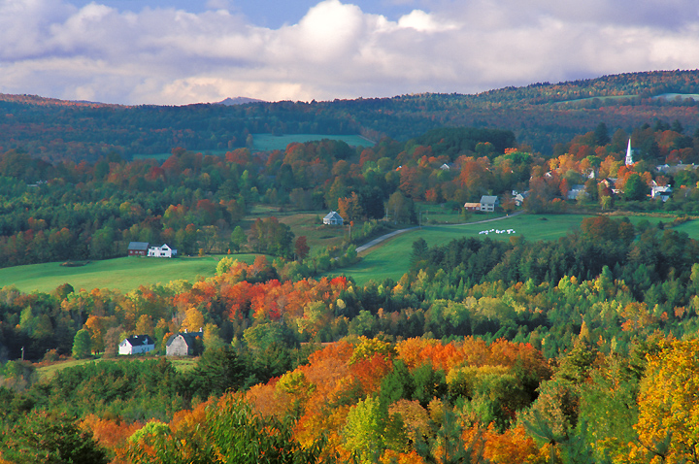
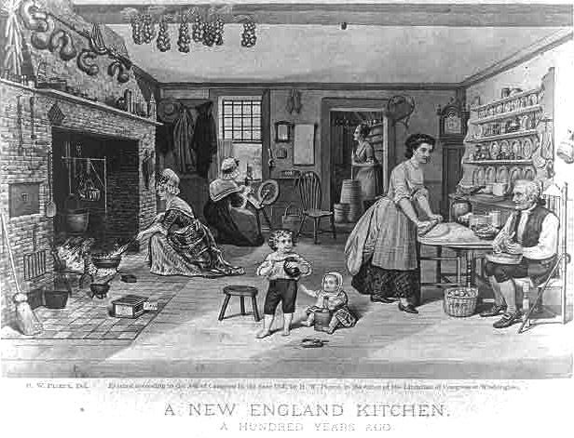

Life in the New England towns
Themes: Identity, Have/Have nots
Small villages and farms. Puritanism united the people with a strong moral code. (In the 1800s, it’s the New Englanders who want to abolish slavery).
New England society grew in a very orderly way. A proprietor (or town father) would get a charter and then bring his family and lay out his town. Towns of more than 50 families had to provide schools, and most people were literate.
After just 8 years after the colony’s founding, Massachusetts Puritans established Harvard College
Lots of democracy going on in the churches and town meetings

Slide 13
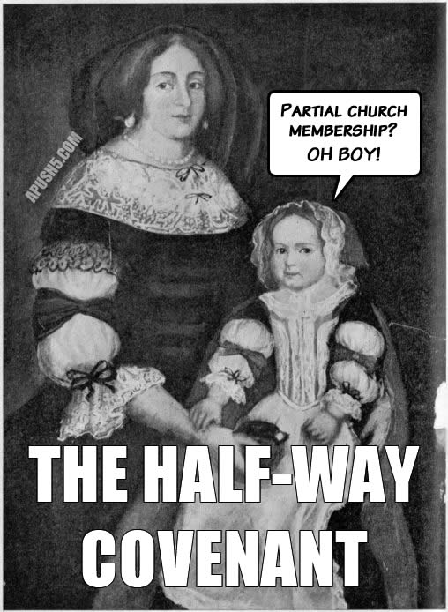
The Half- Way Covenant
Themes: Religion
As NE settlements grew, the people started to move farther out, away from the control of the church and neighbors. The first generation flame for religious zeal was starting to die out, so a group of people called the “Jeremiads” started preaching and scolding people for their waning piety.
There were fewer conversions going on, which went hand and hand with church membership.
So the Half-way Covenant offered partial membership rights to people not yet converted.
The strict religious purity was sacrificed for larger church attendance

Slide 14
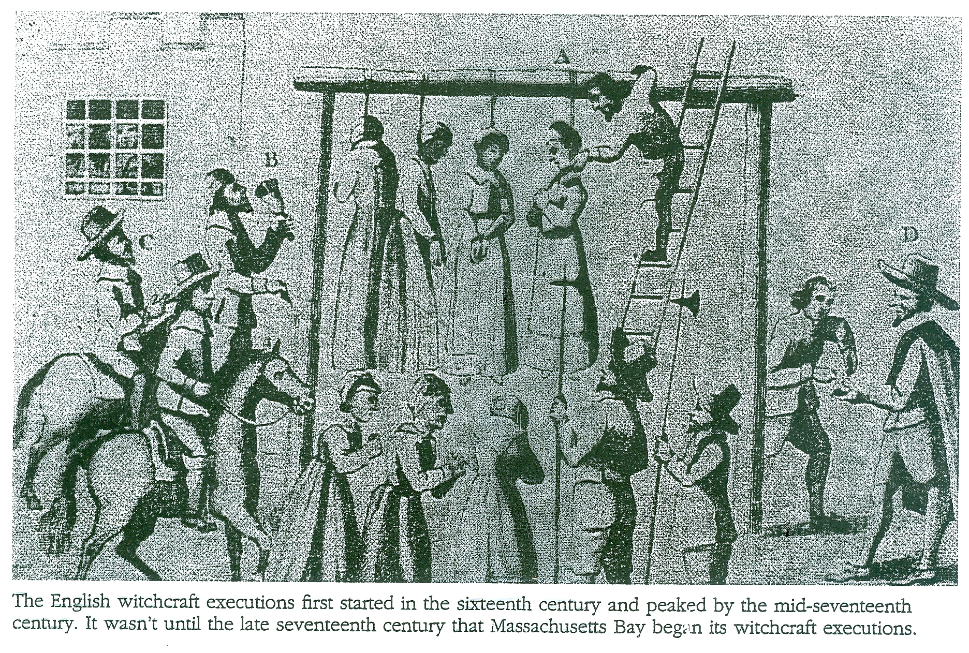
Salem Witch Trials
Themes: Religion, Have/Have nots
Groups of young teens claimed to have been “bewitched” by older women. A “witch hunt” ensued leading to the lynching (1692) of 20 individuals and 2 dogs.
Many of the accusers came from the poorer agricultural families while the accused came from the merchant families
It ended in 1693 when the governor’s wife was accused. He put a stop to it completely.

Slide 15
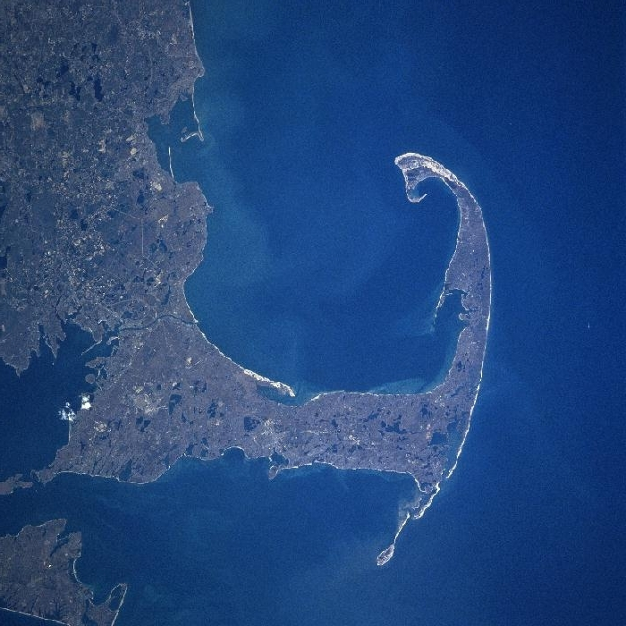
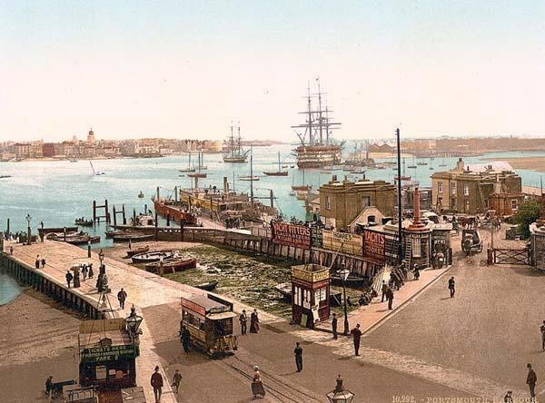
The New England Way of Life
Themes: Environment, American Identity: conscious, purposeful, stern, self-reliant, resourceful
New england had a lot of rocks and had grudging land, unlike the fertile South. It remained less ethnically mixed b/c immigrants didn’t want to move to a place with soil so stony and sermons so sulfurous.
The climate was extreme: uncomfortably hot in the summer and freezing during winter. Planting was hard b/c you would end up with stones.
NA left imprint on NE earth. They beat trails through the woods and burned woodlands to restore forests. They did not believe in ownership of land
English settlers thought the NA were wasting the earth. They felt it was their duty to improve the land by tilling the land, building fences and settlements.
English brought in livestock: pigs, horses, sheep, cattle which made them want to clear more woodlands for them to live on.
NE is known for their natural harbors, which made them great at ship building and commerce. They also caught a LOT of cod fish which became the “goldmine of NE.” Don’t forget! Cod and God.

