Slide 1
Biotic and Abiotic Factors
EQ: What are some of the factors that shape an ecosystem?

Slide 2
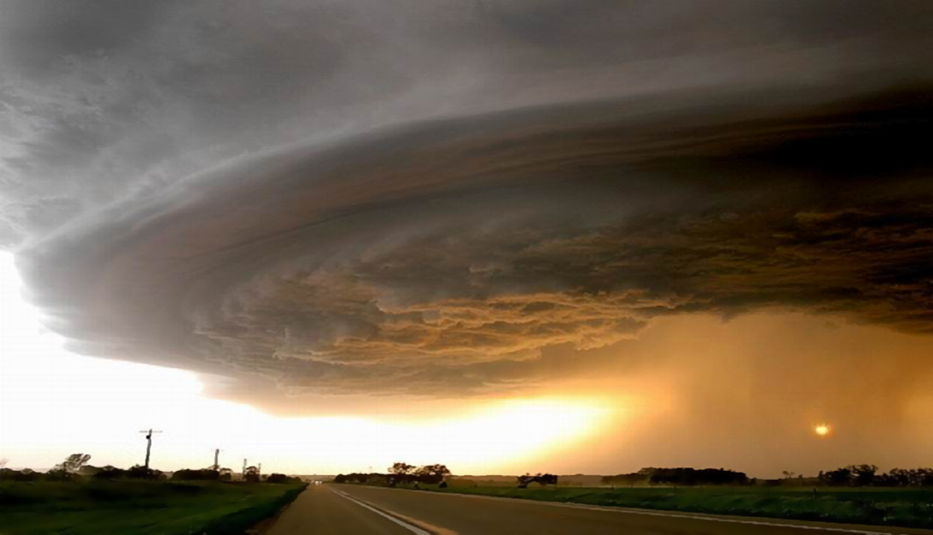
Biotic and Abiotic Factors
Ecosystems are influenced by a combination of biological and nonliving factors.
Biotic – Biological (Living) factors
Abiotic – nonliving factors
Temperature
Precipitation
Soil type
sunlight

Slide 3
Habitat vs. Niche
The habitat is the area where an organism lives. It includes both biotic and abiotic factors.
Niche – full range of nonliving and biological conditions in which an organism lives and the way in which the organism uses those conditions

Slide 4
Symbiosis
Any relationship in which two species live closely together is called symbiosis.
Symbiotic relationships include
Mutualism
Commensalism
Parasitism

Slide 5
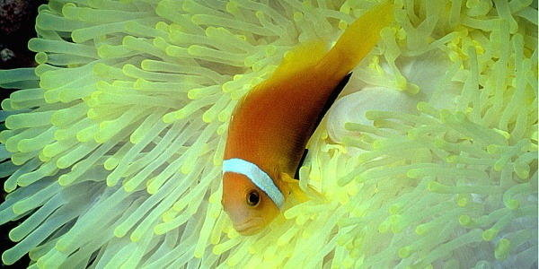
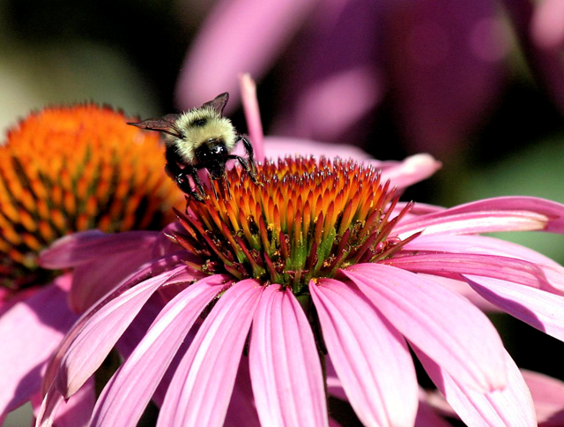
Symbiosis
Mutualism – Both species benefit from the relationship
Commensalism – One member of the association benefits and the other is neither helped nor harmed

Slide 6
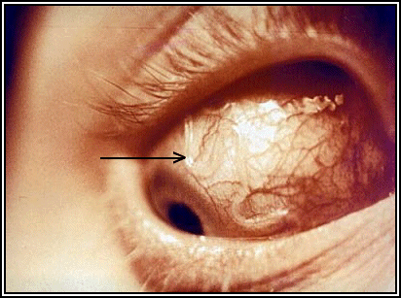
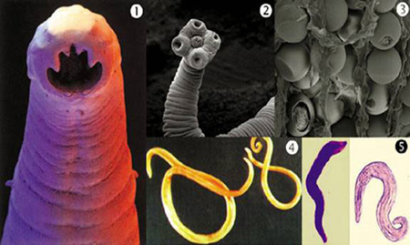
Symbiosis
Parasitism – one organism lives on or inside another organism and harms it.

Slide 7
Ecological Succession
Succession – a series of predictable changes that occur in a community overtime
Sometimes, an ecosystem changes in response to an abrupt disturbance.
At other times, change occurs as a more gradual response to natural changes in the environment

Slide 8
Ecological Succession
Primary Succession
Succession that occurs on surfaces where no soil exists is called primary succession.
Ex: succession that occurs on rock surfaces formed after volcanos erupt.
The first species to populate the area are called pioneer species
Ex: lichen

Slide 9
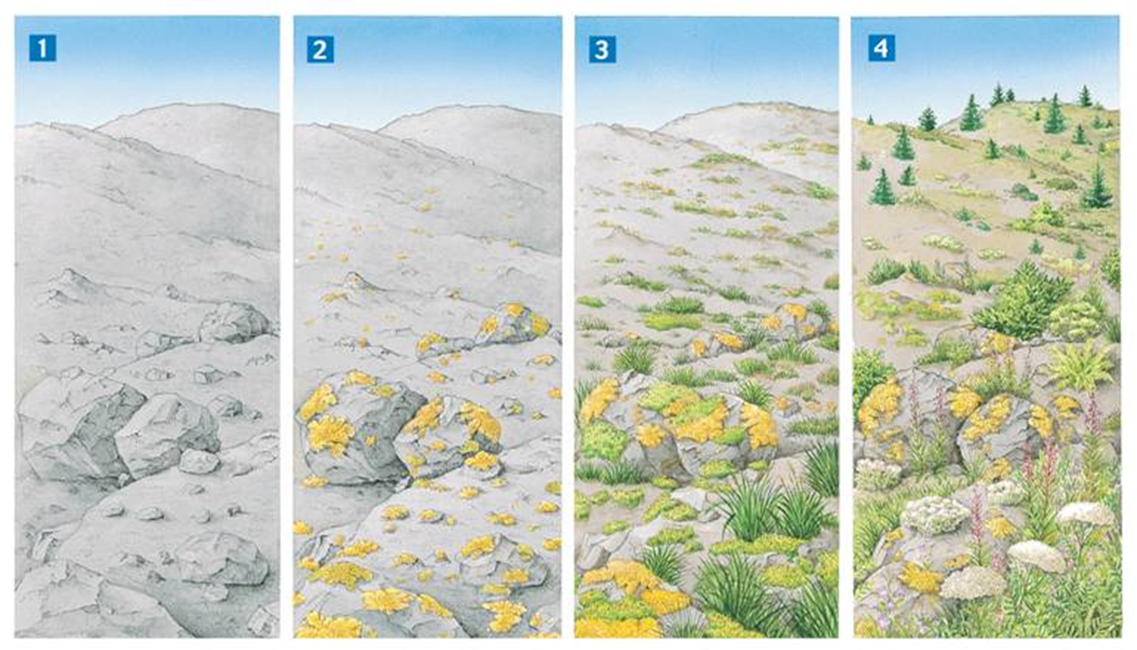
Primary Succession

Slide 10
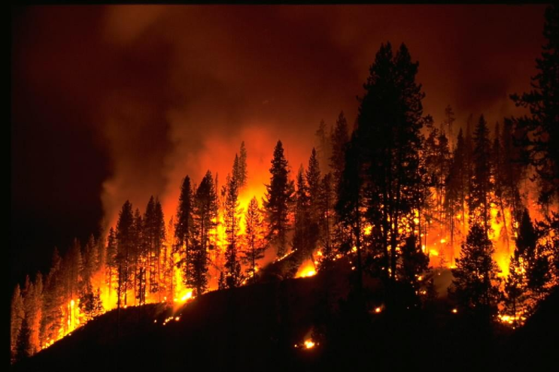
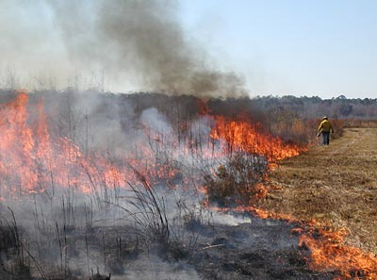
Secondary Succession
Components of an ecosystem can be changed by natural events, such as fires.
Secondary Succession – when the community is restored to it’s original condition after the disaster is over

Slide 11
Test Review
What is the difference between an autotroph and a heterotroph?
What are the 5 different consumers?
Tell me what each feed on.
What is the difference between a Food Web and Food Chain?
What is the 10% rule?
What kind of chart does the 10% rule apply?
Where does the other 90% go?
What are the 3 different symbiotic relationships?
What is the difference between Primary and Secondary Succession?

