Slide 1
1984 Chapter IX
The Theory and Practice of Oligarchical Collectivism

Slide 2
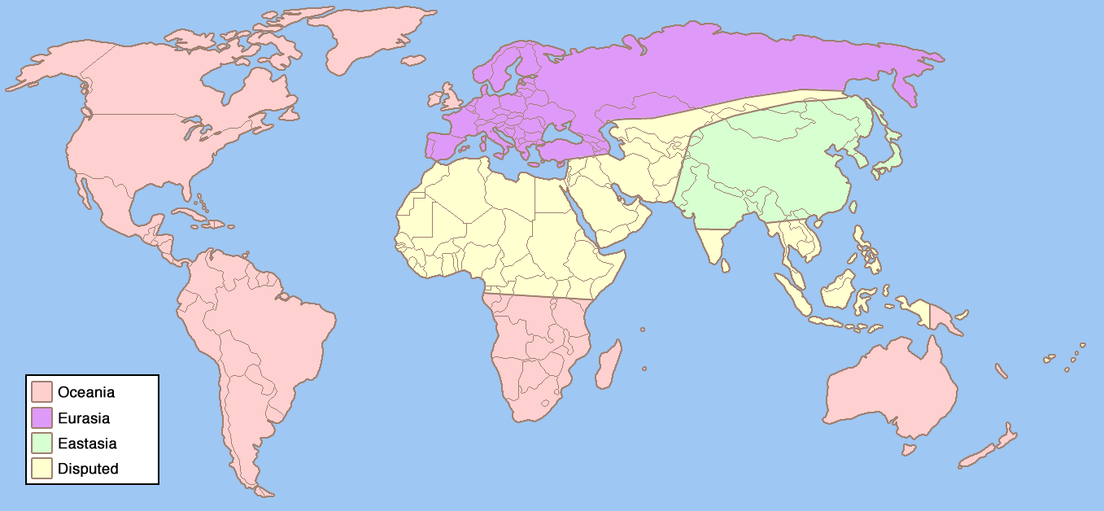
The world of 1984

Slide 3
The enemy has changed
At one rally during hateweek, the speaker is forced to change his speech halfway through to point out that Oceania is not, and has never been, at war with Eurasia. Rather, the speaker says, Oceania is, and always has been, at war with Eastasia.

Slide 4
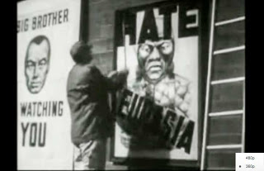
The enemy has changed
The people become embarrassed about carrying the anti-Eurasia signs and blame Emmanuel Goldstein’s agents for sabotage
They immediately exhibit full-fledged hatred for Eastasia.

Slide 5
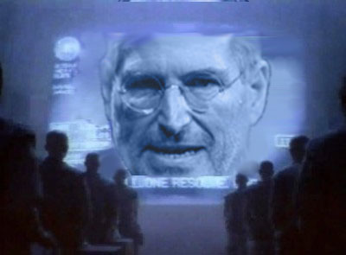
Goldstein’s Book
(Sect. 2, ch. 9: p.152-164, 166-179)
In the room at Charrington’s, Winston reads through Goldstein’s book, The Theory and Practice of Oligarchical Collectivism, given to him by O’Brien.

Slide 6
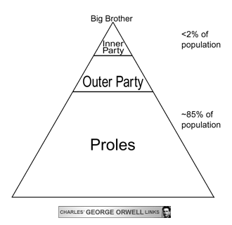
Oligarchy
An oligarchy is a form of government in which a few select people have all of the power to rule over the masses.

Slide 7
Goldstein’s Book
The chapter titles are taken from party slogans such as “WAR IS PEACE” and “IGNORANCE IS STRENGTH”
The book traces a theory of social classes throughout recent history: High Class, Middle Class, and Low Class—the Inner Party, the Outer Party, and the Proles.

Slide 8
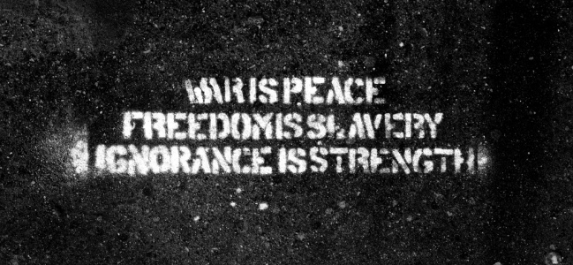
War is Peace
The war is simply a fact of life that enables the ruling powers to keep the masses ignorant of life in other places—the real meaning of the phrase “WAR IS PEACE.”

Slide 9
Read Ch. 9 to fully understand
This chapter is important to really understand the world of 1984, but it is also the most complicated chapter in the book

