Slide 1
Warm-up #3
Write a paragraph explaining the factors that caused Buddhism to spread to China.

Slide 2
Tang & Song Achievements
You and your partner will take notes about one area of achievements during the Tang and Song Dynasties.
  1 = Agriculture
  2 = Cities
  3 = Trade
  4 = Art
  5 = Inventions
Then you will have a mixer where you move around the room to exchange ideas with other pairs. You will have 10 minutes to interview classmates and complete the worksheet.

Slide 3
Tang & Song Achievements cont…
Use the worksheet you just finished and the text from chapter 7.2 to define each of the inventions on the list and the matching activity.

Slide 4
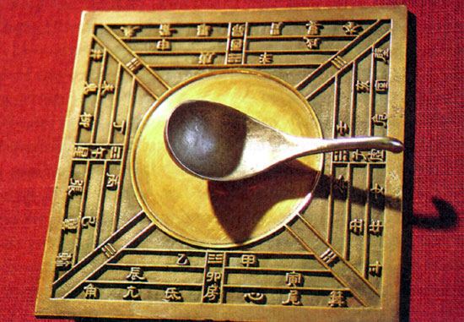
Compass

Slide 5
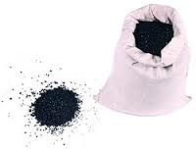

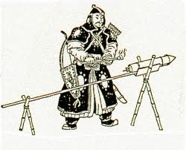
gunpowder

Slide 6
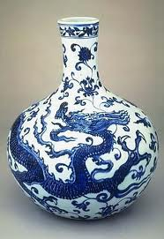
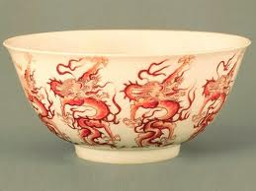
porcelain

Slide 7
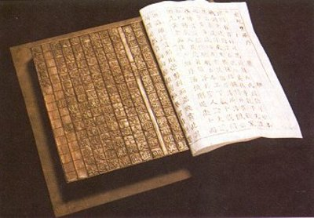
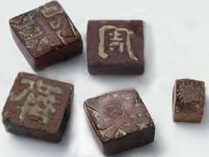
Woodblock Printing
Characters carved from wood would be set together to form the text of a page then “stamped” onto paper. Each time a new page was created, al l the characters for printing would have to be made from scratch.

Slide 8
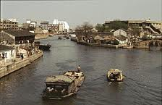
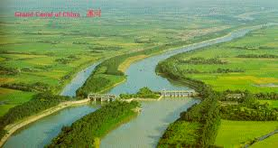
Grand Canal
The Grand Canal is the longest canal (man-made river in the world. It begins in Beijing and ends in Hangzhou. It’s construction dates back to the 5th century but was not completed until the Sui Dynasty (which lasted from 581 to 618 C.E.).

Slide 9
Movable Type
In the Song Dynasty (960-1279), a man named Bi Sheng carved individual characters on identical pieces of fine clay. Each piece of movable type had on it one Chinese character which was carved in relief on a small block of moistened clay. After the block had been hardened by fire, the type became hard and durable and could be used wherever required. The pieces of movable type could be glued to an iron plate and easily detached from the plate. Each piece of character could be assembled to print a page and then broken up and redistributed as needed. When the printing was finished, the pieces were put away for future use.
By the year 1000, paged books in the modern style had replaced scrolls. Two color printing (black and red) was seen as early as 1340.
This technology then spread to Korea, Japan, Vietnam and Europe. Later, German Johann Gutenberg invented movable type made of metal in the 1440s. Movable Type Printing developed very fast. Based on clay type, type made of wood, lead, tin and copper gradually appeared.
From http://www1.chinaculture.org/gb/en_aboutchina/2003-09/24/content_26509.htm

Slide 10
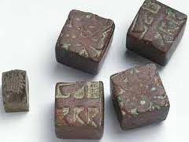
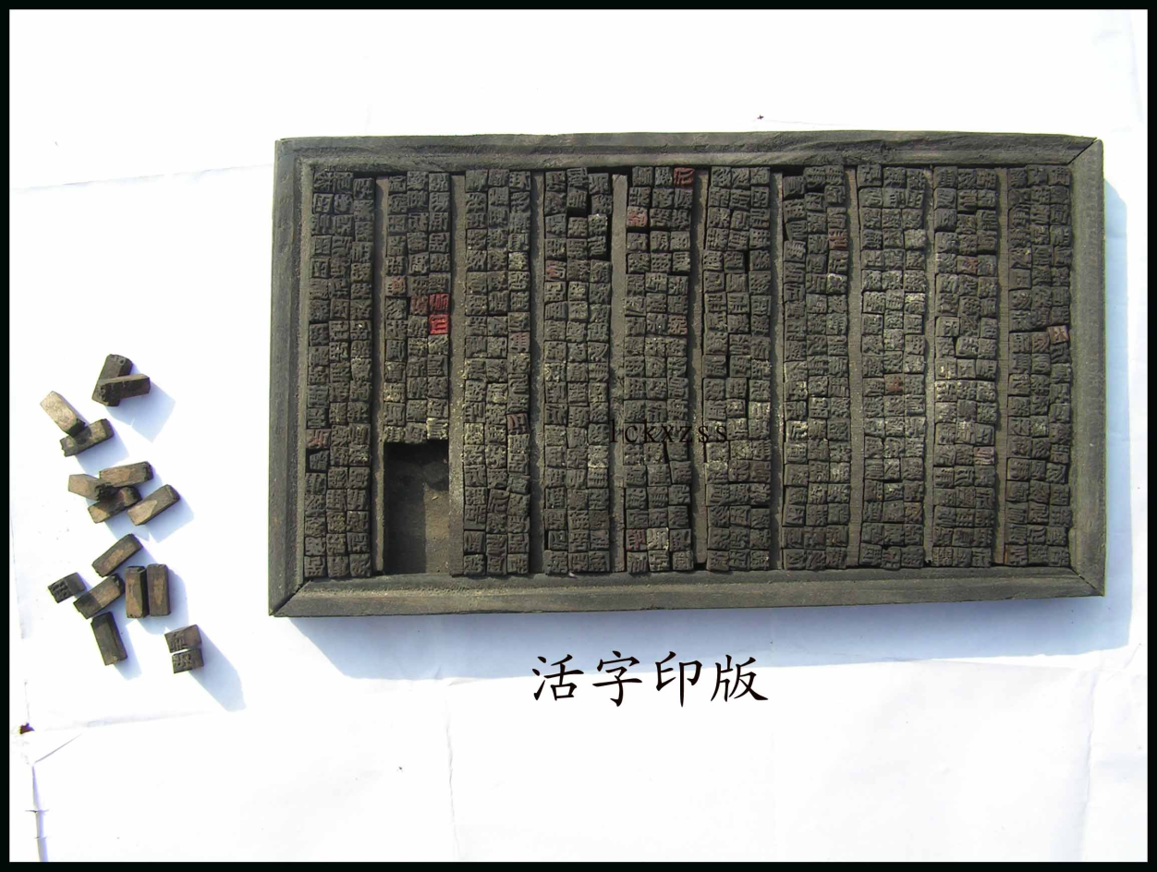
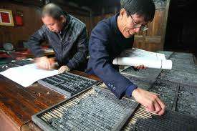
Movable Type…

Slide 11
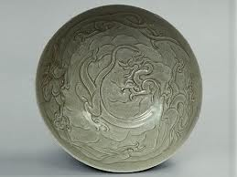
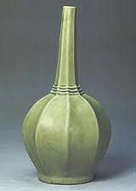
celadon
Celadon, a famous type of ancient Chinese stoneware, came into being during the period of the Five Dynasties (907-960). It is characterized by simple but refined shapes , jade-like glaze, solid substance and a distinctive style.

Slide 12
Merchant class
Innovations in trade allowed merchants to become important members of the Chinese class system.

Slide 13
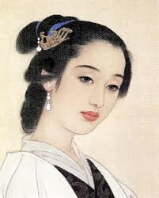
Li Quingzhao
To the Tune of LIKE A DREAM
I always remember the sunset over the pavalion by the river.
So tipsy, we could not find our way home.
Our interest exhausted, the evening late, we tried to turn the boat homeward.
By mistake, we entered deep within the lotus bed.
Row! Row the boat!
A flock of herons, frightened, suddenly flew skyward.
The most famous female poet during the Song Dynasty. She was known especially for the unaffected emotional intensity of her ci (collections of poems)
http://history.cultural-china.com/en/48History519.html
http://en.wikipedia.org/wiki/Li_Qingzhao
http://home.infionline.net/~ddisse/liquinzh.html

Slide 14
Empress Wu Zetain
Read the hand out.
Mark your text.
Answer the questions on the back in complete sentences.

