Slide 1
Chapter 3
Settling the Northern Colonies
1619-1700

Slide 2
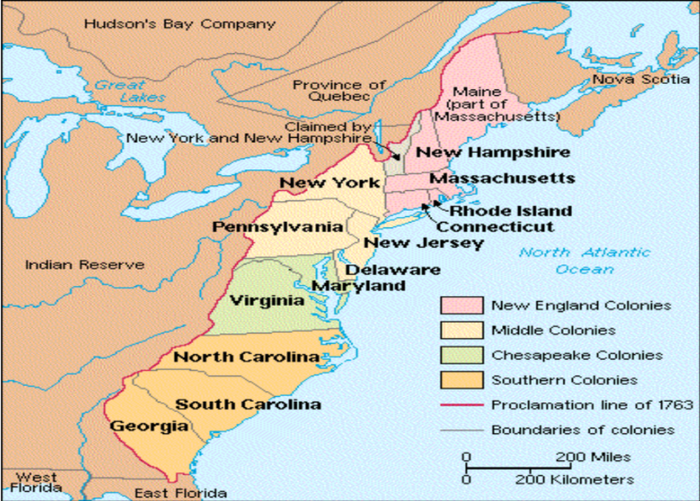
Chapter 3
Settling the Northern Colonies
1619-1700

Slide 3
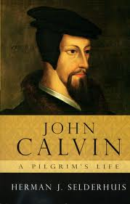
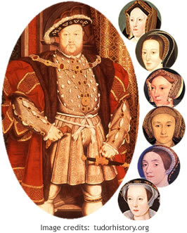
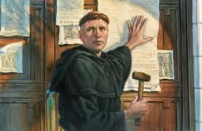
New religious thoughts sweep Europe
Themes: Religion, Demographics, Globalization
Martin Luther says bible is the only source of God’s word and that you do not need priests and popes. This idea divided people
John Calvin says God is all-powerful and good. Humans are weak and wicked. “Predestination” - God is all knowing and knows who is going to heaven and hell (the elect) – what people will choose. You live a holier life.
These calvinists hated the Church of England led by King Henry VIII (guy who got his wife killed) and wanted to see his church separate from theirs.
Puritans wanted church membership of the “visible saints” but Church of England lets all subjects in.
Separatists are the extreme puritans who wanted to break away from the Church of England. THE HARD CORE COME FIRST!
Notes:
Martin Luther says bible is the only source of God’s word and that you do not need priests and popes. This idea divided people
John Calvin says God is all-powerful and good. Humans are weak and wicked. “Predestination” - God is all knowing and knows who is going to heaven and hell (the elect) – what people will choose. You live a holier life.
These calvinists hated the Church of England led by King Henry VIII (guy who got his wife killed) and wanted to see his church separate from theirs.
Puritans wanted church membership of the “visible saints” but Church of England lets all subjects in.
Separatists are the extreme puritans (aka pilgrims)who wanted to break away from the Church of England. THE HARD CORE COME FIRST! Pilgrims go to Plymouth.

Slide 4
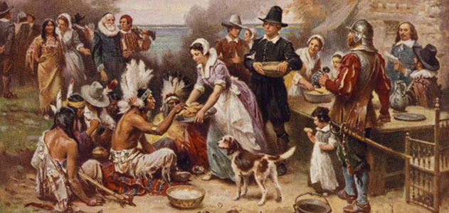
Pilgrims (Separatists) at Plymouth: God and Cod
Themes: Culture, Demographics, Agency, Politics/Citizenship
Group of separatists secured rights under VA company to get on the Mayflower. Fewer than half on boat were separatists. Lots of non-belongers
Before leaving the Mayflower, they drew up and signed the Mayflower compact, an agreement to form a crude government and to submit to the will of the majority
Only 44/102 survived. Very uninviting region, but by autumn of 1621, they had a bountiful harvest and celebrated the first thanksgiving.
William Bradford – Great leader. Wanted to keep Plymouth untainted by the ungodly.
Plymouth ended up merging with it’s great neighbor: Massachusetts Bay Colony
Notes:
Plymouth is actually outside the VA company domain. So technically, they were squatters.

Slide 5
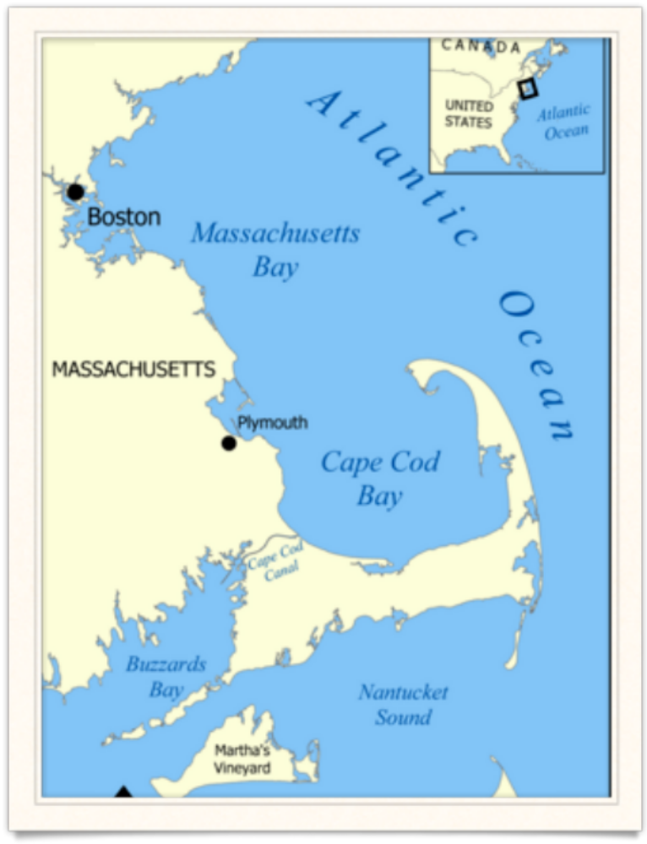
Massachusetts Bay Colony: Bible Commonwealth (1630)
Theme: Identity
Non-separatists (Puritans) secured a royal charter to form the Massachusetts Bay Colony with Boston as the hub. Wanted to be separate from only the “impurities” of the Church of England.
This was a larger colony than other English settlements with over 1,000
John Winthrop – first governor for 19 years. Helped Massachusetts prosper in fur trade, fishing, shipbuilding. “City on a Hill” – model for humankind.

Slide 6
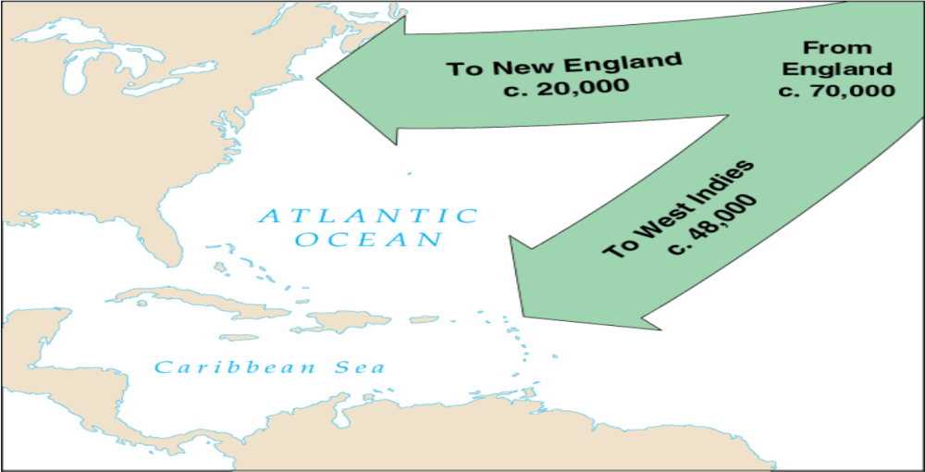
1630 – Great Puritan Migration helps populate Mass. Bay Colony even more
Theme: Demographics

Slide 7
Building up Massachusetts Bay Colony
Theme: Have/Have nots, Politics
The Franchise- given to all adult males who belong to the puritan congregation. The unchurched and women did not get the vote
Winthrop feared and distrusted the commons. It wasn’t a true democracy because only the saints of the church could vote and they enforced God’s laws, even to the unchurched.
Therefore, clergy gets really big and powerful but they aren’t allowed to hold political positions (beginning of separation of church and state). - John Cotton
Earned the title of “Blue Law State” because of the blue paper in which the repressive laws were printed. “You’re such a puritan.”

Slide 8
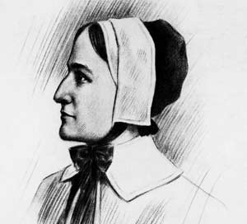
Trouble in the Bible Commonwealth
Anne Hutchinson challenged Puritan orthodoxy. Mother of 14, strong-willed, intelligent. Went against predestination.
She was all for “antinomianism” – the truly saved did not need to obey the laws of either God or man.
Banished from Massachusetts Bay Colony and went to Rhode Island. Ended up in NY killed by Native Americans.
Roger Williams was a extreme separatists and thought the puritans weren’t doing enough to separate from the Church of England. He was banished as well. Very friendly to the Native Americans.
Themes: Religion
Anti-against Nomos-Law
Notes:
A separatist is already an EXTREME puritan. So Roger Williams is an extreme, extreme Puritan.

Slide 9
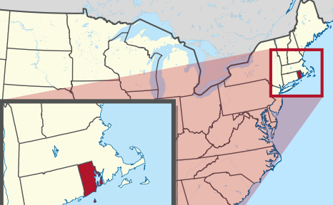
Rhode Island “Sewer”
Theme: Identity
Roger Williams escaped to Rhode Island with the help of friendly Natives.
Established the first Baptist church and established freedom of religion for Catholics and Jews.
Soon, all the unwelcomed people began to settle here and that’s what the reputation became
Started off as a squatter colony in 1636 but finally became secured a charter from Parliament in 1644

Slide 10
New England spreads out
Theme: War/Diplomacy, politics/citizenship,
Bostonian Puritans, led by Thomas Hooker, went westward to Hartford (Connecticut)
  Created the Fundamental Orders: citizens democratically controlled.
  Another settlement was at New Haven (1638)
  Maine and New Hampshire sprung from fishing and trading activities
  Pequot War: hostilities explode between English/Naragansett vs. pequot as they expand west into connecticut
  A pan-indian alliance created under Metacom, to attack English villages.

Slide 11
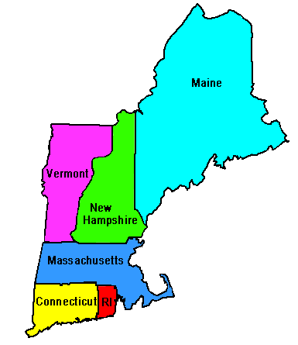
Colonial Unity
Theme: Identity, War/Diplomacy,
Politics/citizenship
Four colonies band to form NEW ENGLAND: bay colony, Plymouth, and two Connecticut settlements. Rhode Island and Maine rejected because they have too many “heretics” and “undesirables.” Later east/west jersey, and New York join.
Purpose: to defend against enemies like Natives, French, and Dutch
When there were issues within England, the colonies were almost autonomous. But with Charles II back on the throne, the micromanaging is back and colonists hate it!

Slide 12
The first real American revolution
Themes: globalization, politics
King George II sets up a Dominion of England in the colonies for the purpose of micromanaging and making sure the King knows more about the daily lives and transactions of the colonies.
Led by Sir Edmund Andros who brought British soldiers who were cussing, drinking, and being noisy in the Bible Commonwealth.
Americans hated the confinement by all the new laws created, esp the Navigation Laws.
In Old England, the Glorious Revolution occurred in which the people James II and enthroned William III and Mary. When this news arrived to New England, the colonists were amped and rose against Andros who escaped in women’s clothing

Slide 13
The Dutch in America
Netherlands hired Henry Hudson to venture into the Delaware Bay and New York Bay and then to Hudson River.
Dutch West India Company had enterprises in Caribbean
New Netherland was planted off the Hudson
Themes: identity, diversity

Slide 14
Dutch Residues in NY
New Netherland lay under the shadow of English colonies. They were surrounded by New England immigrants and NE peeps made up more than half of New Netherland’s 10,000 population.
English regarded the Dutch as intruders. Charles II granted the area to his bro, Duke of York. An English squadron appears off the coast and PETER STUYVESANT surrenders without a shot
New Amsterdam renamed New York. England gained a great harbor and the Hudson penetrating the interior. SHHHHAWING!
England now owns from Maine all the way down to the Carolinas.

Slide 15
Dutch residues (continued)
Harlem (Haarlem)
Brooklyn (Breuckelen)
Hell Gate (Hellegat)
Gambrel-roofed architecture
Easter eggs
Santa Claus
Waffles
Sauerkraut
Bowling
Sleighing, skating, kolf (golf)
Theme: Identity, Diversity

Slide 16
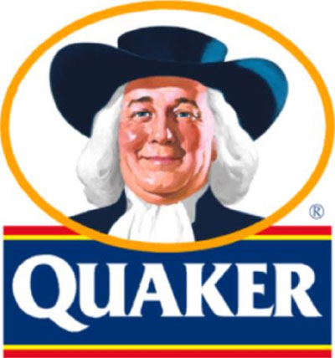
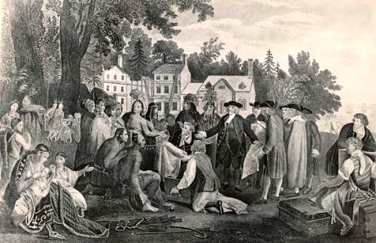
Penn’s Holy Experiment in Pennsylvania
New group of dissenters rose in New England (NE) called quakers. They “quaked” under deep religious emotions. AKA Religious Society of Friends NOT INTO THE “SHOW” Establishes Religious/Civil Liberty
Refused to support Church of England w/ taxes
No paid clergy, spoke up when moved, wouldn’t take an oath, treated everyone the same, people of deep conviction, hated warfare and military services, for passive resistance, simple, devoted, democratic people, wanted religious and civic freedom

Slide 17
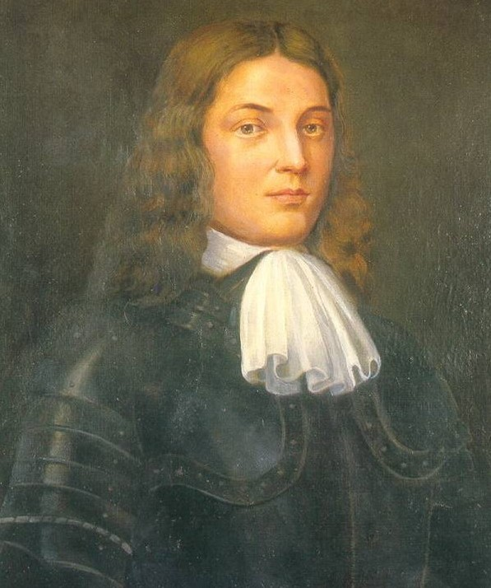
William Penn
Well born englishman was attracted to quaker faith at 16 years of age
Even through persecution from parents, he continued in his faith. Many quakers endured cruel treatment, and were fined, flogged, or cast into prisons.
Wanted to find an asylum for his people, he secured an immense land grant owed to his deceased father by the king. He then promoted the land heavily through pamphlets. Was looking for forward-looking spirits and good citizens, including carpenters, masons, shoemakers, and other manual workers.

Slide 18
Quaker Pennsylvania and it’s neighbors
Penn launched his colony in 1681. There were tons of “squatters” on the land already (Dutch, Swedish, English, Welsh). Philadelphia meant “brotherly love” in Greek and was a well-planned city with wide, attractive seats.
Penn bought land from the Natives like Chief Tammany. Quakers treated Natives well, so they could walk around unarmed. Some Southern tribes even moved to Pennsylvania to seek the Quaker haven.
But the Quakers were also very tolerant to whoever moved in the area. Those immigrants (Scots-Irish) weren’t nice to the Natives and undermined the good relationships built
The regime was liberal and had a representative assembly chosen by land owners. Freedom of worship guaranteed. Death penalty only for murders or treason.
No provision for military defense, no restrictions on immigrants, strong dislike for black slavery. This attracted a rich mix of ethnic groups.
“Blue Laws” still prohibited “ungodly revelers”, stage plays, playing cards, dice, games, and excessive hilarity.
William Penn only spent 4 years in Pennsylvania and died full of sorrows

Slide 19
Pennsylvania’s Neighbors
Small Quaker settlements flourished next door. New Jersey was sold to a group of Quakers. Delaware had Quakers and remained under the governorship of Pennsylvania.

Slide 20
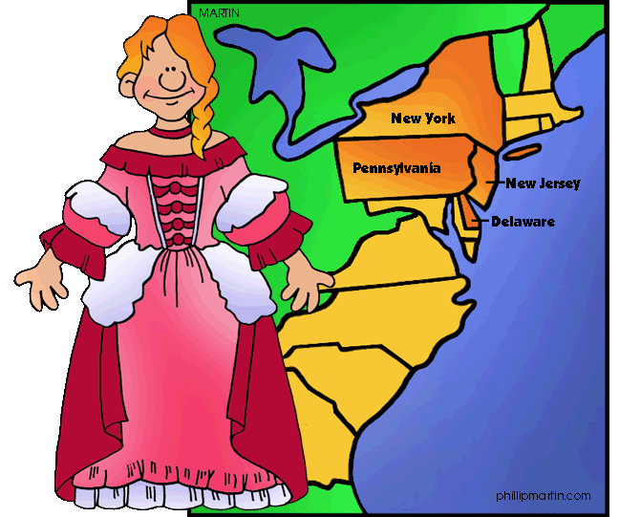
The Middle Colonies
NY, NJ, Delaware, and Pennsylvania: fertile soil and expanse of land was broad, known as the “Bread colonies” because of heavy exports of grain, had great rivers (Susquehanna, Delaware, and Hudson), virginal forests for lumbering and shipbuilding, deep river estuaries for commerce and seaports like NY and Philadephia.
The middle colonies are in between NE and Southern plantations. South had large farms. NE had small-farms.
Middle colonies were more ethnically mixed, had more religious tolerance.
Generally, the British had a hands-off policy, leaving colonists fashion their own local governments, run churches, and develop trade. The colonies weren’t just surviving. They were now thriving removed from the MUTHAland.

