Slide 1
Jeffersonian Republic
Objectives- look into the Presidency of Thomas Jefferson and analyze the growth and changes the country and government experienced during Jefferson’s term as President
1) Explain why the Election of 1800 was revolutionary.
2) Analyze importance of the Louisiana Purchase to the future success of the United Sates
3) Evaluate President Jefferson’s decision to buy the LA. Territory and explain why President’s often go against their beliefs fater they become President
4) Identify Tecumseh’and explain how his ideas that worried the Government of the United States.

Slide 2
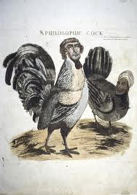
ID-Examining the Evidence (P 213) “Thomas-Jefferson-Sally Hemings Controversy”
Summary 1- Who are the two people depicted in the politcal cartoon?
Thomas Jefferson and his slave/lover Sally Hemings
OI –Examining the Evidence
1) What is the controversy surrounding Jefferson?
Sexual relations with his slave, Sally Hemings
2) What was Jefferson’s response?
He denied his affair with his slave

Slide 3
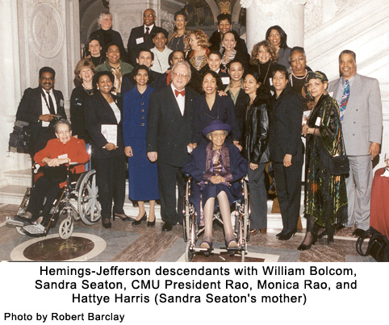
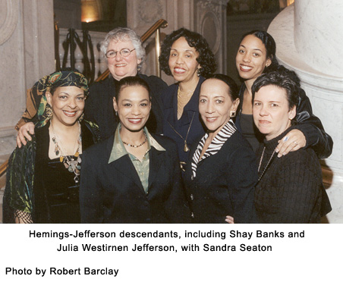
3) What was the truth?
Jefferson had several children with Sally Hemings (proven w DNA evidence)
4) Think- Why would Jefferson refute the claims against him so adamantly?
Being in love with one’s slave would be the political equivalent today of running for President and having a Gay lover

Slide 4
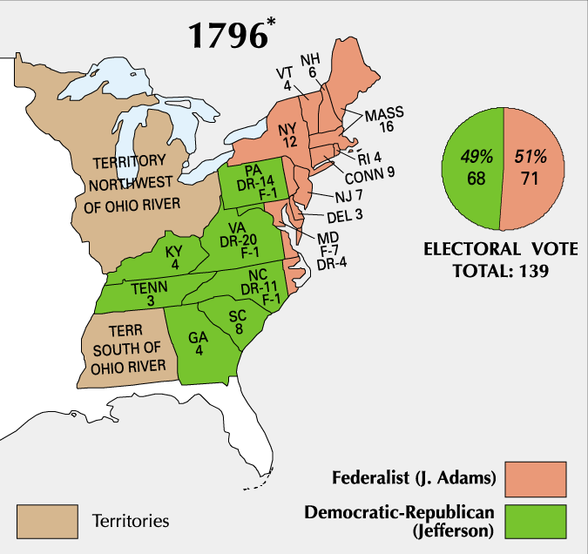
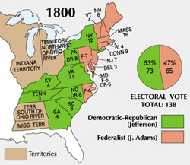
ID- Pres. Election of 1800 (214)
Summary 2- What region of the country sided most with the Federalists?
New England
Summary 3- What two new states have entered the Union? How did they vote?
Kentucky, Tennessee (and Vermont), Dem/Republican
Why do you believe New England and Ky/Tenn voted so radically different?

Slide 5
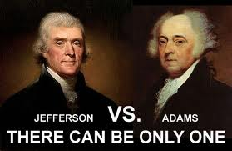
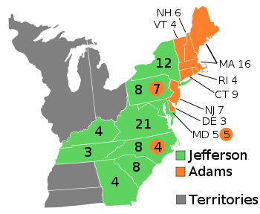
OI- The Jeffersonian “Revolution of 1800”
5) Who won the election of 1800?
Jefferson
6) How did the Constitution help tip the balance in favor of Jefferson?
3/5’s compromise gave Southern extra representation/Electoral College votes to put Jefferson over the top
7) What was so “revolutionary” about this election?
Peaceful transfer of power from one political group in power to the party out of power selected by voters

Slide 6
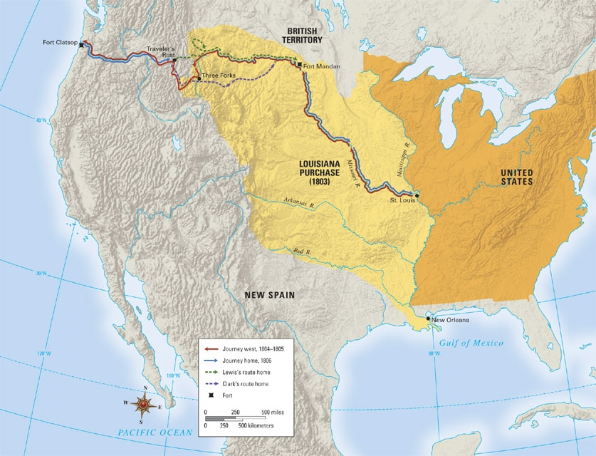
ID- Exploring the La Purchase and the West (p224)
Summary 4- Approximately how much larger was the US after the LA. Purchase?
Doubled in size
OI-The Louisana Godsend (220)
8) How did France acquire the LA. Territory?
Secret agreement with Spain in 1795
9) What did the US want to purchase originally from France?
Access to New Orleans into the interior

Slide 7
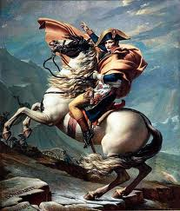
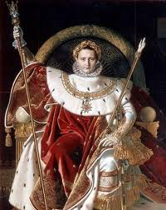
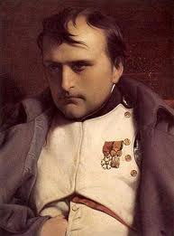
10/11) What were the two reasons Napoleon wanted to sell all of the La. Territory to the US?
Napoleon could not defend all of La. From invasion (would probably lose it to US anyways eventually)
Napoleon needed money to fight a war in Europe
12) Why was Jefferson conflicted about the purchase of the La. Territory?
Strict Construction- Nowhere in the Constitution does it give the President power to buy new land
Do you feel Jefferson did the right thing when he changed from his belief (IS it all right for Presidents today to say one thing while running for Pres. and do something else as President?)

Slide 8
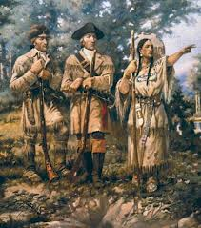
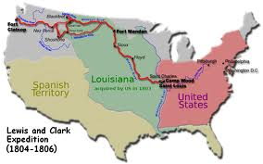
ID- Exploring the La Purchase and the West (p224)
Summary 5- How (ID) Lewis dressed?
Like a Native American
OI- Louisiana in the Long View
13) Who were the two people commissioned to explore the La. Territory?
Lewis and Clark (on a scientific exploration of La. Territory and claim land in Pacific Northwest)

Slide 9
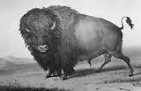
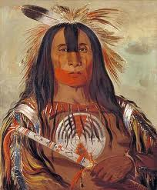
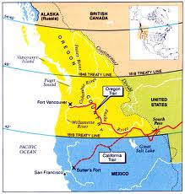
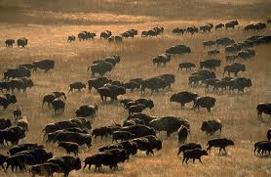
14) What were some of the observations and discoveries on the expedition?
Buffalo (elk, deer, antelope) loads of free range animals and meat
Maps- trails later explorers and settlers would use to move west
Native Americans- first introductions w. Plains Indians
15) What area of the US was the US able to claim because of the expedition?
Oregon Country

Slide 10
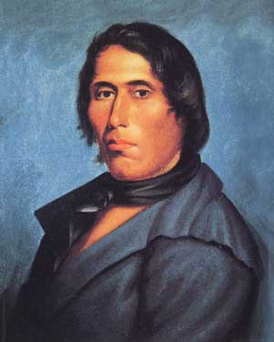
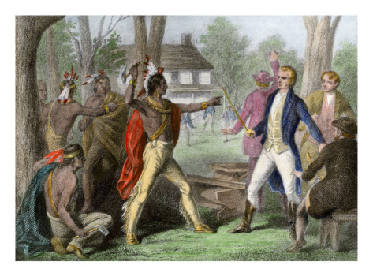
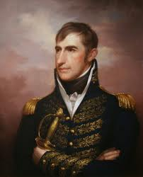
ID- Tecumseh (P 230), William Henry Harrison (230)
Summary 6- What was Tecumseh’s opinion on land?
Tecumsah believed the land belonged to the Indians
Summary 7- How did Harrison view Tecumsah?
Military genius who would have controlled an empire in another area
Imagine if the Indians in the US were united as the Aztecs were in Mexico. What difficulties would this have created for the US?

Slide 11
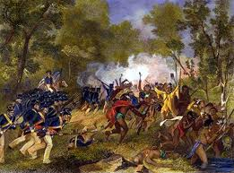
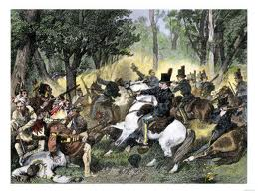
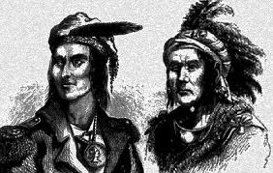
OI- Tecumseh and the Prophet
16) What did Tecumsah and his brother inspire in the Tribes east of the Miss. R?
A confederacy/unity among Indian tribes to fight together against the US
17) What did they want Indians to “forswore?”
All things white ( No alcohol, clothes, guns, supplies)
18) What dream vanished when Tecumseh died?
A united Indian nation
Do you feel that Native Americans could have successfully held off the westward progression of Americans if they had united under a strong leader like Tecumsah? Explain (How they could have won or lost?

