Slide 1
Biblical Allusions 4
The New Testament & other often mentioned people, places, or things

Slide 2
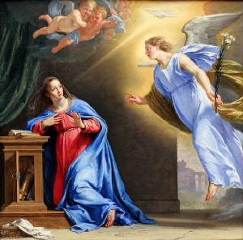
Mary and the angel Gabriel
Mary, Jesus’ mother, was engaged to Joseph when she was visited by the angel Gabriel who told her she had conceived “immaculately” which Christians believe means God implanted the child in her womb.
Joseph was told through a dream that he should still marry Mary and they married.
At the end of her pregnancy, Mary and Joseph were required by a decree of the Roman emperor Augustus to return to Bethlehem, a small city in the land of their births to be marked down for the tax rolls.

Slide 3
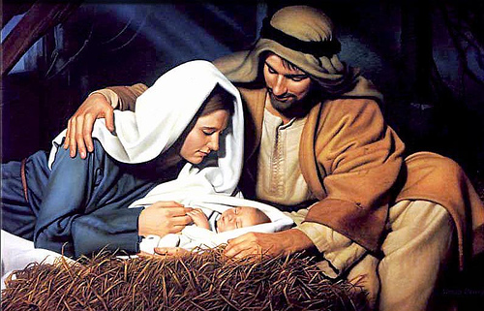
Jesus’ Birth

Slide 4
When they arrived in Bethlehem, there was no where for them to stay because all of the inns were full.
An inn owner let Mary and Joseph stay in his stable. Here, Jesus was born. He was among many barn animals and hay. Jesus was wrapped in swaddling clothes and laid in a manger.
A new star appeared in the sky. Angels appeared to some shepherds and proclaimed that the son of God had been born. The angels told the shepherds where to find Jesus. The shepherds found the baby right where the angel said he would be; the shepherds spread the good news and all were in awe of the joyous occasion.
We now celebrate his birthday on December 25 (Christmas) even though we do no know the exact date of his birth.

Slide 5
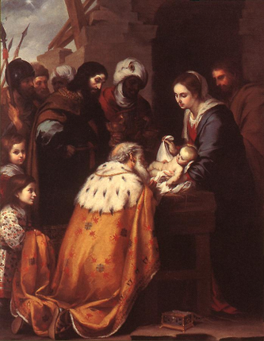
Jesus and the Magi
The Magi were Wise Men, or Kings from the East. Traditionally there were thought to be 3
When the news of the birth of a savior, the Messiah, reached the group of wise men, they traveled from eastern countries the Jerusalem and Bethlehem to worship the new King.
First they stopped by King Herod’s palace who had been told a “new king” would be born

Slide 6
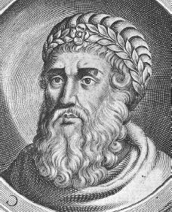
King Herod
Formally known as Herod the Great, he was the King of Judea.
Shortly after Jesus’ birth, Magi from the East came to visit him and ask about the “one being born king of the Jews.”
He asked the Magi to seek this newborn out in order to “pay homage to him.” Secretly he planned to kill this usurper.

Slide 7
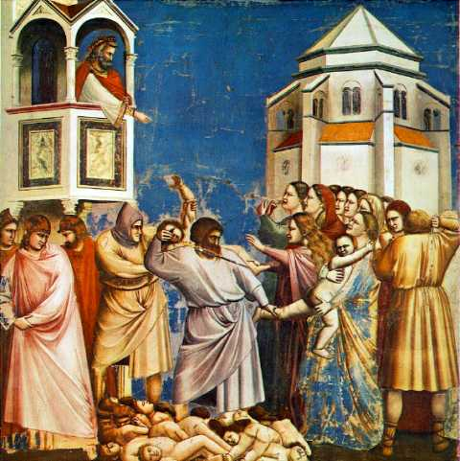
Massacre of the Innocents
However, the Magi had a dream that warned them not to reveal where Jesus was.
When Herod found out that he had been tricked by the Magi, he gave orders to kill all boys age two and under in Bethlehem and its vicinity.
Mary and Joseph were told to flee to Egypt where their son would be safe.

Slide 8
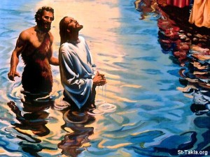
According to the New
Testament, John is the son
of Mary’s cousin who had
been childless for many
years.
The adult John was unusual –
he lived in the desert, wore
camel’s hair, and ate wild
honey and locusts; things
that marked him as an
ascetic.
When Jesus asks him to
baptize him, John asks why –
indicating that Jesus didn’t
need baptism. However, he
does baptize him.
John spoke out against
King Herod’s incestuous
marriage. In retaliation,
Herod has John beheaded.
Jesus’ Baptism by John

Slide 9


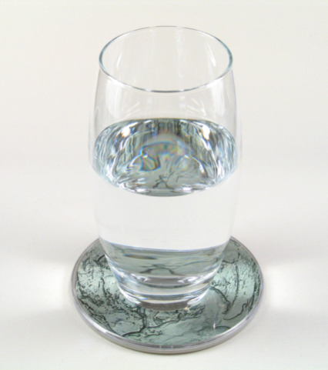
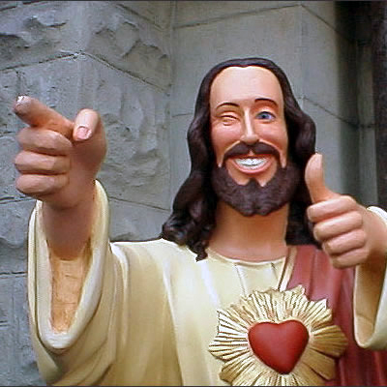
Wine at the Wedding
At the age of 33, Jesus and his mother Mary were at a wedding where the wine ran out. Jesus had 6 pots filled with water, and turned them into fine wine for all to see. This was his first miracle and led to the public belief in his works.

Slide 10
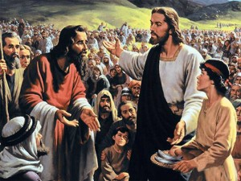
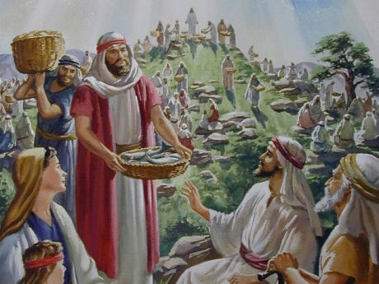
Jesus’ Ministry: Loaves and Fishes
Many followed Jesus to listen to him preach. After a long day Jesus’ disciples noted there were only 2 fish and 5 loaves – certainly not enough to feed the people so they should be sent away. Jesus said not to send them away.
He blessed the food, broke it and gave it to the disciples to be distributed to everyone.
The food fed the 5000 people present not counting women and children. There were 12 baskets of leftovers.

Slide 11
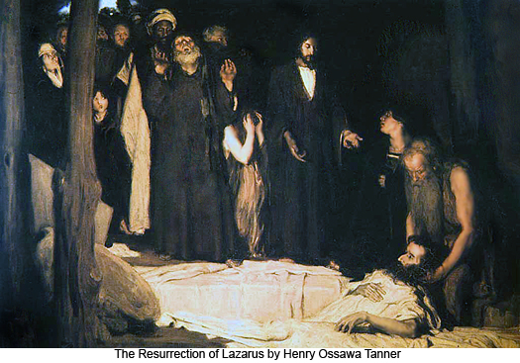
LAZARUS

Slide 12
Lazarus and his two sisters were friends of Jesus. When Lazarus fell ill, his sisters sent a message to Jesus to let him know. When Jesus received the news he did not hurry to go to Bethany, Lazarus’ home, lingering after two days. When he arrived Lazarus had been dead and in a tomb for four days. His sister Mary exclaimed to Jesus that if he had been there Lazarus would not have died.
Jesus calms her and her sister and goes to his tomb. There, he resurrects Lazarus. As a result, many people put their faith in Jesus.

Slide 13
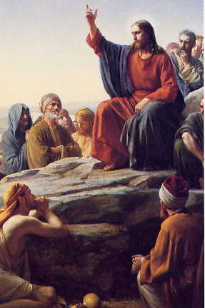
The Story of the Prodigal Son
Is a parable or story with a message told by Jesus of two sons.
The younger of the two demanded for his share of the inheritance while his father was still alive.
The younger son goes off to a distant country, wasting his substance with riotous living, and eventually has to work as a swine herder

Slide 14
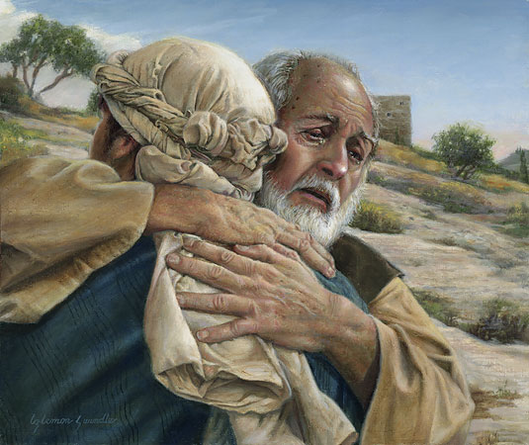
The Story of the Prodigal Son cont’d
The younger son finally comes to his senses and plans to return home and throw himself at his father’s mercy, but the father accepts him home with open arms and doesn’t even give time for his son to express his repentance.
The father slaughtered a fat cow to celebrate his return.
The older son became jealous at the favored treatment of his faithless brother and upset at the lack or reward for his own faithfulness but the father explains all that he has will be the older son’s.

Slide 15
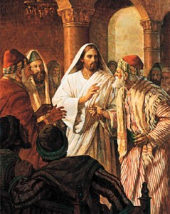
Jesus and the Pharisees
The Pharisees were a socio-religious-political group made up of blue collar people noted for their strict adherence to the Jewish laws and traditions
To them, Jesus was a blasphemer and law-breaker; a radical in their midst and a threat to their ideas. They often questioned Jesus through-out His ministry trying to catch Him in His answers in order to hand Him over to the Roman Governor.
Throughout His ministry, Jesus was openly opposed to the Pharisees. He denounced them publicly for their hypocrisy, spiritual blindness, and evil ways.

Slide 16
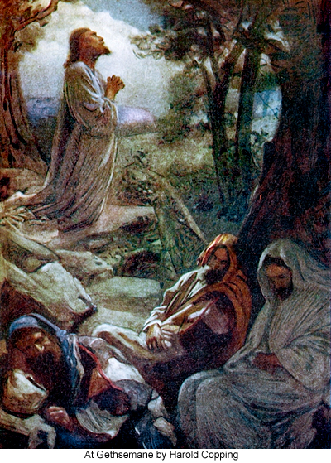
The Garden of Gethsemane
This is the garden where Jesus prayed after the Last Supper. In his prayer he experienced a great agony, taking on the sins of every man (known as the Atonement).
While Jesus prayed Judas brought in soldiers to arrest Jesus.

Slide 17
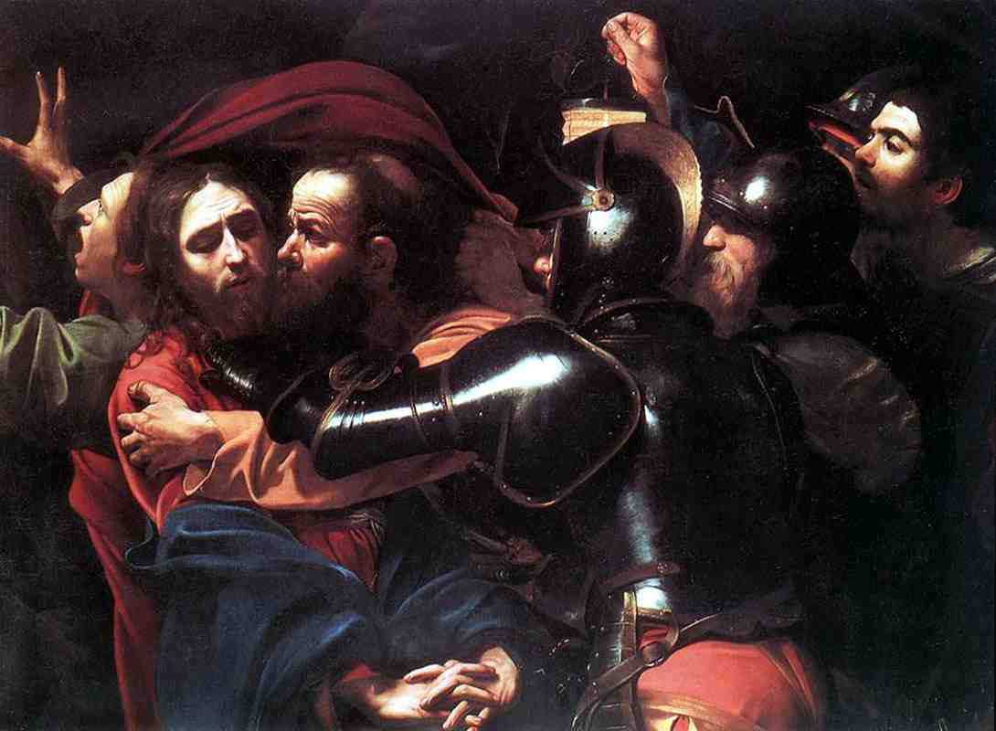
Judas Iscariot
The Betrayer
An original apostle
Led the soldiers to the garden of Gethsemane
Identified Jesus to the soldiers by kissing Jesus’ cheek.
Earned 30 pieces of silver for his betrayal
Realizing what he’d done, he left the silver in the temple and hanged himself.
The priests of the temple, bought land to use as a cemetery for the poor and indigent.

Slide 18
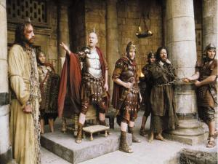
Jesus’ Death Sentence
Jesus had been brought to the Roman Governor Pontius Pilate by the Jewish Sanhedrin (the Jewish religious court)who did not have the power to legally judge Jesus.
Pilate famously claims he found Jesus was without fault, and asked who should be released before the Jewish Passover holiday Jesus or Barabbas, a well-known thief.
The crowd chooses
Jesus, freeing Barabbas.
Pilate washes his hands
of the matter.
The soldiers take Jesus
away and dress him in
red with a crown of
thorns; he was mocked by the crowds
as “King of the Jews.”
He was forced to carry
his own crucifix to the
hill at Calvary.

Slide 19
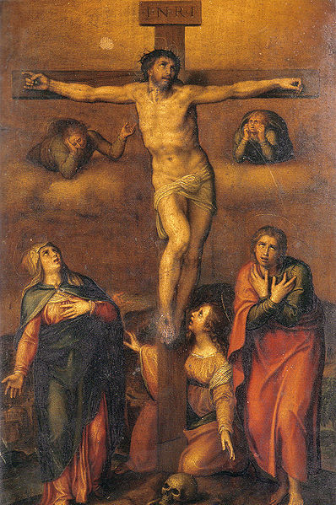
The Crucifixion of Jesus
Jesus was stripped, nailed at palms, wrists, and feet and hung on a cross between two thieves.
Supernatural events such as an eclipse and earthquakes occurred after Jesus was hung.
His death was hastened by a sword plunged into his side
His mother witnessed his death
Because his death occurred on the eve of Sabbath, he was hurriedly buried in a tomb given to his family by Joseph of Arimathea

Slide 20
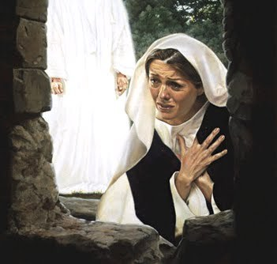
An Empty Tomb and a Visit
Mary Magdelen and other
women went to the tomb on
Sunday morning (in Jewish
tradition, it’s the first time
after the Sabbath has
concluded.
It’s assumed the women
either wished to complete
burial rights that had been
quickly done before the
Sabbath started or they
were mourning.
When they get to the tomb,
the stone blocking the
opening had been removed.
The body of Jesus is gone.
Angels tell them that Jesus
had been resurrected
Jesus appears to others
showing the nail marks in his
hands and feet.

Slide 21
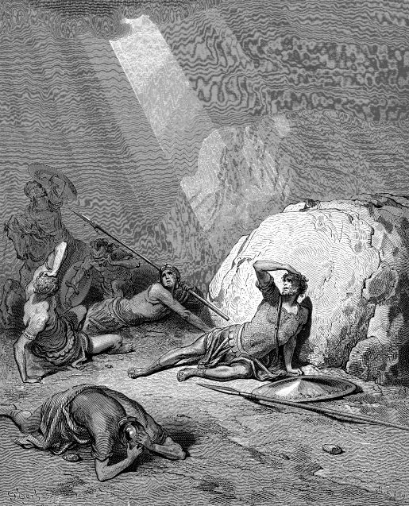
The Conversion of Saul
Saulwas given instruction from the high priest ordering him to persecute Christians and he was know to be good at persecuting.
While he was traveling to Damascus with companions, he saw a light, fell to the ground, and was blinded by God for what he had done.

Slide 22
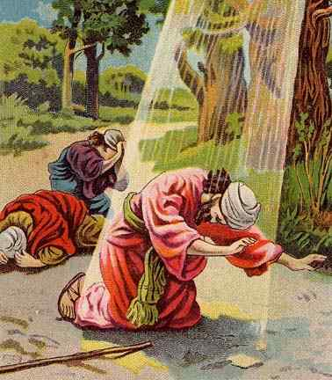
The Conversion of Saul contd.
After meeting a prophesied priest and being healed, he changed his name to Paul and began preaching God’s word.
From this conversion, we get the metaphorical reference, "Road to Damascus" that has come to refer to a sudden conversion of thought or a change of heart.

Slide 23
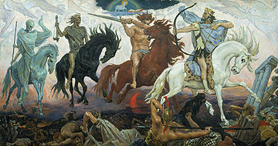
Four Horsemen of the Apocalypse
Name | Horse | Rider’s weapon | Power
Conquest | White | Crown & bow | To go forth in conquest; to kill with the beasts of the earth.
War or Mass Destruction | Red | Sword | To take peace from the earth, and let men kill one another with the sword
Famine | Black | Balance | To bring famine To kill with hunger.
Death | Pale /Green | Scythe | To kill with death and disease
Notes:
Part of the Book of Revelations (the last book in the New Testament), these four riders bring destruction to the world as part of the final days before the Messiah returns to the earth.

Slide 24
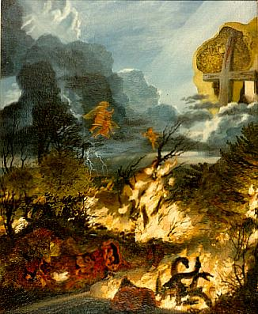
Armageddon
In the last book of the New Testament called The Book of Revelations, Armegeddon is the site of an epic battle where Jesus, the Messiah, defeats the Anti-Christ, Satan.
After this defeat, Satan will be put into the bottomless pit or abyss for 1,000 years, known as the Millennial age.

Slide 25
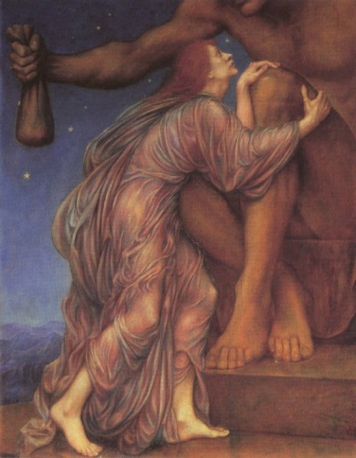
Mammon
Mammon is a Hebrew word describing
material wealth or greed
Personified in the Bible:
“No one can serve two masters, for either he will hate the one and love the other; or else he will be devoted to one and despise the other. You can not serve both God and Mammon.”

Slide 26
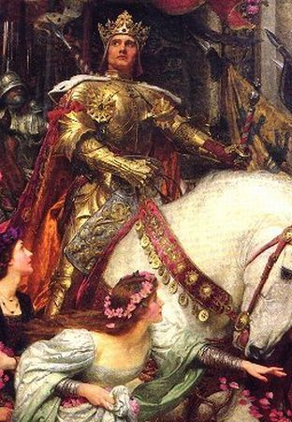
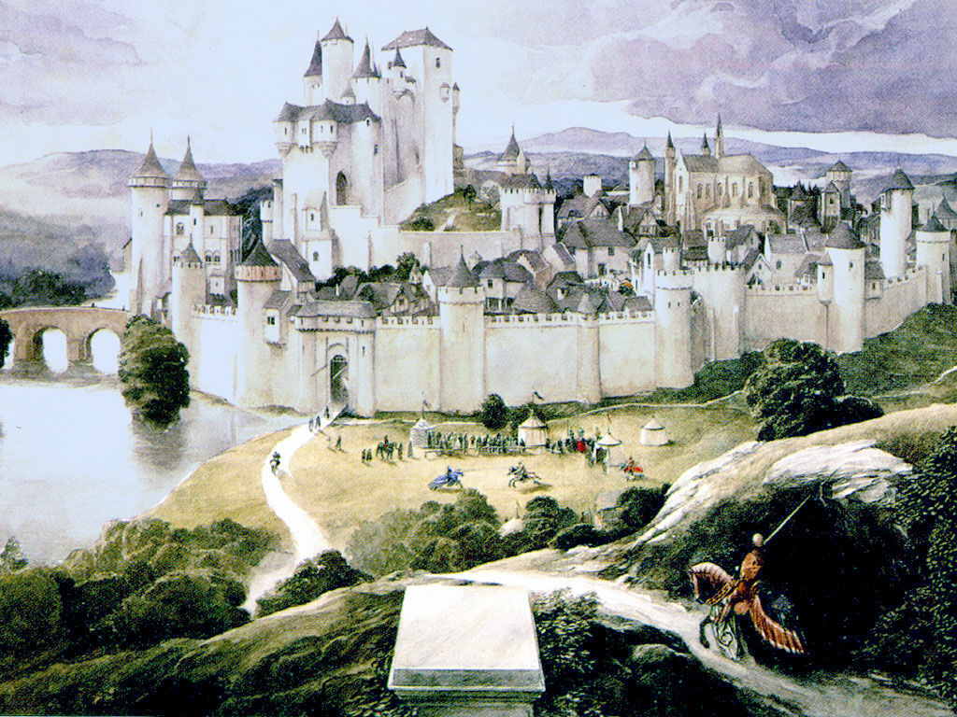
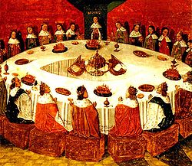
King Arthur & Camelot
Camelot was the famous court of King Arthur in
ancient England
The knights of his court uphold noble virtues of
justice, truth and bravery
The knights sat at a round table in order that all
would be considered equal

Slide 27
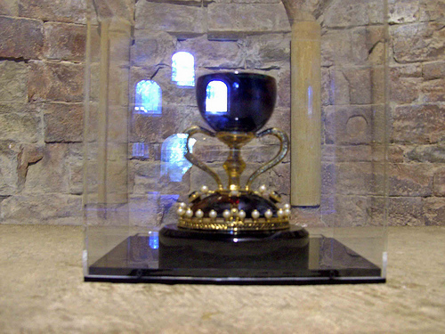
Holy Grail
The Grail was said to be the cup used by Jesus at the Last Supper.
It was also used at the Crucifixion, the one that received the blood which flowed from the spear thrust in Christ's side.
Numerous legends of the quest for the Holy Grail, which would bring healing and eternal life, have been recounted in various ancient times.

Slide 28
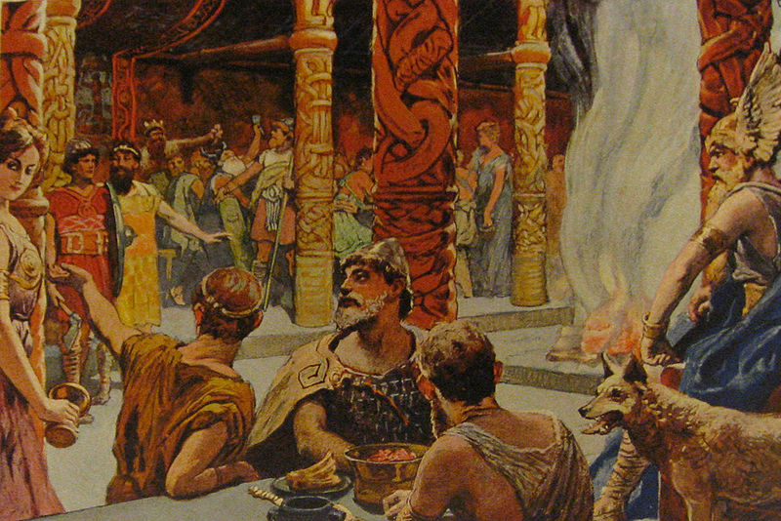
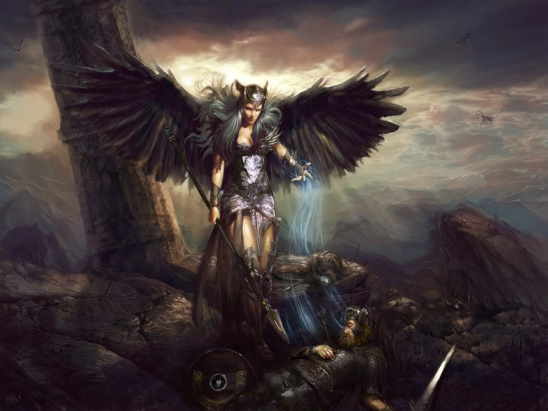
Valhalla
The ancient Norse “hall of the dead” for those who died in combat.
Those who died were led there by the valkyries, women who decided who lived or died in battle.
A valkyrie chosing after a battle

