Slide 1
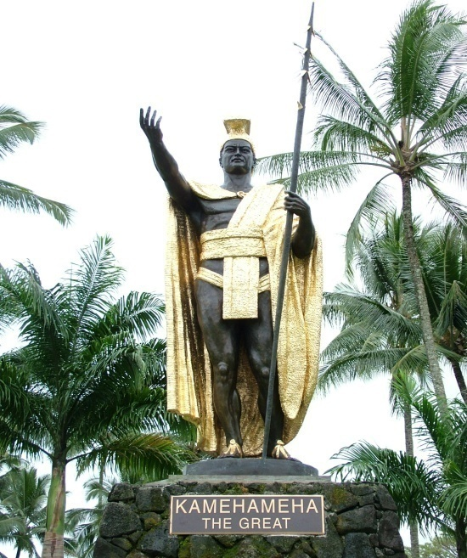
The Life of Kamehameha the Great
Oh what a life!

Slide 2
Birth
Parents:
Mother: Keku`iapoiwa II
Father: Kahekili chief of Maui or Keoua Kalani (debate on who was his biological father)
Where: Kohala on the northern tip of the Big Island
When: Around 1753 during the reign of Alapa`inui, Ali`i Nui (High chief )

Slide 3
Prophecy of Kamehameha’s Birth
A child born on the night of a comet would kill Alapa`inui
Kamehameha born on the night of a comet (Haley’s comet)
Alapa`inui orders Kamehameha to be killed
Nae`ole hides Kamehameha
Kamehameha raised in secrecy in Kohala

Slide 4
K’s Childhood
Trained by Kekuhaupi`o as a high ranking warrior
Raised in the Court of the High Chief of the Big Island (Alapa`inui)
Gained reputation as an excellent warrior

Slide 5
Legend of the Naha stone
This 2 1/2-ton stone was used as a test of royal strength: Ancient legend said that whoever could move the stone would conquer and unite the islands. As a 14-year-old boy, King Kamehameha the Great is said to have moved the stone --

Slide 6
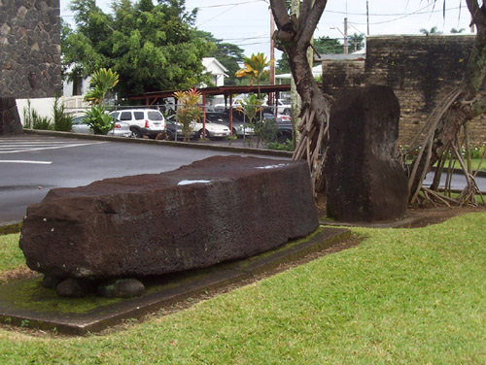
The Naha Stone…

Slide 7
Personal Life
Married Multiple women (part of the culture)
1. Keopuolani
2. Kaahumanu (his favorite wife)
Notable Children
1. Liholiho (Kamehameha II)
2. Kauikeaouli (Kamehameha III)

Slide 8
Notable Achievements
1. Uniting the Hawaiian Islands
Many feel this brought peace among the islands because of fighting chiefs

Slide 9

Notable Achievements
2. Relationships with Foreigners
Wanted to learn about other arts and skills from the foreigners
John Young and Isaac Davis gave Kamehameha weapons and taught him military tactics

Slide 10

Notable Achievements
3. Trade in the form of bartering (no money involved)
Foreigners brought porcelain, furs, weapons, cloth, silk cloth, iron tools
Hawaiians gave them pigs, water, salt, and
SANDALWOOD

Slide 11
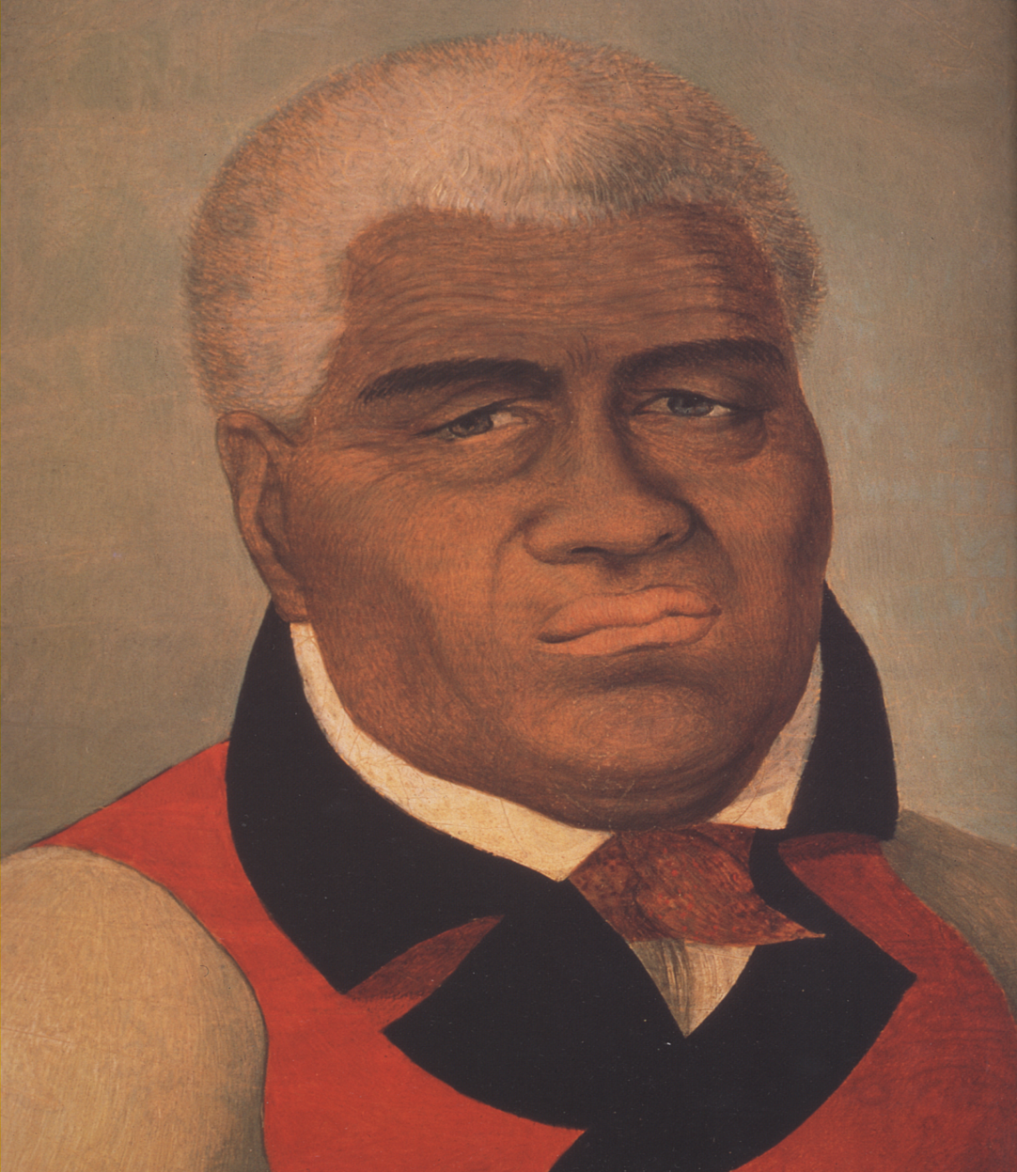
Kamehameha in his older days

Slide 12

Death
Kailua, Kona May 8, 1819
Was King from 1795-1819
His burial ground remains a secret to this day

