Slide 1
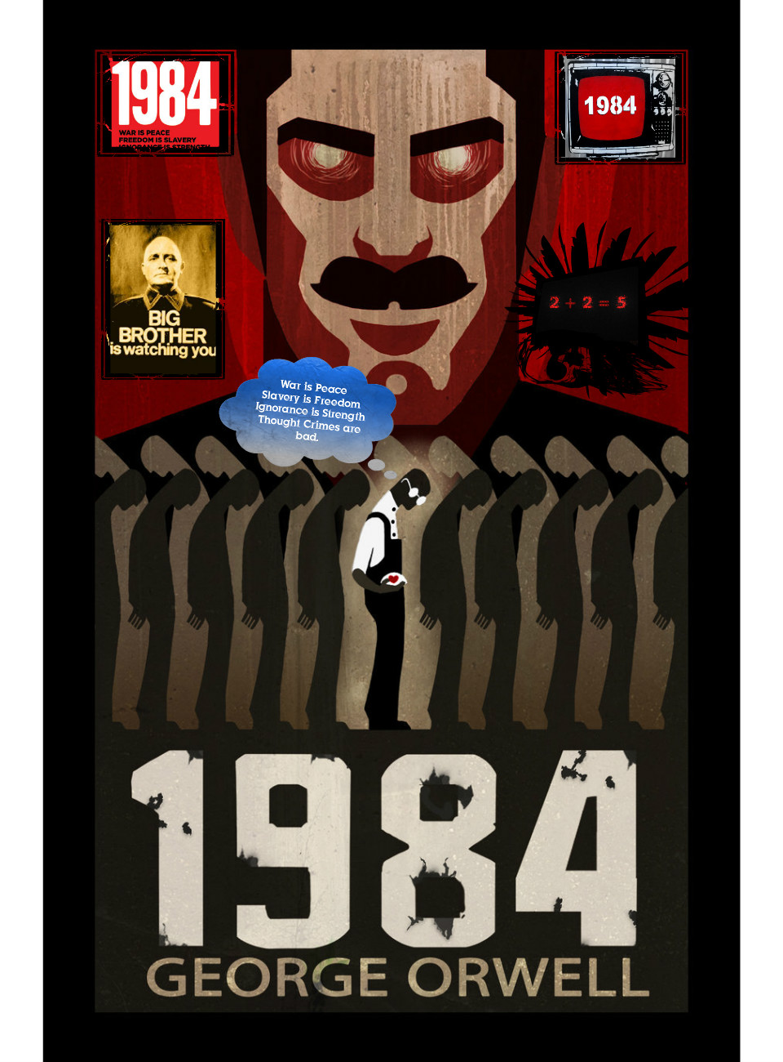
1984 Final Project
Choose one to conclude your 1984 reading.

Slide 2
NEWSPAPER
Create a newspaper with three or four sections (each section should have 2-3 articles, pictures, etc.) written from the Party’s point of view. Concentrate on propaganda techniques.

Slide 3
POSTER
2) Put together a poster full of photographs of current images that capture the tone of 1984. Include a written description of why you chose each image.

Slide 4
VIDEO
3) Make a five minute video depicting any scene from the book. (Please avoid one of the sex scenes).

Slide 5
RESOLUTION
4) Write a new ending for the book. Either take out the last chapter and replace it with your own OR you can write a chapter that follows the current last chapter of the book.

Slide 6
OUR GRADE?
This assignment is out of 100 points, based on:
  Originality,
  Creativity
  Effort,
  How thought-provoking your project is.
  *You will present your project in a gallery walk.

