Slide 1
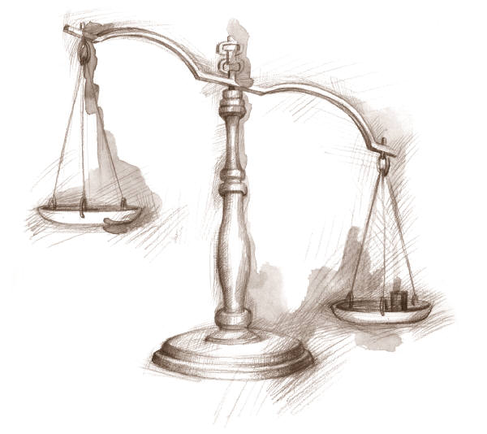
Introduction to
The Bill of Rights
The First 10 Amendments
Notes:
1

Slide 2
Why do our rights matter?
Answer the question on your worksheet

Slide 3
Objective:
Students will be able to discuss the meaning and importance of each of the rights guaranteed under the Bill of Rights and how each is secured by correctly describing each amendment and the limitations for each amendment.

Slide 4
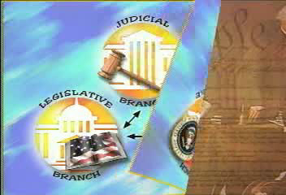
Film Clip: Bill of Rights

Slide 5

Who Determines What the Bill of Rights Mean?
The Supreme Court makes rulings on the meaning
The Supreme Court balances the rights of the individual with the needs of society
Individuals?
Society?

Slide 6
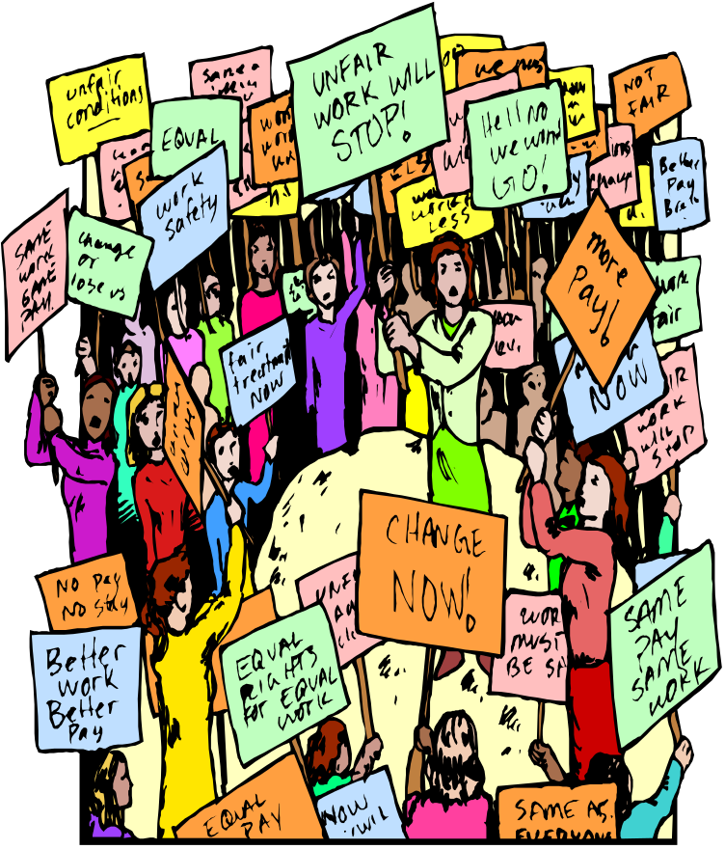
What are the 5 rights mentioned in the First Amendment?
Freedom of Speech
Freedom of Religion
Freedom of the Press
Freedom of Assembly
Right to petition the government

Slide 7
Freedom of Religion
“Congress shall make no law respecting an establishment of religion or prohibiting the free exercise there of”
Two clauses:
  Establishment clause
  Free Exercise clause
    What is the difference?

Slide 8
Establishment and Free Exercise clause often conflict with each other
In schools, the religion issue is most prevalent.
If a student raises his hand and says “teacher, can we say an opening prayer before this test?”
If the teacher says “Yes”,
S/he is violating the establishment clause.
“No”
S/he is not in violation

Slide 9
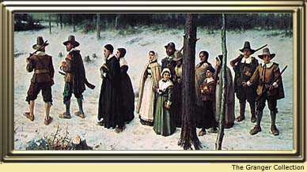
Establishment Clause
Government cannot promote religion

Slide 10

Under the Establishment Clause the Government;
Can Cannot
Teach about religions in school
Allow voluntary prayer in many examples
Transport students to a religious school
Read Bible for culture or literacy content
Set a state religion
Government cannot order a prayer
Teach religious doctrine in the school
Pay seminary teachers
Teach creationism

Slide 11
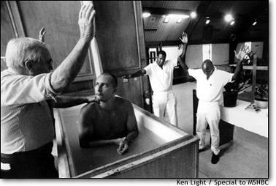
Free exercise of religion

Slide 12
Under the Free Exercise clause, the person Can Cannot
Choose whatever religion you want
Pray to any god you want
Ask questions about religions
Worship any way you want
Break the law and claim it is religious belief
Raise children without education
Deprive children of basic needs

Slide 13
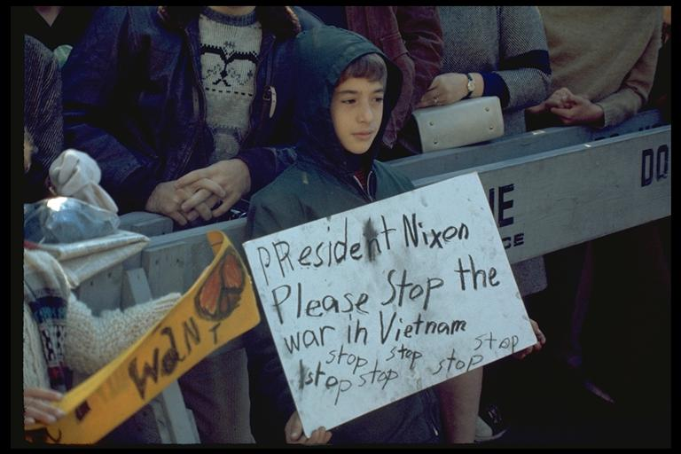
Freedom of Speech
“Congress shall make no laws . . . abridging the freedom of speech”

Slide 14
You can:
Say any political belief
Protest (without getting out of control)
Say things about someone that are true
Burn the flag
Say racist and hate slogans
Free speech means someone might say something you disagree with

Slide 15
You can’t:
Threaten to blow up airplanes, schools or the president
Sexual harassment
Create too much social chaos
Extremely crude language in a public place
Disrespectful, vulgar language in schools
Hate crimes

Slide 16

Freedom of the press
Congress shall make no law . . . abridging . . . the freedom of the press.”

Slide 17
Freedom of the Press
Can Cannot
Print any political position
Make fun of people, especially politicians
Expose wrongs by the government
Say things you might not agree with
intentionally injure a person’s reputation by false facts
  Libel–printed words
  Slander - spoken
Disclose defense-security secrets
Detail how to make a certain weapons

Slide 18
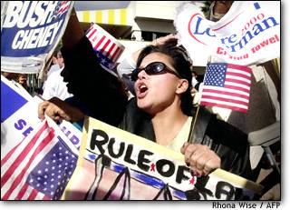
Freedom of Assembly
Congress shall make no law . . . Abridging . . . The people to peaceably assemble”

Slide 19
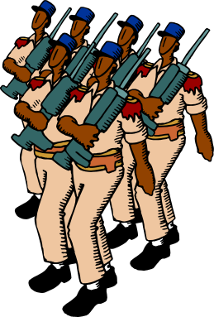
Freedom of Assembly-
The Individual
Can Cannot
Protest by throwing rocks and breaking windows
Hang out on private land against owners will—loitering
Teen curfew
Protest
Parade (with a permit)
Parade chanting hate slogans
Gang members can congregate in public

Slide 20

Petition the Government
“Congress shall make no law . . . Abridging . . . the people. . . to petition the government for a redress of grievances”

Slide 21
What is a petition?
Petitions are signed documents that ask or demand the government to do something.

Slide 22
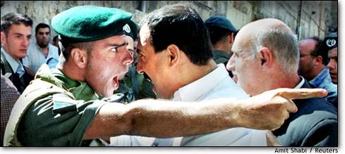
Petition the government
You may sue the government for wrongs
You cannot be punished for exposing wrongs by the government
The courts decide the wrongs

Slide 23
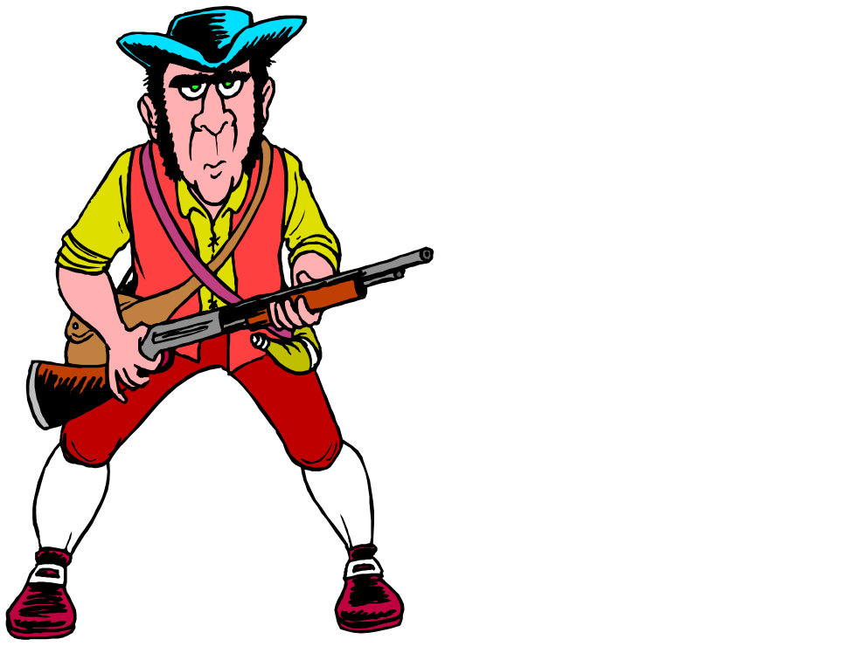
2nd Amendment—Right to bear arms
“A well-regulated militia, being necessary to the security of a free state, the right of the people to bear arms shall not be infringed.”

Slide 24

What is the debate with the right to bear arms?
How much can the government keep guns from criminals and youth?
In order to keep guns away from criminals, does that limit the right of law abiding citizens?

Slide 25
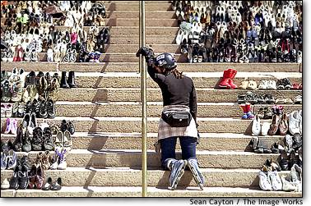
Gun debate continued…
Thousands of people die every year because of guns
Thousands of crimes are prevented because of guns
Shoes representing gun deaths.

Slide 26
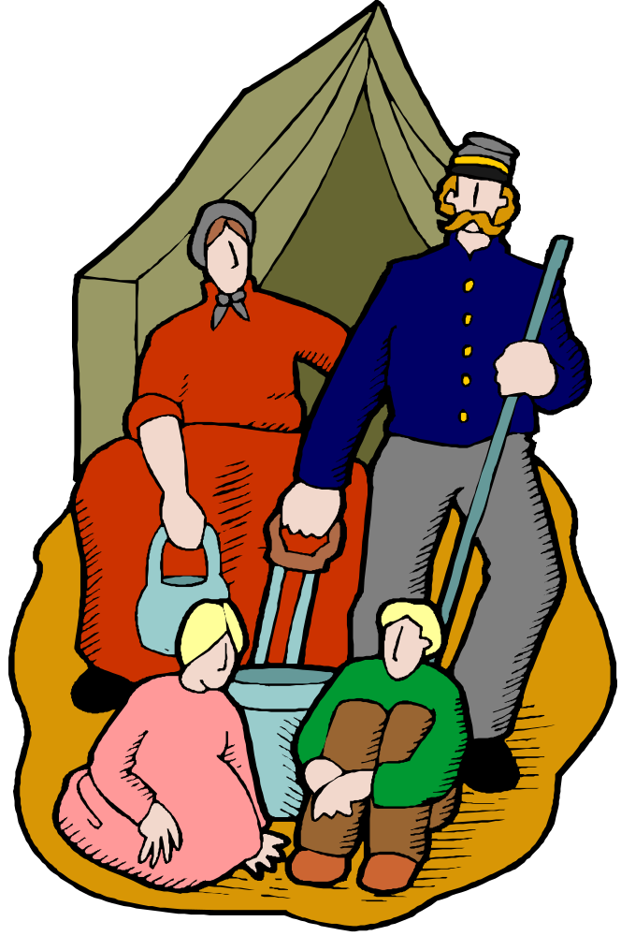
Third Amendment
The Government cannot force you to shelter soldiers in your home without your consent in time of war or peace.

Slide 27
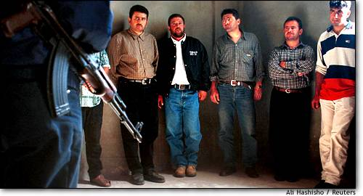
Rights of the Accused
Amendments #4-8

Slide 28

Fourth Amendment
What does a policeman need in order to search your home?
  A warrant given to him by a judge
  Probable cause is also needed

Slide 29
Fifth Amendment
You cannot be tried for the same crime twice—called “Double Jeopardy”
You do not have to testify against your self. “I plead the fifth”
You must have due process of law before you are convicted
The government cannot take your land unless it pays.

Slide 30
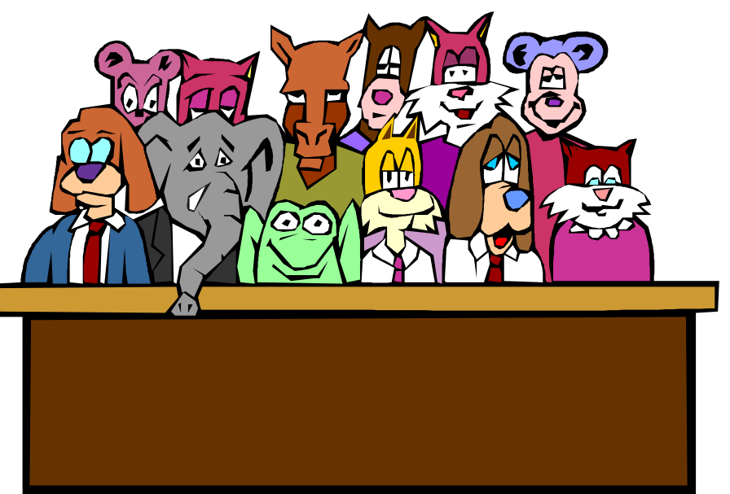
Sixth Amendment
Right to speedy trial by impartial jury—meaning not favoring either side

Slide 31
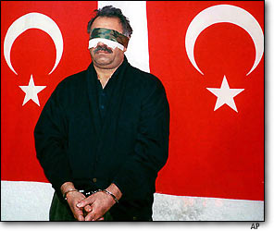
Sixth Amendment continued
You must be told of charges
You must be provided a free lawyer if you cannot afford one

Slide 32
Seventh Amendment
The Seventh Amendment extends the right to a jury trial to federal civil cases such as car accidents, disputes between corporations for breach of contract, or most discrimination or employment disputes.
In civil cases, the person bringing the lawsuit (the plaintiff) seeks money damages or a court order preventing the person being sued (the defendant) from engaging in certain conduct.
To win, the plaintiff must prove his or her case by “a preponderance of the evidence,” that is by over fifty percent of the proof.

Slide 33
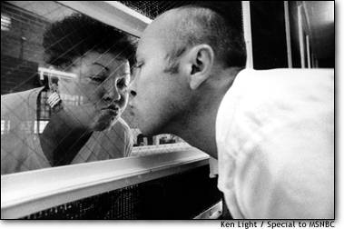
Eighth Amendment
No excessive bail
No cruel and unusual punishment

Slide 34
9th Amendment
Rights not listed in other amendments are not necessarily denied.

Slide 35
10th Amendment
Powers not delegated to the National government or denied to the states are reserved to the states.

Slide 36
Wrap-Up
If you were to create a Bill of Rights for the 21st century, what rights would be included?

