Slide 1
Materialism
What do you think materialism means?
Think of all your families possessions- could they all be displayed on the sidewalk outside the house or apartment? Explain

Slide 2

http://www.mtv.com/videos/mtv-cribs-season-15-ep-7-50-cent-special/1574770/playlist.jhtml

Slide 3
A Material World
Examining photos by Peter Menzel

Slide 4
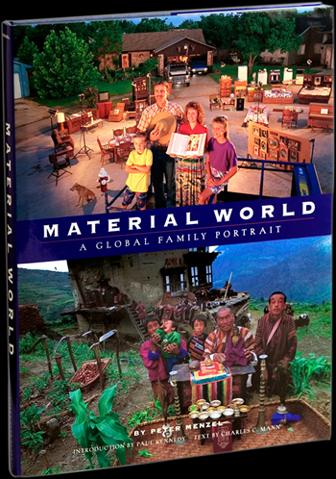
Material World
In the early 1990s, after hearing a story about "Material Girl" Madonna's latest self-promotional enterprise, photojournalist Peter Menzel had a vision: Rather than take viewers into the mansions of the rich or the "cribs" of MTV celebrities, he wanted to capture the material life of average families around the globe.
His resulting book, Material World, offers extraordinary images of families in front of their dwellings with all (or nearly all) of their possessions. Experts at the United Nations and World Bank helped determine the criteria for average families according to location (urban, rural, suburban, small town, or village), type of dwelling, family size, annual income, occupation, and religion. Here, we present five of the photographs Menzel and his team produced, along with updated statistical data for each country.—Susan K. Lewis

Slide 5
China: The Wu Family
The nine members of this extended family—father Wu Ba Jiu (59), mother Guo Yu Xian (57), their sons, daughters-in-law, and three grandchildren—live in a three-bedroom, 600-square-foot dwelling in rural Yunnan Province.
While they have no telephone, they get news and images of a wider world through two radios and the family's most prized possession, a television.
In the future, they hope to get one with a 30-inch screen as well as a VCR, a refrigerator, and drugs to combat diseases in the carp they raise in their ponds.
Not included in the photo are their 100 mandarin trees, vegetable patch, and three pigs.

Slide 6


Slide 7
China Stats
Population: 1.3 billion
Population density: 627 people per sq. km.
Total fertility rate: 1.7 children per woman
Population doubling time: 67 years
Percentage urban/rural: 37% urban, 63% rural
Per capita energy use: 905 kg. oil equivalent
Infant mortality: 32 deaths per 1,000 births
Life expectancy: 69 (male), 73 (female)
Adult illiteracy: 7.9% (male), 22.1% (female)
Internet users: 46 million

Slide 8
India: The Yadev Family
At age 25, Mashre Yadev is already mother to four children, the oldest of whom was born when she was 17.
Each morning at their home in rural Uttar Pradesh, she draws water from a well so that her older children can wash before school. She cooks over a wood fire in a windowless, six-by-nine-foot kitchen, and such labor-intensive domestic work keeps her busy from dawn to dusk.
Her husband Bachau, 32, works roughly 56 hours a week, when he can find work. In rough times, family members have gone more than two weeks with little food.
Everything they own—including two beds, three bags of rice, a broken bicycle, and their most cherished belonging, a print of Hindu gods—appears in this photograph.

Slide 9
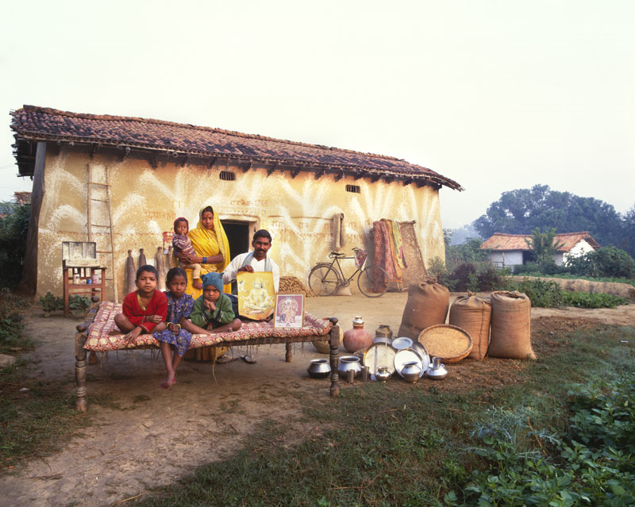

Slide 10
India Stats
Population: 1.0 billion
Population density: 318 people per sq. km.
Total fertility rate: 3.0 children per woman
Population doubling time: 36 years
Percentage urban/rural: 28% urban, 72% rural
Per capita energy use: 494 kg. oil equivalent
Infant mortality: 66 deaths per 1,000 births
Life expectancy: 62 (male), 64 (female)
Adult illiteracy: 32% (male), 55% (female)
Internet users: 7 million

Slide 11
Japan: The Ukita Family
Like many Japanese women, 43-year-old Sayo Ukita had children relatively late in life. Her youngest daughter is now in kindergarten, not yet burdened by the pressures of exams and Saturday "cram school" that face her nine-year-old sister.
Sayo is supremely well-organized, which helps her manage the busy schedules of her children and maintain order in their 1,421-square-foot Tokyo home stuffed with clothes, appliances, and an abundance of toys for both her daughters and dog.
She and her husband Kazuo, 45, have all the electronic and gas-powered conveniences of modern life, but their most cherished possessions are a ring and heirloom pottery.
The family's wish for the future: a larger house with more storage space.

Slide 12
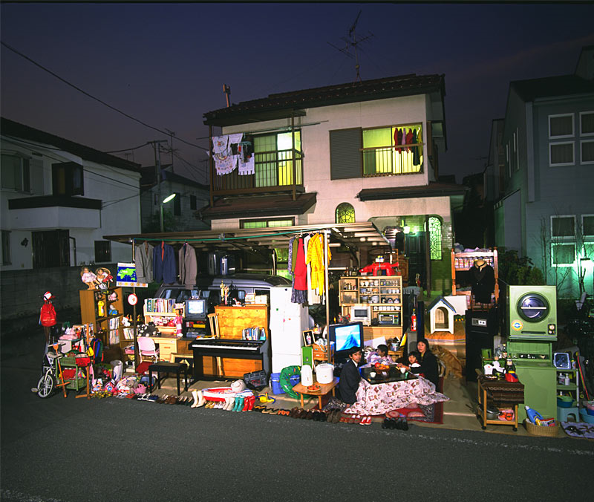

Slide 13
Japan Stats
Population: 128 million
Population density: 336 people per sq. km.
Total fertility rate: 1.3 children per woman
Population doubling time: 289 years
Percentage urban/rural: 79% urban, 21% rural
Per capita energy use: 4,316 kg. oil equivalent
Infant mortality: 3 deaths per 1,000 births
Life expectancy: 78 (male), 85 (female)
Adult illiteracy: 1% (male), 1% (female)
Internet users: 56 million

Slide 14
Mali: The Natomo Family
It is not unusual in this West African country for men to have two wives, as 39-year-old Soumana Natomo does. More wives mean more progeny—and a greater chance you will be supported in old age.
Soumana now has eight children, and his wives, Pama Kondo (28) and Fatouma Niangani Toure (26), will likely have more. How many of these children will survive, though, is uncertain: Mali's infant mortality rate ranks among the ten highest in the world.
Some of the family's possessions are not included in this photo—another mortar and pestle for pounding grain, two wooden mattress platforms, 30 mango trees, and old radio batteries that the children use as toys.
(Note: The Natomos appear on the adobe roof of their house in Kouakourou. An infant son is nestled in his mother's arms. One daughter is absent.)

Slide 15
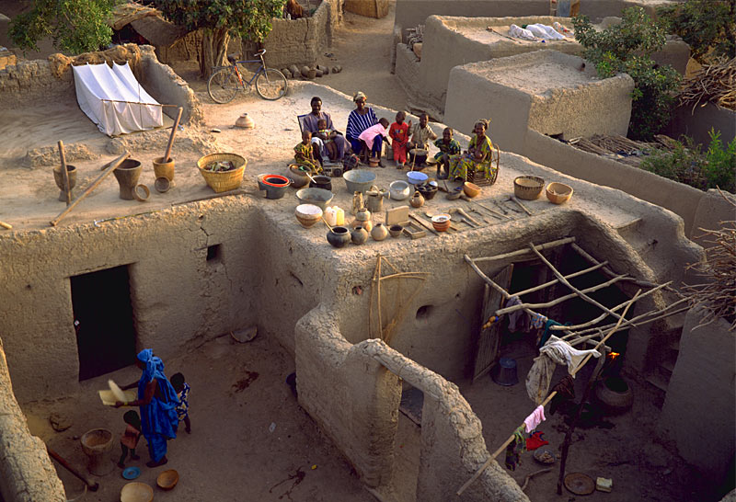

Slide 16
Mali Stats
Population: 12 million
Population density: 9.1 people per sq. km.
Total fertility rate: 7.0 children per woman
Population doubling time: 23 years
Percentage urban/rural: 26% urban, 64% rural
Per capita energy use: 22 kg. oil equivalent
Infant mortality: 118.7 deaths per 1,000 births
Life expectancy: 48 (male), 49 (female)
Adult illiteracy: 64% (male), 84% (female)
Internet users: 30,000

Slide 17
United States: The Skeen Family
Rick and Pattie Skeen's 1,600-square-foot house lies on a cul-de-sac in Pearland, Texas, a suburb of Houston.
The fire hydrant in this photo is real, but not working—a souvenir from Rick's days as a firefighter. Rick, 36, now splices cables for a phone company. Pattie, 34, teaches school at a Christian academy.
To get the picture, photographers hoisted the family up in a cherry picker. Yet the image still leaves out a refrigerator-freezer, camcorder, woodworking tools, computer, glass butterfly collection, trampoline, fishing equipment, and the rifles Rick uses for deer hunting, among other things.
Though rich with possessions, nothing is as important to the Skeens as their Bible. For this devoutly Baptist family, like many families around the world, it is a spiritual—rather than material—life that matters most.

Slide 18
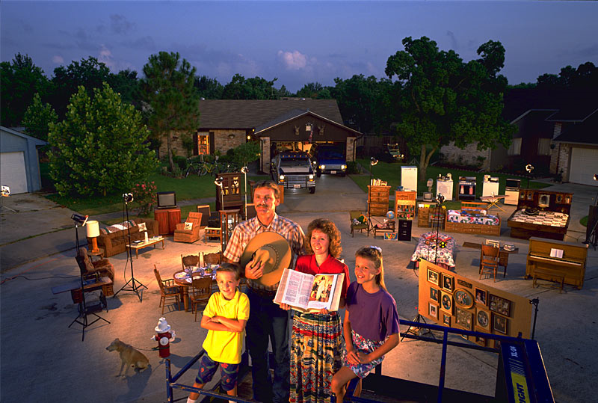

Slide 19
U.S. Stats
Population: 292 million
Population density: 29 people per sq. km.
Total fertility rate: 2.0 children per woman
Population doubling time: 116 years
Percentage urban/rural: 78% urban, 22% rural
Per capita energy use: 8,148 kg. oil equivalent
Infant mortality: 6.7 deaths per 1,000 births
Life expectancy: 74 (male), 80 (female)
Adult illiteracy: 3% (male), 3% (female)
Internet users: 165 million

Slide 20
Sources
Material World: A Global Family Portrait by Peter Menzel. San Francisco: Sierra Club Books, 1994
http://www.pbs.org/wgbh/nova/worldbalance/mate-sources.html
Sources of Country Statistics
Population Reference Bureau's 2003 World Population Data Sheet
United Nations Population Division's World Population Prospects: The 2002 Revision and World Urbanization Prospects: The 2001 Revision
The Central Intelligence Agency's World Factbook 2003, an online atlas containing current political, demographic, and cultural information
The Population and Development Database, an online resource produced in 1998 by Population Concern

