Slide 1
The Confederation & the Constitution , 1781-1790
APUSH Chapter 9
Topic 5: The Early Republic 1789-1815

Slide 2
Constitutional Convention
& The “ Real Revolution”
The war is over… now what?
Early Republican Period 1789-1812

Slide 3
“The Real Revolution…”
…was the radical change in the principles , opinions, sentiments, and affections of the people.”
– John Adams

Slide 4

Defining “Democracy”
Greek word meaning:
“demos” = people
“kratos” = power
The rule/power of the people

Slide 5

“Direct Democracy”
A form of democracy in which citizens rule and make laws directly, rather than through representatives.

Slide 6

“Representative Democracy”
A government in which leaders make decisions by winning a competitive struggle for the popular vote

Slide 7


What is a “Republic”??
A government in which power rests with citizens who have the right to elect the leaders who make governmental decisions

Slide 8
Republicanism & Civic Duty
1. “civic virtue” – democracy depends on the unselfish commitment of each citizen to public good
2. “Republican Motherhood” – women’s responsibility to rear socially responsible citizens

Slide 9
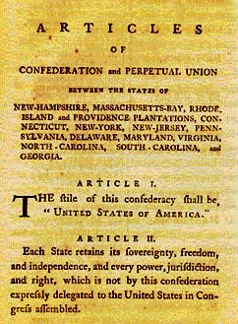
Articles of Confederation (1781)
1st attempt at constitution
Created a “league of friendship” rather than a strong “nation”

Slide 10
The Articles of Confederation…
Reserved the right of each STATE (not National Government)
“sovereignty, freedom, and independence”

Slide 11
Weaknesses of the Articles of Confederation
1. Congress could not regulate commerce
2. Congress could not levy taxes
3. Each state retained sovereignty & independence
4. no national judiciary system
5. all 13 colonies had to agree when voting

Slide 12
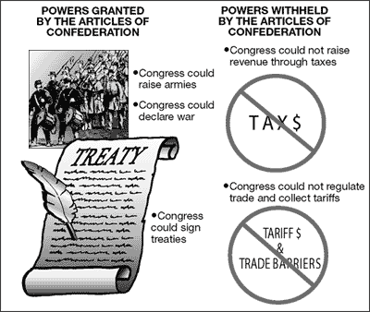
Congress could ONLY…
1. raise armies
2. declare war
3. sign treaties

Slide 13

Shay’s Rebellion, January 1787
ex-revolutionary soldiers
Led by: Daniel Shays
Protested debt, high taxes
Feared losing properties to tax collectors

Slide 14
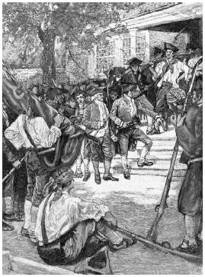
Shays led…
1,000 farmers and working class men marched
Towards Boston
Governor of Massachusetts asked continental congress to send troops

Slide 15

Response of Continental Congress:
Troops???What troops???
No national army!!!

Slide 16

Shay’s Troops eventually …
Disintegrated
Some captured & punished
Shays eventually pardoned
died in poverty 1788

Slide 17
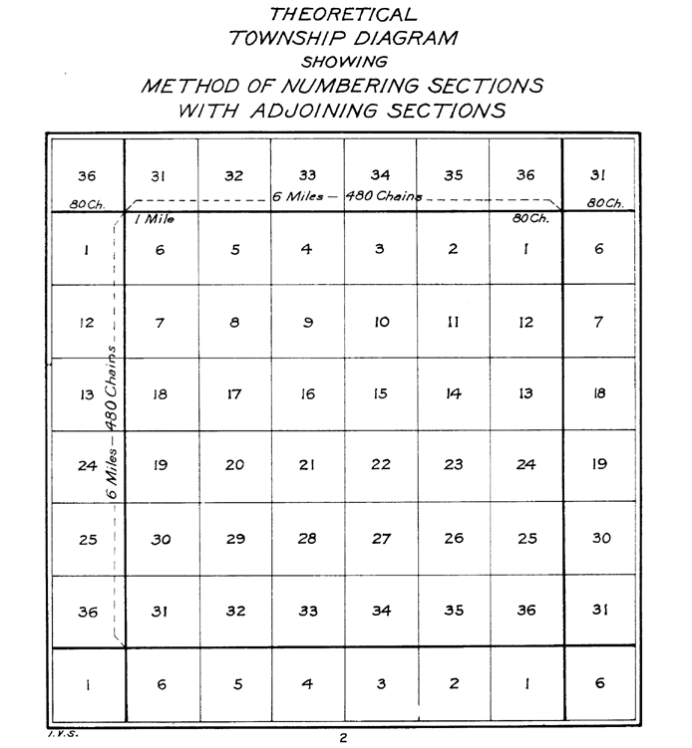
Land Ordinance 1785
Meant to establish “townships” six miles square as basic unit of settlement.
“Land division”

Slide 18
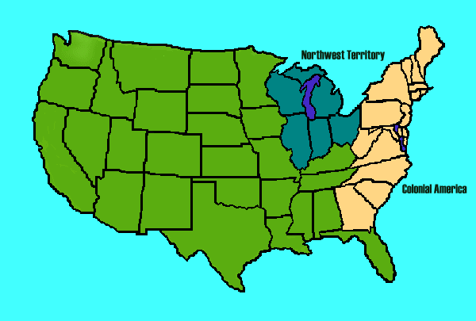
Northwest Ordinance 1787
Steps for Statehood:
1. Congress appoints territorial Governor
2. 5,000 males can approve temporary constitution
3. Total Population of 60,000 can apply for statehood

Slide 19
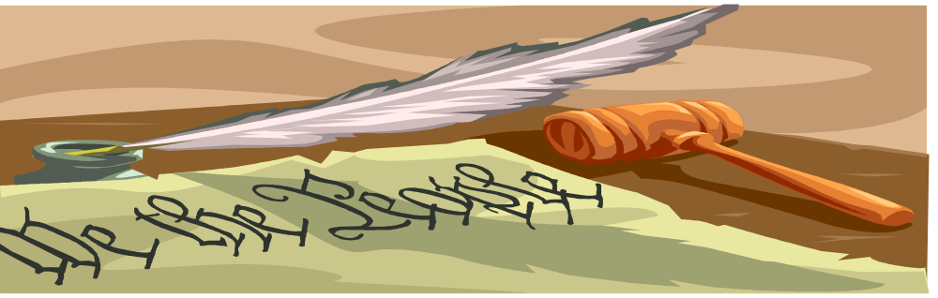
The Creation of the U.S. Constitution
Chap 9

Slide 20
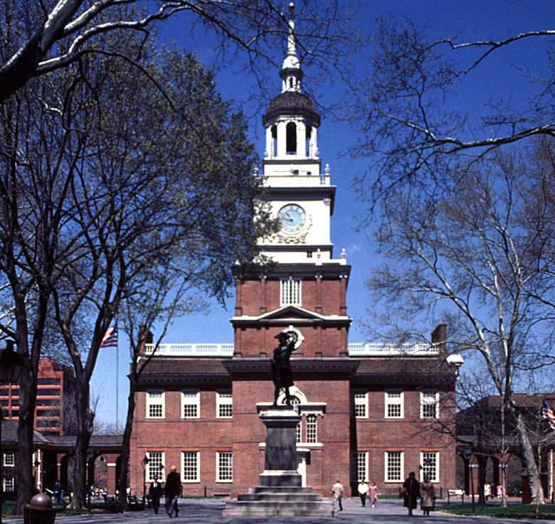
Constitutional Convention
Convened May, 1787
Every state except Rhode Island sent delegates
Independence Hall in Philadelphia

Slide 21
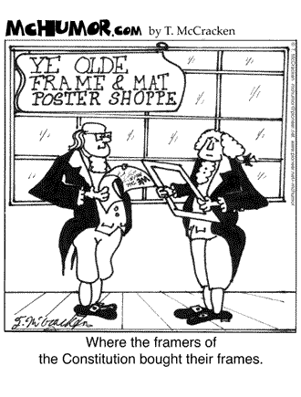

Who are the “Framers”?
The Framers of the constitution are the delegates who wrote it.

Slide 22

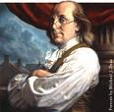
Meet the Delegates…
55 delegates in all
Average age: 42
Oldest : Benjamin Franklin , 81
Youngest : Jonathan Dayton, 27
Favored A “representative democracy”

Slide 23
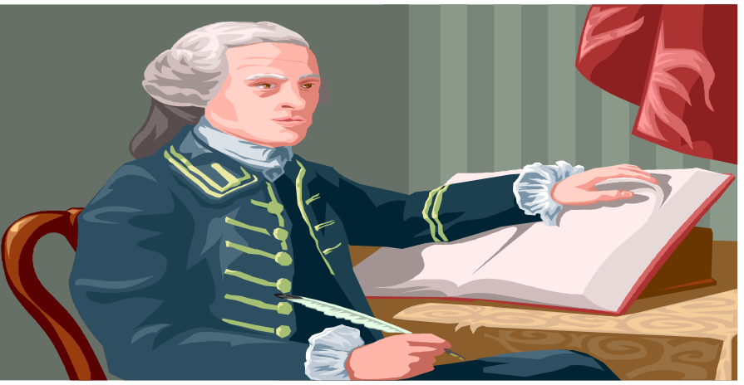
Meet the Delegates…
31 / 55 college educated
19 / 55 slave owners
31 / 55 Lawyers
Only 30 out 55 participate regularly
None represented the poor

Slide 24

Debatable ISSUES…
1. Representation in Congress
2. Slavery
3. Who can vote?
4. Economic Interests
5. Individual Rights

Slide 25

Proposal #1
The Virginia Plan : Strong national government divided into: legislative, executive, judicial
James Madison
1. national legislature has supreme powers
2. 1 house of legislature elected by people.
3. bicameral legislature

Slide 26

Proposal #2
The New Jersey Plan: Weak national government
William Paterson
1. Single chamber congress
2. Each state has an equal vote

Slide 27

Compromises- 1787
1. The Great Compromise:
Equal representation in the Senate (2)
Representation based on Population in
House of Representatives

Slide 28
Compromises 1787
2. 3/5’s Compromise:
Free states vs. slave states
Counts 5 slaves as 3 people
When determining each state’s representation in House of Reps

Slide 29

The Executive Office
Should the President…
1. be elected by congress ?
2.be elected by state governors ?
3. be paid $100,000 ?
4. be elected by the people ?

Slide 30

Resolution
Indirect Vote for President:
State electors (electoral college)

Slide 31

Final Draft Of Constitution
Presented Sept. 17, 1787

Slide 32
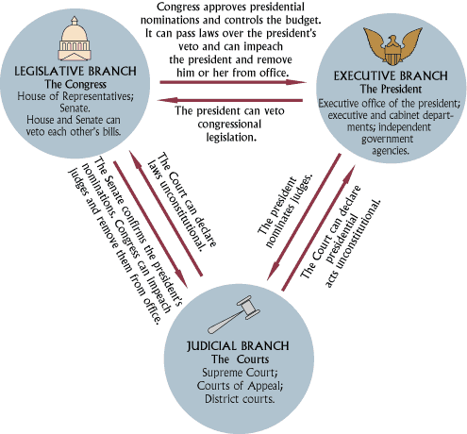
Separation of Powers
National Government:
1. Executive Branch (President)
2. Legislative Branch (Congress)
3. Judicial Branch (Supreme Court)

Slide 33

Branches of Government
1. Legislative: House of Reps + Senate (Congress)
make laws
may override Presidential Veto
confirms Presidential appointments and treaties

Slide 34

Branches of Government
2. Executive: President …
enforces laws
conducts foreign policy,
negotiates treaties
Commander in Chief of army
Appoints judges, and members of executive branch

Slide 35
Branches of Government
3. Judicial: Supreme Court interprets constitution, & the constitutionality of laws
“supremacy clause” – article 6 of the constitution the constitution is the supreme law of the land

Slide 36
Checks and Balances
Prevents any one branch from dominating the other

Slide 37
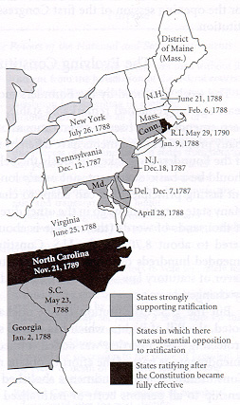

Ratification 1787-1788
Constitution needed approval of 9/13 colonies

Slide 38


Arguments “for”, and “against”
Federalists
Favor Constitution
Strong national government
Anti-federalists
Against Constitution
Favor Strong States rights

Slide 39


The Federalist Papers -1787
85 Essays arguing for Constitution
By: Alexander Hamilton, John Jay, James Madison (A. JAY JAM!)

Slide 40

Federal Constitution Ratified June 21st, 1788
9th state (New Hampshire) approved
The Presidency: Each state chose electors
Electors voted for 2 men (Feb. 1789)
Majority votes won

Slide 41
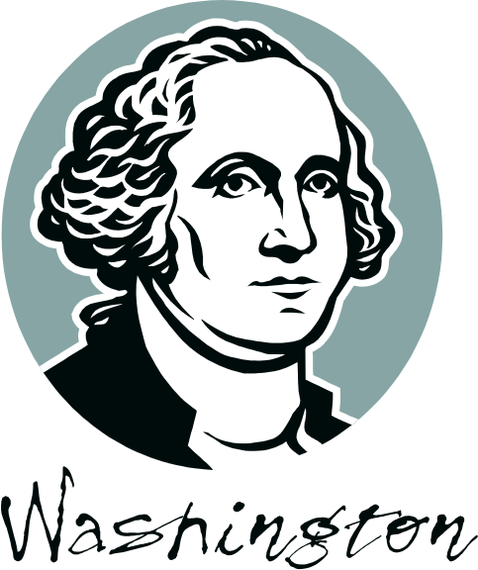

Finally, A President!
George Washington declared Winner -April, 1789
John Adams (runner up) declared Vice President

Slide 42

Bill of Rights, 1791
1st 10 amendments to constitution
Guarantee of people’s liberties

