Slide 1
Word Analysis
380 on Target! =
Ms. Garcia’s chocolate chip cookies!
YUM!
http://staff.esuhsd.org/danielle/english%20department%20lvillage/CAHSEEEnglish2.html

Slide 2

What is Word Analysis?
When we read, we often come upon unfamiliar words.
How do we figure out the meaning?
Word Analysis refers to strategies used to figure out the meaning of unfamiliar words.
In this packet, you will learn seven such strategies.

Slide 3
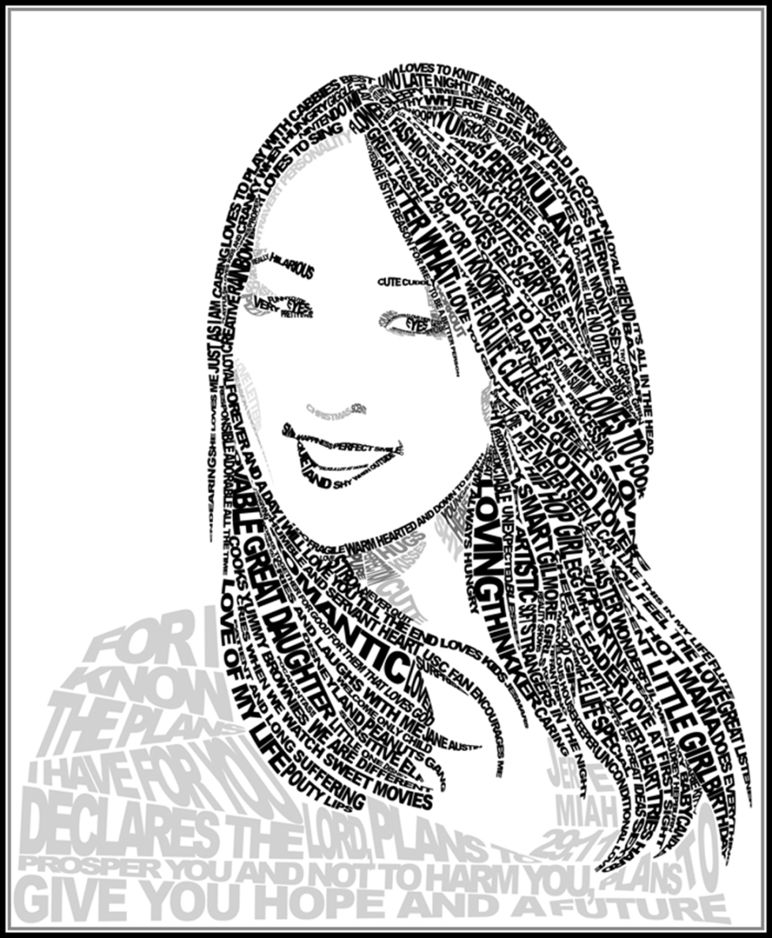
Strategies for Deducing Meaning
1. Context Clues (& Signal Words)
2. Multiple-Choice Strategies
3. Structural Clues
4. Direction
5. Charge
6. Word Association
7. Deconstruction
word analysis skills comes into play whenever we read and will be key to your success in every CAHSEE strand (including math).

Slide 4
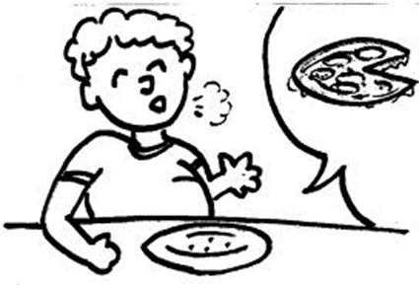
1: Context Clues:
words in a sentence that help the reader deduce (reason out) the meaning of an unfamiliar word.
1. Synonym Clue: an unfamiliar word is used as a synonym; You can infer (figure out) the meaning of the word by replacing it with the familiar word.
Example: I feel completely satiated; in fact, I am so full that I could not possibly eat another morsel of food.
“Full” is a synonym for “satiated.” We can conclude that the word “satiated” means full or satisfied.

Slide 5
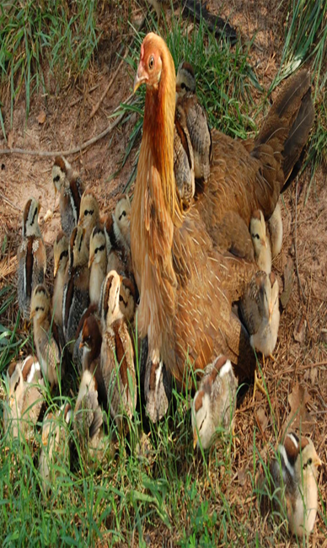
2. Comparison Clue:
Sometimes an unfamiliar word is used in a comparison with a familiar word or group of words.
Example: The children huddle around their teacher, like baby chicks around a mother hen.
The children are being compared to baby chicks around a mother hen; we can conclude, then, that “huddle” means “crowd together closely.”
Note: “like baby chicks around a mother hen” is a simile. A simile uses the words “like” or “as” to describe one thing by comparing it with another.

Slide 6
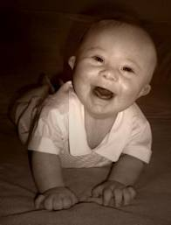
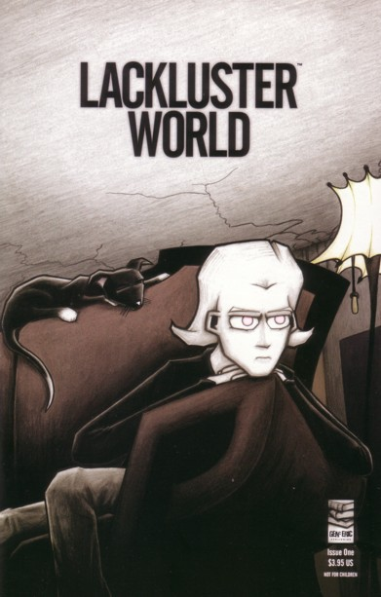
3. Contrast Clue:
Sometimes an unfamiliar word may be used in contrast to a familiar word or group of words. You can infer the meaning of the unfamiliar word by giving it the opposite meaning of the familiar word.
Example: Unlike Robin, who is full of life, Rachel is lackluster.
The opposite of “full of life” is “empty of life.” The word “lackluster” is used to contrast Robin and Rachel. We can conclude, then, that the word “lackluster” means “lacking liveliness.”

Slide 7
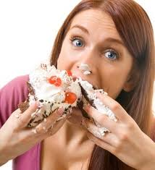
4. Explanation Clue:
Sometimes an unfamiliar word may be followed with an explanation, in which a familiar word or group of words is used.
Example: Marsha is insatiable; she can eat all day and never feel full.
Here, the second part of the sentence (“she can eat all day and never feel full”) is used to explain the first part of the sentence (“Marsha is insatiable”). We can conclude, that “insatiable” means “incapable of being full.”

Slide 8
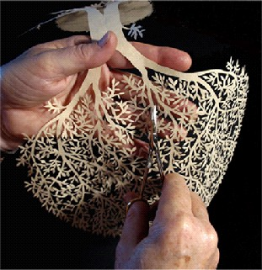
What does delicate mean as used in the following sentence?
Example: Now more than 100 years old, many of Andersen’s delicate paper cuttings still exist in a museum in Denmark devoted to his work.
A. thin
B. fragile
C. creative
D. Old
In the example above, underline your clue words.
What is the correct answer?
B. Fragile; Clue -100 years old

Slide 9

5. Example Clue:
Sometimes an unfamiliar word may be followed by an example, in which the familiar word is used.
Example: In college, you can choose courses from a broad range of academic disciplines, such as history, economics, mathematics, and psychology.
You probably know the primary (first) meaning of “discipline” (control). But that doesn’t fit in the context of the sentence.
Use the context to figure out the meaning. The word (discipline) is followed by several examples: history, economics, mathematics, and psychology. (Note: The words “such as” let us know that examples will follow.)
We can conclude each of these subjects is an example of a discipline and “discipline” means “a branch of instruction or learning.”

Slide 10

Context Clues in Surrounding Sentences
Sometimes the clues to a word’s meaning are not found in the same sentence. You must read a few sentences before and/or after the sentence in which the word appears.
Read the following passage and underline all of the words that provide clues to the meaning of “institutions.”
California has many educational institutions that have been affected by the recent state budget cuts. Its public universities have been badly hit and will need to increase tuition. In addition, next year’s funding for elementary, middle, and high schools has been cut significantly.
Meaning of institution: An organization founded for a religious, educational, social, or similar purpose.

Slide 11

Context clues often follow, signal words & phrases
These alert or “signal to” the reader that an important clue is coming. Pay attention to these words; they will help you infer the meaning of unfamiliar words.
Let’s reexamine an earlier example: Example: Unlike Robin, who is full of life, Rachel is lackluster.
“unlike” is a signal word
Example: In college, you can choose courses from a broad range of academic disciplines, such as history, economics, mathematics, and psychology.
the phrase “such as” signals that examples of academic “disciplines” will follow. if you are unfamiliar with an academic discipline, you are probably familiar with (history, economics, mathematics, psychology).
You can e conclude a “discipline” is a branch of instruction or learning.

Slide 12
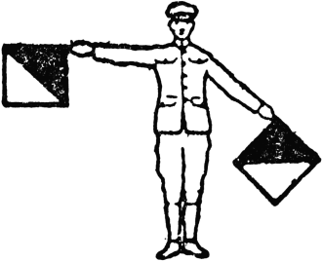

Signal Words
Example: The Sacramento Bee is a quotidian publication because it is put out every day.
In this sentence, “because” is a signal word. It alerts the reader that an explanation follows. The words “every day” define “quotidian.”
Signal Words for Comparison (or Synonyms)
• and
• such as
• like
• similar to
Signal Words for Explanation
• because
• because of
• since
• in other words

Slide 13

Signal Words for Contrast
• however
• although
• though
• despite
• but
• in contrast to
• rather
• unlike
• on the other hand
• as opposed to
• nevertheless
• yet
• while
Signal Words for Example
• for example
• for instance
• such as
• like
• other
• one kind
• includes, including

Slide 14
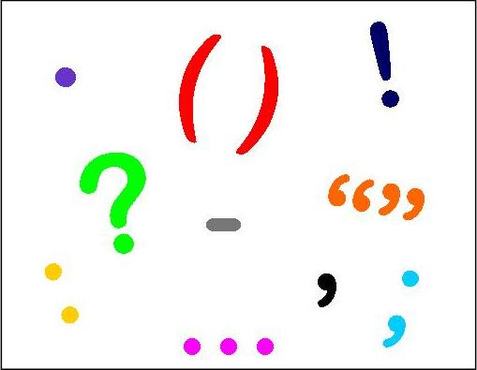
Punctuation Clues
2. Colons
Example: There are many different types of professions in society: law, medicine, accounting, and education.
In the above sentence, the colon (:) signals that a list of examples will follow. Law, medicine, teaching, and accounting are all examples of professions.
Jobs
1. Commas
Example: Netsuke, a small figure of ivory, wood, metal, or ceramic, is a form of Japanese art.
The commas signal to the reader that a definition of the word “netsuke” follows.
, a small figure of ivory, wood, metal, or ceramic,

Slide 15

3. Semicolons
Example: Neil is such a cynic; he finds it difficult to believe that I would help him out of the goodness of my heart.
the semi-colon (;) signals to the reader that an explanation will follow.
The fact that Neil ‘thinks the worst of everyone’ explains why the author believes that he is a cynic.
A cynic is someone who believes that only selfishness motivates human actions.
4. Parenthesis
Example: Damian was fatigued (he hadn’t slept for two days) and came straight home from school.
the parentheses ( ) signal an explanation is provided.
you may not know what the word “fatigued” means, you can probably figure out its meaning through the explanation contained within the parentheses
Someone who hasn’t slept for days is most probably very tired, and that is exactly what “fatigued means.”

Slide 16
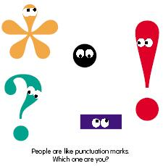
5. Hyphens
Example: Once a nasal infection reaches the bronchial tubes, cilia—tiny hair-like structures — can act to prevent further damage.
the hyphen (—) signals to the reader that a definition follows.
“cilia” means tiny hair-like structures.
6. Dashes
Example: Neurology--the science of the nerves and the nervous system--
is a popular major at our university.
the dashes (--) signal to the reader that a definition or explanation follows.
“neurology” means the science of the nerves and the nervous system.

Slide 17

Exercise: Signal Words and Context Clues
List all signal words (or punctuation marks) and context clues for each sentence; then guess the meaning of the underlined word.
Working with a tutor may have many beneficial results; one positive outcome is that you may feel more comfortable asking questions in a one-on-one setting than you would in a large classroom.
Signal Word/s (or Marks):
Semicolon (;)
Context Clue/s:
one positive outcome is
Meaning of beneficial:
positive, advantageous

Slide 18


List all signal words (or punctuation marks) and context clues for each sentence; then guess the meaning of the underlined word.
2. My itinerary for this trip includes a three-day stay in Italy and a cruise to Greece.
Signal Word/s: __________________
Context Clue/s: _________________
Meaning of itinerary: ____________
3. In contrast to my sister, who is quite taciturn, I am extremely talkative.
Signal Word/s: __________________
Context Clue/s: _________________
Meaning of taciturn: ____________

Slide 19

Vocabulary Strategy 2: Multiple-Choice Strategies
On the CAHSEE you will be asked to find the meaning of a word that appears in a sentence from a reading passage. Let’s look at two strategies for answering these types of questions on the CAHSEE:
Strategy A: Don’t look at the choices until the end.
1. Cover the answer choices with your hand.
2. Go back to the passage to determine how the word is used in context (the sentence).
(Note: These clues may appear in the same sentence or in the sentence/s before and/or after the word.)
3. Underline clue words.
4. Before looking at the answer choices, write what you think the word means.
(What word would fit in the context?)
5. Examine the choices. Eliminate choices that are very different from your word. Pick the answer choice that most closely matches your word.

Slide 20
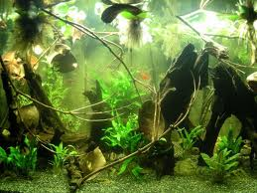
Example:
Tragically, many tropical rain forests are so threatened by overdevelopment that they may be completely eradicated by the end of the century.
Cover the answer choices with your hand.
2. Look at the passage to see how the word is used in context.
3. Underline clue words in the sentence.
4. Write in a word that would fit the context. _______________
5. Now look at the answer choices. Cross out all answer choices that are not synonymous with your word.
A. isolated B. destroyed C. rejuvenated
D. expanded
Eradicated=Destroyed

Slide 21
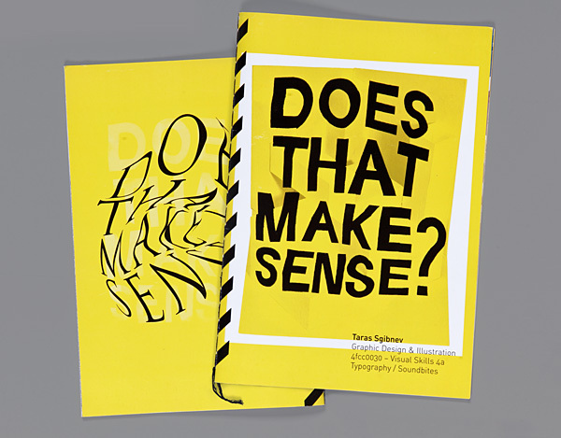
Strategy B: Try out each choice in the original sentence.
1. Read the sentence or paragraph in which the word appears.
2. When you get to word in question, cover it with your hand.
3. Substitute each of the answer choices for the word you have covered and read the sentence.
4. Ask yourself, “Does this word make sense in the sentence?”
5. Cross out those words that do not fit and choose the word that makes the most sense in the sentence.

Slide 22
CAHSEE Example
But in captivity, when their keepers unknowingly were giving them leaves contaminated with acid, the koalas were left with only two options: eat the poisonous leaves or starve.
A. carried with
B. polished with
C. poisoned with
D. grown from
1. Read the entire sentence.
2. Cover the word “contaminated” with your hand.
3. Substitute each of the choices and read the sentence.
4. Ask yourself, “Does this word make sense in the sentence?”
5. Cross out choices that do not make sense and choose the word that makes the most sense in the sentence.
Contaminated = Poisoned with

Slide 23
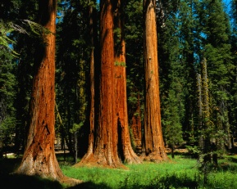
Vocabulary Strategy 3: Structural Clues
• How does the word fit in the sentence? Can sense the word’s meaning by looking at where it appears? Does it appear beside any words you can associate it with?
• Type of Word: Is the word used as a noun, verb, adjective, or adverb?
If it is a noun, is it singular or plural? Is it a proper or common noun?
If it is a verb, look at tense: Is it past, present or future?
If it is an adjective, look at the noun it is modifying. Connect these.
If it is an adverb, look at the verb it is modifying. Connect these.
Example: Some of the Sequoias in these forests are several hundred years old.
Probable meaning of Sequoias:
Clue = Forests
Definition = Trees
Example: The putrid odor seemed to be coming from the garbage cans.
Probable meaning of putrid:
Clue = odor, garbage cans
Definition = Rotten

Slide 24

Vocabulary Strategy 4: Direction; Use signal words, phrases, and punctuation marks to determine the direction of the word.
Same Direction | Change Direction
And | However
Because, since | Although, though
Including | Nevertheless
In fact | But
Indeed | In contrast to
; (semi-colon) | Rather
: (colon) | Despite, yet
The change did not occur overnight; on the contrary, it was progressive.
Direction: Change
On the contrary (contrast)
Meaning of progressive:
Happening or developing gradually or in stages

Slide 25

Vocabulary Exercise: Mark the direction of the underlined word in each passage and guess the word’s meaning.
1. I love taking a long walk early in the morning; in fact, I find the experience invigorating.
Direction: In fact
Meaning of invigorating: Give strength or energy to.
2. Rather than being destroyed, many historical buildings are now being preserved.
Direction: Rather
Meaning of preserved: Maintain (something) in its original state
3. Unlike her sister, who enjoyed time alone, Sylvia preferred the camaraderie of her colleagues.
Direction: Unlike
Meaning of camaraderie: fellowship - companionship - friendship

Slide 26



Vocabulary Strategy 5: connotation
Positive | Negative | neutral
Happy | Frightened | Work
honest | Angry | Change
Brave | Lazy | Brunette
smile | cry | telephone
Exercise: For each sentence, write the charge of the underlined word.
1. When Mrs. Brown saw the horrible mess her students had made while she was absent, she became livid.
What is the charge of “livid”? ________
Definition: Furiously angry
2. “I try to overlook many things,” said Mr. Dalton, “but this mistake is so egregious that I will have to take action!”
What is the charge of “egregious”? ________
Definition: Outstandingly bad; shocking
3. Fred was confident that he had performed well. Several people in the audience went even further and called his performance superlative.
What is the charge of “superlative”? ________
Definition: Of the highest quality

Slide 27
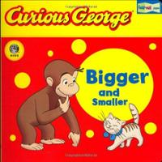
Vocabulary Strategy 6: Word Association
A. Seeing Smaller Words: Examine each word and see if you can recognize a smaller word (or words) inside it. Underline the smaller word.
Superlative
Proffer
Differential
Underlying
Expertise
Enthrone
Egotistical
Belittle
Ingenious
Longevity
Legendary
Marginal
Maniacal
B. Seeing Bigger Words: Examine each word and see if you can recognize a bigger word outside it. Write the bigger word.
Example: Engage: Engagement
Excel: ___________________________
Propel: ___________________________
Repel: ___________________________
Censor: ___________________________
Décor: ___________________________
Converse: _________________________
Repute: ___________________________
C. Seeing Similar Words: Examine each word and see if you can recognize a similar word in it. Write the similar word.
Circulatory: Circulation
Emotive: ___________________________
Exemplify: ___________________________
Brevity: ___________________________
Nutrient: ___________________________
Unison: ___________________________
Spacious: ___________________________
Salutation: ___________________________

Slide 28

Vocabulary Strategy 7: Deconstruction: Many English words can be traced back to Latin and Greek. Often you can guess the meaning of an unfamiliar word if you know the meaning of its parts.
A word root is a part of a word. It contains the core meaning of the word.
Example: The Latin root “scrib-” or “script” means “to write.”
Example: The Greek root “anthrop-” means “human.”
A prefix is placed at the beginning of a word to change its meaning.
Example: The Latin prefix “pre-”
means “before.”
Example: The Greek prefix “bio-”
means “life.”
A suffix is a word part placed at the end of a word to change its meaning.
Example: The Latin suffix “-fy” or
“-ify” means “to make or cause to
become.”
Example: The Greek suffix “-ology”
means “the study of.”

Slide 29
Roots combine with prefixes and suffixes to form new words. Often, you can take apart (or deconstruct) an unknown word by examining each individual part.
Example: The Latin root -tract- means “to pull.” You can combine it with the prefix de-, which means “away” to get the word “detract.” “Detract” means “to pull away.”
Example: Now let’s combine the root -tract- with the prefix re-, which means “again” or “back.” The word “retract,” means “to pull back.”
On Your Own:
1. The Greek prefix “bio-” means “life” and the Greek suffix “-ology” means “the
study of.”
What does the word “biology” mean? ____________________________________
2. The root “-cardio-” means “heart” and the suffix “-ologist” means “one who studies.”
What does the word “cardiologist” mean? ________________________________
3. The prefix “auto-” means “self.” The prefix “bio-” means “life.” The root “-graph-” means “to write.” The suffix “-ical” means “pertaining to,” or “about.”
What does the word “autobiographical” mean? ____________________________

Slide 30
4. Heidi has an inferiority complex; she has absolutely no confidence in herself.
What is the charge of “inferiority”? ________
5. The building is so old and dilapidated that the landlord can’t find anyone willing to rent it.
What is the charge of “dilapidated”? ________
6. If you continue to disobey me, I will have to take punitive action.
What is the charge of “punitive”? ________
7. Never give up; always persevere!
What is the charge of “persevere”? ________
8. She woke up late and showed up to work with her hair disheveled and her clothes wrinkled.
What is the charge of “disheveled”? ________
9. I found her story heart wrenching; I cried for hours.
What is the charge of “heart wrenching”? ________
10. When Mr. Franklin saw his daughter accept her award, he was overcome with mirth.
What is the charge of “mirth”? ________

Slide 31
Vocabulary Exercise
1. Despite her lack of experience, Eleanor handled the difficult project commendably.
Signal Word/s or Punctuation Marks: ________________________________________
Context Clues: __________________________________________________________
Direction: ________
Charge: ________
Meaning of commendably: ________________________________________________
2. Ethan is usually known for his brevity. Today, however, he was horribly long-winded.
Signal Word/s or Punctuation Marks: ________________________________________
Context Clues: __________________________________________________________
Direction: ________
Charge of brevity: ________
Meaning of brevity: ______________________________________________________

Slide 32
3. Pompeii is one of many ancient cities destroyed by a catastrophic event.
Signal Word/s or Punctuation Marks: ________________________________________
Context Clues: __________________________________________________________
Direction: ________
Charge of catastrophic: ________
Meaning of catastrophic: __________________________________________________
4. I find the man arrogant; he looks down on everyone around him.
Signal Word/s or Punctuation Marks: _________________________________________
Context Clues: ___________________________________________________________
Direction: ________
Charge of arrogant: ________
Meaning of arrogant: ______________________________________________________

Slide 33
5. He gingerly placed the delicate and priceless vase on the table and sighed with relief.
Signal Word/s or Punctuation Marks: _________________________________________
Context Clues: ___________________________________________________________
Direction: ________
Charge of gingerly: ________
Meaning of gingerly: ______________________________________________________
6. Because of the altercation, the two men never spoke to one another again.
Signal Word/s or Punctuation Marks: _________________________________________
Context Clues: ___________________________________________________________
Direction: ________
Charge of altercation: ________
Meaning of altercation: ____________________________________________________

Slide 34
7. Jason is a genuine raconteur: he excels at telling stories that fascinate his listeners.
Signal Word/s or Punctuation Marks: ________________________________________
Context Clues: __________________________________________________________
Direction: ________
Charge of raconteur: ________
Meaning of raconteur: ____________________________________________________
8. The divorce was extremely acrimonious. The husband and wife had really come to hate one another.
Signal Word/s or Punctuation Marks: ________________________________________
Context Clues: __________________________________________________________
Direction: ________
Charge of acrimonious: ________
Meaning of acrimonious: __________________________________________________

Slide 35
