Slide 1

Demographic Transition Model Review

Slide 2
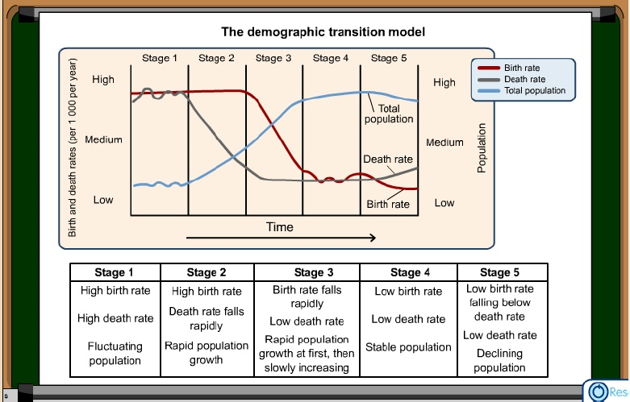

Slide 3
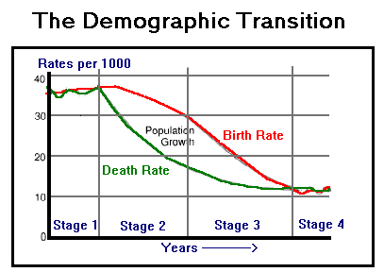
Stage 1 - High Fluctuating
Birth Rate and Death rate are both high. Population growth is slow and fluctuating.
Reasons
Birth Rate is high as a result of:
  Lack of family planning
  High Infant Mortality Rate
  Need for workers in agriculture
  Religious beliefs
  Children as economic assets
  Death Rate is high because of:
  High levels of disease
  Famine
  Lack of clean water and sanitation
  Lack of health care
  War
  Competition for food from predators such as rats
  Lack of education

Slide 4
Stage 2 - Early Expanding
Birth Rate remains high. Death Rate is falling. Population begins to rise steadily.
Reasons
Death Rate is falling as a result of:
  Improved health care (e.g. Smallpox Vaccine)
  Improved Hygiene (Water for drinking is boiled)
  Improved sanitation
  Improved food production and storage
  Improved transport for food
Decreased Infant Mortality Rates

Slide 5
Stage 3 - Late Expanding
Birth Rate starts to fall. Death Rate continues to fall. Population rising.
Reasons:
Family planning available
Lower Infant Mortality Rate
Increased mechanization reduces need for workers
Increased standard of living
Changing status of women

Slide 6
Stage 4 - Low Fluctuating
Birth Rate and Death Rate both low. Population steady.
Typical of USA; Sweden; Japan; Britain

