Slide 1
CH 4/5 Insights
Objective Questions
  1) Explain the motives behind Bacon’s Rebeliion and describe the impact Bacon’s Rebellion had on the colonies.
  2) Identify 3 ways slaves were treated harshly or unfairly.
  3) Identify the 5 largest ethnic groups that settled the colonies. Explain the changed that occurred in the makeup of the colonies between 1700 and 1755.

Slide 2
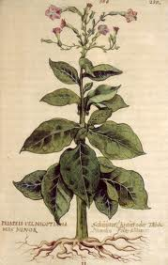
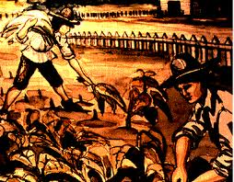
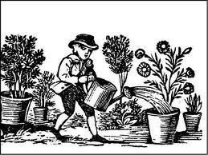
CH 4/5 Insights
ID- Early Tobacco Advertising (P 67)
Summary #1- What does the ad claim is the benefit of smoking tobacco?
That smoking is healthy
OI-The Tobacco Economy
1) What was the problem that tobacco cultivation did to the soil?
Destroys nutrients
2) What was an “indentured servant”?
Person who trades passage to New World in exchange for 3-5 years labor
“White Slave”
Q1-Evaluate if indentured servant different from a slave?

Slide 3
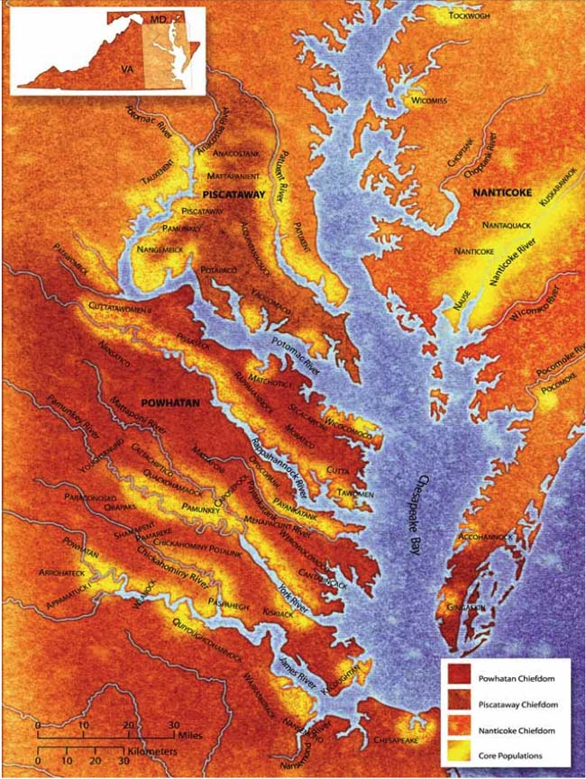
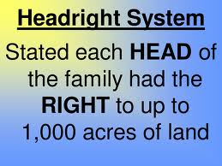
3) What was the “Headright” system and how did it benefit growers (people that owned the land)?
Whoever paid for passage of an indentured servant was given 50 acres
Able to expand land owned into huge estates that dominated best land on the coast
Q2) Predict how poorer, later settlers be impacted by Headright System?

Slide 4
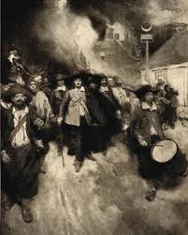
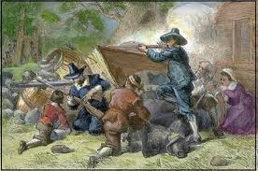
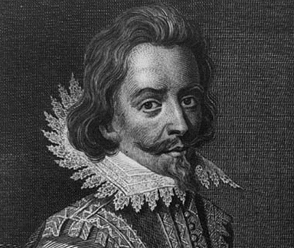
ID-Nathaniel Bacon assailed Virginia’s Governor Berkeley… (p. 68)
Summary #2- What was Bacon’s complaint on Berkeley?
That Gov. Berkeley favored and protected the Native Americans
Summary #3- Why did Berkeley feel he should not listen to Bacon?
  That Bacon is not a local (only 2 years in Va.) and does not know how things really are
OI- Frustrated Freemen and Bacon’s Rebellion
4) What annoyed freemen (former indentured servants) when they became free?
Difficulty in obtaining good land and finding a wife
  Q3) Isn’t there land available? Explain what the problem is with the land that was availible?

Slide 5
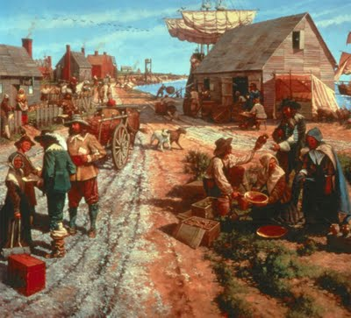
5) What did Bacon and his followers want from Governor Berkeley?
Protection from Na.Am. attacks
6) What was the end result of Bacon’s Rebellion in regards to solving the labor problem made up of indentured servants who might become troublesome?
African slaves became the main form of cheap labor
  Af. Slaves were not English (had no rights), could not speak same language or read, could not organized, unfamiliar surroundings

Slide 6
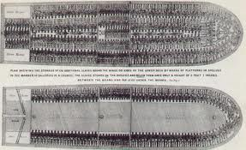
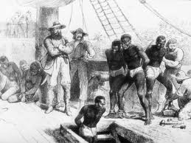
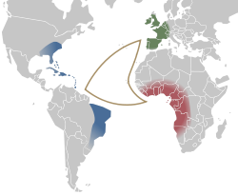
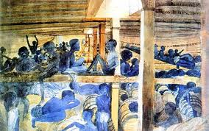
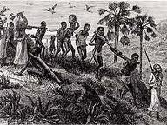
ID- Middle Passage, Estimated Slave Imports (70), Main Sources of Af. Slaves (71)
Summary #4- What was the “Middle Passage”? \
Journey African slaves made to colonies
Summary #5-Where did British North America rank among European countries that imported slaves?
6th (#1 Brazil, #2 British Caribbean)
Summary #6- Where did most African slaves come from in Africa?
West Africa

Slide 7
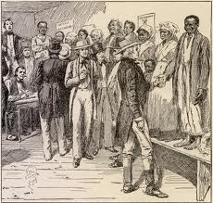
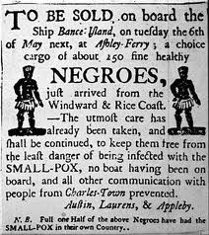
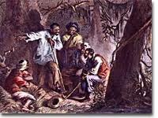
OI- Colonial Slavery
7) Why were African slaves at first not a popular source of labor in the British colonies?
Too expensive, Africans could die (risky investment)
8) What was the death rate on the “middle passage”?
20%
9) ID one rule in the “slave codes”
Slaves were property for life
Crime to teach a slave to read
Could not be freed (even if converted to Christianity)

Slide 8
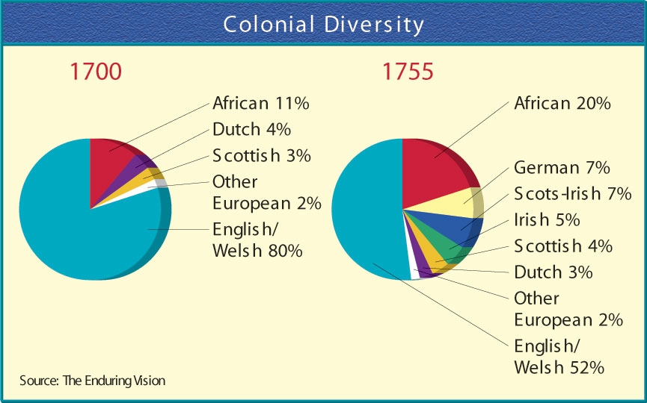
ID- Immigrant Groups in 1775 (85)
  Q4- What is your definition of a “White” person? Explain if whites are all the same? Can they be different? Explain
Summary #7- How many ethnic groups does the map identify?
11
Summary #8- What geographic area do the English dominate?
Coast
Summary #9- What region did poorer groups like the Germans and Scot-Irish live?
Far inland
Summary #10- Why do you feel there is a separation between the two groups?
English arrived first, Scot-Irish too poor to afford land near coast

Slide 9
OI- Mingling of the Races
10) German made up what percent of the population?
6%
11) What percent of the population were Scot-Irish?
7%
12) 5% of the population was made up of what other groups (Identify 4)
French, Welsh, Dutch, Swedes, Jews, Scots, Swiss
13) What ethnic group was the second largest in the colonies making up 20% of the population?
African-American
14) Think- Why might this diverse mingling of groups sew the seeds for a Revolutionary War in which the colonies break away from English rule?
Because the colonies were not entirely made up of English people loyal to the king of England
  Q5- Predict the impact that this mingling and diversity of settlers will have on the furutre of the colonies.

