Slide 1
Subliminal messages can raise our self-esteem and improve our memories.
True
False

Slide 2
People who are born without the ability to feel pain may die before early adulthood.
True
False

Slide 3
Without their smells, a cold cup of coffee may be hard to distinguish from a glass of
Gatorade.
True
False

Slide 4
Persons who have sight in only one eye are totally unable to gauge distances.
True
False

Slide 5
A person who is born blind but gains sight as an adult cannot recognize objects that were familiar by touch.
True
False

Slide 6
If required to look through a pair of glasses that turns the world upside down, we soon adapt and coordinate our movements without difficulty.
True
False

Slide 7
If we stare at a green square for a while and then look at a white sheet of paper, we see red.
True
False

Slide 8

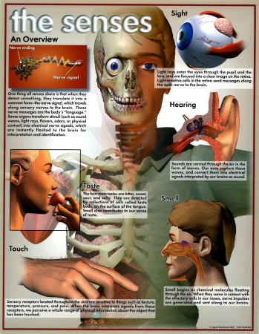
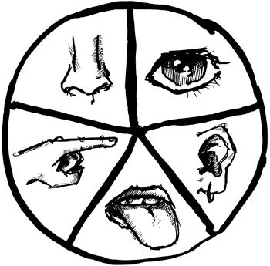
Sensation and Perception
Opening Activity: Which of the senses would you be willing to give up? Explain your reasoning.

Slide 9

Sensation & Perception

Slide 10

Sensation and Perception
Ordered Share: Do you agree with your sensitivity self assessment? Are you a sensitive person? Why or why not?

Slide 11

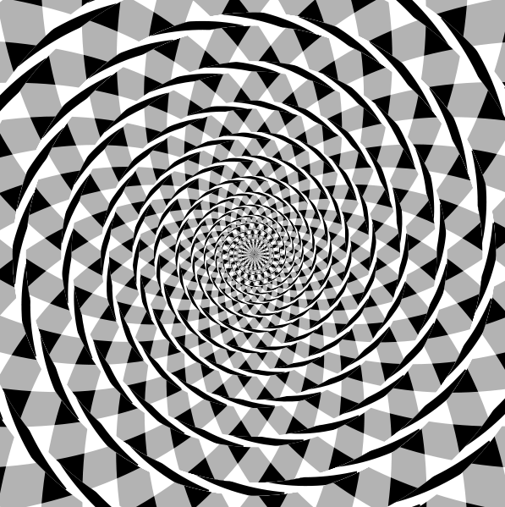
Sensation and Perception
Key Concepts:
  Sensations are not perceptions

Slide 12
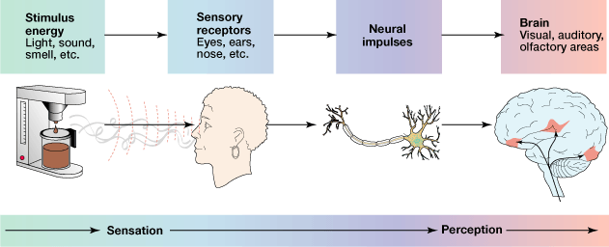
Sensation and Perception
Key Concepts:
  Sensations are not perceptions

Slide 13
Sensation and Perception
Key Concepts:
  Sensations are not perceptions
  The eye is not a camera (active mind)
    memories, past experience and context affects our perception of the world

Slide 14


Slide 15


Slide 16

Checking for Understanding
Opening Activity: What is the rough distinction between sensation and perception. Give an example to illustrate you understanding of the difference.
Sensation is the bottom-up process by which the physical sensory system receives and represents stimuli. Perception is the top-down mental process of organizing and interpreting sensory input. In our everyday experiences, sensation and perception a different aspects of one continuous process.

Slide 17
Sensation and Perception
Core Concepts:
  Sensations are not perceptions
  The eye is not a camera (active mind)
    memories, past experience and context effect perception
  The likelihood principle

Slide 18
Sensation and Perception
Aoccdrnig to rscheearch at Cmabrigde Uinervtisy, it deosn’t mttaer in waht oredr the ltteers in a wrod are, the olny iprmoetnt tihng is taht the frist and lsat ltteer be at the rghit pclae. The rset can be a total mses and you can sitll raed it wouthit a porbelm. This is bcuseae the huamn mnid deos not raed ervey lteter by istlef, but the wrod a a wlohe.

Slide 19
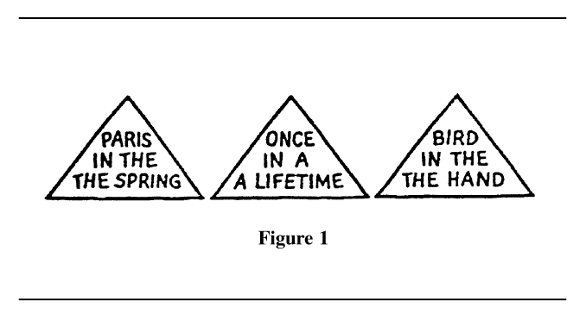
Sensation and Perception

Slide 20
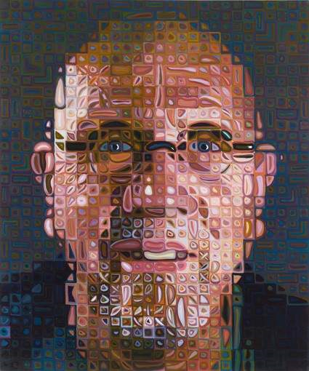
Sensation and Perception
Core Concepts:
  Sensations are not perceptions
  The eye is not a camera (active mind)
    memories, past experience and context effect perception
  The likelihood principle
  Localization of function

Slide 21
Sensation and Perception
Sensation & Perception
Psychophysics
Absolute
Threshold
Difference
Threshold
Weber’s Law
Signal Detection Theory
The study of how stimulus from the world
affect your sensory experience

Slide 22
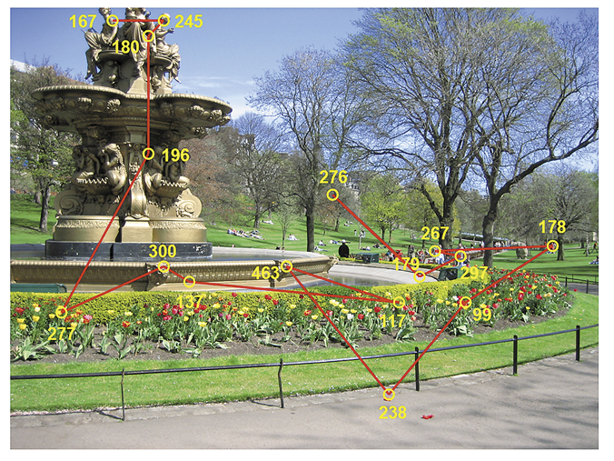
Sensation and Perception

Slide 23
Sensation and Perception
Sensation & Perception
Psychophysics
Absolute
Threshold
Difference
Threshold
Weber’s Law
Signal Detection Theory
The study of how stimulus from the world
affect your sensory experience
The weakest amount of a stimulus required to produce a sensation correctly half the time

Slide 24
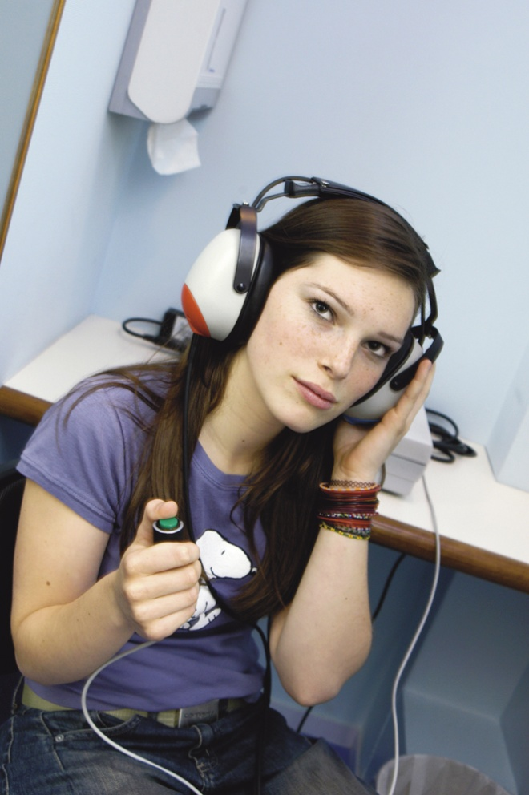
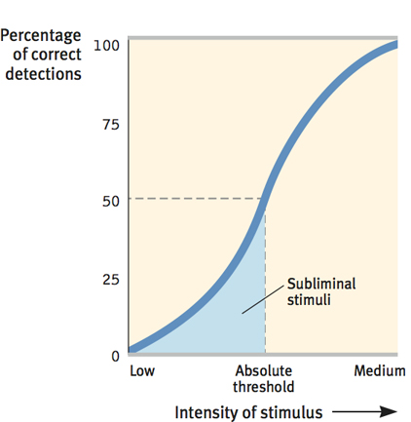
Sensation and Perception

Slide 25
Sensation and Perception
Sensation & Perception
Psychophysics
Absolute
Threshold
Difference
Threshold
Weber’s Law
Signal Detection Theory
The study of how stimulus from the world
affect your sensory experience
The principle that the larger or stronger a stimulus, the larger the change required for an observer to notice a difference
Studies the relations between motivation, sensitivity, and decision making in detecting a stimulus
The weakest amount of a stimulus required to produce a sensation correctly half the time
The smallest change in a physical stimulus that can be detected between two stimuli

Slide 26
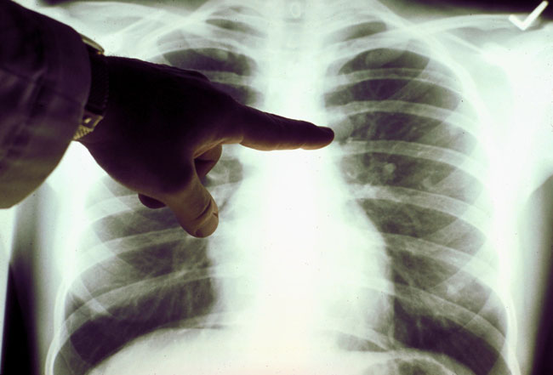
Signal Detection Theory
What might influnces a

Slide 27

Signal Detection Theory

Slide 28
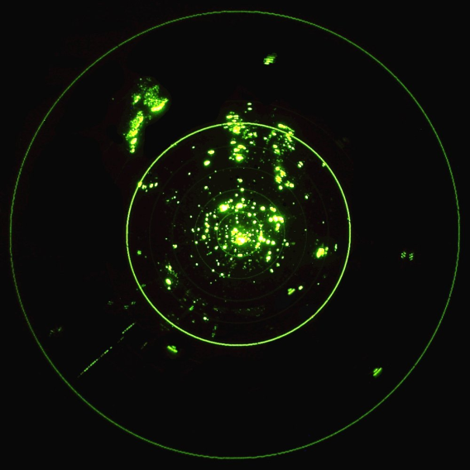
Signal Detection Theory
 | Signal Present | Signal Absent
Response “Yes” | Hit | False alarm
Response “No” | Miss | Correct rejection

Slide 29
Checking for Understanding
Write a short summary, 4-5 sentences, based on your tree map and what you learned today in class.

Slide 30

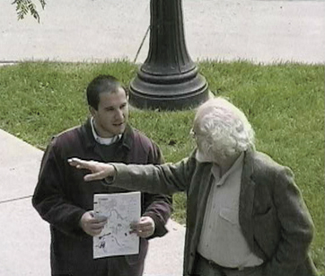
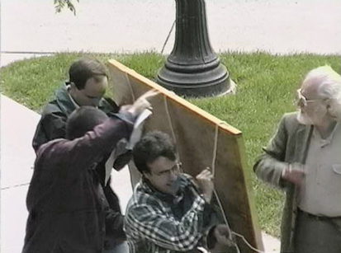
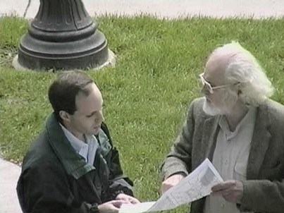
Sensation and Perception
Sensory adaptation
Selective attention
  Cocktail party effect
  Change blindness
  Choice blindness
  The pop-out phenomenon

Slide 31
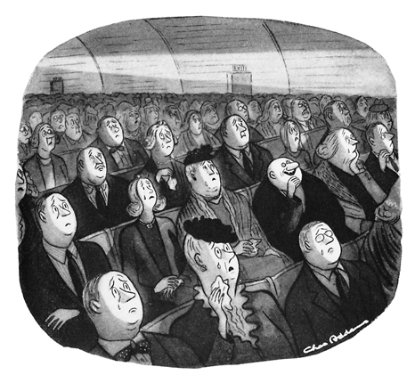
Sensation and Perception

Slide 32
Checking for Understanding
Discussion: Can you recall a recent time when your attention focused on one thing, while you were oblivious to something else (perhaps to pain, to someone’s approach, or to background music)?

Slide 33

Sensation and Perception
Subliminal messages
  Priming – the activation, often unconscious, of certain associations, thus predisposing one’s perception or memory.
  No long lasting or enduring effects

Slide 34
Sensation and Perception
Opening Activity: Write a short summary of what you learned about selective attention.

Slide 35

Sensation and Perception
The Eye

Slide 36
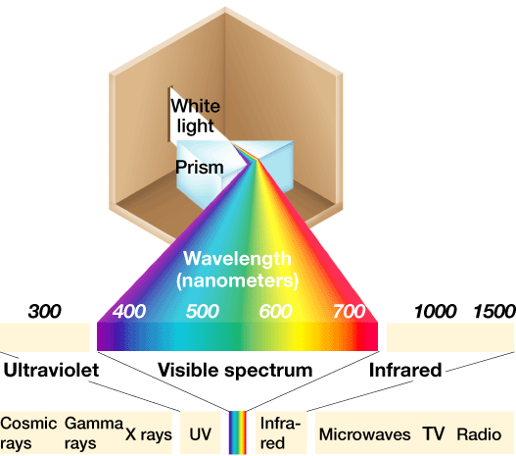
Sensation and Perception

Slide 37
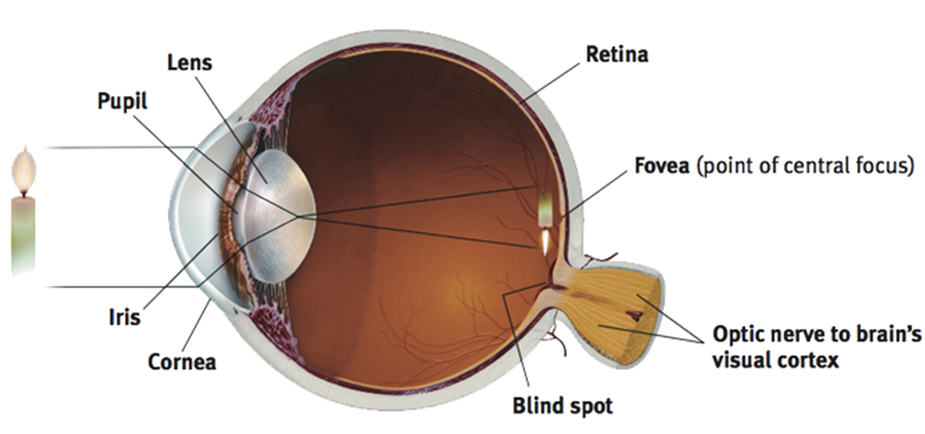

Slide 38
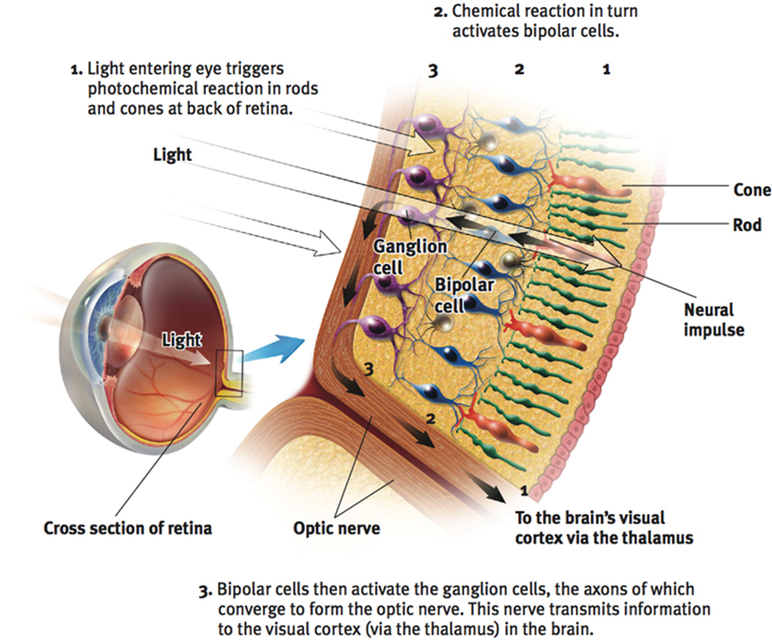

Slide 39

Sensation and Perception

Slide 40
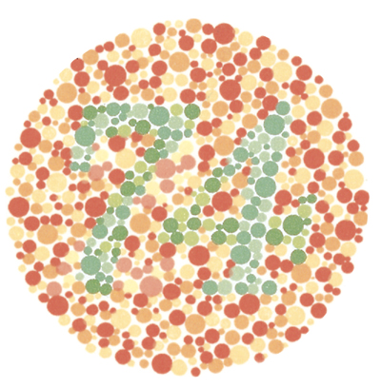
Sensation and Perception
Colorblindness
  Normal Trichromatic
    Red
    Green
    Blue
  Dichromatic
  Mono Chromatic

Slide 41
Sensation and Perception
The Ear

Slide 42
Sensation and Perception
Hearing (audition)
  Sound waves
    Frequency = Pitch
    Amplitude = Loudness
    Timber
High Frequency
Low Amplitude
High Amplitude
Low Frequency

Slide 43
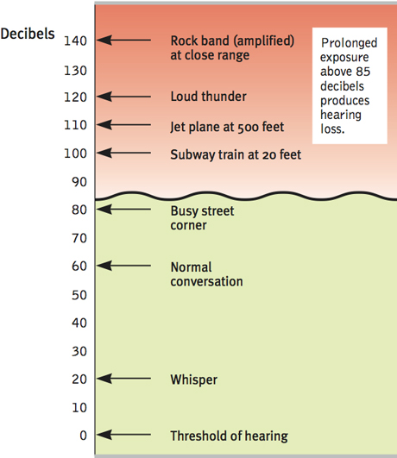
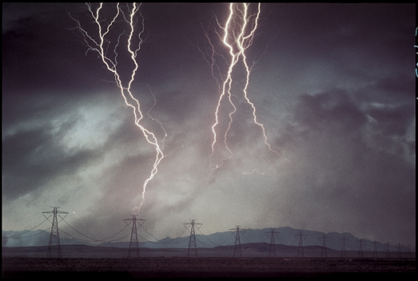
Sensation and Perception

Slide 44
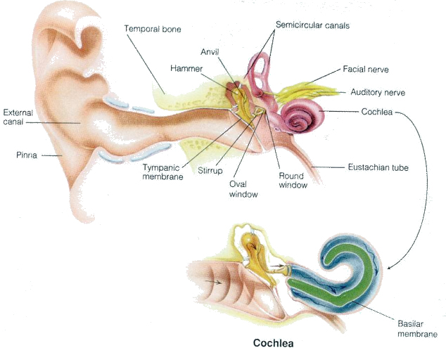
Sensation and Perception
Tympanic membrane –
The eardrum

Slide 45
Sensation and Perception
Cochlea –
Where sound waves are transduced

Slide 46
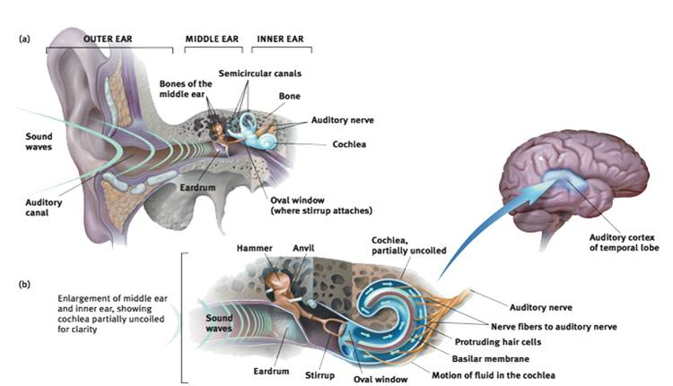

Slide 47
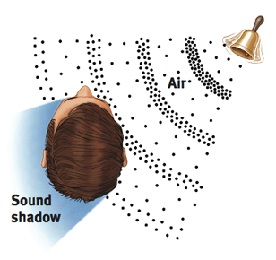
Sensation and Perception

Slide 48
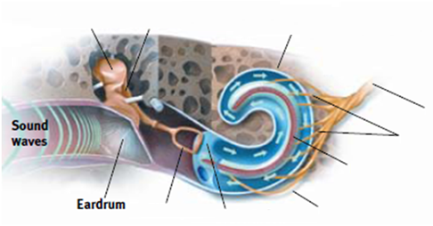
Sensation and Perception
Perceiving Pitch
  Place theory
  High pitched sounds
Frequency theory
  Low pitched sounds
  Volley principle

Slide 49
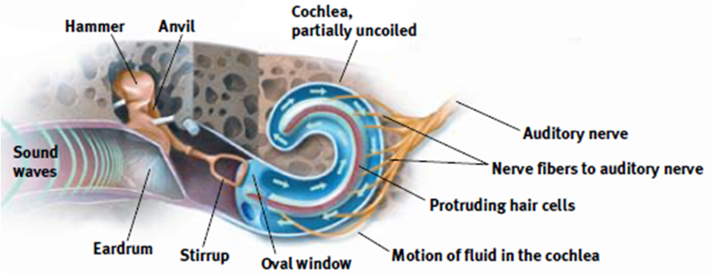
Sensation and Perception
Deafness
  Conductive
  Nerve deafness

Slide 50
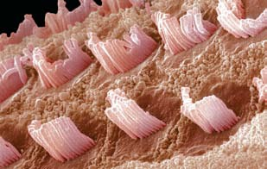
Sensation and Perception

Slide 51
Sensation and Perception
Smell

Slide 52
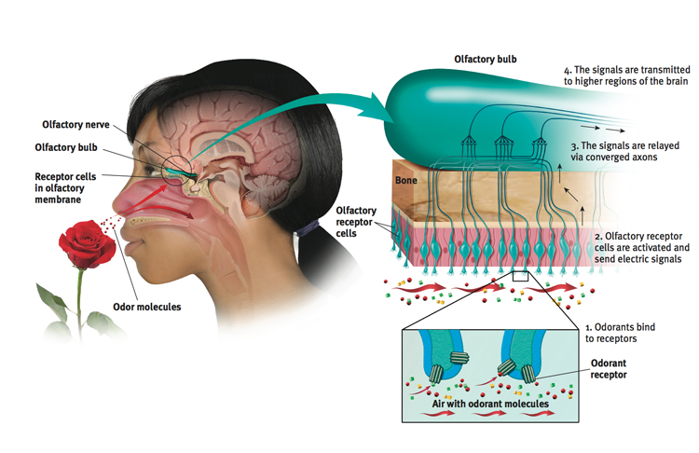
Sensation and Perception
Smell and Taste
  The Chemical Senses
  Olfactory Nerve

Slide 53
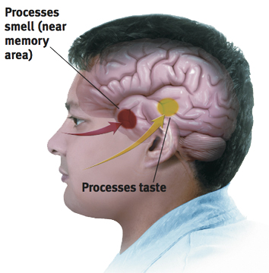
Sensation and Perception
Smell
  Pheromones

Slide 54
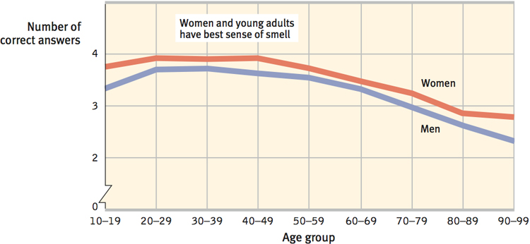
Sensation and Perception

Slide 55
Sensation and Perception
Taste

Slide 56
Sensation and Perception
Touch

Slide 57
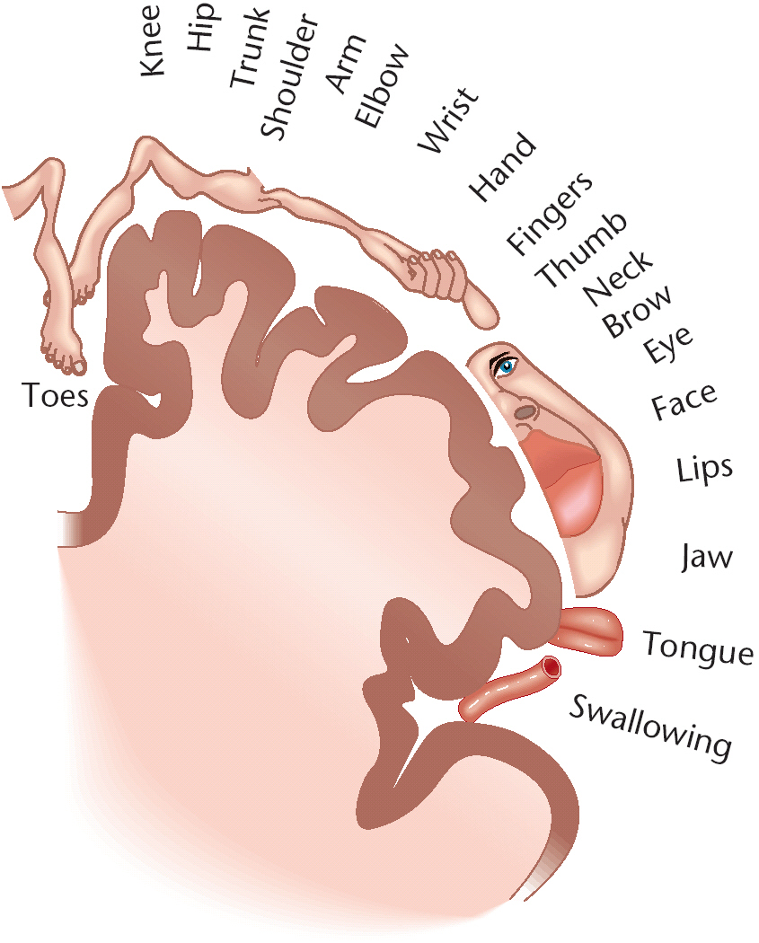

Slide 58
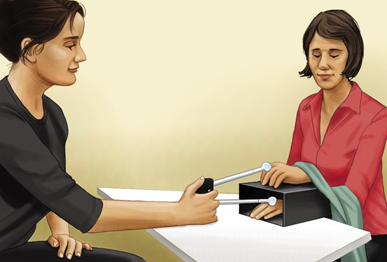
Sensation and Perception
Touch
  Pressure

Slide 59
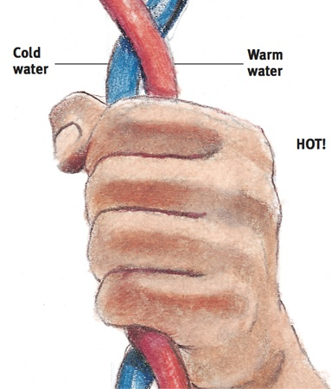
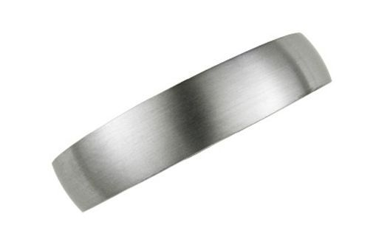
Sensation and Perception
Touch four type of receptors
  Pressure
  Warmth
  Cold
  Pain

Slide 60
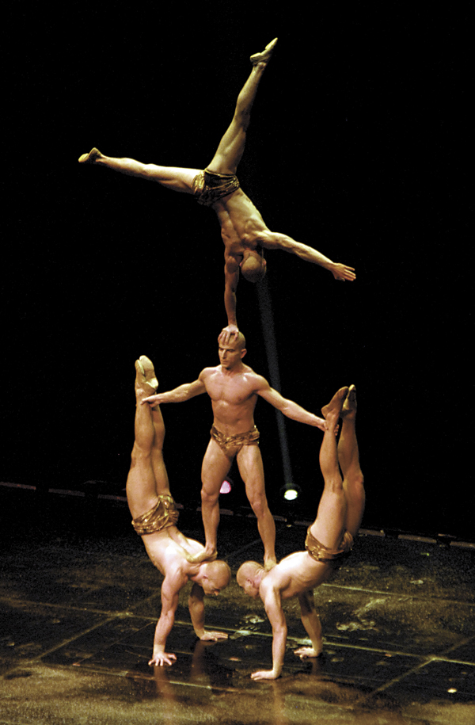
Sensation and Perception
Other Senses
  Kinesthetic sense – sensors in your joints, tendons, bones and skin that help you sense your position and movement
  Vestibular sense (semicircular canals) – position movement of head and sense of balance

Slide 61
Sensation and Perception
Opening Activity: Describe the worst physical pain you have ever experienced or remember. How did you deal with your pain?

Slide 62
Sensation and Perception
Understanding Pain
  Biological influences
    Gate-control theory
    Least adaptable

Slide 63
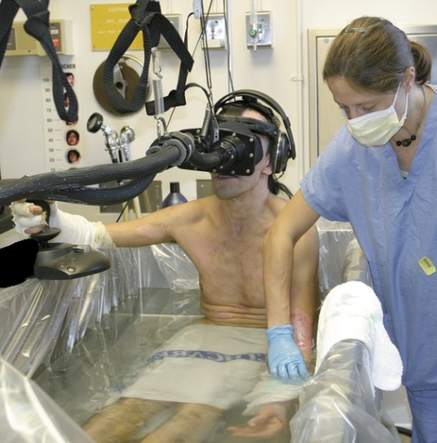
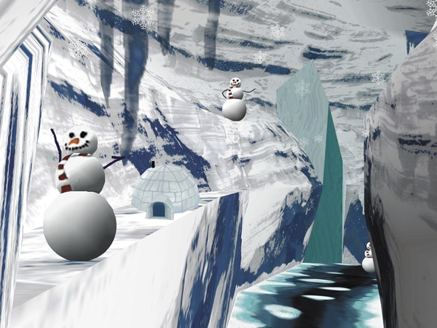
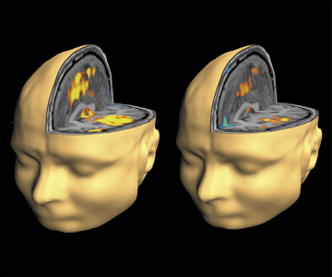
Sensation and Perception
Psychological influences
  Expectations
  Learning through experience
  Deep relaxation
  Distraction
No distraction Distraction

Slide 64
Sensation and Perception
Cultural influences of pain
  Presence of other
  Empathy
  Cultural expectations

Slide 65
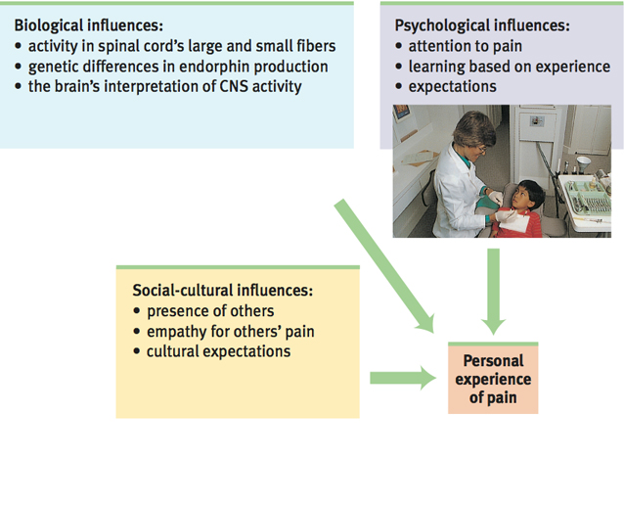
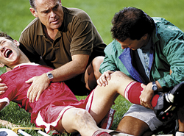
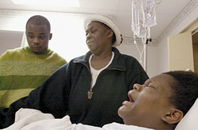
Sensation and Perception

Slide 66

Sensation and Perception
Phantom Limb syndrome
  Dr. V.S. Ramachandran

Slide 67
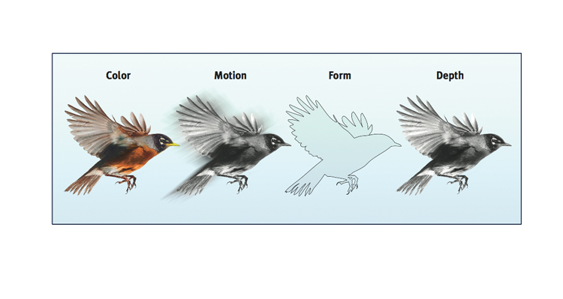
Sensation and Perception
Perceptual processing
  Feature detection
  Parallel processing

Slide 68
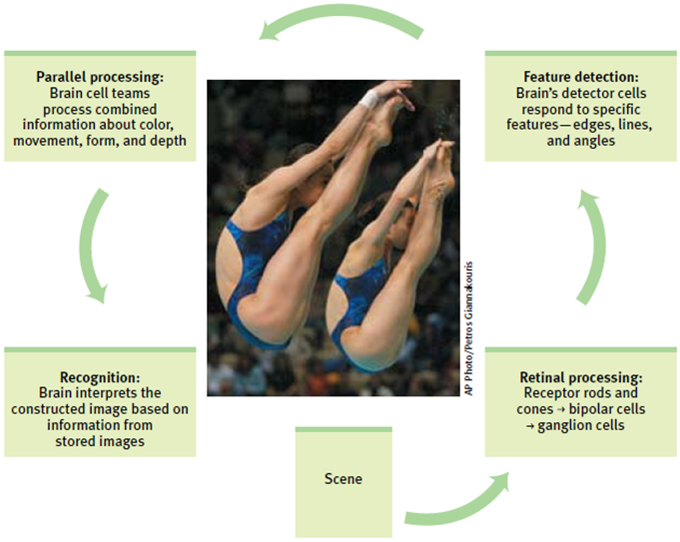
Sensation and Perception

Slide 69
Sensation and Perception
Perceptual processing
  Feature detection
  Parallel processing
  Binding problem
  Bottom-up processing = stimulus features
  Top down processing
  Perceptual Constancy
    Color constancy
    Size constancy
    Shape constancy

Slide 70
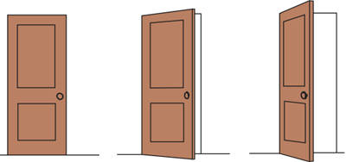
Sensation and Perception

Slide 71


Sensation and Perception
Ambiguous figures

Slide 72
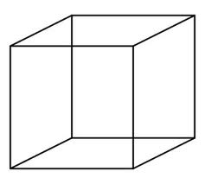
Sensation and Perception
The Necker Cube

Slide 73
Sensation and Perception
Illusions
  The stimulus is unclear
  Information is missing
  Familiar patterns are absent
  Elements are constructed in unusual ways

Slide 74
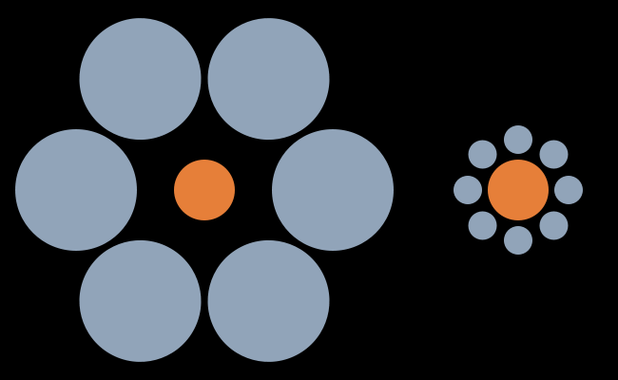
Sensation and Perception
Illusions (Ebbinghaus)

Slide 75
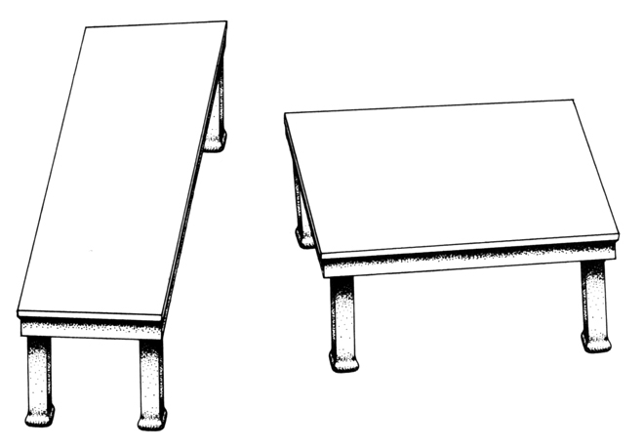
Sensation and Perception
Illusions

Slide 76
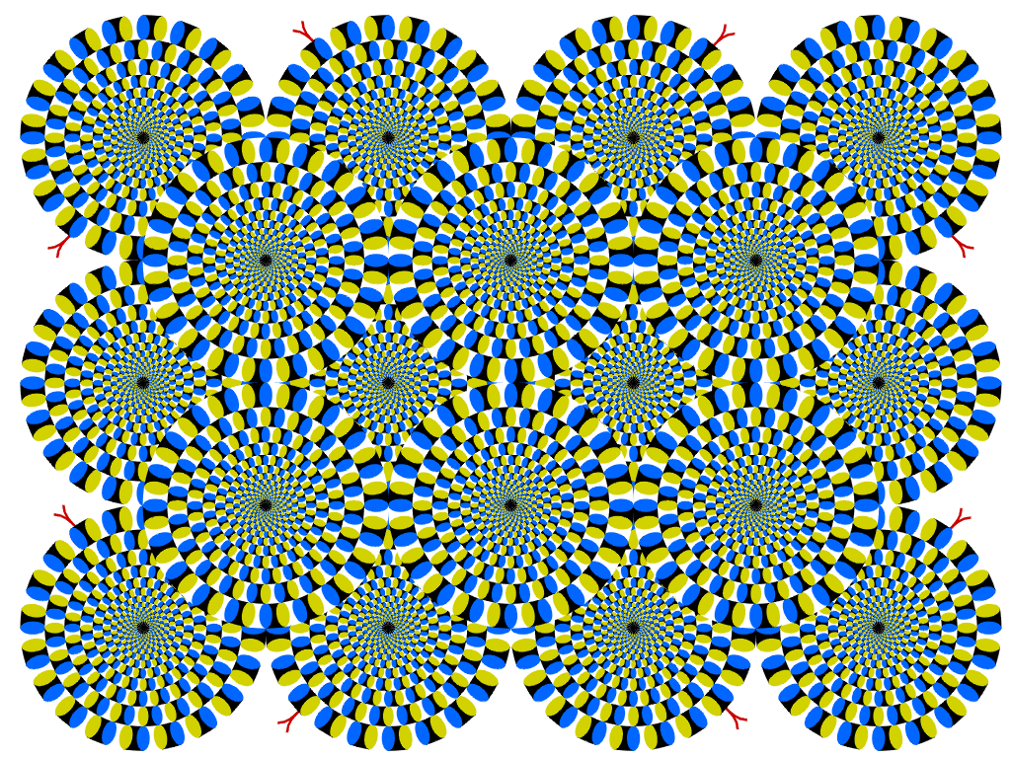
Sensation and Perception
Illusions

Slide 77
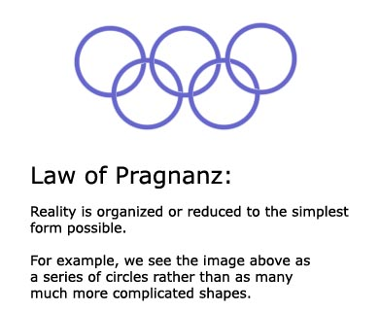
Sensation and Perception
Gestalt psychology: Pragnanz “meaningfulness”

Slide 78
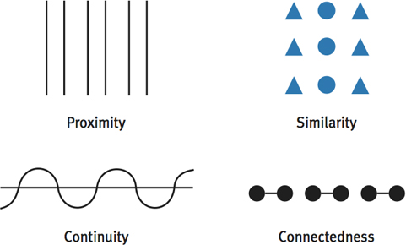
Sensation and Perception
Gestalt Psychology: Principles or Laws

Slide 79

Sensation and Perception
Gestalt Psychology: Closure

Slide 80

Sensation and Perception
Gestalt Psychology: Figure Ground

Slide 81

Sensation and Perception
Gestalt Psychology: Figure Ground

Slide 82

Sensation and Perception
Depth Perception

Slide 83
Sensation and Perception
Binocular cues
  Convergence
  Retinal disparity
Monocular cues
  Relative size
  Light and shadow
  Interposition
  Relative motion
  Atmospheric perspective

Slide 84

Sensation and Perception

Slide 85


Sensation and Perception

Slide 86
Sensation and Perception
Opening Activity: Does the culture you are from influence the way you perceive the world? Give an example to support your position.

Slide 87

Sensation and Perception
Learning-based inference theory
  Hermann von Helmholtz

Slide 88

Sensation and Perception
Context and expectations

Slide 89

Sensation and Perception
Context and expectations

Slide 90

Sensation and Perception
Context and expectations

Slide 91

Sensation and Perception
Context and expectations

Slide 92

Sensation and Perception
Perceptual set

Slide 93

Sensation and Perception
Perceptual set

Slide 94

Sensation and Perception
Perceptual set

Slide 95

Sensation and Perception
Culture influence

