Slide 1
Chapter 6: The Duel for North America, 1608-1763
AP Topic #4: The American Revolutionary Era

Slide 2
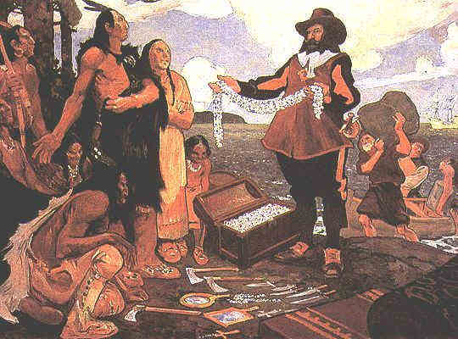
I Will Gain an Understanding of:
1. The competition between France, England, and Spain for North America
2. The French colonies in North America
3. Causes and Consequences of the French & Indian War

Slide 3
Essential Questions:
1. Why did the Ohio River Valley become the arena of conflict between the French and British in America?
2. The French & Indian War has also been called the “Great War for Empire” . Explain why this might be an appropriate name for this war.

Slide 4
European Nations Fought for Control of North America
1. Spain
2. England
3. France
The Seven Year’s War is also known as the French & Indian War (1754-1763)
In this context, North America includes Modern day U.S. & Canada

Slide 5
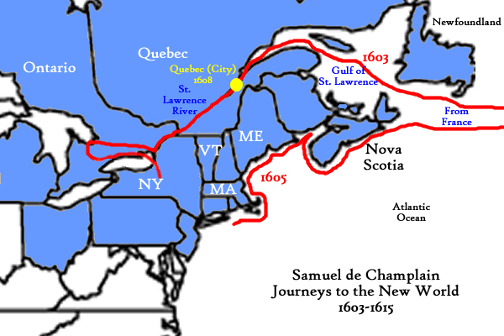
French Territories In North America
Quebec Founded in 1608
By: Samuel De Champlain-
“Father of New France”
Along the St. Lawrence River
(modern Canada)

Slide 6
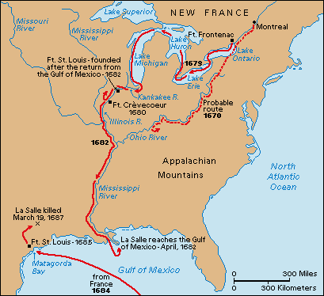
French Territories in North America
Robert de La Salle
Explored & claimed the Mississippi River Valley for France, 1682
Also Explored Great Lakes region

Slide 7
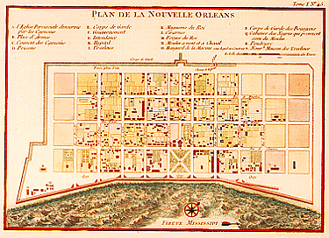
French Territories in North America
New Orleans – founded in 1718 by the French
Strategic location (mouth of Mississippi River & Gulf of Mexico)

Slide 8

French Economic Practices in North America
1. Created trade alliances with Native American tribes
2. Used “reciprocity”
3. Established fur trade
4. #1 trade item : Beaver pelts

Slide 9

French/European Interaction With Native Americans…
Caused conflict in Native American life:
1. the introduction of alcohol
2. Disease
3. firearms
4. disrespect of nature
Encouraged a cultural exchange
Glass beads introduced to Native Americans

Slide 10
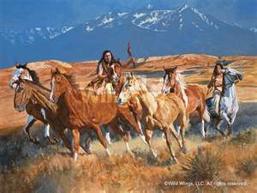
Spanish in North America
Footholds in the Southwest, Florida
Introduced Native Americans to the Horse
Horses then adopted into Native American Culture!

Slide 11
French Competition for North America
1. Established Detroit in the Ohio River Valley to discouraged English settlers
2. Established New Orleans in order to discourage Spanish settlers

Slide 12
The French & Indian War

Slide 13
Wars in Europe 1688-1763
Side 1: Great Britain (England) & Prussia
Side two: France, Spain, Austria, Russia
“Anglo-French “ wars started in Europe
Conflict eventually made its way to North America

Slide 14
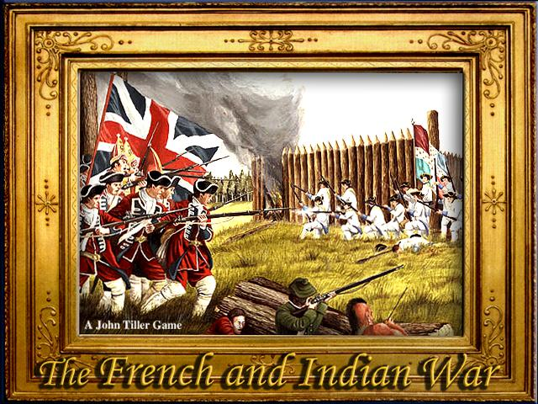
The French & Indian War
A.K.A. The Seven Year’s War
Local Cause:
Territory dispute between British vs. French
Over the Ohio River Valley

Slide 15
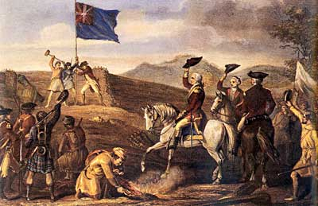
French Built Fort Duquesne
in Modern day Pittsburgh
Strategic location for transportation & possible settlement
But wait! British claimed that the territory was theirs!
Who did this territory belong to?

Slide 16
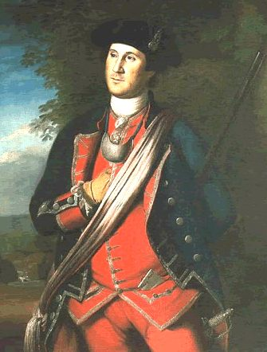
The Conflict Began When…
Governor of Virginia Dispatched Lt. Coronel George Washington & Troops
To Fort Duquesne
Washington’s job: Tell the French they were trespassing on British soil!

Slide 17
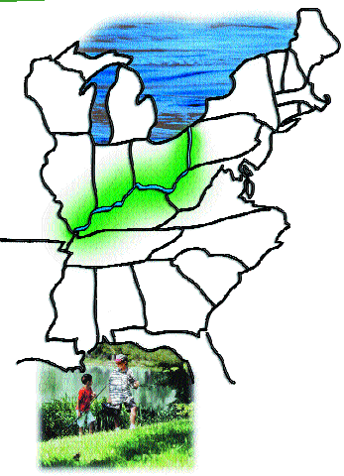
Fight Over Ohio River Valley
British Troops
VS.
French & their Native American allies
Whose territory is it?

Slide 18
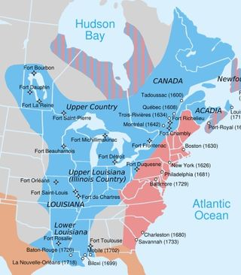
French vs. British
Immediate Causes:
Fight for territory in North America
Territory in dispute: Ohio River Valley

Slide 19
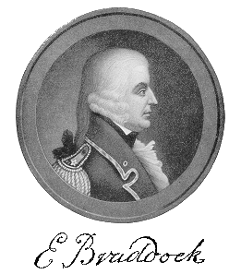
General Edward Braddock
And 2,000 British & colonial troops
Were Sent to seize Fort Duquesne

Slide 20
The War…
The French:
1. Had less population
2. had more experienced military
3. counted on Native American allies
As a result:
The British General Braddock was Defeated by Native American /French Troops
1755 in Ft. Duquesne

Slide 21
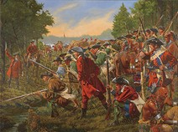
British Retreat/Defeat
A wake up call…

Slide 22
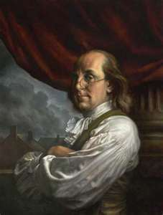
British Officials Called a Meeting…
Albany, New York
To devise defense plan against French
Representatives of only 7 colonies attended

Slide 23

Albany Plan of Union
Benjamin Franklin’s Plan
To form Confederation of colonies
Working TOGETHER for survival…
B.F.’s political cartoon→

Slide 24
Albany Plan of Union
Colonists:
Rejected Plan:
“too restrictive”
British Government:
Rejected Plan: “colonies have too much freedom”

Slide 25
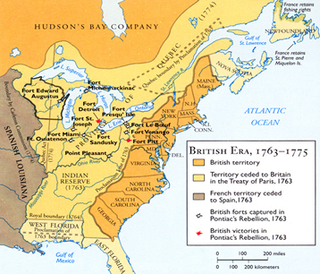
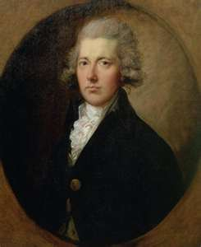

William Pitt’s Strategy to Win War
1. Naval Warfare
2. More British troops
3. Chose energetic leaders
4. Targeted Quebec & Montreal (French Canadian strongholds)

Slide 26
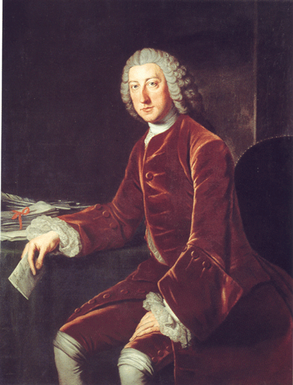

William Pitt
Strategy: to recruit colonial soldiers
Promised colonists they would not have to pay for cost of war

Slide 27
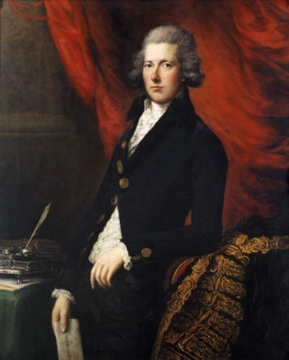
William Pitt…
“A tall and imposing figure, whose flashing eyes were set in a hawk like face, he was popularly known as the great commander”

Slide 28
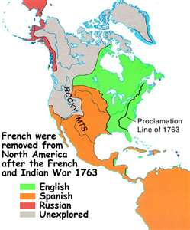
Treaty of Paris, 1763
Treaty Negotiations between “Winners” (Britain) & “Losers” (France)
1. France gave New Orleans to Spain
2. Spain gave Florida to Britain
3. Britain gave Cuba to Spain
4. Great Britain gained modern day Canada & territory east of the Mississippi

Slide 29
As a Result…
1.Great Britain = dominant colonial power north America
2. “American” Colonists proud they defeated French!
3. Great Britain left in debt ☹
4. Plan of Albany planted the seed of independence & revolution

Slide 30
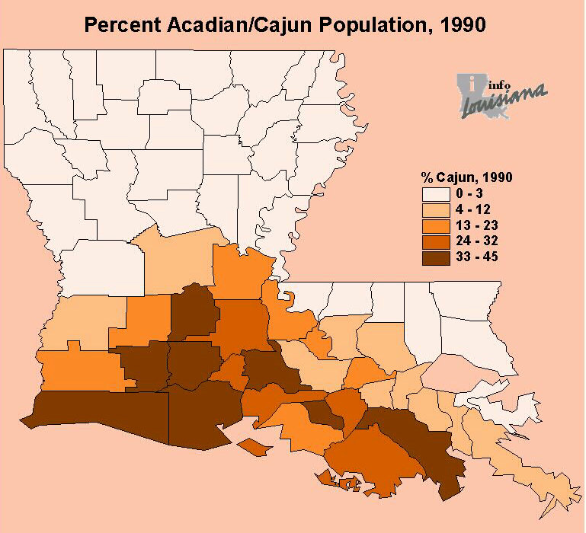
As A Result…
Displacement of French Colonists
7,000-18,000 Acadians forced to migrate to
Louisiana
“Cajuns”

Slide 31
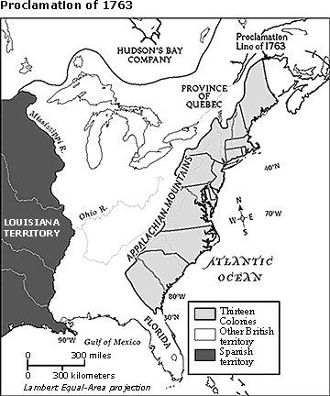
Proclamation of 1763
“American” Colonists not allowed to move West of Appalachian Mountains
Why? Peace w/ Native American tribes
However…
Most Colonists ignored ruling

Slide 32
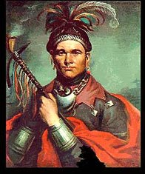
Impact on Native American Tribes
1. Loss of French Allies
2. Settlers wanted more land
4. Way of life threatened
5. Uncertain Future

Slide 33
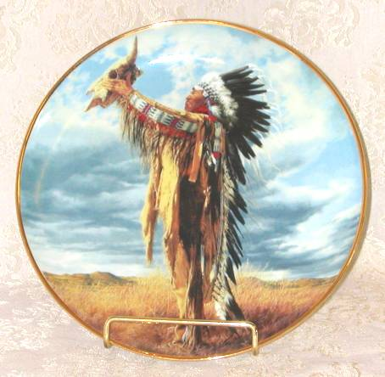
Whose Land ?
Tensions escalated between Colonists & Native Americans
Native American Tribes began to “band together”

Slide 34
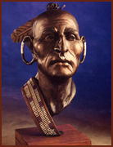
1. Neolin
“The Delaware Prophet” urged NA tribes to unify & not become tempted by European ways
“Great Spirit” vision

Slide 35
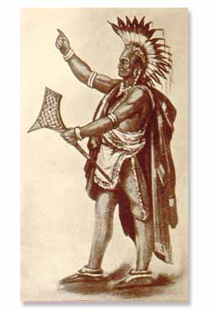
2. Pontiac’s Rebellion, 1763
Pontiac and his followers raided 8 British forts
“anti-British” sentiments

Slide 36

3. Iroquois League/Confederacy
Made up of 5 Native American Tribes (upper New York):
MOHAWK
ONEIDA
ONANDAGA
CAYUGA
SENECA

Slide 37
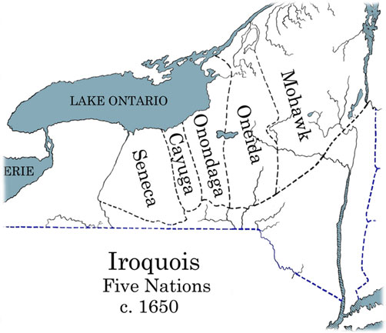
Iroquois League/Confederacy
Originally “5 nations”
Tuscarora tribe joined 1715
AKA “six nations”

Slide 38
Iroquois Constitution
Created 1450-1600
5 Independent nations under 1 constitution
Democratic government
Elected officials
laws

Slide 39
Iroquois Constitution
“Great Law of Peace”
Earliest form of democracy in North America
Possibly Inspired the Founding Fathers of U.S. Constitution?

