Slide 1
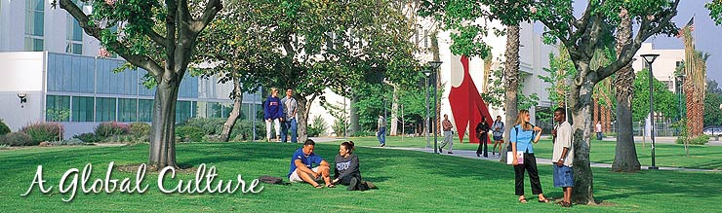
CSU Overview
&
CSUF Highlights

Slide 2
About Me
Matthew Payan
I’m in the Career Center
Mondays and Wednesdays from 10am- 3pm.

Slide 3
Systems at a Glance
System
California Community Colleges
(CCC)
www.ccco.edu
California State University
(CSU)
www.csumentor.edu
University of California
(UC)
www.ucop.edu
Independent Colleges and Universities
www.aiccu.edu
Number of Campuses
110
23
10
More than 75
Required Entrance Exam(s)
English and math Placement test prior to enrolling
ACT or SAT Reasoning
ACT plus writing or
SAT Reasoning and
two SAT Subject Tests
Varies: (Check with College or University of your choice)
Degrees Offered
Associate degrees and vocational certificates
Bachelors, Masters,
And limited Doctoral Degrees
Bachelors, Masters, Doctoral and, Professional Degrees
Associates, Bachelors, Masters, Doctoral, and Professional Degrees
Student Fees / Tuition
(subject to change)
$26 per unit
Approximately
$4,800 per year
Approximately
$ 11,233 per year
Average
$22,750 per year

Slide 4

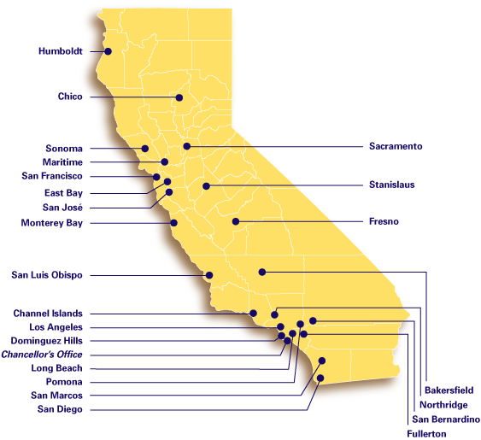
California State University
Application Process
$55 application fee
Apply Oct.1- Nov.30
www.csumentor.edu
Degrees Offered
Bachelors, Masters, and Doctoral degrees in Education (at some campuses)
Take English Placement Test (EPT) and Entry Level math (ELM) unless exempt
CSU draws from the top 33% of CA’s high school graduates
Requirements
Complete A-G ACT or SAT Reasoning
(Without Writing)

Slide 5
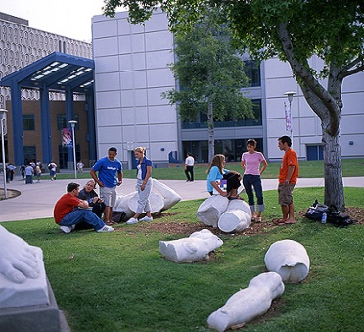
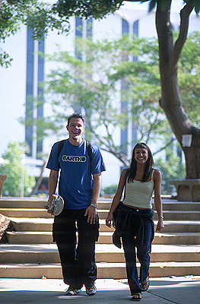
The Difference…
UC – States primary academic agency for research
CSU – Focus on teaching and practical experience
- Campuses are community oriented through
accessible internships students are well
prepared for the workplace.
CC – Academic & vocational instruction through
1st and 2nd years of undergraduate
California Master Plan
Notes:
The CSU system was created under the mission of teaching as its first priority. Our system is renowned for the quality of its teaching as well as its preparation of job-ready graduates. The CSU system provides education for a large proportion of many career fields in California. 80-90% of teachers, criminal justice workers, social workers, and public administrators in California have earned a bachelor’s degree from one of our 23 campuses. We emphasize not only the importance of learning in the classroom, but also the application of skills to real world experiences such as group projects, internships, or research projects with professors.

Slide 6
The A-G Study Pattern
College Preparatory Requirements | 9th Grade | 10th Grade | 11th Grade | 12th Grade | Total Units
A
B
C
D
E
F
G
History / Social Science- 2 years | World History / Cultures / World Civilizations |  | US History | Government / Civics (1 semester) | 2.5 Years / Units
English: 4 Years |  |  |  |  | 4 Years / Units
College Prep English
4 years completed with a C or better
Math: 3 Years, 4 Recommended | Algebra or Geometry | Geometry or Algebra 2 | Algebra 2 or Pre-Calculus |  | 3 Years / Units
Pre-Calculus or Calculus
4 Years / Units
Laboratory Science: 2 Years, 3 Recommended |  | Biology | Chemistry |  | 2 Years / Units
Physics
3 Years / Units
Language Other Than English: 2 Years 3 Recommended | Spanish 1 | Spanish 2 |  |  | 2 Years / Units
Spanish 3
3 Years / Units
Visual and Performing Arts: 1 Year- Same course |  | Art |  |  | 1 Year / Units
College Preparatory Elective: 1 Year |  |  |  | Economics (1 semester) | .5 Years / Units
College Prep
Physical Science
1.5 Years / Units
15 Years/ Units
21 Years/ Units

Slide 7


Eligibility Index
(Local Area)
Eligibility Index of 2900 using SAT or 694 using ACT
(GPA X 800) + SAT Reasoning (Critical Thinking & Math)
(GPA X 200) + (10 X ACT Composite)

Slide 8
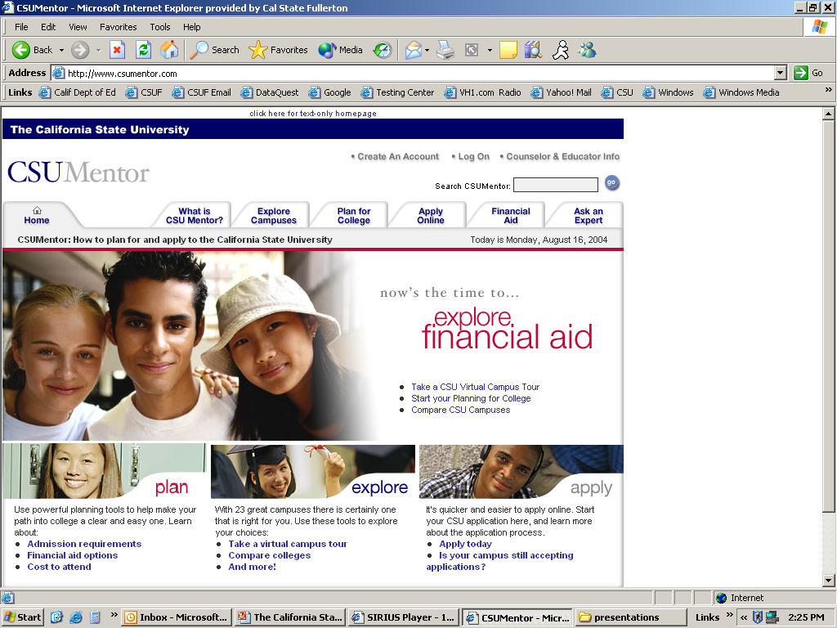
CSU Mentor
Apply online
  Oct 1st – Nov 30th
Plan for College
Search Campuses
Explore Financial Aid
www.csumentor.edu

Slide 9

Cost of Attendance
Fees | At Home | On Campus | Off-Campus
State University Fee | $4,866 | $4,866 | $4,866
Miscellaneous | $2,800 | $2,800 | $2,800
Books/Supplies | $1,620 | $1,620 | $1,620
Meals/Housing | $4,392 | $9,632 | $11,430
Transportation | $1,200 | $1,100 | $1,200
Total | $14,878 | $20,018 | $21,916

Slide 10

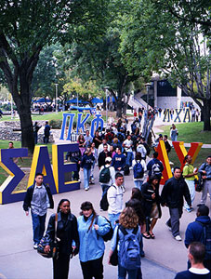
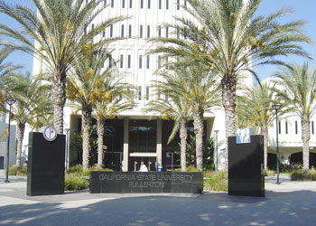
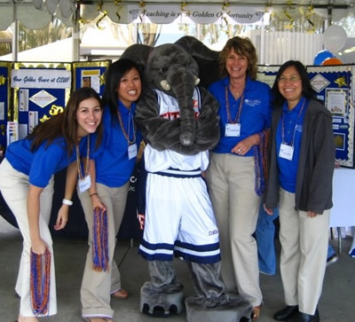
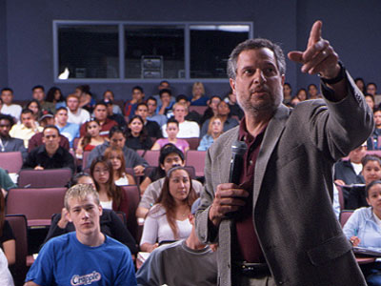

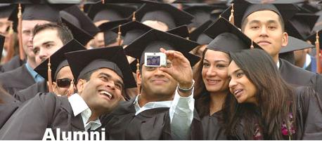
Why Fullerton?
Cal State Fullerton is a dynamic, metropolitan university centrally located in Southern California with a comfortable small-college atmosphere.
“We aspire to combine the best qualities of teaching and research universities where actively engaged students, faculty and staff work in close collaboration to expand knowledge.”

Slide 11
First-time Freshman Statistics - Fall 2008
Majors Most Often Declared
  Business Administration
  Psychology
  Communications
  Kinesiology
  Theatre
University Enrollment by Ethnicity
  Freshman Statistics
    Total Class Enrollment: 4,697
    59% Female, 41% Male
    Average GPA: 3.20
    Average SAT: 984
      Math: 503
      Verbal: 481
    Total Applications Received:
      33,287
    Total Admitted:
      19,780 (59%)

Slide 12

Fall 2010 Admission
Requirements
  Complete all A-G courses with at least a “C” or better
  Achieve at least a minimum eligibility index of 2900 (Local Area)
  Submit an application as early as possible between Oct 1st - Nov 30th
  Take SAT or ACT by December of Senior year
  Complete the ELM / EPT by May 1, 2010, if not exempt by EAP
  Close attention to dates and deadlines
Impaction
  Campus-wide Impaction for First-time Freshman & Transfer
    Recommend 4000 index for students outside the local area
  The EL-BSN is an impacted program
    Admission to the University as a pre-nursing student does not guarantee admission to the EL-BSN nursing major.

Slide 13
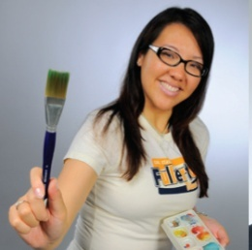

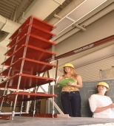





Academics
College of the Arts
The College of the Arts is among the top 16 highly recommended programs in the nation.
COTA students receive top awards and recognition in annual competitions and festivals such as ImagiNations, Microsoft Imagine Cup, Key Art, VASTA, American College Dance and International Music Scholar Laureate Program.
College of Engineering & Computer Science
Work on real world research projects with faculty members and industry professionals. Study in small classes and participate research and design competitions with highly qualified professors.
College of Health & Human Development
Fastest growing college since 2000, graduating students that are very employable.
    • Child and Adolescent Studies Health Science
    • Counseling and Social Work Human Services
    • Kinesiology, Athletic Training
College of Business & Economics
Mihaylo College is the largest accredited business school in California and the 4th largest in the United States. It is listed in Princeton Review’s Best 290 Business Schools. This college has its own advisement counselors.

Slide 14
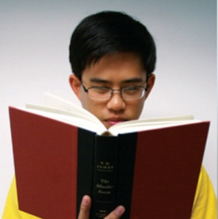
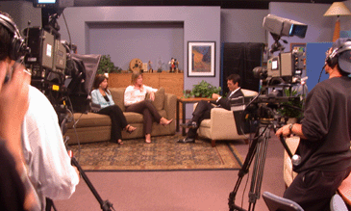
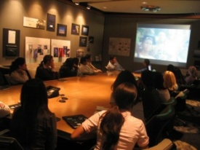

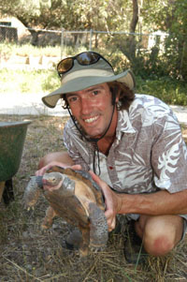



Academics
College of Humanities & Social Sciences
HSS: Home of Student Success | Largest College in the CSU
Focus on education, research, public service and professional development
The College hosts its own Study Abroad Program: Spring in London, Summer in Italy or Spain
College Alumni Internships Programs in Washington D.C.
College of Communications
Our College of Communications is the largest in the western United States and fourth largest in the nation. Through professional faculty we maintain contacts with communications professionals throughout the region and nation.
College of Natural Sciences & Mathematics
Emphasis on instruction and student involvement in research such as the Tucker Wildlife Sanctuary, a 12 acre nature preserve providing hands-on research opportunities.
With plenty of scholarship opportunities
College of Education
The College of Education at CSUF provides the only university teacher preparation program in Orange County that is accredited by the National Council for Accreditation of Teacher Education (NCATE).

Slide 15
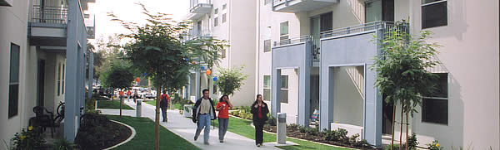
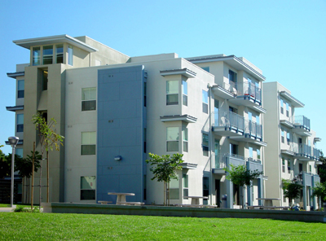
Housing
On-campus housing accommodates
836 students.
The residence hall complex consists of
apartment style suites and a
community center.
Students do not have to be admitted
to the University to submit a Housing
Application.
Single occupancy: $7675
Double occupancy: $5775
A new housing complex is
planned to open in Fall 2011 and
will accommodate 1,000
additional students
  Traditional style dorms & cafeteria
Contact Info:
Phone: (714) 278-2168
Email: housing@fullerton.edu
Hours: Monday-Friday 8am to 5pm
Apply as early as October 1st at www.fullerton.edu/housing

Slide 16
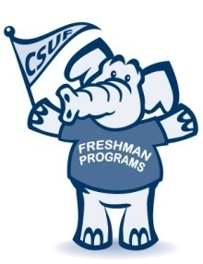
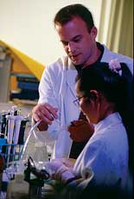
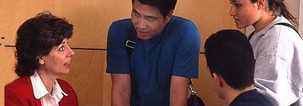
Available Programs
Freshman Programs
Honors Program
Smaller Learning Communities
to help you transition to college life…
Fullerton First Year
Compass
Live n’ Learn
Freshman Future Teachers
Freshman Future Nurses
Benefits
Priority Registration
Honors classes with smaller class sizes
Support in navigating the college system
Peer mentors
Social activities
Community Involvement
Help with applying to scholarships
Education Opportunity Program
Eligibility
At least a 3.5 GPA
Leadership, service, or creativity
Admitted First-time Freshman
Two Letters of Recommendation
Benefits
Pre-admission counseling
Admission assistance, referrals for tutoring
Career Guidance
Financial Advisement
Eligibility
California Resident
Meet income criteria
Complete application by deadline

Slide 17


President’s Scholars Scholarship
Benefits Include:
4 year Scholarship
Laptop
$750 for Books
Admission to Honors Program
Priority Registration
Complimentary Parking Permit
Competitive Eligibility Process Requirements Include:
At least a 3.75
A min of 4050 academic index
School and Community Service
Outstanding Academic
Achievement
Admitted First-Time Freshman
California Resident

Slide 18
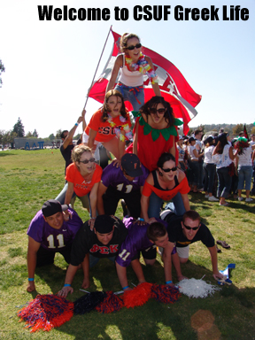
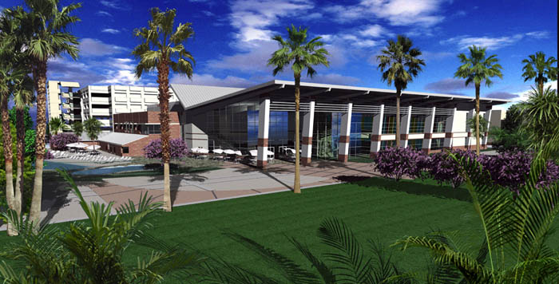
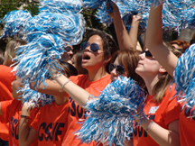
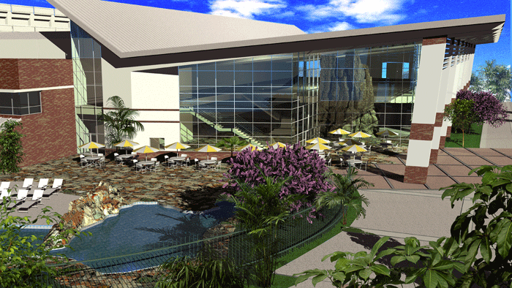
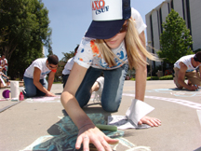
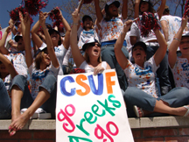
Student Clubs & Organizations
250+ clubs and organizations
29 Greek, Cultural, and Local Fraternities and Sororities
Start your own!
Numerous student development opportunities through the Dean of Students office including Student Leadership Institute, Multicultural Leadership Center, Volunteer and Service Center, New Student Programs, and Associated Students
Student Rec Center
*Indoor track *Rock Climbing wall *Outdoor pool…. & more

Slide 19



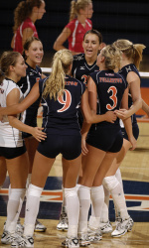
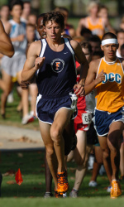

Titan Athletics: NCAA Division I
Baseball (1979, 1984, 1995, 2004)
Basketball
Cross-Country
Gymnastics (1979)
Soccer
Softball
Tennis
Track & Field
Volleyball
Wrestling

Slide 20

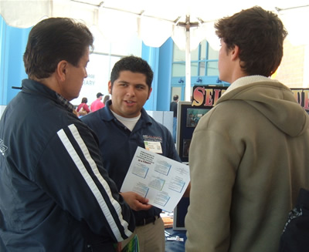
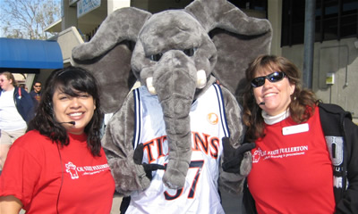

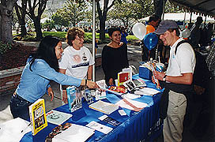
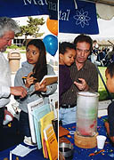
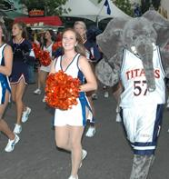
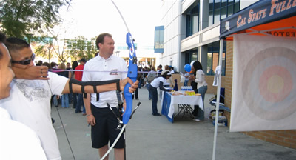
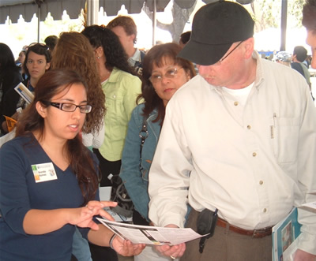
Welcome to Cal State Fullerton Day
Saturday, April 16th, 2011
Explore university clubs, student services and all of CSU Fullerton’s academic departments
Workshops & Activities
Campus Tours & more…
Register online at:
http://calstatefullerton.com

Slide 21


Questions?
Important Dates
Oct 1 – Nov 30: Apply for admission
Jan 21: SAT/ACT scores must be received
March 2: Financial Aid application due
April 16: Welcome to Cal State Fullerton Day
May 1: Last day to pay Enrollment Deposit
May 7: Last day to take ELM/EPT placement exams
May 12 at 5:00pm: Last day to register for mandatory New Student Orientation
July 15: Final official high school transcript must be received
Contact Info:
Admissions - 657.278.2370 admissions@fullerton.edu
Campus Tours - 657.278.3120
Disabled Student Services -657.278.3117 dsservices@fullerton.edu
Financial Aid – 657.278.3125 fa@fullerton.edu
Housing – 657.278.2168 housing@fullerton.edu
Transfer Services – 657.278.3358 transfer@fullerton.edu
University Outreach – 657.278.2086 outreach@fullerton.edu

