Slide 1
Warm-up #7
Where the Mongols good rulers? Why or why not?
Why do you think the Mongols (Yuan Dynasty) fell?

Slide 2
Ming Dynasty Cornell Notes
In what ways did isolationism effect the Ming dynasty?

Slide 3
I. Ming Dynasty
In the 1300s many Chinese groups rebelled against the Yuan dynasty.
In 1368 a former monk named Zhu Yuanzhang (JOO yoo-ahn-JAHNG) took charge of a rebel group and defeated the Mongols.
    Zhu Yuanzhang took the name Hongwu and became the first emperor of the Ming Dynasty.
The Ming Dynasty ruled China from 1368-1644 (almost 300 years)

Slide 4
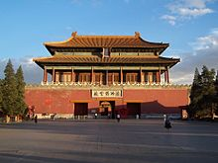

II. Ming Building Projects
Forbidden City, Built for emperor Yongle (Hongwu’s Grandson. 2.5 million sq. feet

Slide 5
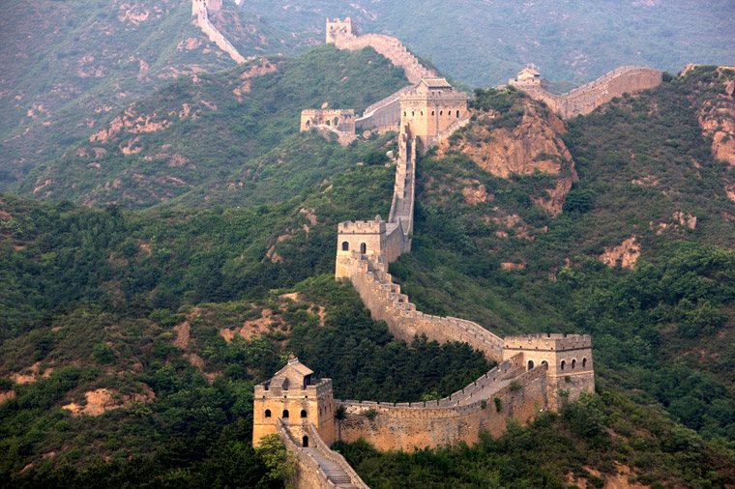
II. Ming Building Projects
Continued construction of the Great Wall of China.
More than 2,000 miles long.
Built to keep out nomadic invaders.

Slide 6
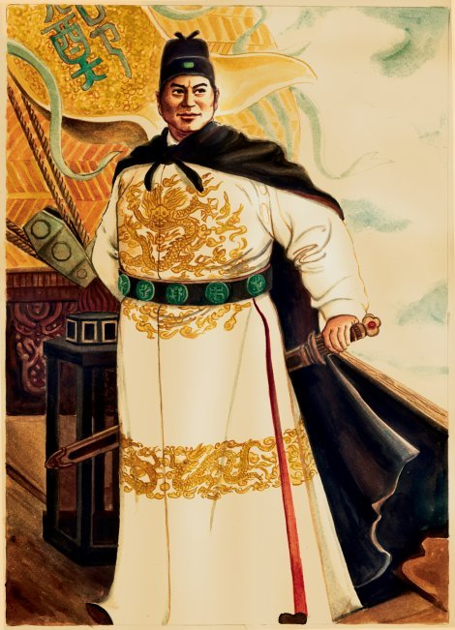
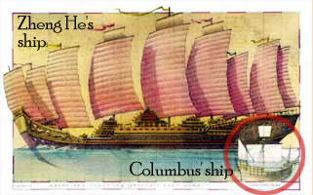
III. Zheng He
7 grand voyages: Asia, India, Arabia, and Africa.
Fleets included over 60 ships, 25,000 sailors, and ships perhaps longer than 300 ft
Voyages were diplomatic efforts. Gifts were given to foreign leaders from the emperor.
YouTube Zheng He

Slide 7
Pair-Share
Why were Zheng He’s voyages impressive?

Slide 8
IV. Ming Government
Ming emperors were very powerful.
Officials reported directly to the emperor and helped keep his affairs organized.
Censors: officials that investigated the behavior of local leaders & judged the quality of schools and other institutions.
  Censors took examinations in order to be appointed.
Isolationism: a government policy of avoiding contact with other countries was adopted after Yongle’s death. Navel fleet was dismantled, his logs burned, and foreign trade banned.

Slide 9
Think About It…
What is isolationism? Can you think of any examples of isolationism during the Ming Dynasty?

Slide 10
Warm-up #8
Name and describe at least one example of isolationism under the Ming Dynasty?
In what way was color significant in the Forbidden City?

Slide 11
Gallery Walk
You will visit four stations.
As you visit each station, answer the corresponding questions on your handout.
How to rotate between stations:
  Rotate clockwise on Ms. Schaller’s command.
  “A”s stay at “A” stations only.
  “B”s go to “B” stations only.
  Station #4 is BrainPop
    Play video (press the CC key if you want to read along)
    Take the graded quiz at the end of the video.
    Cue up video for the next person.
    Do not log out!

