Slide 1
Organic Chemistry and Enzymes
EQ: What kind of organic compound are enzymes and what do enzymes do?

Slide 2
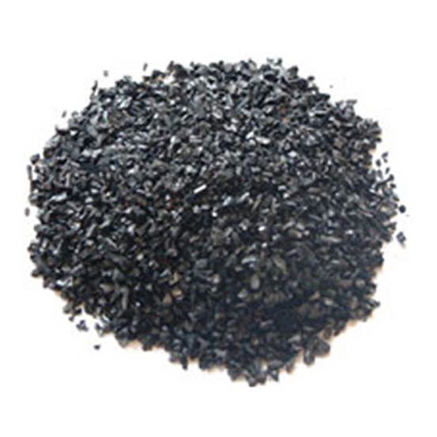
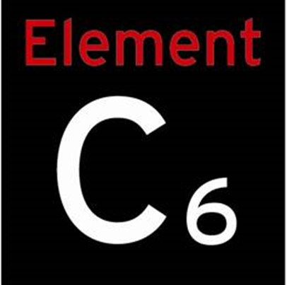
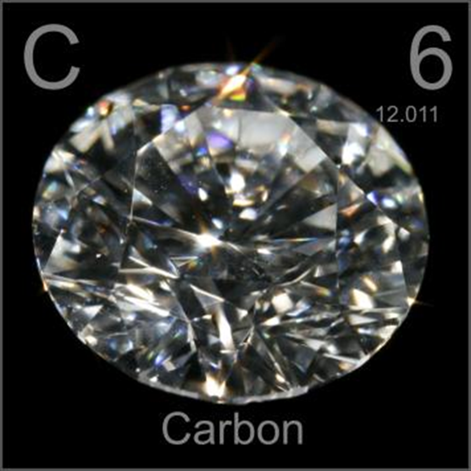
Chemistry of Carbon
Organic chemistry is the study of all compounds that contain bonds between carbon atoms

Slide 3
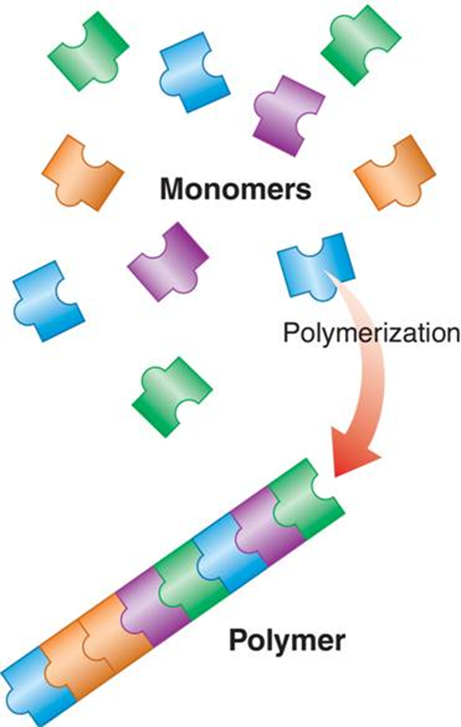
Macromolecules
Macromolecules are formed by connecting many monomers together to create a polymer

Slide 4

The Four Organic Compounds
These 4 compounds are found in living things:
Carbohydrates
Lipids
Nucleic acids
Proteins

Slide 5
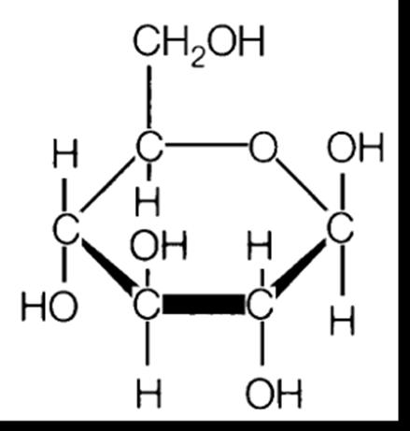
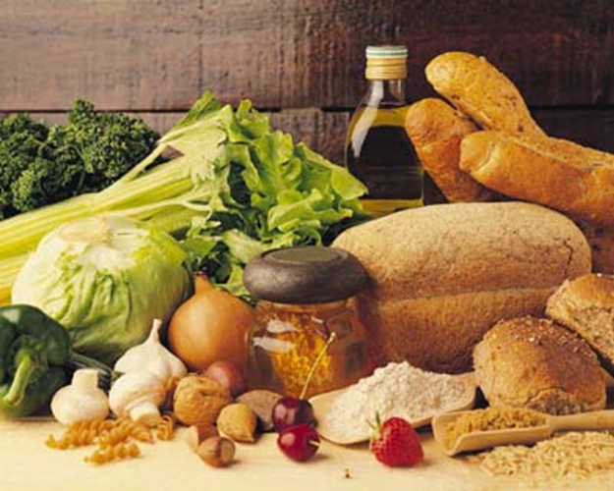
Carbohydrates
Made up Carbon, 2 Hydrogen, and Oxygen
Source of Energy
Creates structure for plants

Slide 6
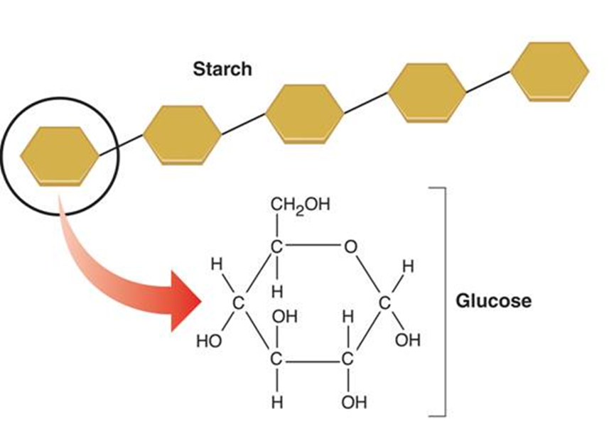
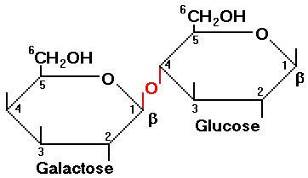
Different sizes of Carbohydrates
Monosaccharides
Disaccharides
Polysaccharides

Slide 7
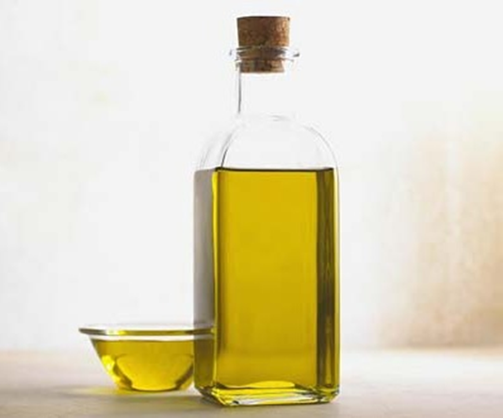
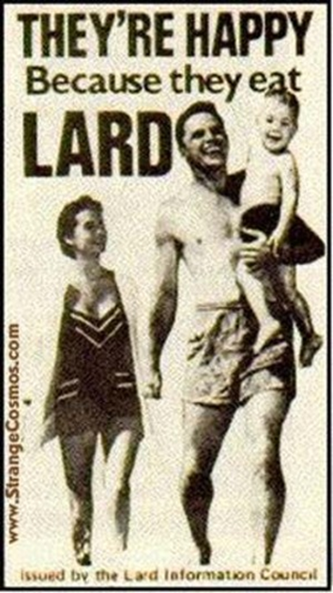
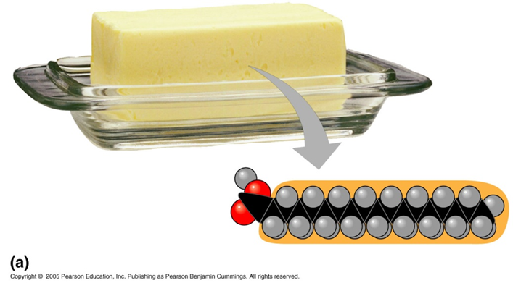
Lipids
Lipids do not dissolve in water
Different types of lipids
Fats
Oils
Waxes
Steroids

Slide 8
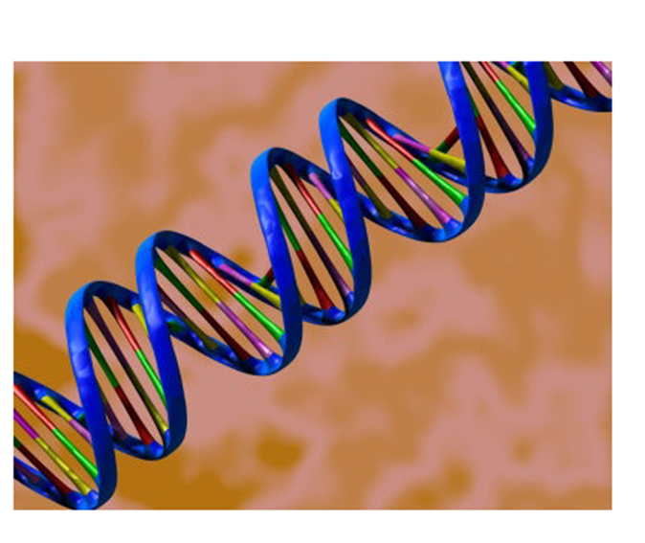
Nucleic Acids
Nucleic acids are polymers assembled from individual monomers known as nucleotides

Slide 9
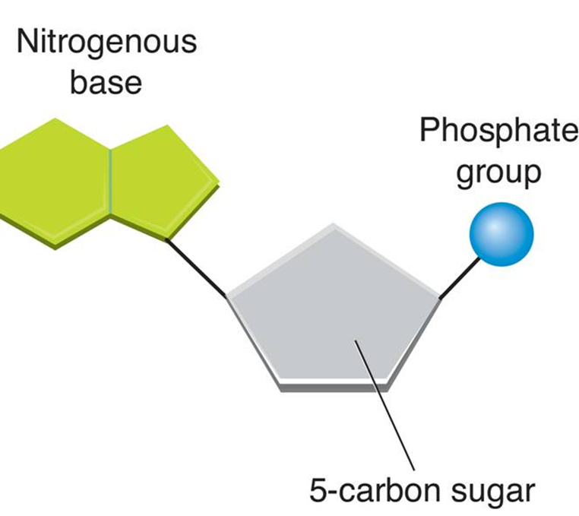
Nucleotides
Smallest sub-unit for nucleic acids
Examples of Nucleic acids:
DNA
RNA

Slide 10
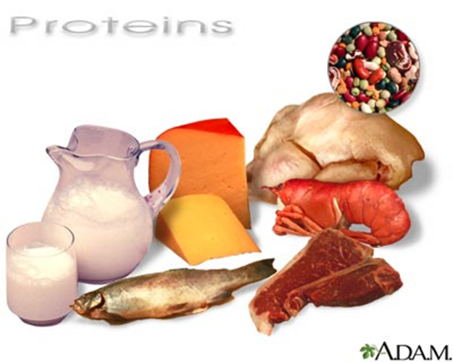
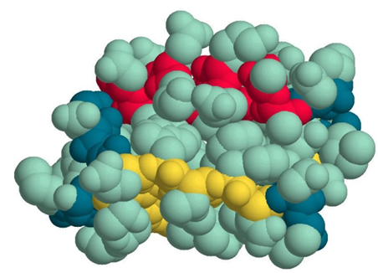
Proteins
Proteins are macromolecules that contain nitrogen, carbon, hydrogen, sulfur and oxygen
The monomer (sub-unit) of proteins are amino acids

Slide 11
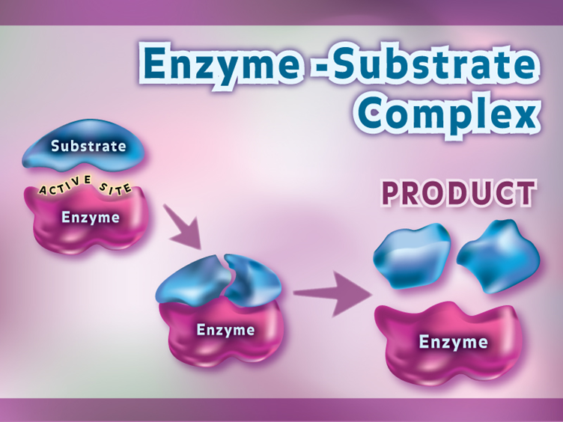
Functions of Proteins
Speed up reactions – Enzymes
Used to form bones and muscles
Transport substances into or out of cells
Help to fight disease - antibodies

Slide 12

Enzymes
Enzymes provide a site where reactants can be brought together to react.
Enzymes speed up chemical reactions that take place in cells

Slide 13
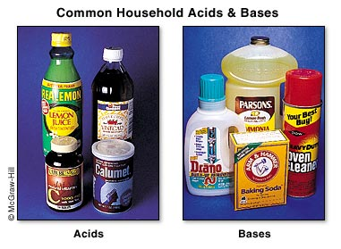
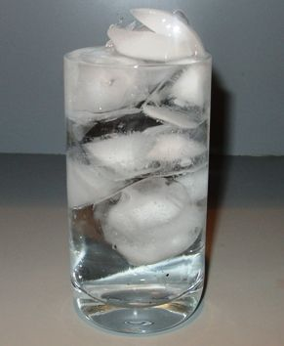
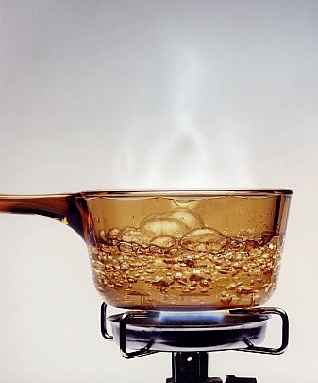
Regulation of Enzyme Activity
Enzymes can be affected by any variable that influences a chemical reaction.
pH values
Changes in temperature
Amount and concentrations of enzyme or substrate

