Slide 1
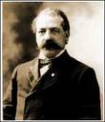
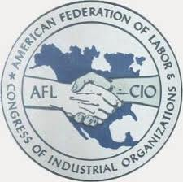
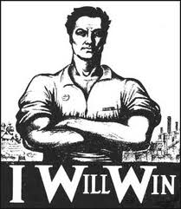
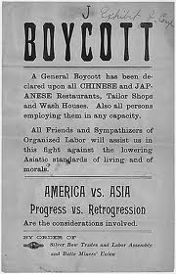
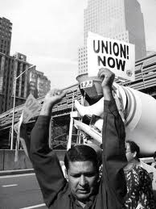
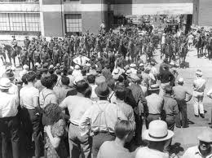
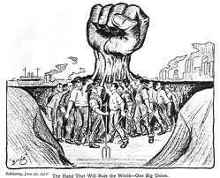
Labor Unions

Slide 2
Left side of notebook- How Best to Help Labor?
By the late 1880s, many workers in America were-
  Unskilled: factories (such as steel, meatpacking, textiles), coal mines
  Service industries: banks, department stores, secretaries, nurses
  Skilled: for example- carpenters, bricklayers
  Using the Decision Making Skills (notes behind your U.S. map)-

Slide 3
  You are a labor union leader during the late 1800s!
  *Problem:
  Who (which groups of people or types of workers) would you allow in or recruit for your union? (Use from the list under “Groups” on the handout)
  2. Which issues will you address as a labor union leader ? (Refer to the list under “Issues” on the handout?
  3. What assumptions do you have as a labor union leader? (About the people you represent, issues you want to change)

Slide 4
  *Goals:
  1. What strategies would you use to accomplish your goals as a labor union leader? (Top 3-Refer to the list under “Strategies”)
Effects:
1. Predict the unintended (unplanned) consequences of the choices you wrote under Problem and Goals.

Slide 5
Analysis- look at Handout 3
Which actual labor union came closest to your answers? Explain how you were close to the same strategies or far from their strategies.

Slide 6
Right Side notes- (use handout 3 to complete definitions)
Union: a worker organization that aims to improve working conditions and wages ($).
Strike: workers refuse to work until their demands are met.

Slide 7
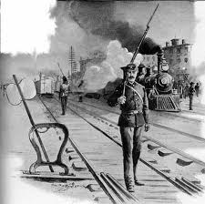
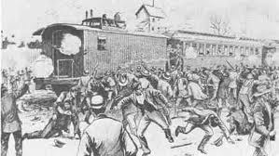
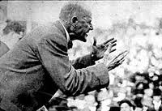
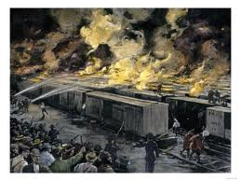
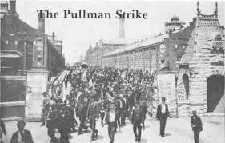
Strikes! 1877-1894

Slide 8
Right Side of Notebook notes-
Strike: workers refuse to work until their demands are met.
Strikebreaker/ Scab: a worker hired to take a striker’s job during a strike.
Blacklist: a list of workers not to be hired in an industry.
American Federation of Labor: Union for skilled workers; led by Samuel Gompers. Issues they addressed: higher pay, better working conditions, shorter hours.
Eugene Debs: led the American Railway Union, supported workers in the 1894 Pullman strike- lost.

Slide 9
Procedure For Making Decisions Today!
We will read 4 different problems.
After each problem, you will have time to decide what you will do and write it down.
Then the class will vote on whether to strike.
The class will then find out the outcome of the strike

Slide 10
Topic | 1) My Decision | 2) Real Decision | 3) Why different or similar? | 4) What I learned about P.A.G.E from this topic
Problem 1: 1877-
Problem 2: 1892-
Problem 3: 1892-
Problem 4: 1894-

Slide 11
Actual Outcomes- Problem 1 1877
What actually happened:
The workers went on strike-> Great Railroad Strike of 1877
Unintended Consequences:
  No union or strike committee= strike had no discipline
  Strike spread to other railroads-> mobs of strikers destroyed railroad cars, tracks, buildings. Strikers fought with police and soldiers-> Army brought in to restore order.
  100 people died, 500 wounded
  The public first sympathized then was horrified at the violence, calling for stricter measures to prevent future strikes.
  If you joined the strike, you probably didn’t die but you probably lost your job.

Slide 12
Actual Outcomes- Problem 2 1892
What actually happened:
This time, strikers had discipline and organization, however the strike was crushed by the governor. Workers had to accept: pay cut, ↑workday to 12 hrs. Many were fired & blacklisted. Union membership ↓=24,000 in 1892 to 7,000in 1902
Unintended consequences:
  Strikers used violence against detectives, killed 7-> press reports & public opinion ↓
  Governor called in state militia to restore order
  Attempted assassination on the governor-> less public support for the strike

Slide 13
Actual Outcomes- Problem 3 1892
What actually happened:
The strike led to violence in the mining district- miners had no union.
Unintended consequences:
  No discipline= miners attacked and killed several strikebreakers.
  Public turned against the miners
  Idaho governor ordered National Guard troops to restore order
  Pay cut remained, many strikers fired

Slide 14
Actual Outcomes- Problem 4 1894
What actually happened:
The American Railway Union supported the strike and stopped rail traffic all across the Midwest. Strike affected every railroad in the region.
Unintended consequences:
  Railroad owners pulled together with the fed. gov’t to continue mail delivery with trains.
  Some strikers attacked deputies, destroyed railroad property= ↓ public opinion of strikers
  Strikebreakers were plentiful, especially African-Americans because the union excluded blacks.
  President Cleveland sent in troops, a judge ruled union leaders couldn’t ask workers not to work.
  Union leaders were arrested and strike failed.

