Slide 1


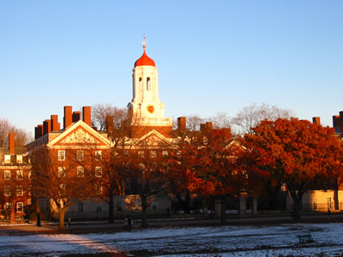


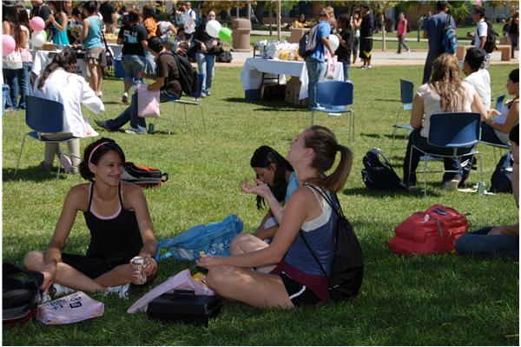



Senior Timeline

Slide 2







It’s your senior year!
Class of
2011!

Slide 3

Make a Plan
“Any Great Journey, big or small, begins with a Plan”
Mark your calendar with important dates
Be sure to stay on top of application and financial aid deadlines
Talk to your counselor and CSUF Titan Choices Intern about college plans, financial aid options, and your transcript

Slide 4
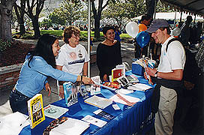
Every university has its own personality…
Get a feel for the campus
Take a tour of the campus
  Go on a weekday when the campus is open and students are there
  Schedule a tour at www.fullerton.edu/tours
Attend campus-wide
  Welcome to CSUF Day – April 24, 2010
  Meet staff, faculty, and other students!
Sit in on a class
Try to stay overnight in a residence hall
If you plan to compete in Division I or Division II college sports and want to be eligible to be recruited by colleges, you must register with the NCAA

Slide 5

College Tours
What to ask
Find out what department your major lies in
  (ex. Liberal Studies is in the Humanities Department)
  Get brochures about your major and other majors your interested about
Ask to see the classrooms and find out the ratio of students per teacher
How many students attend this University?
What student clubs and organizations are available to get involved with?
Do they have on-campus housing? Ask to see their housing.
  Are meal plans available?
  Do first time freshman have priority?
  When should you apply for housing?

Slide 6


September-October
November - December
Register for the SAT I, ACT and SAT II
  Colleges receive scores about three weeks after the test
Apply to Cal State Universities
  October 1 – November 30
  Apply for housing at CSUF
Use on-line College Search engines to explore campuses
  www.csumentor.edu
Request brochures on admissions and financial aid
Narrow your college list to about five to eight colleges
  Create a Plan A and a Plan B
Get a head start on your personal statement
Cal State Universities-
  Apply between October 1 – November 30
  www.csumentor.edu
University of California-
  Apply between November 1-November 30
  www.ucop.edu
Independent Colleges & Universities
  Application deadlines vary, check with specific campuses
  www.aiccumentor.org
  Ensure your application is complete
  All schools received official SAT/ACT scores and high school transcripts
  CHECK YOUR PORTAL!

Slide 7


January-March
Submit FAFSA between January 1 and March 2 of your senior year
  www.fafsa.ed.gov
Attend a Financial Aid Night with your parents at a school in your area
  About four weeks after submitting your FAFSA, review your SAR (Student Aid Report) for accuracy
Most private universities like USC require the CSS/Financial Aid PROFILE in addition to FAFSA
Apply for scholarships
  www.fastweb.com
Register for placement exams (if required)
Submit 7th semester transcripts (if required)

Slide 8



April
June
Attend Welcome to Cal State Fullerton Day
  April 24, 2010
Review admission decisions and financial aid award packages
  Read each carefully and note all reply deadlines
  Register for New Student Orientation
  Send the enrollment form and deposit check to the college of your choice (if needed)
If you're waitlisted by a college, contact the admission department to inquire about next steps
If you're not admitted to any of the colleges to which you applied, find out what colleges are still accepting admission applications and speak with a counselor to review all options.
Send your final official transcripts to the college of your choice
Finalize your summer plans
Send thank-you notes to teachers, mentors, counselors and anyone else who has helped you in your college process

Slide 9
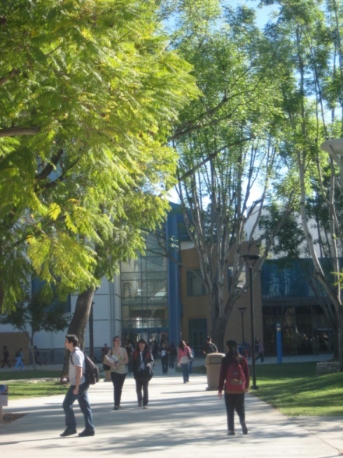

College life
Find out:
What kind of Freshman Programs are available?
  When can I apply? What are the requirements? What kind of benefits are there? /How many students are accepted?
How many student clubs and organizations are on campus?
What sports do they have?
Is it a commuter school?
What does the surrounding city have to offer?
Are buses/trains/subways near by?

Slide 10
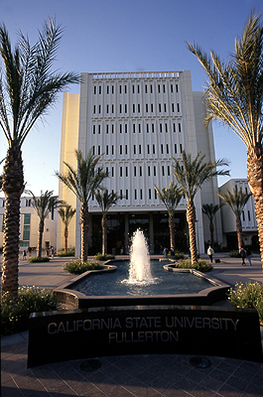
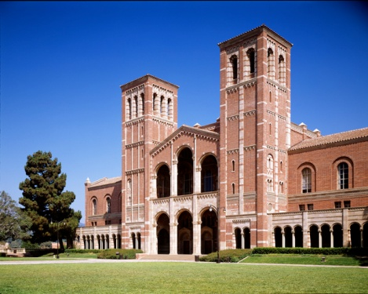
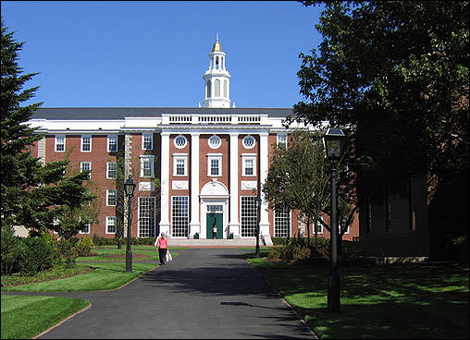
Your College Choice
Ask yourself…
Is this a place I can see myself in for four years?
Do they have programs/clubs I can benefit from?
Is the environment friendly?
Can I afford to live on campus?
What did I like/dislike?
What does this school have that the others do not (& vice-versa)?
How can I find my niche and leave my mark?

Slide 11

Good luck!
Come by the higher education center
if you have any questions!
Matthew Payan
I’m in the Career Center
Monday and Wednesday 10am-3pm

