Slide 1
The Middle Ages
By Gabrielle N. Zegers

Slide 2
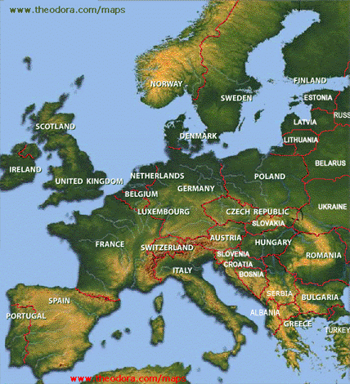
Geography
Europe is a great peninsula ejecting from Asia.
Vast Northern European Plain
  Fertile ground for planting crops
  Provided safe passage for traveling tribes
Mountain Ranges
  Pyrenees- along the northern and eastern borders of Spain
  Alps- blocked moist wind from reaching Mediterranean countries

Slide 3
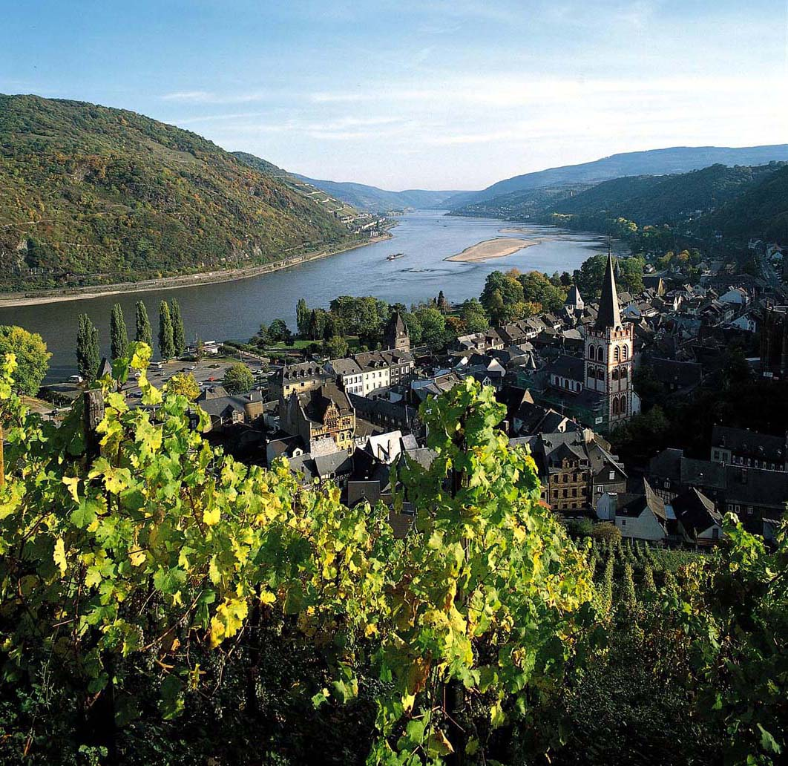
Geography
Europe has a climate that is warm and moist, though the Mediterranean countries are dry due to the Alps blocking the moist wind from reaching them
Rivers; Rhine and Danube
  Natural boundaries
  Highways for trade
  Water for farms

Slide 4
Geography quiz
Europe is a/n
Peninsula
Island
Volcano
Planet

Slide 5
Geography Quiz
What mountain range blocks moist wing from reaching the Mediterranean countries?
  The Himalayas
  The Pyrenees
  The Alps
  The Rockies

Slide 6
Geography quiz
What were the major rivers in Europe (all that apply)?
  Rhine
  Yellow
  Sacramento
  Danube

Slide 7
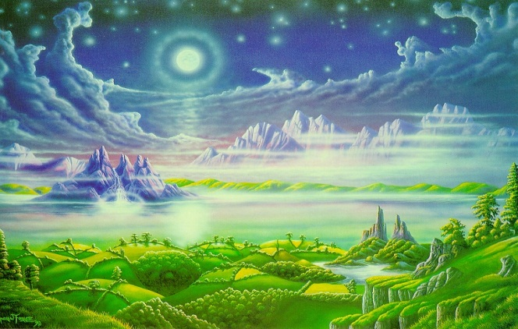
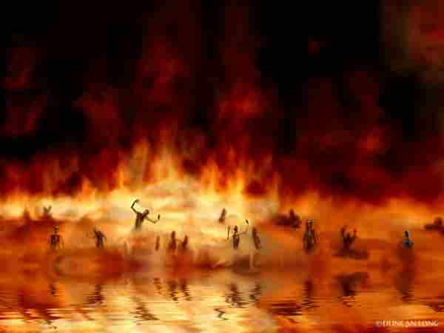
Religion
Christianity became the dominant religion
  There is one God
  Humans are weak and sinful ever since Satan brought sin into the world
  If humans did not seek forgiveness from God, they went to hell when they died
  Hell-a fiery pit of eternal misery
Or you could go to heaven
  A place of eternal happiness and paradise
  Observe sacraments
  Obey Jesus/have faith in him
  Abandon sinful ways

Slide 8
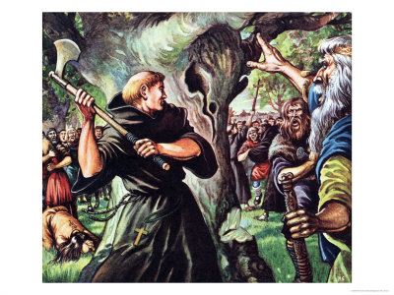
Religion
St. Patrick
  Founded over 300 churches in Ireland
St. Boniface
  Cut down the sacred tree of Thor and converted Germany and the Netherlands
Pope Gregory I
  Sent monks to England to convert the king. His subjects followed

Slide 9
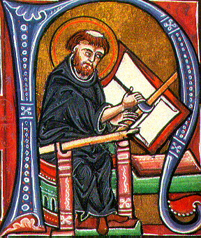
Religion
Monks
  Lived in Monasteries
  Took vows
    Poverty
    Chastity
    Obedience
    To be a monk until death
  Duties
    Workshops
    Copying Manuscripts
    Praying
    Helping the sick and weak

Slide 10
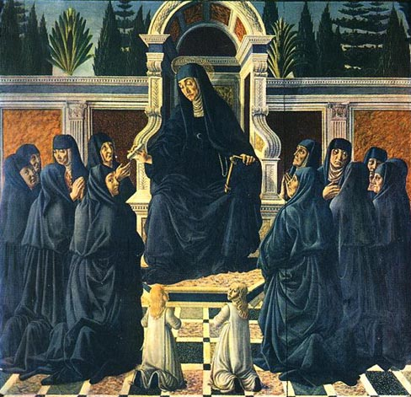
Religion
Nuns
  Lived in Convents
    Escaped marriage
    Wanted a Medieval scholarship
  Took similar vows and did similar duties as monks
    Beekeeping
    Growing herbs
    Studying
    Copying manuscripts
    Praying

Slide 11
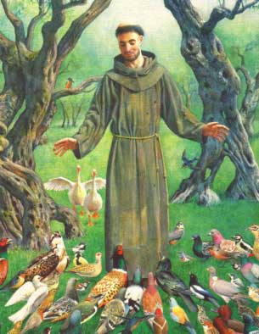
Religion
Later, new orders were founded with outward looking goals
  St. Francis of Assisi lived like Jesus, being a friend to everything and everyone
    Attracted many followers with his pure life, founded the Franciscan order
  St. Clare of Assisi founded an order based off his teachings

Slide 12
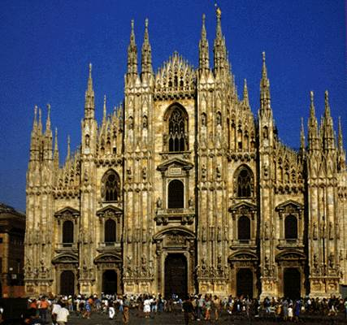
Religion
Great Cathedrals were built
  A major church headed by a bishop overseeing the regions’ other churches
  First they had domed roof, thick walls and narrow windows
  Later built gothic style:

Slide 13
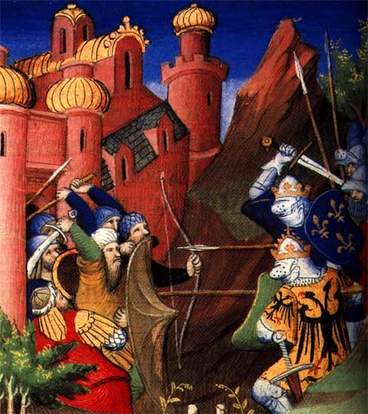
Religion
When Muslims started to attack pilgrims, Pope Urban called the first Crusade, or religious war
  First- extremely successful; the Turks in the Holy Land were defeated
  The Other Crusades
    Crusaders didn’t respect Muslims
    Crusaders didn’t gain any local support
    Constantinople was looted

Slide 14
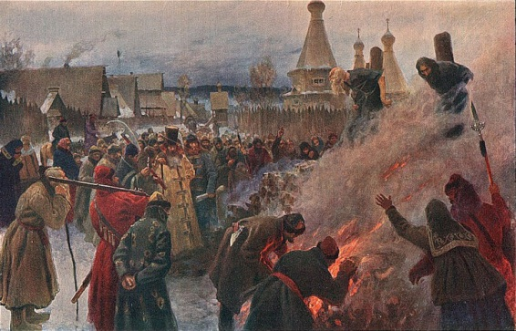
Religion
Heresy- a belief rejected by the Church
Heretics, or people who believed in heresies, were persecuted
  Inquisition- a church court who judged and punished heretics
  Punishments ranged from whippings to executions

Slide 15
Religion Quiz
What was something Christians did NOT have to do to go to heaven?
  Give up their sinful ways
  Go to the tomb of Simon Peter
  Have faith in and follow the ways of Jesus
  Observe the sacraments

Slide 16
Religion Quiz
The Crusades affected Jews and other heretics because people respected them more.
True
False

Slide 17
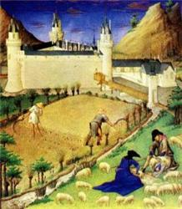
Achievements
Improvements in farming brought the population back up
Iron plows instead of wooden ones made it easier for crops to grow
Three field system
  One fallow
  One spring crops
  One summer crops
  Made it so if one crop failed the other would support the farmer
Used horses to plow fields instead of oxen because they ate less food for more work

Slide 18

Achievements
Trade and business increased
  Merchants traveled to areas to buy and sell items in towns
  More goods were available
    Iron knives, Leather boots, metal pots/pans
  Guilds formed to regulate and protect businesses
  Banking systems formed since merchants needed a safe place to keep money
    Notes of credit: can put money in one bank and withdraw it from any city

Slide 19
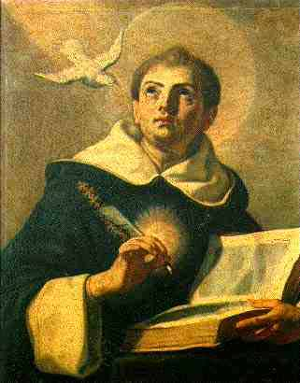
Achievements
Universities were attached to cathedrals. Young men from all over the world crowded in universities to obtain the highest knowledge.
Thomas Aquinas believed that the use of human reason and religion did NOT disagree with each other. He also believed that there were laws of nature that are basic to both the natural world and human affairs
  Reason and Faith could come from God
  Followed Aristotle

Slide 20
Achievements quiz
The ______ system prevented farmers from starving because if one crop failed, the farmers could rely on the other one.
Three field
Bureaucracy
Slash and burn
_________ regulated and protected businesses.
Swords
Bailiffs
Guilds
_______ claimed that reason and faith came from God and there were laws applicable to natural and human behaviors.
Charles Martel
Thomas Aquinas
Joan of Arc

Slide 21
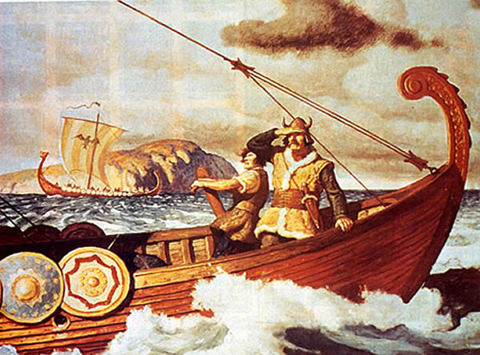
Politics
Foreign invasions were frequent
  Magyars from Hungary
  Arabs from Muslim Spain
  Vikings from Scandinavia
    Most successful
    Sailed down coast and up rivers
    Wanted loot, better climate, and better land

Slide 22
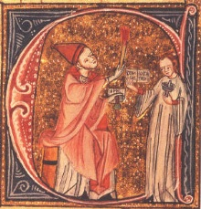
Politics
The coronation of Charlemagne split the east and west churches
Pope Gregory VII
  Could choose bishops
  Should be able to take emperor off throne
King Henry IV
  Chose own bishop to Milan
  Tried to remove Gregory from office and ended up excommunicated
  Was successful later

Slide 23
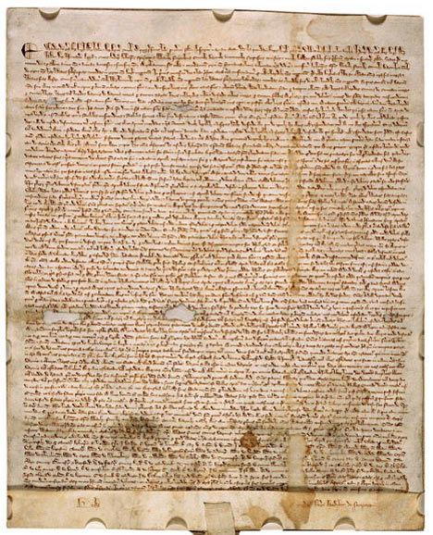
Politics
King John lost control of France and wanted to gain it back, so he taxed the barons for money
  Nobles created the Magna Carta
    Could not collect more taxes/pass more laws without consent of council of barons
    Had to recognize right to a trial by jury
    Mix of Norman French Feudal Law, Church Law, and Anglo Saxon common law

Slide 24
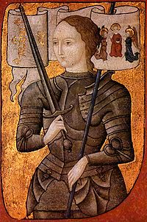
Politics
When king Edward claimed to have rule over France in 1337, fighting broke out
  At first the English were winning
  Joan of Arc heard voices from saints, put on the armor of knights, and lead the French to victory. She was captured and burned at the stake at age 19 later on.

Slide 25
Politics quiz
Who were the most successful invaders?
  The Magyars
  The Arabs
  The Vikings
  The Russians
The King could pass any law he wanted without consent from the council according to Magna Carta.
  True
  False
Who was the heroine who helped the French defeat the English?
  Charlemagne
  Mulan
  Joan of Arc
  Queen Elizabeth

Slide 26
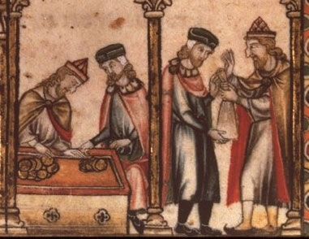
Economy
Banking System
  Letters of Credit
  Deposit in one bank and remove from another
  Safe Travel for merchants
Improved farming
  More goods to sell/trade
  Specialized goods
    Toledo-swords, France-wine
  Better goods for commoners

Slide 27
Economy Quiz! ☺
Why were banking systems created?
Answer: So merchants did not have to carry all their money with them.
What effect did improved farming have on commoners?
Answer: They were able to afford better quality goods.

Slide 28
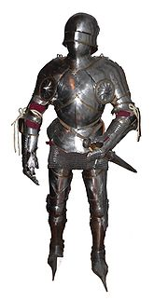
Social structure
Feudalism- an exchange of land for loyalty
Fief-a grant of land
  A lord gives a fief to a loyal follower called a vassal
  Vassals appoint knights to protect the people in his land
  Knights: Followed a code of chivalry
    Defend church
    Protect women and children/weak
    Loyal to lord

Slide 29
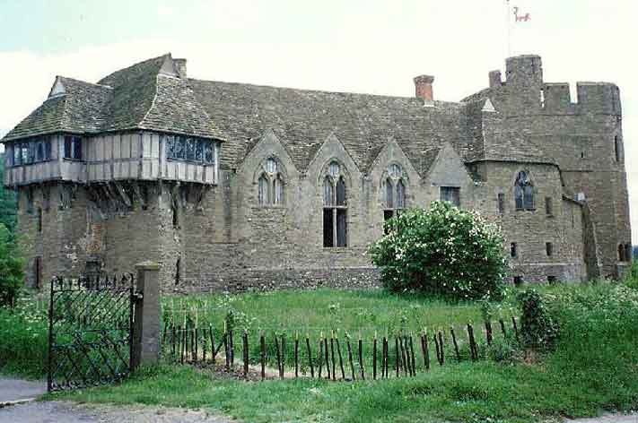
Social Structure
Lords settled minor arguments
Peasants planted and tended the lord’s land
  Legally tied to the land
  Generally poor
  Worked for free; protection from knights was the reward.
The lady of the manor ran the manor while the lord was away and made sure the manor was stocked

Slide 30
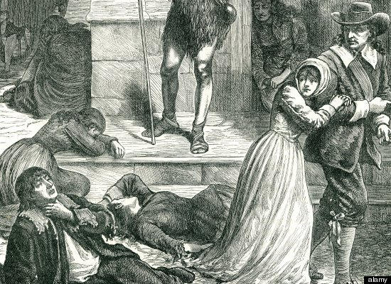
Social Structure
The bubonic plague caused the social structure to change
  Spread along trade routes to China
  Wiped out 25 million Europeans
  Land was uncultivated, so not much food and not much money. Peasants left lord’s land to find where wages were highest
  Old ties between lords and serfs (peasants) demolished
  People didn’t have to stay in the same social class anymore

Slide 31
Social Quiz
What did the code of chivalry require a knight to do?
Answer: Defend the Church, be kind to women and the weak, and be loyal to the lord he serves under.
How did the ties between lords and serfs become affected by the bubonic plague?
Answer: They were broken because peasants left the lord’s land to find higher wages.

