Slide 1
Warm-up #9
Make a KWL chart showing at least three things you know about samurai and three things you would like to know about samurai.
Know | Want to Know | Learn

Slide 2
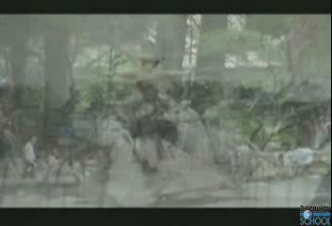
Describe the values and responsibilities of the Samurai.
How were Samurai similar and different from European Knights?

Slide 3
Samurai Values
Read the text. Stop at the end of each section and fill out the corresponding part of your worksheet.
Use complete sentences.

