Slide 1
CH.3-2 Notes
Cell Membrane / Cellular Transport
EQ: What does the term semi-permeable mean and how does that term relate to the cell membrane?

Slide 2
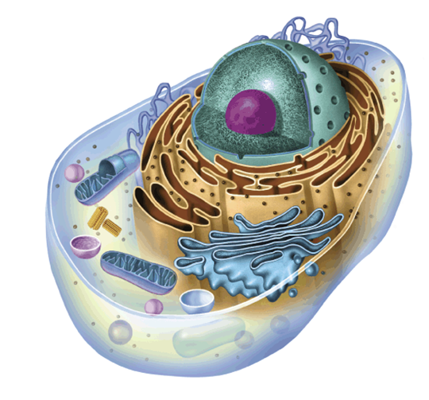
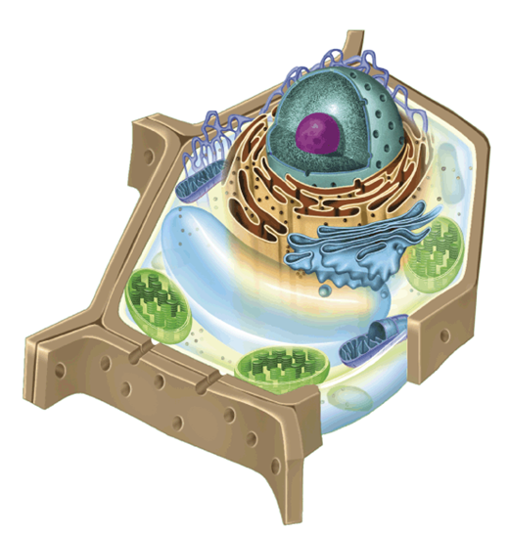
Cell Boundaries
All cells are surrounded by a cell membrane
Many cells also produce a strong supporting layer around the membrane known as a cell wall

Slide 3
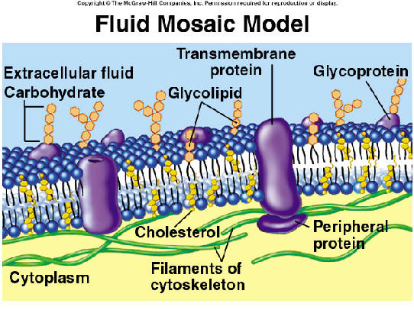
Cell Membrane
The role of the cell membrane is to regulate what enters the cell and what leaves the cell. It also provides protection and support for the cell

Slide 4
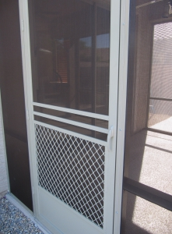
Cell Membrane
Cell Membrane is a semi-permeable membrane. It’s considered to be one because it allows some material into the cell but keeps other material out.
Example of this would be a screen door.

Slide 5
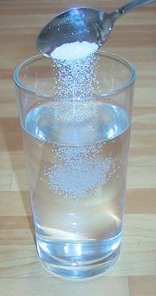
Measuring Concentrations
A solution is a mixture of two or more substances
The substances that are dissolved in the solution are called solutes.
The concentration of a solution is the mass of the solute in a given volume

Slide 6
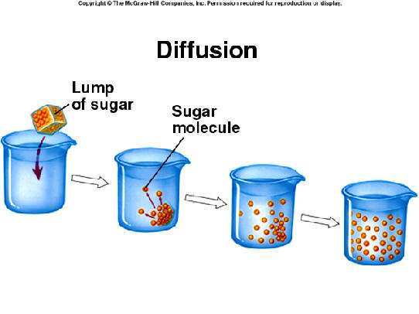
What happens during diffusion
Particles tend to move from an area of HIGH CONCENTRATION to an area of LOW CONCENTRATION.
This process is called diffusion

Slide 7
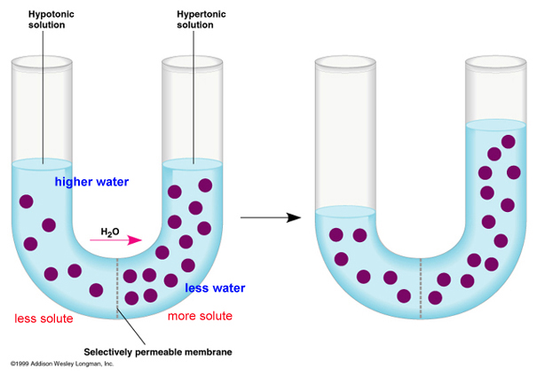
Equilibrium
When the concentrations of what ever material we are observing is the same throughout the system we consider the solution to be at equilibrium.

Slide 8
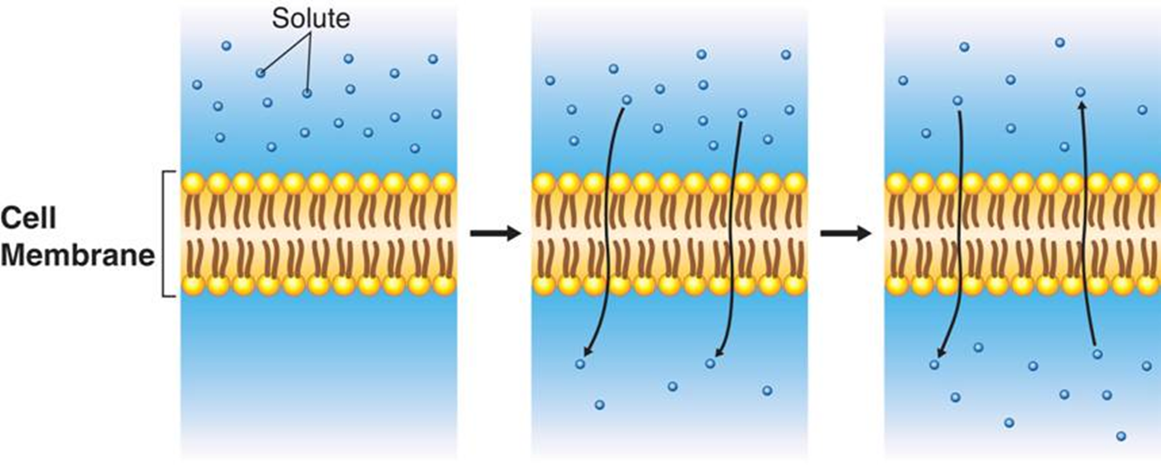

Slide 9
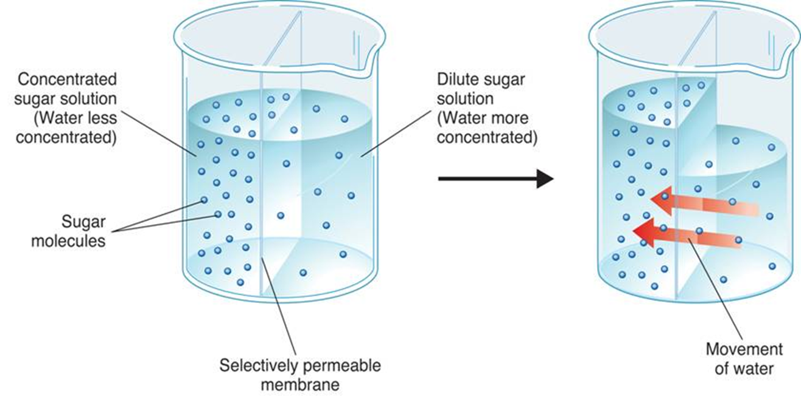
What is Osmosis?
Osmosis is the diffusion of water through a selectively permeable membrane

Slide 10
Osmosis
Water tends to diffuse from a high concentration of water to a low concentration of water.
If you compare two solutions, three different terms can be used to describe the concentrations:
Hypertonic
Hypotonic
Isotonic

Slide 11
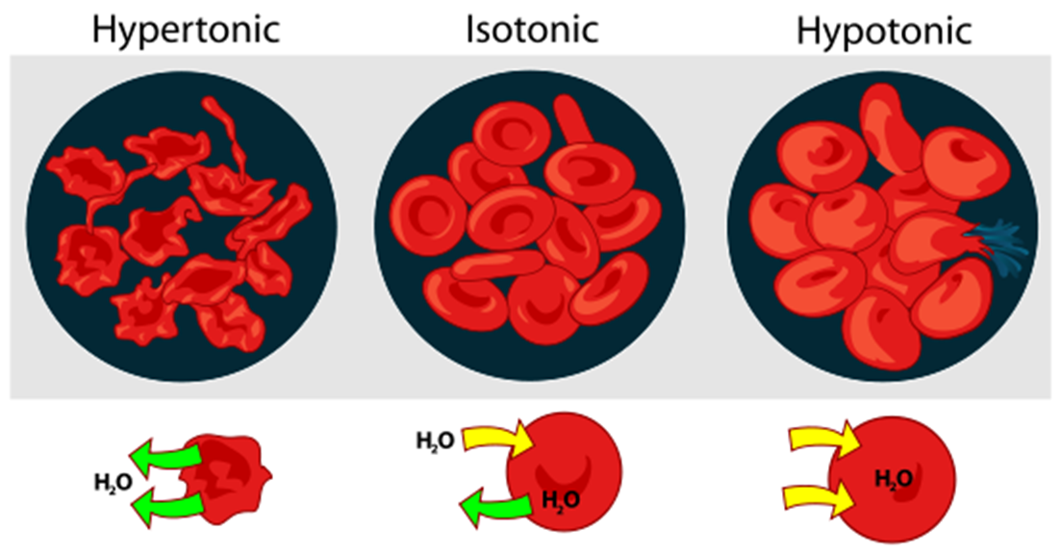
Osmosis
Osmosis exerts a pressure known as osmotic pressure that will change the shape of cells depending on what kind of solution it is put into.

Slide 12
Active Transport
Occurs when you move material in the opposite direction of diffusion.
This type of transport is different from Passive Transport because Active Transport requires energy

Slide 13
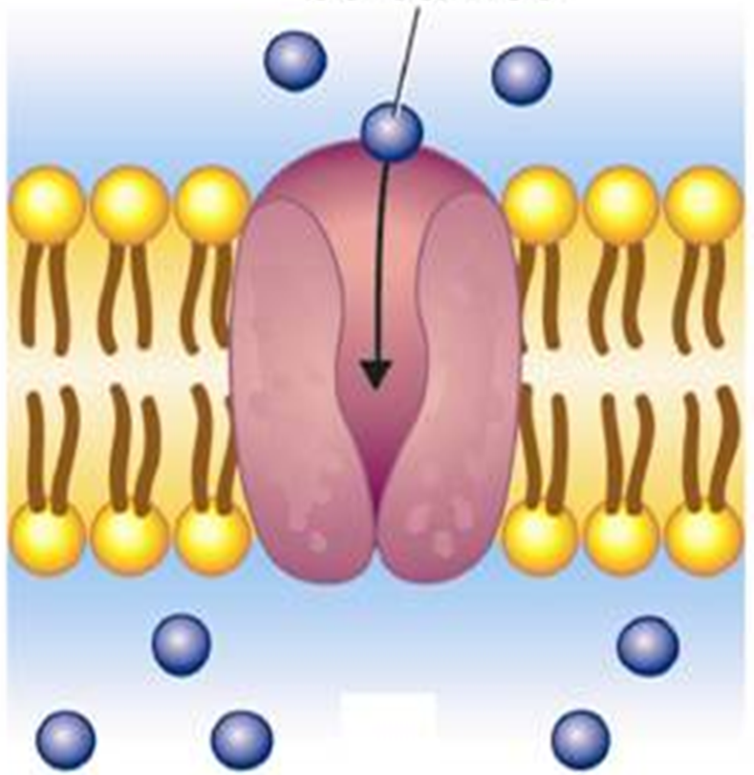
Active Transport
In active transport, small molecules are carried across the cell membrane with the help of proteins that are found in the membrane
Energy is required for these proteins to move the substances across the cell membrane.

Slide 14
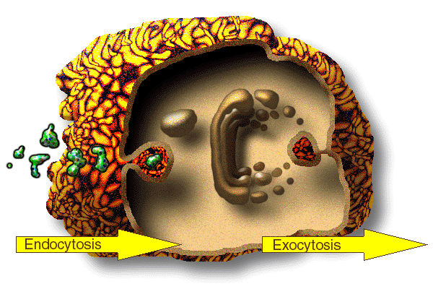
Endocytosis and Exocytosis
Endocytosis is the process of taking material into the cell
Examples:
  Phagocytosis: Cell eating
  Pinocytosis: Cell drinking
During exocytosis, materials are forced out of the cell

