Slide 1
Warm-up #2
Which astronomer created an incorrect model of the universe but gathered data on Mars that would help Kepler develop the laws of planetary motion?
2) Which astronomer do you think contributed the most to the study of the solar system? Explain your answer.

Slide 2

Galileo BrainPop
Log in to BrianPop:
  Login: southpointms
  Password: walnut
Search for Galileo, click link, and view video.

Slide 3
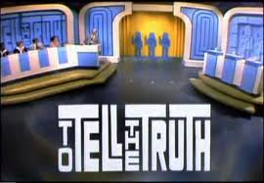
Welcome to the most amazing history game show ever.
Today we have three contestants here to tell you about their lives. One of them is the “real” Galileo. The other two are imposters! By asking them questions and listening closely to their answers, you will try to discover which contestant is the real Galileo. Good luck!
Students on the field trip will be excused from this activity.

Slide 4
Galileo Reader (regular)
Read
Answer questions #1 & #2 in complete sentences (skip #3)
Mark the text
  Number
  Circle
  Underline
  Annotate

Slide 5
Galileo’s Testimony Before the Catholic Church (advanced Period A)
Read
Answer the following questions on page SR 8 of you notebook, using complete sentences.
  What is Galileo’s attitude toward the Church’s questioners? Provide details from the passage to support your answer.
  Does Galileo’s portrayal of his book, the Dialogue, seem like one a scientist would make? Explain.
  Had Galileo admitted that he believed the sun to be the center of the universe, he would very likely have been killed. Do you think he did the right things? Why or why not?
Mark the text
  Number
  Circle
  Underline
  Annotate

