Slide 1
14- Forging the National economy 1790-1860

Slide 2
Economic & Social Revolution
U.S. population grows
Advancements in transportation leads to:
Creation of market economy, 1820-1860

Slide 3
Regional Economies
1. West – grows grains
2. East – Industrial Powerhouse
3. South – Plantation economies

Slide 4
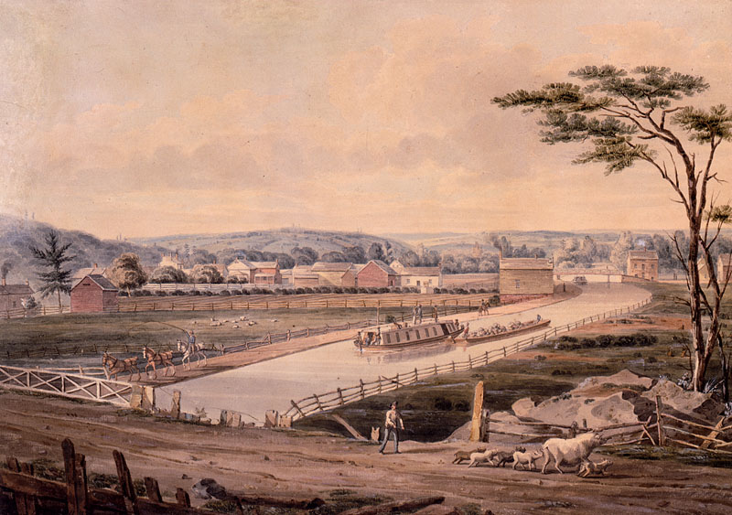
Transportation Revolution
1820 emphasis on building roads, canals
To facilitate movement & trade

Slide 5
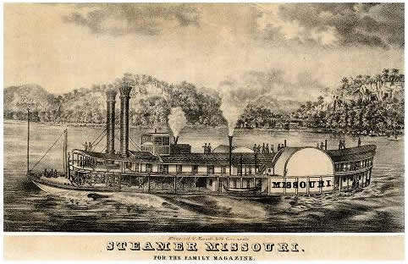
The Steamboat
Invented by Robert Fulton & Robert Livingston, Clermont 1807
Establish New York- New Jersey Ferry service
Monopoly!

Slide 6
Gibbons v. Ogden
Supreme Court has constitutional power to regulate interstate commerce
Also applies to navigation
Breaks up monopoly

Slide 7
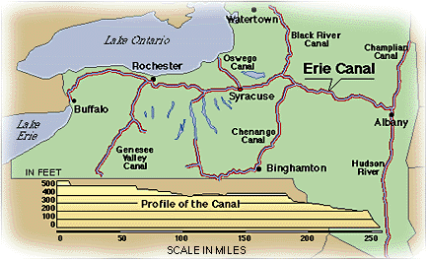
Erie Canal
Constructed 1817-1825
Linked Great Lakes to Hudson River
363 miles long
New York - Ohio

Slide 8
The Erie Canal
1. Facilitated shipping of goods
2. Shipping costs dropped = more business
3. Brings mid-west products to Atlantic ports
4. Growth of port cites along canal routes
5. Promoted Migration along route
6. New York Grew overnight

Slide 9
Canals…
Built by state governments
Reduced shipping costs
“canal” building boom 1820’s-1830’s
Thanks to Erie Canal Success

Slide 10
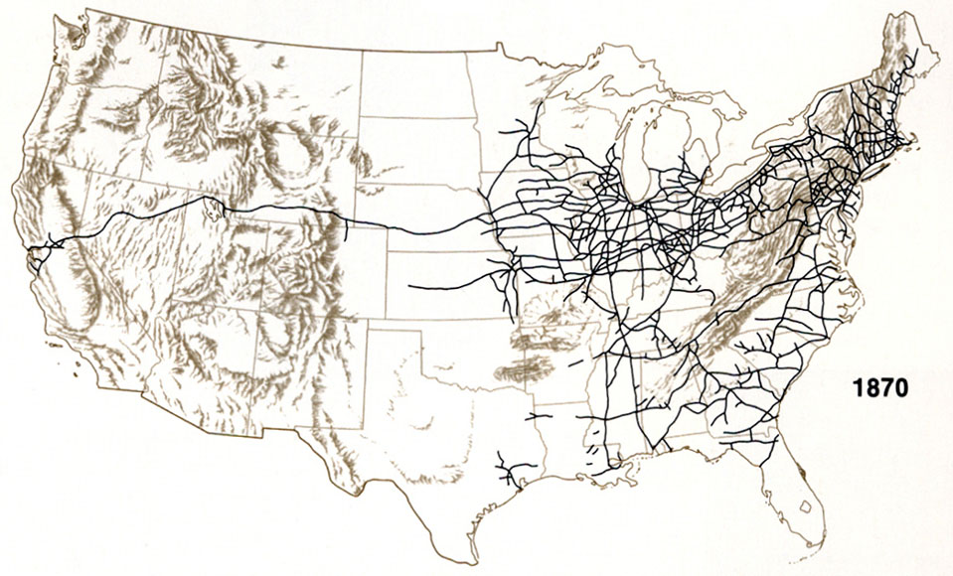
Railroads
By 1830 investment in railroads – huge!
Cheaper to build, faster, can reach more places
Canals built by state funding
Railroads built by private corporations

Slide 11
Growth of Cities
Transportation sped the growth of cities & towns
Most rapid urbanization between 1820-1860

Slide 12
Prominent Cities Emerge
Near waterways, canals, railroads.
After 1820: gain importance
River ports: Pittsburg, Cincinnati, Louisville, St Louis, New Orleans
Lake Cities: Buffalo (NY), Cleveland, Detroit, Chicago, Milwaukee

Slide 13
Industrial Beginnings
CH14

Slide 14
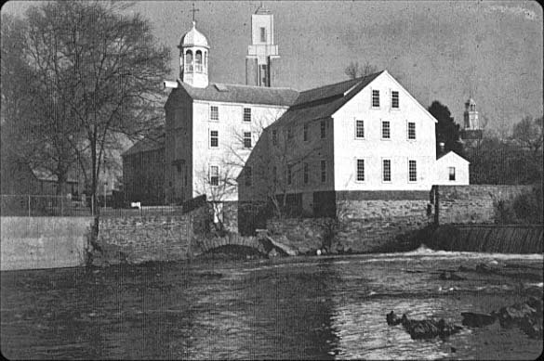
Samuel Slater
British Immigrant
Arrived in U.S. 1789
Helped design 1st cotton mill

Slide 15
Shift to a Market Economy
An economic system that allows for…
1. Freedom of consumer to choose between products & services
2.Freedom of producer to start or expand business
3. Freedom of worker to choose job & employer

Slide 16
Prior to Market Econ…
Most People worked at home
Grew own food
Made cloth
Own necessities

Slide 17
Change… Market “Revolution”
people increasingly work outside home
Factories
Businesses
Other people’s farms

Slide 18
Greater Productivity = More Profit
“Industrial Capitalism” – expanding factories, investing new businesses
“Factory System”- workers & machines under control of managers

Slide 19
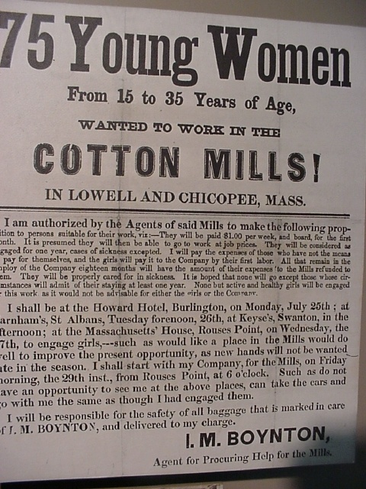
Textile Mills, North
Example: Lowell, Massachusetts
Recruits young, single women to work in factories
Why?
Cheaper labor
Familiar with cloth making

Slide 20
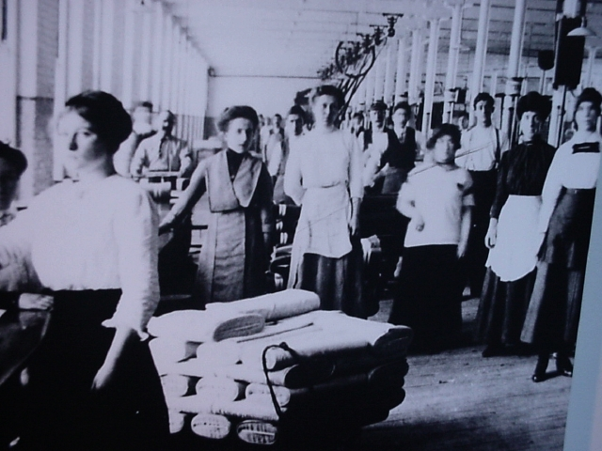
Waltham & Lowell Textile Mills
Lowell Girls - “operatives” (operadoras)
12 hour shifts
No ventilation, dangerous machinery, no breaks.
No labor or safety laws

Slide 21
Why Work in Factories?
Shelter provided
- Live in company “boardinghouses”
Independence
Leave farm move to city
Help out family economically

Slide 22
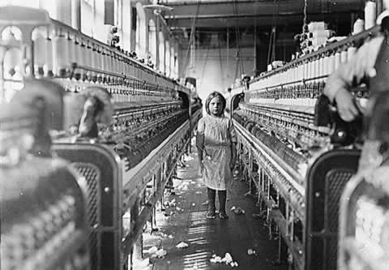
Child Labor
As young as 6 yrs old
2 out of 5 factory workers in New England children (1830’s)
Also work in Mines
12 + hour shifts

Slide 23
Conclusion: 1820-1860
1. Expansion of white settlement out “west”
2. Transportation facilitates movement of people goods
3. Creation of a Market economy
4. Early Industrialization
5. Early Urban Growth

Slide 24
The Ferment of Reform & Culture
Chapter 15 APUSH

Slide 25
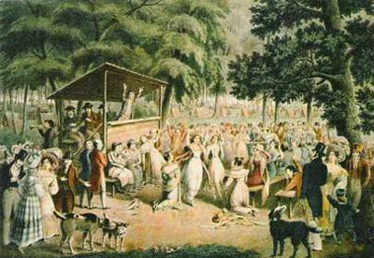
Rise of Popular Religion
The Second Great Awakening – a revival of interest in religion
Unity amongst various Protestant denominations
Open air sermons

Slide 26
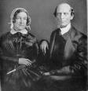
1. Charles G. Finney
Religious conversion in 1821
Becomes Presbyterian Minister
“Father of modern revivalism”

Slide 27
Charles G. Finney’s Beliefs
1. Revivals are “human creations”
2. Sin is a “voluntary act”
3. Human can “will themselves free of all sin”
Evangelical Protestantism

Slide 28

2. William Miller
“The end of the world is near!!” – cites the Bible
Predicts World would end October 22, 1844
Followers: “Millerites”

Slide 29
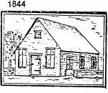
3. Methodists
Successful along frontier
By 1844 largest Protestant denomination
Preachers preach in houses, open fields, not churches.

Slide 30
4. Unitarians
“critics of revival” movement
Each should model his/her behavior after Jesus
And achieve…
“the perfection of human nature the elevation of men into higher beings”

Slide 31
5. Mormons
Founder: Joseph Smith
Church of Jesus Christ of Latter-day Saints
Killed in 1844
Brigham Young later moved congregation further west - UTAH
Founder of Salt Lake City, Utah 1847

Slide 32
AGE OF REFORM
APUSH CH 15

Slide 33
REFORM MOVEMENTS
Organizations aim to improve society:
1. Temperance
2. Public School Reform
3. Better treatment of criminals & insane
4. Women’s rights
5. Abolition

Slide 34
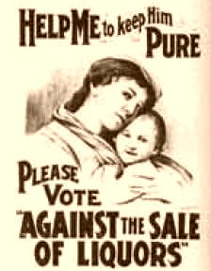
1. Temperance Movement
By 1820’s the average male adult drank ½ pint of liquor a day!!!
Men buy liquor instead of food, spousal abuse
The American Temperance Society, 1834

Slide 35
2. Public School Reform
Late 1800’s
Compulsory Elementary education
Literacy Rates rise to 90% by 1900’s
Horace Mann:
Secretary of Massachusetts state board of education, 1837
“father “ of public education

Slide 36
3. Abolition & Women’s Rights
Society deems race and gender as “unequal”
White middle class women join abolition movements

Slide 37
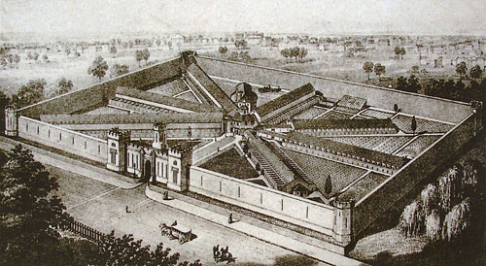
4. Crime & Penitentiaries
Parents are responsible for raising “criminals”
Lack of discipline
Criminals can be “cured” and can “repent”
1. New York System:
prisoners work together by day are
Solitary Confinement - small windowless cell by night.
2. Pennsylvania System:
Prisoners in solitary confinement at all times
Kept isolated form others, including visitors.

Slide 38
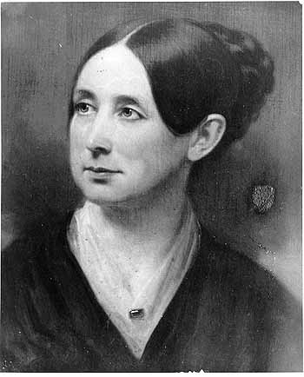
5. Mental Asylums
Dorothea Dix pioneered the rights of the insane
Encouraged the construction of insane asylums
Humane treatment

Slide 39
Immigration 1840’s -1860’s

Slide 40
Irish Immigrants 1840’s
Largest group : 1.9 million
Why:? Poverty, hunger (potato famine)
Settled Northern Cities, In Poor “slums”
Willing to work :
Lowest paying jobs
Building canals, railroads, mining, factories, garbage collector
Catholic- establish churches

Slide 41
German Immigrants
2nd largest group of immigrants
1.5. Million arrived 1831-1860
Skilled labor: bakers, butchers, tailors
Mostly Protestant (Lutheran)
1/3 Catholic
250,000 Jewish
Settled in northern cities & Rural areas

Slide 42
Nativism
Native born Americans View immigrants as:
“socially inferior”
“politically corrupt”
Nativism- favoring native born Americans over foreign born
Nativists responded to increased Irish & German immigration with violence, demands for limits on immigrant rights

