Slide 1
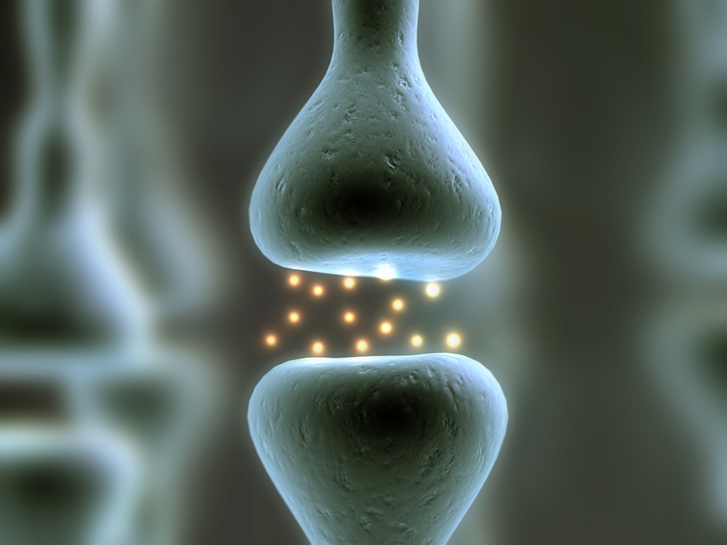
Nervous System
CORE 6.5.1-6.5.6, OPTION E1, E2, E4

Slide 2
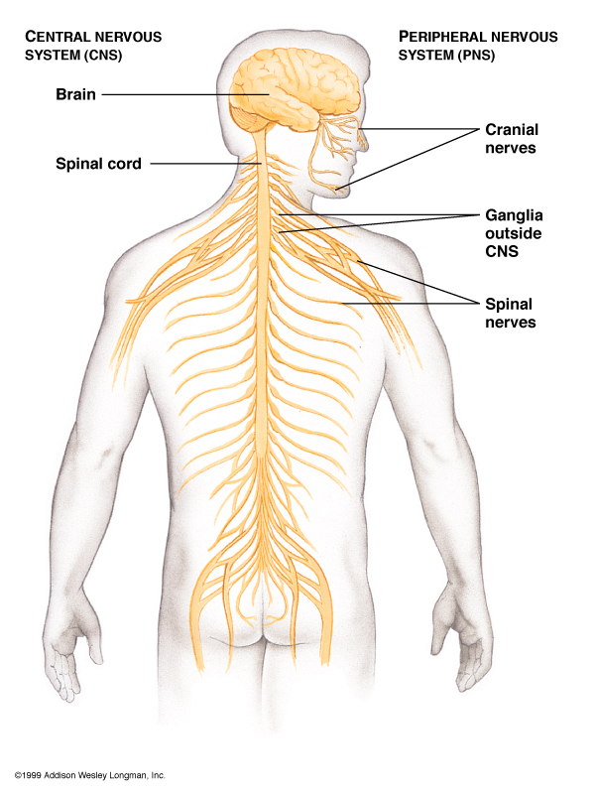
6.5.1 State that the nervous system consists of the central nervous system (CNS) and peripheral nerves, and is composed of cells called neurons that can carry rapid electrical impulses.
The Nervous System allows organisms to
It consists of:
  Brain and spinal cord –
  Sensory Receptors & Peripheral Nerves –
  – functional unit of the nervous system; specialized cells for transmitting electrical and chemical signals

Slide 3
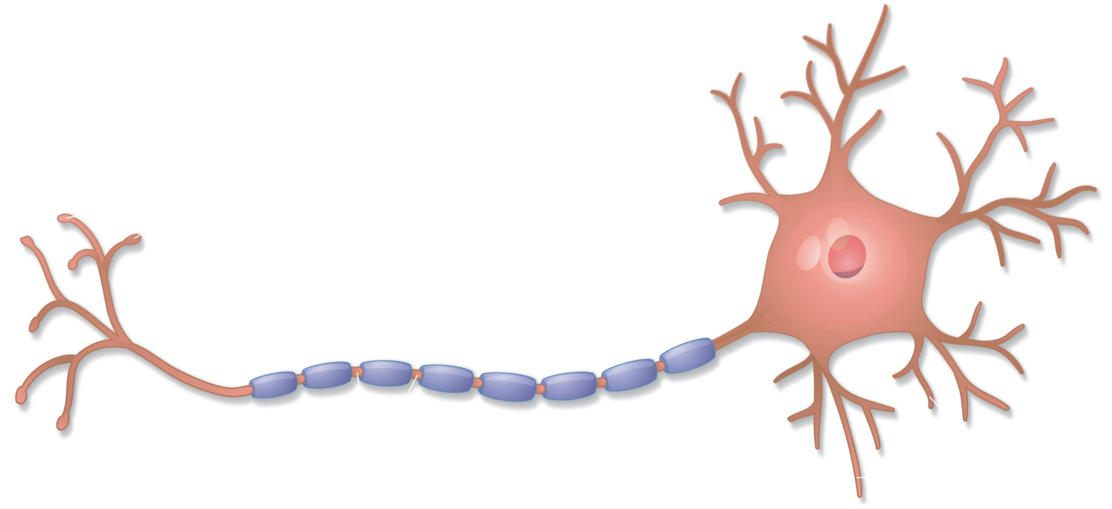
Anatomy of a Nerve Cell:
  Cell body –
    Dendrites and axon extend from the cell body
  Dendrites – short and highly branched
Dendrites
Cell body

Slide 4
Anatomy of a Nerve Cell:
  Axon –
    Microscopic in diameter but may extend a meter or more in length
    May divide forming branches –
    Divides at the end to form – in motor neurons these are called and send messages to muscles
    Synaptic terminals release (chemicals) (gap between neurons)

Slide 5
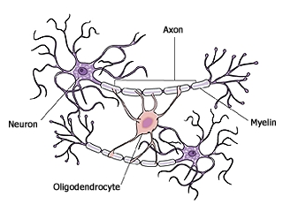
6.5.1 State that the nervous system consists of the central nervous system (CNS) and peripheral nerves, and is composed of cells called neurons that can carry rapid electrical impulses.
Myelin Sheath –
  Composed of Schwann cells that form insulation
  – gaps between Schwann cells
Oligodendrocyte is a neuroglia cell in CNS

Slide 6
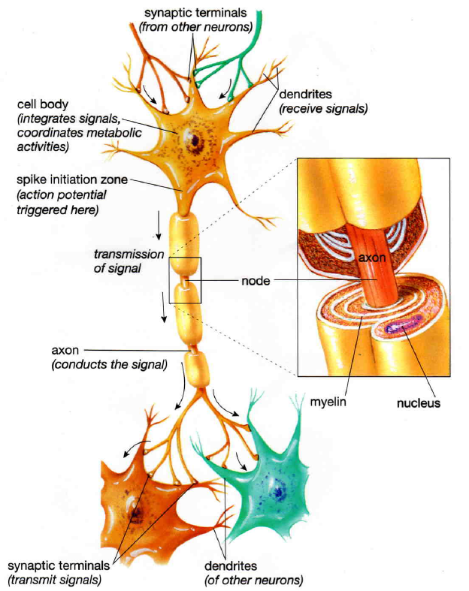
6.5.2 Draw and label a diagram of the structure of a motor neuron
In Motor neurons these are called motor end plates
Notes:
Include dendrites, cell body with nucleus, axon, myelin sheath, nodes of Ranvier and motor end plates

Slide 7
Outside the CNS:
  Nerves consist of
  Cell bodies are usually grouped together in masses called
In the CNS:
  Bundles of axons are called instead of nerves
  Collection of cell bodies are called

Slide 8
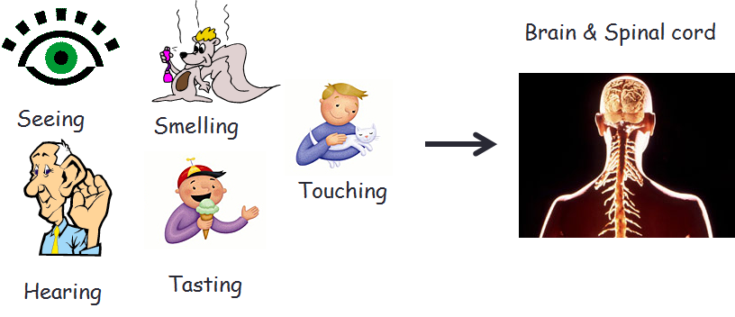
6.5.3 State that nerve impulses are conducted from receptors to the CNS by sensory neurons, within the CNS by relay neurons, and from the CNS to effectors by motor neurons.
Types of Neurons:
  – conduct impulses into CNS from the periphery (sensory impulses)
    Pick up stimulus from sensory receptors – mechanoreceptors, chemoreceptors, thermoreceptors, photoreceptors

Slide 9
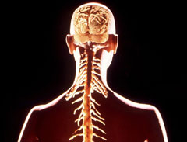
6.5.3 State that nerve impulses are conducted from receptors to the CNS by sensory neurons, within the CNS by relay neurons, and from the CNS to effectors by motor neurons.
  – afferent neurons usually transmit impulses to interneurons
    Located within
    Neurons that integrate input and output
    Integration involves
    Forms connecting lines between sensory and motor neurons
Brain & Spinal cord

Slide 10
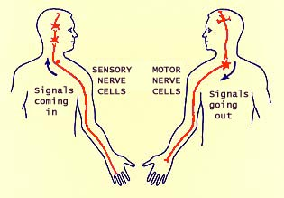
6.5.3 State that nerve impulses are conducted from receptors to the CNS by sensory neurons, within the CNS by relay neurons, and from the CNS to effectors by motor neurons.
  – transmit messages from CNS to effectors (muscle or gland)
  Sensory receptors, afferent and efferent neurons are part of the
Afferent
Efferent
http://www.siumed.edu/~dking2/ssb/neuron.htm#4b

Slide 11
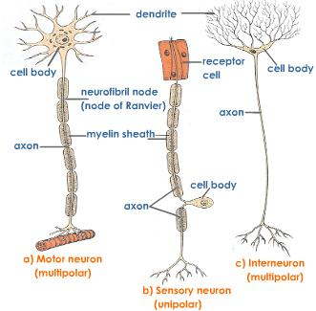
Multipolar = many extensions that branch into dendrites
Unipolar = one extension
http://www.tutorvista.com/content/biology/biology-iv/nervous-coordination/neurons-types.php

Slide 12
Organization of the Nervous System

Slide 13
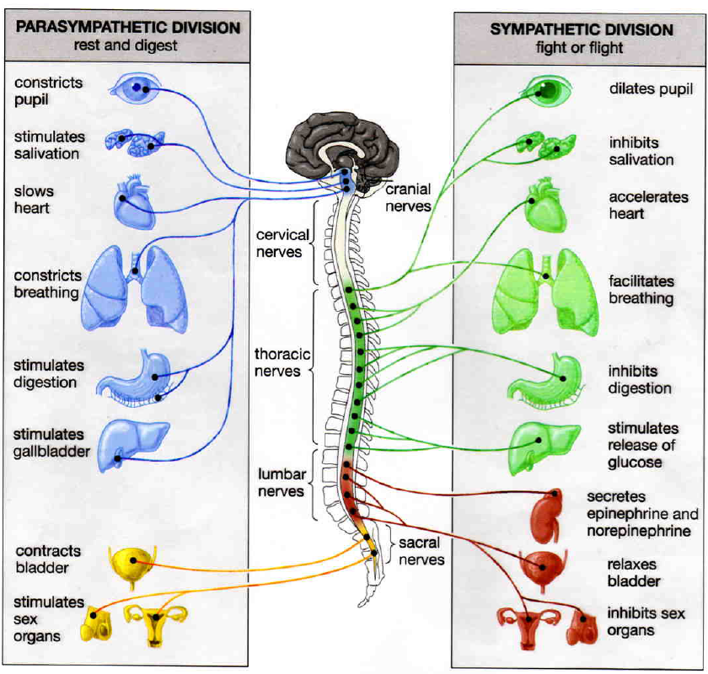
PNS
Motor Division
Autonomic NS
Sypathetic & Parasympathetic Divsions:

Slide 14
6.5.4 Define resting potential and action potential (depolarization and repolarization).
Membrane potential is the
Resting potential is the .
  Slight excess of positive ions outside the membrane and slight excess of negative ions inside the membrane
  Resting potential is normally about (mV)
  Membrane of neuron is due to unequal distribution of ions – as a result, the cell can produce an action potential (impulse)

Slide 15
6.5.4 Define resting potential and action potential (depolarization and repolarization).
Depolarization is
Action potential is the .
Repolarization is .

Slide 16
6.5.5 Explain how a nerve impulse passes along a non-myelinated neuron.
Na+ concentration is the cell and K+ concentration is
Ion pumps, ion channels and gates cause a specific distribution of ions across the cell membrane
Sodium-potassium pumps in the membrane
K+ tends to through ion channels causing further negative charge inside as compared to outside of cell
Ion channels that allow the passage of Na+ are closed at resting potential
Notes:
Include the movement of Na+ and K+ ions to create a resting potential and an action potential

Slide 17
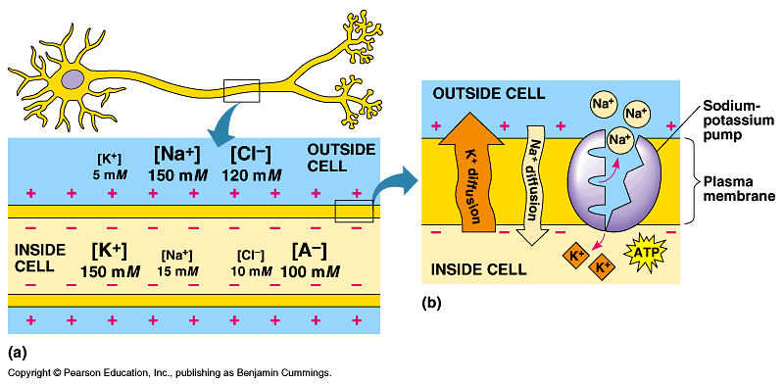

Slide 18
6.5.5 Explain how a nerve impulse passes along a non-myelinated neuron.
Stimulation –
  – minimum amount needed for depolarization to occur
  Causes
  Disturbs adjacent areas –
  Polarity across membrane is momentarily
  K+ channels also open but more slowly allowing
Notes:
Include the movement of Na+ and K+ ions to create a resting potential and an action potential

Slide 19
Notes:
Include the movement of Na+ and K+ ions to create a resting potential and an action potential

Slide 20
Notes:
Include the movement of Na+ and K+ ions to create a resting potential and an action potential

Slide 21
6.5.5 Explain how a nerve impulse passes along a non-myelinated neuron.
Repolarization – after action potential passes, membrane begins to repolarize
  Na+ channels
  Open K+ channels
  Impulse is actually a series of depolarization and repolarization waves sweeping down the axon (takes place in )
  Then K+ channels close and
Notes:
Include the movement of Na+ and K+ ions to create a resting potential and an action potential

Slide 22
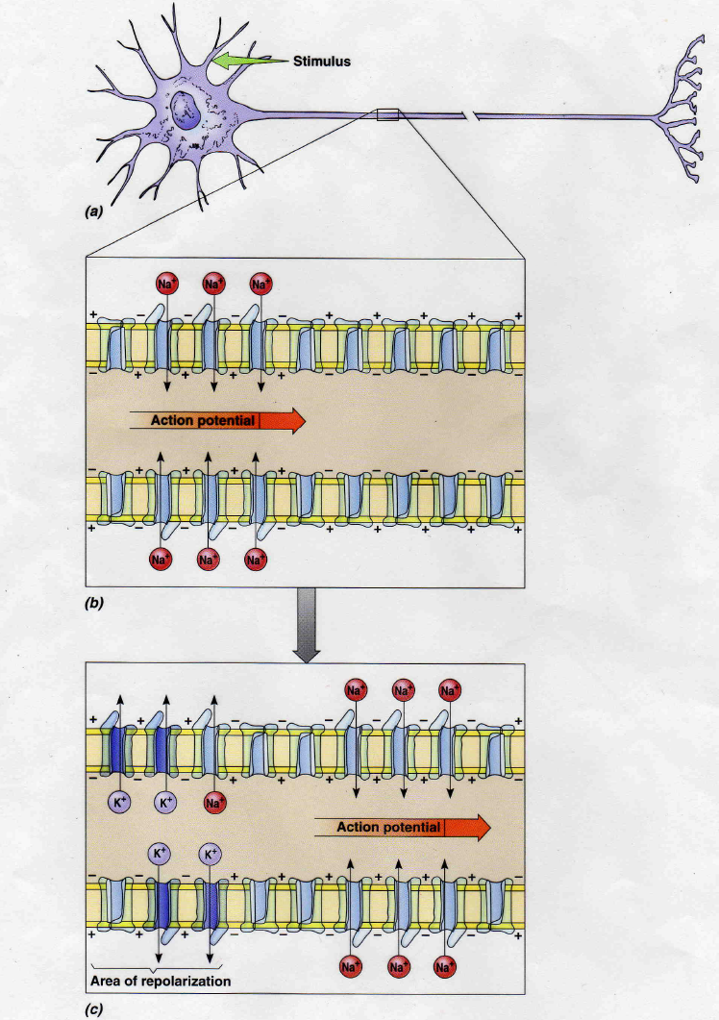

Slide 23
6.5.5 Explain how a nerve impulse passes along a non-myelinated neuron.
Impulse conduction video
Notes:
Include the movement of Na+ and K+ ions to create a resting potential and an action potential

Slide 24
Myelinated vs. Non-myelinated
  Impulse conduction is
    Here there is continuous conduction, the
  Vertebrate neurons are
    Depolarization occurs only at the – Action Potential “jumps” from one node to the next →
  Diameter of axon affects speed of transmission
Notes:
Include the movement of Na+ and K+ ions to create a resting potential and an action potential

Slide 25
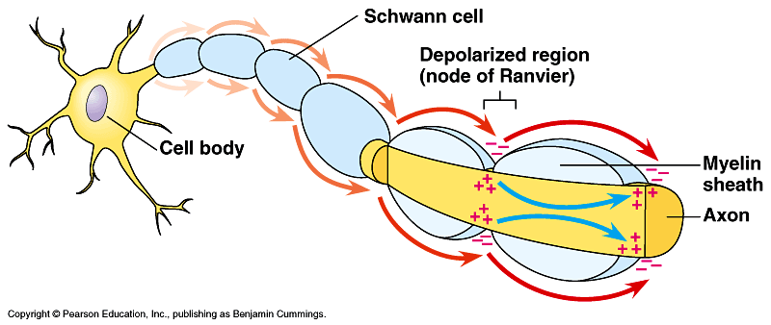
Notes:
Include the movement of Na+ and K+ ions to create a resting potential and an action potential

Slide 26
6.5.6 Explain the principles of synaptic transmission.
Synapse –
Synapse between neuron and muscle cell is called a
Notes:
Include the movement of Na+ and K+ ions to create a resting potential and an action potential

Slide 27
6.5.6 Explain the principles of synaptic transmission.
Neurotransmitters act as chemical messengers to conduct the signal across the synapse
contain neurotransmitter
When action potential reaches axon terminal, calcium ions begin to diffuse in →
and neurotransmitter diffuses across synapse
Notes:
Include the release, diffusion and binding of the neurotransmitter, initiation of an action potential in the post-synaptic membrane, and subsequent removal of the neurotransmitter.

Slide 28
6.5.6 Explain the principles of synaptic transmission.
Neurotransmitters (specific to the type of neurotransmitter) –
to free up receptor sites for next impulse and the (reuptake)
Notes:
Include the release, diffusion and binding of the neurotransmitter, initiation of an action potential in the post-synaptic membrane, and subsequent removal of the neurotransmitter.

Slide 29
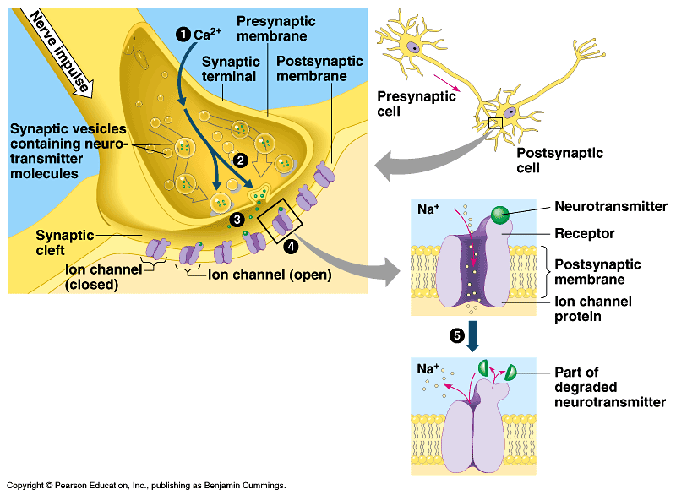
Notes:
Include the release, diffusion and binding of the neurotransmitter, initiation of an action potential in the post-synaptic membrane, and subsequent removal of the neurotransmitter.

Slide 30
E.4.1 State that some presynaptic neurons excite postsynaptic transmission and others inhibit postsynaptic transmission.
Neurotransmitters each have a different function:
  Excitatory –
    (stimulate muscle contraction)
    (affect mood)
  Inhibitory –
    – inhibits neurons in brain and spinal cord; results in a calming effect; may be used to treat anxiety

Slide 31
E.4.2 Explain how decision-making in the CNS can result from the interaction between the activities of excitatory and inhibitory presynaptic neurons at synapses.
  Excitatory Postsynaptic Potential (EPSP) – if a
    Causes partial depolarization bringing neuron closer to firing
    One EPSP is probably too week to trigger an action potential –

Slide 32
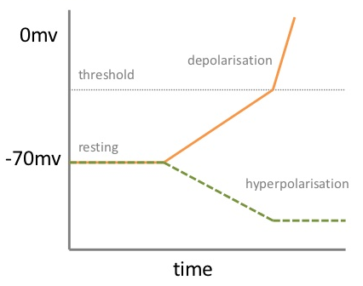
E.4.2 Explain how decision-making in the CNS can result from the interaction between the activities of excitatory and inhibitory presynaptic neurons at synapses.
  Inhibitory Postsynaptic Potential (IPSP) – occur when neurotransmitter – brings membrane potential and a

Slide 33
E.4.2 Explain how decision-making in the CNS can result from the interaction between the activities of excitatory and inhibitory presynaptic neurons at synapses.
How are decisions made in the CNS?
  Different areas of the brain carry out different functions
  Impulses are received in the brain and integration takes place –
  There is
  There are different types of connection pathways between the neurons

Slide 34
Important “classical” neurotransmitters that have been recognized for many years:
  Acetylcholine
    Secreted at
    Neurons that release acetylcholine are called cholinergic neurons
    ( )
    May be

Slide 35
  Noradrenaline (also called Norepinephrine)
    Secreted by
    Chemically very similar to the hormone adrenaline (also called epinephrine)
    Prepares body

Slide 36
  Dopamine
    Secreted by
    Thought to
    May be involved in causing
    in a specific brain region causes
      Characterized by difficulty in initiating conscious movements, uncontrolled tremors, shuffling gait, and muscle weakness
      Without dopamine,
      The drug can be used by unharmed neurons in the brain to synthesize dopamine – reduces symptoms

Slide 37
Classifying synapses in the peripheral nervous system:
  Cholinergic synapses use
    Most synapses in the
    are cholinergic
  Adrenergic synapses use
    Most synapses of
Central nervous system uses a much wider range of neurotransmitters

Slide 38
E.1.1 Define the terms stimulus, response and reflex in the context of animal behaviour.
The actions of the nervous system are essential for survival.
It allows living things to detect and respond to external and internal stimuli.
A stimulus is a .
A response is the .

Slide 39
E.1.1 Define the terms stimulus, response and reflex in the context of animal behaviour.
Some response are immediate, quick and short lived. These responses are involuntary and referred to as a reflex.
A reflex is a .
Reflexes are the product of natural selection. Rapid and unconscious responses allow for – so pain is a good thing!
The pain reflex is moderated by the spinal cord rather than the brain – shorter paths, faster responses and no conscious decisions needed!

Slide 40
E.1.2 Explain the role of receptors, sensory neurons, relay neurons, motor neurons, synapses and effectors in the response of animals to stimuli.
The pathway a message travels to elicit a reflex is called a reflex arc.
It involves:
receptor organ (sense organ)
sensory neuron
relay neuron (interneuron)
motor neurons
effector organ (muscle or gland)
stimulus
response

Slide 41
E.1.2 Explain the role of receptors, sensory neurons, relay neurons, motor neurons, synapses and effectors in the response of animals to stimuli.
The .
The sensory neuron is . Its cell body is located in the dorsal root ganglion.
The relay neuron is . It connects the sensory neuron to the motor neuron.
The motor neuron is (neuro-muscular junction). It’s cell body is in the grey matter and it’s axon leaves through the ventral root of the spinal cord.

Slide 42
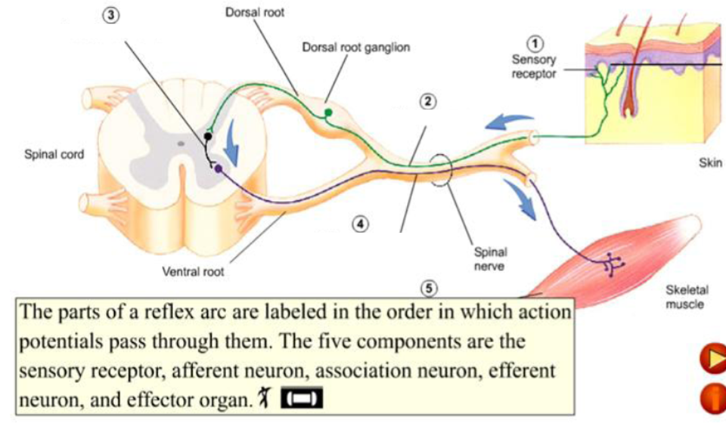
E.1.2 Explain the role of receptors, sensory neurons, relay neurons, motor neurons, synapses and effectors in the response of animals to stimuli.
White matter
Grey matter

Slide 43
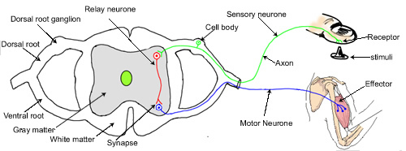
E.1.3 Draw and label a diagram of a reflex arc for a pain withdrawal reflex, including the spinal cord and its spinal nerves, the receptor cell, sensory neuron, relay neuron, motor neuron and effector.

Slide 44
Our bodies have natural pain killers – enkephalins and endorphins
  These are
Enkephalins:
  Pain control pathways in brain lead to neurons that carry impulses down a descending tract of the spinal cord
  These neurons release at synapses where pain signals are passed to neurons that carry them to brain
  Enkephalins

Slide 45
Endorphins:
  releases endorphins
  Endorphins are carried in blood to brain and other organs
  They bind to receptors in membranes of neurons that

Slide 46
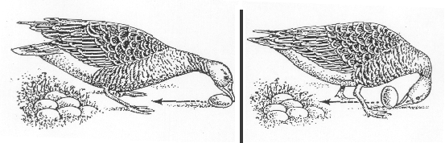
E.1.4 Explain how animal responses can be affected by natural selection, using two examples.
Instinct = Automatic behavioral responses to stimuli, also known as
These behaviors are fixed in the species and are genetically coded.
(Remember the greylag goose egg rolling)

Slide 47
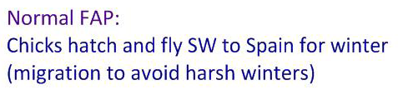
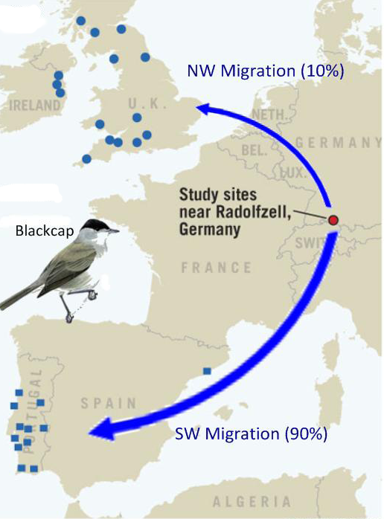
E.1.4 Explain how animal responses can be affected by natural selection, using two examples.
Natural selection influences FAPs #1
Alternate behavior:
Some flew _________ – where birdfeeders
provide easy sources of food.
Advantage:
___________________ and ____________
_____ from bird enthusiasts allow blacktop
to return to German breeding sites ahead
of Spanish migrants and be more repro-
ductively successful.

Slide 48

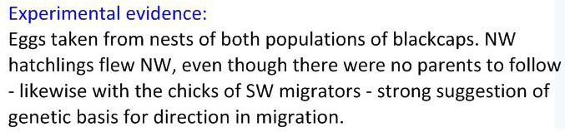
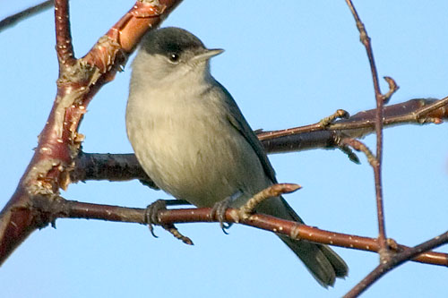
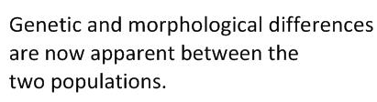
E.1.4 Explain how animal responses can be affected by natural selection, using two examples.

Slide 49
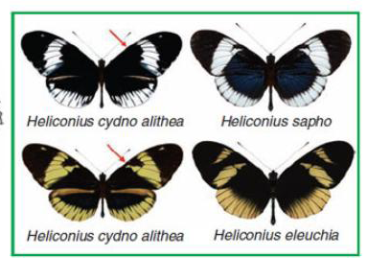
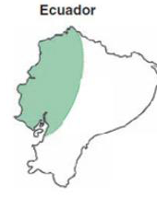
E.1.4 Explain how animal responses can be affected by natural selection, using two examples.
Natural Selection Influences Fixed Action Patterns #2
Example: Butterfly (Heliconius cydno) mate preference
Normal FAP:
Heliconius has a huge range of _______ and individuals will mate with any other variant.
Alternate behavior:
Yellow Heliconius butterflies have
developed preference for
________________.

Slide 50
E.1.4 Explain how animal responses can be affected by natural selection, using two examples.
Natural Selection Influences Fixed Action Patterns
Example: Butterfly (Heliconius cydno) mate preference
Advantage:
Suggested link between ____________ and ____________ : yellow individuals may be able to see yellow mates more easily. Population may become better adapted to specific niches.
Natural Selection:
Yellow individuals are becoming reproductively isolated through
________________. This is the likely to result in them becoming a separate species.

Slide 51
E.1.4 Explain how animal responses can be affected by natural selection, using two examples.
Experimental evidence:
Observations of yellow Heliconius shows a strong preference for mating with other yellow individuals. Previous speciation of Heliconius shows that hybrids are possible, yet ______________ as they are _________________ to the local niches.
The two colors of H. cydno alithea are genetically identical,
except for the color and preference, suggesting __________ for mate preference and color.

Slide 52
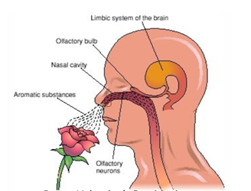
E.2.1 Outline the delivery of stimuli that can be detected by human sensory receptors, including mechanoreceptors, chemoreceptors, thermoreceptors and photoreceptors.
A wide range of stimuli can be detected by diverse receptors in humans.
Each receptor is specific to it’s stimulus and adapted to suit it’s function.

Slide 53
E.2.1 Outline the delivery of stimuli that can be detected by human sensory receptors, including mechanoreceptors, chemoreceptors, thermoreceptors and photoreceptors.
Mechanoreceptors
  changes in , e.g. touch, pain, and tension receptors
  changes in , e.g. touch receptors in skin
  changes in , e.g. inner ear for hearing and balance
Chemoreceptors
  chemical , e.g. taste in tongue, CO₂ concentration in the blood
  chemical , e.g. smell in the nose

Slide 54
E.2.1 Outline the delivery of stimuli that can be detected by human sensory receptors, including mechanoreceptors, chemoreceptors, thermoreceptors and photoreceptors.
Thermoreceptors
  changes in
  thermoreceptive nerve endings in skin
Photoreceptors
  electromagnetic radiation
  e.g. and cells in the retina

Slide 55
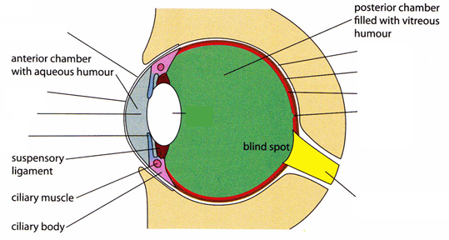
E.2.2 Label a diagram of the structure of the human eye.
(covers the sclera & cornea & keeps eye moist)
(protects & supports the eyeball)
(absorbs stray light)
(focusing begins here)
(contains receptors for vision)
(admits light)
Lens (focuses light rays)
(an area of densely packed cone cells where vision is most acute)
(regulates the size of the pupil)
(transmits impulses to the brain)
Aqueous humour & Vitreous humour – transmits light rays and supports the eyeball

Slide 56
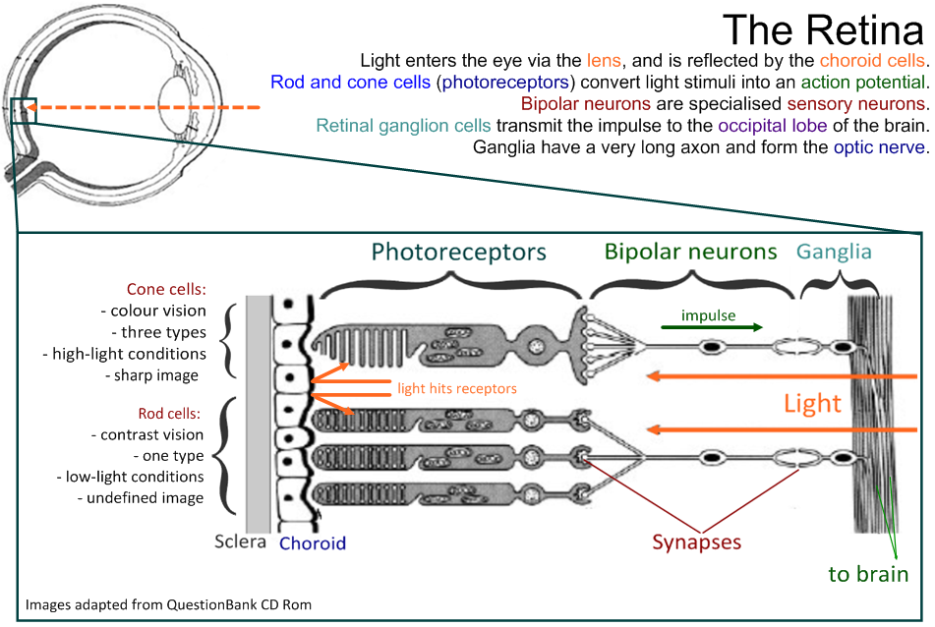
E.2.3 Annotate a diagram of the retina to show the cell types and the direction in which light moves.

Slide 57
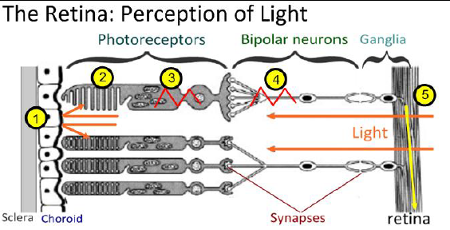
E.2.3 Annotate a diagram of the retina to show the cell types and the direction in which light moves.
5.

Slide 58
Rod Cells | Comparison | Cone Cells
Dominant in ______ light conditions (“bleached” in bright light) | Light brightness | Dominant ________ light conditions (not activated in dim light)
_____ type | Diversity | _______ types
Throughout _______ | Distribution | Concentrated around ________
Responsive to ____ visible wavelengths | Wavelength sensitivity | Short – ________ Medium – greens Long – _______
______: many rods connect to one ganglion | Receptor: ganglion ratio | _______(even 1:1)
_________ | Visual acuity | _________
Rhodopsin (made of protein ) & retinal (made from Vitamin A) | Pigment | Iodopsin
E.2.4

Slide 59
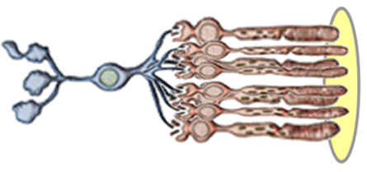
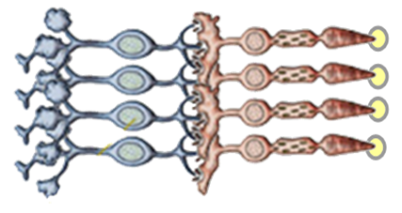
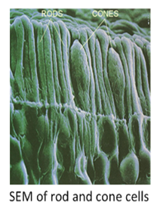
Receptive Fields and Processing Stimuli
A receptive field is the .
Rods
.
Gives a .
Differences in light within the receptive
field are not likely to be perceived with clarity.
Cones
Cone cells .
Gives many .
Different types of cone cells detect different
wavelengths of light and can perceive small
details.

Slide 60
E.2.5 Explain the processing of visual stimuli, including edge enhancement and contralateral processing.
Processing visual stimuli
  Light passes through the pupil and is
  Image is focused on
  of retina are stimulated (rods/cones)
  Impulse is sent to
  Impulse is then sent to

Slide 61

E.2.5 Explain the processing of visual stimuli, including edge enhancement and contralateral processing.
Edge Enhancement
  The receptive fields in each eye is a .
  The ganglion cells of the optic nerve neurons respond differently, depending on whether on the .
  The on-centre ganglia
  The decreased activity is known as
  As a result, the intersections appear grey until you look directly at it
Surround – inhibitory
Centre - excitatory

Slide 62
E.2.5 Explain the processing of visual stimuli, including edge enhancement and contralateral processing.
Contralateral Processing
  Right and left optic nerves meet at the
  Image information coming from the and pass to the
  Image information coming from the
  Brain interprets information so we see entire field of vision

Slide 63
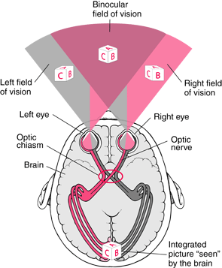
E.2.5 Explain the processing of visual stimuli, including edge enhancement and contralateral processing.
Both eyes have a right and
left visual field.
The right side of each
retina collects light from the
left visual field and vice
versa.

Slide 64
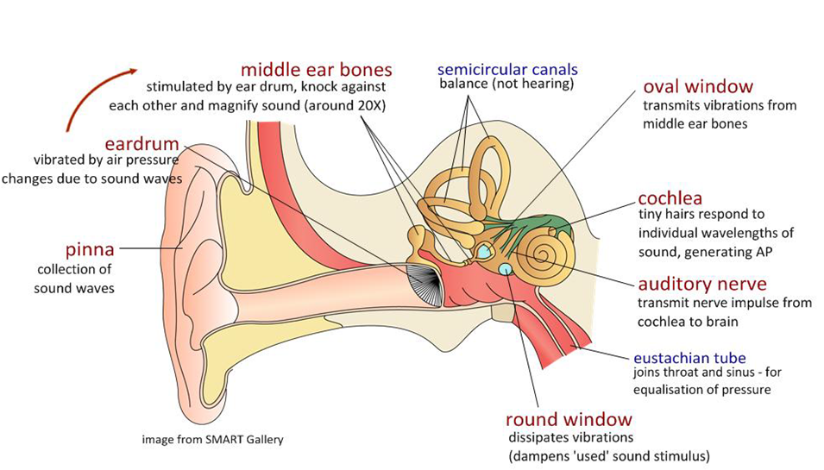
E.2.6 Label a diagram of the ear.
The ear is an example of mechanoreceptors in action: vibrations in the air are converted into action potential.

Slide 65
E.2.7 Explain how sound is perceived by the ear, including the roles of the eardrum, bones of the middle ear, oval and round windows, and the hair cells of the cochlea.
How sound is perceived:
  Sound waves cause
  Eardrum causes ( ) – bones multiply the vibrations
  Stapes strikes
  Vibration causes
  Fluid movement
  Basilar membrane generates an

Slide 66
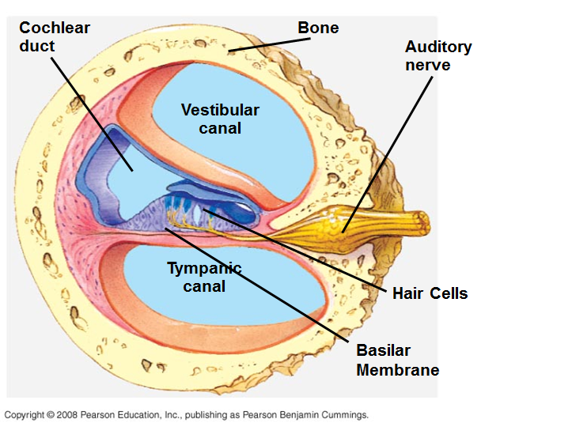
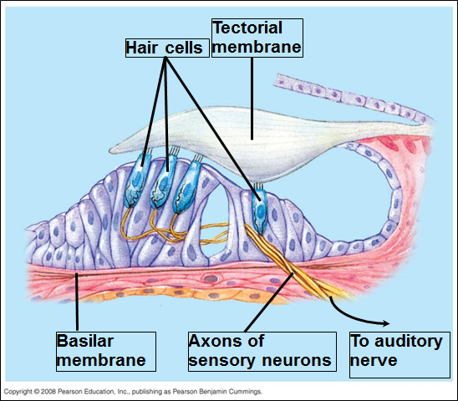
Structure of Cochlea and Basilar Membrane

Slide 67
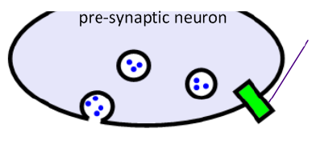
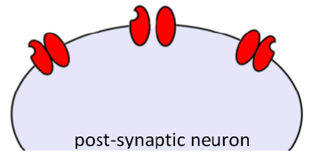
E.4.3 Explain how psychoactive drugs affect the brain and personality by either increasing or decreasing postsynaptic transmission.
Excitatory drugs
Inhibitory drugs
Block re-uptake pumps for NTs
- NT
e.g. cocaine’s effect on
dopamine
Mimic inhibitory NTs
↑
fewer
e.g. alcohol mimics GABA
effects, reducing APs
Mimic excitatory NTs
- ↑
e.g. nicotine
Blocks excitatory NTs
e.g. opiates (heroin)
block pain pathway by
competitive inhibition
Block inhibitory NTs
- of APs
e.g. caffeine competitively
inhibit adenosine
http://outreach.mcb.harvard.edu/animations/synapse.swf

Slide 68
E.4.4 List three examples of excitatory and three examples of inhibitory psychoactive drugs.
Excitatory:
  Nicotine –
  Caffeine –
  Cocaine –

Slide 69
E.4.4 List three examples of excitatory and three examples of inhibitory psychoactive drugs.
Excitatory:
  Amphetamines –
    Ex: “ecstasy” – derivation of amphetamines that causes
      Has some unusual behavioral effects: causes feelings of empathy, openness and caring, lowers feelings of aggression and increases sexual behavior – causes long-term damage to neurons

Slide 70
E.4.4 List three examples of excitatory and three examples of inhibitory psychoactive drugs.
Inhibitory:
  Benzodiazepines – include valium, temazepam, librium –
  Tetrahydrocannabinol (THC) –
  Alcohol –

Slide 71
E.4.5 Explain the effects of THC and cocaine in terms of their action at synapses in the brain
  Excitatory drugs = Cocaine
Normal:
Dopamine
Dopamine is
With Cocaine:
Dopamine not re-uptaken;
More dopamine is released
Effect on mood/behavior
Enhanced feelings of pleasure (dopamine is a “pleasure” NT)
Increased energy and alertness
Highly addictive
Associated with depression (body reduces its own dopamine)
http://thebrain.mcgill.ca/flash/i/i_03/i_03_m/i_03_m_par/i_03_m_par_cocaine.html#drogues

Slide 72
E.4.5 Explain the effects of THC and cocaine in terms of their action at synapses in the brain
  Inhibitory drugs = THC (cannibis)
Normal:
Two pathways to consider
1) pathway released dopamine, increasing feelings of pleasure
2) GABA has an
With THC:
GABA
More dopamine is released
Effect on mood/behavior
Enhanced feelings of pleasure (dopamine is a “pleasure” NT)
Intoxication (drunk feeling), hunger, memory impairment
http://thebrain.mcgill.ca/flash/i/i_03/i_03_m/i_03_m_par/i_03_m_par_cannabis.html#drogues

Slide 73
E.4.6 Discuss the causes of addiction, including genetic predisposition, social factors and dopamine secretion.
Addiction is a chemical dependency on drugs
  The drug has “ ” the brain and has become an
  Body often develops a

Slide 74
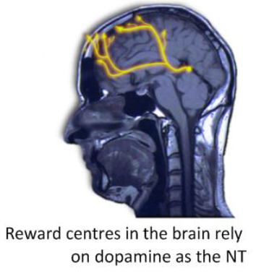
E.4.6 Discuss the causes of addiction, including genetic predisposition, social factors and dopamine secretion.
Three factors increase the levels of addiction:
  : many addictive drugs stimulate transmission in synapses that use dopamine
    These synapses are part of the “ ” that leads to feelings of well-being
    Withdrawal of the drug leads to
  Reward Pathway
  - makes one feel good when he/she engages in behaviors that are necessary for survival (e.g. eating, drinking)

Slide 75
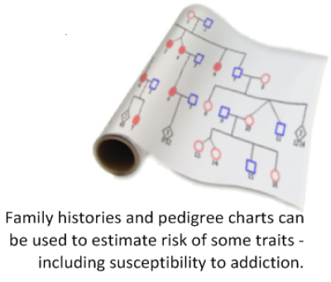
E.4.6 Discuss the causes of addiction, including genetic predisposition, social factors and dopamine secretion.
  : there appears to be a genetic link to addiction (i.e., alcoholism may run in families)
    May be the result of

Slide 76
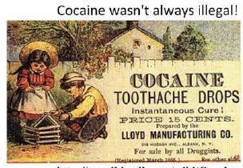
E.4.6 Discuss the causes of addiction, including genetic predisposition, social factors and dopamine secretion.
  :
    Cultural traditions
    Legality or religion
    Peer pressure
    Family addiction
    Family parenting skills
    Poverty and social deprivation
    Traumatic life experiences
    Mental health problems

